Slide 1

PAVO
An introduction and overview

Slide 2
The aim
A flexible and integrated workflow for working with spectral and spatial colour data.

Slide 3
History & team
~2011 -> Inception
2013 -> v0.5. Maia et al. (2013) original paper
~2014 -> I joined. v 1.0.
~2017 -> Hugo aboard
~2019 -> v2
Present -> v2.9.0
Thomas White
Hugo Gruson
Rafael Maia
Chad Eliason
Pierre-Paul Bitton
Matthew Shawkey
Stephanie Doucet

Slide 4
Installation
Thomas White
Hugo Gruson
Rafael Maia
Chad Eliason
Pierre-Paul Bitton
Matthew Shawkey
Stephanie Doucet

Slide 5
Workflow
Organisation
Visualisation
Analysis

Slide 6
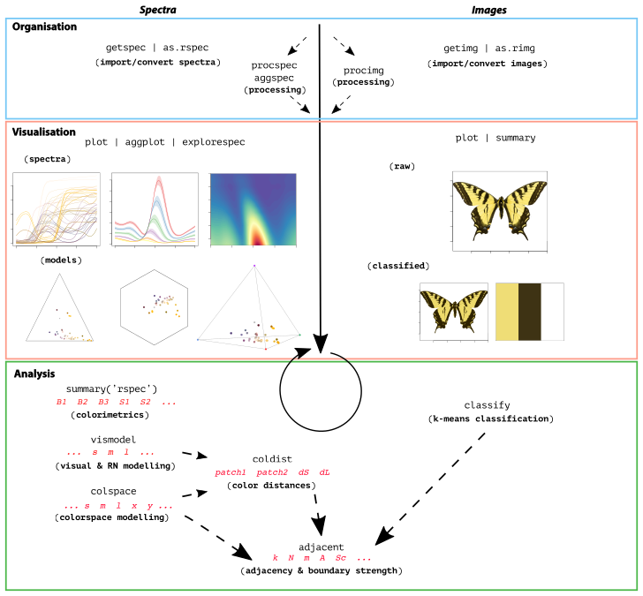
Workflow

Slide 7
Newish stuff (up to v.2.9.0)

Slide 8
Organisation

Slide 9
Visualisation

Slide 10
Analysis

Slide 11
TODO

Slide 12
Today: question-driven examples

