Slide 1
DopplerML:
Ultrasonic Gesture Recognition
Matthew Harding, Tom Eliot • 15-780 Graduate AI

Slide 2




Experiment Setup
Fast Fourier Transform
Bandpass filtering
Artificial Classifiers

Slide 3
Prior Work
Touch & activate: adding interactivity to existing objects using active acoustic sensing
Makoto Ono, Buntarou Shizuki, and Jiro Tanaka.
In Proceedings of the 26th annual ACM symposium on User interface software and technology (UIST '13)
Using piezo-electric microphone and paired vibration speaker attached to common items, this work demonstrated successful classification of touch gestures with some robustness to user
SoundWave: Using the Doppler Effect to Sense Gestures
Sidhant Gupta, Dan Morris, Shwetak Patel, Desney Tan
Proceedings of ACM CHI 2012, May 2012
Informally, this work tests the robustness of Doppler Effect for free space gesture recognition in human environments and across users. Describes a thresholding yet reliable Doppler-shift-based motion-detection algorithm that can be used on everyday laptop computers

Slide 4
Motivation:
Inspired by a “maker project” that enabled webpage-control using simple ultrasonic laptop-detected gestures, we set out to attempt to bring the power of machine learning techniques to this unsown area of ultrasonic perception research. We hypothesized that a stereo speaker system may provide more spatial information about a gesture necessary for machine learning to provide an improvement over the previous smart thresholding technique.
The proof-of-concept is already incredible, classifying between 5 simple free space gestures and exploring the feature-space on which to learn over. If not only because it’s more practical than computationally intensive computer vision techniques, one can imagine cheap sonar sensors can plausibly assist in facial and object recognition, increasing modern techniques’ robustness to illumination. As well, an application we are especially excited about includes real-time translation of variants of Sign Language for mute or blind users, enabling a cheap and efficient alternative to computer vision’s current direction.

Slide 5

Method
We present an approach to gestural recognition that requires minimal hardware. There exists an ultrasonic band of frequencies from 18kHz to 22kHz that a laptop or cellphone is capable of processing. To recognize gestures, techniques used commonly in radar and sonar may be applied, such as measuring doppler shift and measuring time delay. We emit sinusoidal tones in stereo from the speakers, and measure the frequency response of the reflected signal. When the body moves in relation to the impinging sound waves, the waves are reflected and shifted in frequency through the doppler effect.
Gestures are classified using a machine learning KNN algorithm using the frequency spectrum as a feature vector.

Slide 6
Implementation
The ML Gesture recognition program is implemented in the dataflow language PureData, using ml-lib for the machine learning algorithm. PureData provides many advantages when working with sound data, including rapid prototyping and visualization, and powerful concurrency. A Macbook air was used to create and receive audio. Two stereo speakers output 2 3kHz-separated ultrasonic tones. Our feature vector is a raw high-pass window of the FFT containing the 2 stereo speakers’ frequencies, an array of length 255.
ml-lib’s functionality was such that we could easily drag-and-drop new supervised classification algorithms during our preliminary rounds of testing. Our best performance was observed using K-nearest neighbors as opposed to linear classifiers like a Support Vector Machine. We believe this non-linearity to be related to the time-sensitivity of the observed Doppler effect with gesture speed.

Slide 7
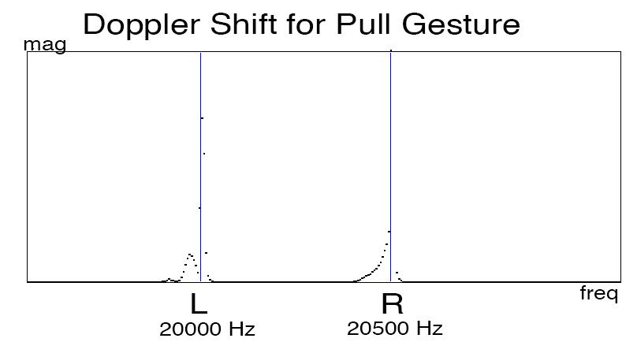

Slide 8
3 Classes
Trained 15 samples/class using KNN algorithm, and tested on 15 more
Gesture | Classification Accuracy
Still | 100%
Push | 100%
Pull | 100%
5 Classes
Gesture | Classification Accuracy
Still | 33%
Push | 33%
Pull | 47%
Swipe Left | 53%
Swipe Right | 60%
Notes:
KNN > SVM for 5 classes

Slide 9
Results
For three gestures, the classifier is 100% effective. We attribute this success to the nature of the frequency spectrum with the doppler effect. With no movement, the feature vector is zero except for two peaks at the sinusoid tones. With movement toward the device, there is a hump on the right side of the peaks. The opposite with movement away. When compared with the thresholding technique in prior work, this result is an improvement. Previously the thresholding technique was unable to differentiate between faster and slower gestures, thus making it difficult to create a ‘push’ gesture without later causing a ‘pull’ gesture when returning the hand to a neutral position. Classification with 5 gestures was much less effective. We attribute the classification error to a lack of distinction between training classes and inconsistency within. Part of the problem may be that the FFT is windowed, representing only a snapshot in time of part of the gesture, as compared to a more time-invariant technique using spectrogram feature-analysis.

Slide 10
Future Work
Working in a dataflow language like PureData provided many advantages in streamlining our workflow. However we were also constrained to a max feature vector size of 255. We know that there is much higher resolution data that may be collected on the frequency spectrum and trained upon. Additionally, using a time-varying frequency spectrum i.e. sonogram would add another dimension to the data, capturing the progression of a gesture. There is a precedent for recognition in Daniel Nouri’s work on the use of deep neural networks on sonogram data in the classification of animal noises e.g. whale and bird calls. We would like to harness the same technique for gesture recognition, as we believe there are minute differences in the signals that can distinguish complex gestures. Additionally, as gestures in invariant in time, i.e. they are similar no matter when the are performed, a CNN may perform well. We would also like to try to apply the technique of sonar to gesture recognition, where the reflection delay is measured.

Slide 11
Conclusions
This application of Machine Learning to this technology is not surprisingly very young. Our exploration here shows early results into applying Doppler-phenomenon feature classification in the ultrasonic range for practical use in gesture classifying applications. After exploring the features and our algorithms’ sensitivity to them, we can wager that regression techniques, like K-nearest neighbors, may be better suited for classification of these complicated frequency-time functions.

