Slide 1
DevOps
CI 101

Slide 2
CircleCI
concepts

Slide 3
Steps
Image
Jobs
cache
Workflows
workspaces and artifacts
Orbs

Slide 4
Steps
Steps are actions that need to be taken to perform your job.
Steps are usually a collection of executable commands.
#...
steps:
- checkout
- run:
name: Running tests
command: make test
#...

Slide 5
Image
An image is a packaged system that has the instructions for creating a running container.
This is where commands are executed for jobs using the Docker executor.
The Primary Container is defined by the first image listed in .circleci/config.yml file.
version: 2
jobs:
build1:
docker:
- image: buildpack-deps:trusty
- image: postgres:9.4.1
environment:
POSTGRES_USER: root
...
build2:
machine:
image: circleci/classic:201708-01
...
build3:
macos
xcode: "9.0"
...

Slide 6
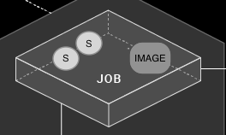
Jobs
Jobs are a collection of steps
each job must declare an executor that is either docker, machine, or macos.
Machine includes a default image if not specified
for Docker and macOS, you must also declare an image

Slide 7
cache
A cache stores a file or directory of files such as dependencies or source code in object storage.
Each job may contain special steps for caching dependencies from previous jobs to speed up the build.
version: 2
jobs:
build1:
docker:
- image: circleci/ruby:2.4-node
- image: circleci/postgres:9.4.12-alpine
steps:
- checkout
- save_cache:
key: v1-repo-{{ .Environment.CIRCLE_SHA1 }}
paths:
- ~/circleci-demo-workflows
build2:
docker:
- image: circleci/ruby:2.4-node
- image: circleci/postgres:9.4.12-alpine
steps:
- restore_cache:
key: v1-repo-{{ .Environment.CIRCLE_SHA1 }}

Slide 8
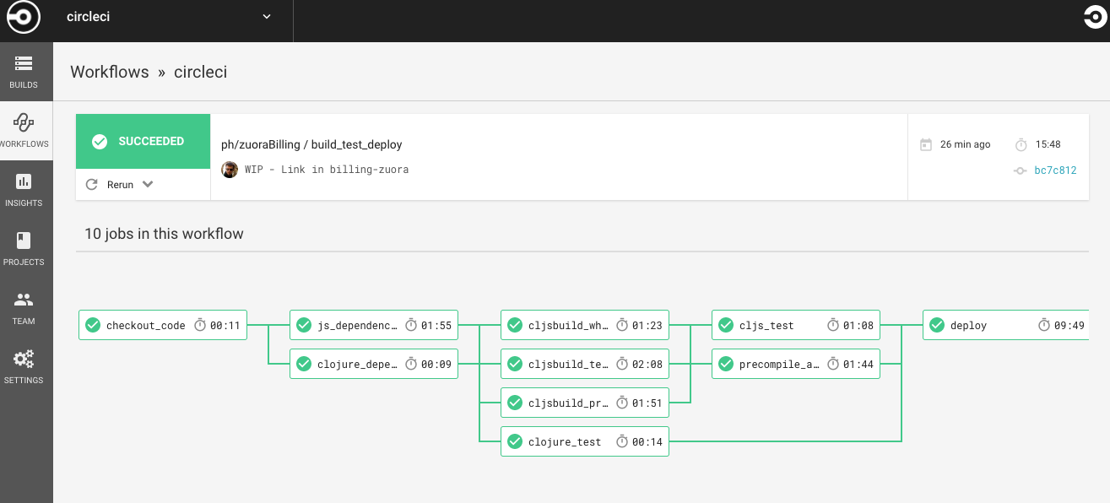
Workflows
Workflows define a list of jobs and their run order.
It is possible to run jobs in parallel, sequentially, on a schedule, or with a manual gate using an approval job.

Slide 9
Workflows
version: 2
jobs:
build1:
docker:
- image: circleci/ruby:2.4-node
- image: circleci/postgres:9.4.12-alpine
steps:
- checkout
- save_cache:
key: v1-repo-{{ .Environment.CIRCLE_SHA1 }}
paths:
- ~/circleci-demo-workflows
build2:
docker:
- image: circleci/ruby:2.4-node
- image: circleci/postgres:9.4.12-alpine
steps:
- restore_cache:
key: v1-repo-{{ .Environment.CIRCLE_SHA1 }}
- run:
name: Running tests
command: make test

Slide 10
Workflows
build3:
docker:
- image: circleci/ruby:2.4-node
- image: circleci/postgres:9.4.12-alpine
steps:
- restore_cache:
key: v1-repo-{{ .Environment.CIRCLE_SHA1 }}
- run:
name: Precompile assets
command: bundle exec rake assets:precompile
...
workflows:
version: 2
build_and_test:
jobs:
- build1
- build2:
requires:
- build1
- build3:
requires:
- build1

Slide 11
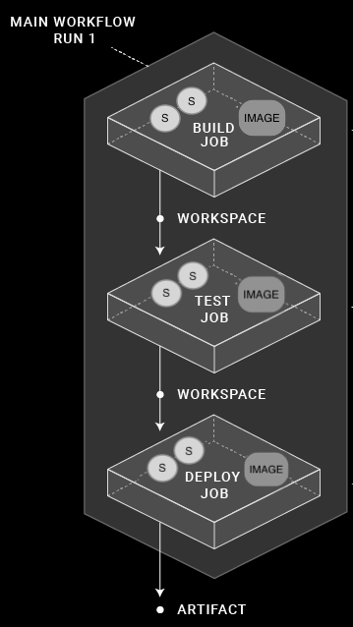
Workspaces and Artifacts
A workspace stores data unique to the job, which may be
needed in downstream jobs.
Artifacts persist data after a workflow is completed
and may be used for longer-term storage of the outputs
of your build process.
Each workflow has a temporary workspace associated
with it.
The workspace can be used to pass along unique data
built during a job to other jobs in the same workflow.

Slide 12
Workspaces and Artifacts
version: 2
jobs:
build1:
...
steps:
- persist_to_workspace:
paths:
- echo-output
build2:
...
steps:
- attach_workspace:
at: /tmp/workspace
build3:
...
steps:
- store_artifacts:
path: /tmp/artifact-1
destination: artifact-file
...

Slide 13
Workspaces and Artifacts
Differences between Artifacts, Workspaces and Caches:
Type | Lifetime | Use | Example
Artifacts | Months | Preserve long-term artifacts. | Available in the Artifacts tab of the Job page under the tmp/circle-artifacts.<hash>/container or similar directory.
Workspaces | Duration of workflow | Attach the workspace in a downstream container with the attach_workspace:step. | The attach_workspace copies and re-creates the entire workspace content when it runs.
Caches | Months | Store non-vital data that may help the job run faster, for example npm or Gem packages. | The save_cache job step with a path to a list of directories to add and a key to uniquely identify the cache (for example, the branch, build number, or revision). Restore the cache with restore_cache and the appropriate key

Slide 14
Orbs
Orbs are packages of config that you can reuse
Orbs enable you to share, standardize, and simplify config across the projects.
You may also want to use orbs as a reference for config best practices.
Check out Orbs Registry for the complete list of available orbs https://circleci.com/orbs/registry/
The following example invokes the hello-build orb in the circleci namespace:
version: 2.1
orbs:
hello: circleci/hello-build@0.0.13
workflows:
"Hello Workflow":
jobs:
- hello/hello-build

Slide 15
Orbs
Orbs consist of the following elements:
Commands
Jobs
Executors
version: 2.1
jobs:
myjob: #job
docker: #executor
- image: "circleci/node:9.6.1"
steps:
- myorb/sayhello: #command
to: "Lev"

