Slide 1
Embedded 2 – Cosy cafetaria Presentation
By Tobias Cromheecke, Thomas Feys, Robin Van de Poel, Arthur Van den Storme
13-5-2020

Slide 2
Index
Introduction
Hardware architecture
Power management
Microcontroller + main PCB
Sensor design
Housing design
Software design
Wi-Fi communication
Dashboard

Slide 3
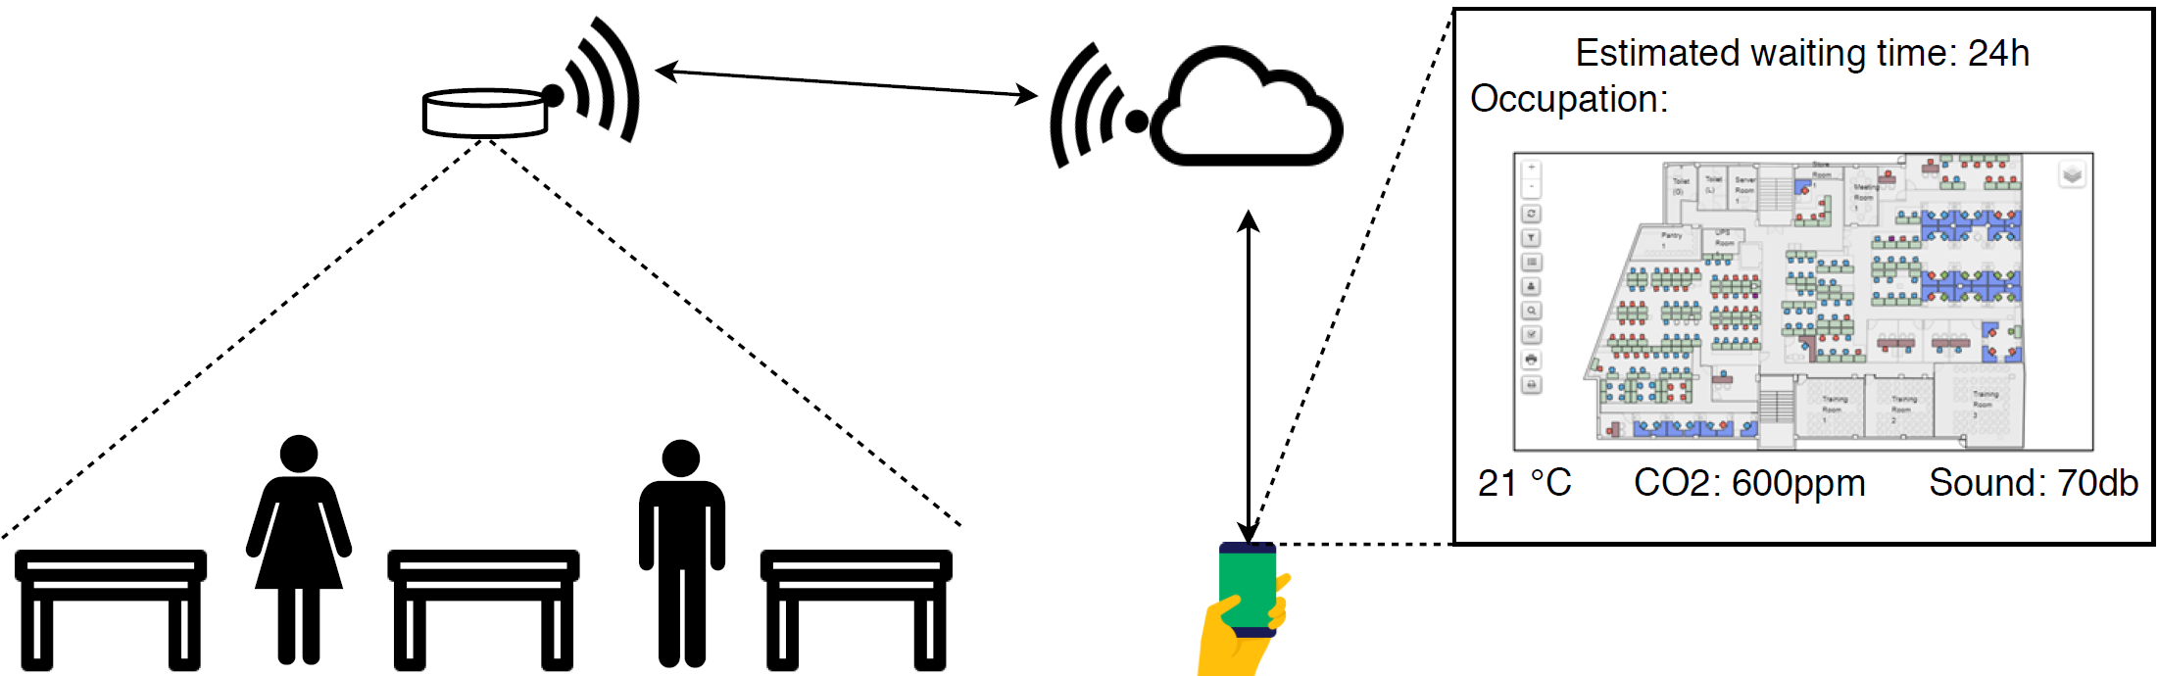
Introduction
Notes:
Volledige systeem eens bespreken zodat duidelijk is wat we willen bereiken

Slide 4
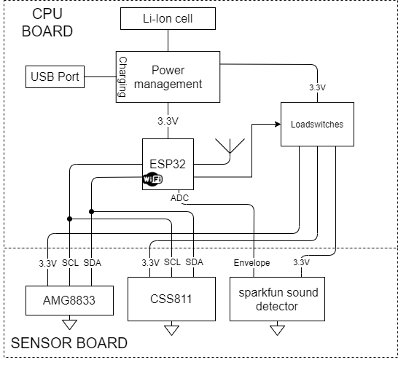
Hardware architecture
Notes:
Overzicht van de hardware bespreken zodat het volledige beeld duidelijk is

Slide 5
Power management
Completed:
To do:
Battery: Lithium-Ion battery
Charger IC
Protection IC
Reverse polarity protection circtuit
LDO: 3,7 V to 3,3 V
Load switches to turn on/off the sensors
Availability to measure current via wire to put a currentprobe on or sense resistor
Soldering
Testing
Designing revision

Slide 6
Problems/limitations
Delay times for deliveries due corona measures
Lack of tools/instruments to solder and for testing:
Most power management IC’s have an exposed pad which needs a solder oven to solder properly
Lack of oscilloscope etc.

Slide 7
Microcontroller + main PCB
Completed:
To do:
ESP32 single core
Design main pcb
Boot and reset button
Soldering
Testing
Designing revision

Slide 8
Sensor design
Completed:
To do:
PCB design of separate sensor board
Investigating response time of sensors
Bringing sensors
Functions: init, get data, sleep,…
Power measurements
Checking measure mode is the most efficient
Checking with a Gecko development board

Slide 9
Problems/limitations
Limitations due to corona measures
Correct cooperation of sensor board with the main board.
Power measurements => break out boards send to Thomas for functionality tests

Slide 10
Housing design
Completed:
To do:
Discussing a basic idea of the housing
Getting the measurements of all available part
A tutorial on 3D-printing design with fusion360
Design of housing
Checking hardware fits in housing

Slide 11
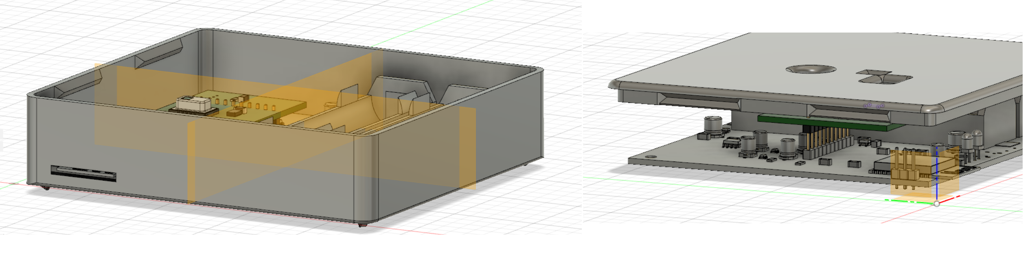
Problems/limitations
Delay on delivery housing
Due to corona measurements
Fitting design housing not possible

Slide 12
Wi-Fi communication
TCP connection between ESP32 and Python server
Python server on Raspberry Pi
Server updates SQL database with received data

Slide 13
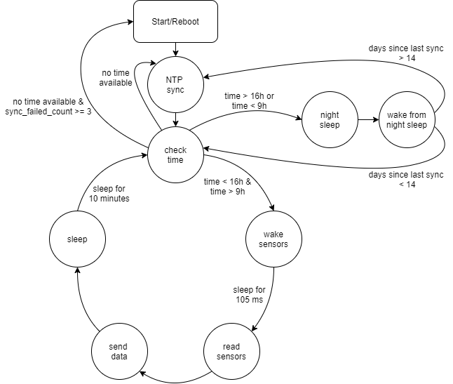
Software design
Functionality:
Pull sensors from sleep every 10 minutes and read sensor values
Send sensor data to Python server, over Wi-Fi
Perform periodic synchronisation to get time information
Use time information to disable power to sensors and put CPU in deepsleep during night (4 pm – 9 am)

Slide 14
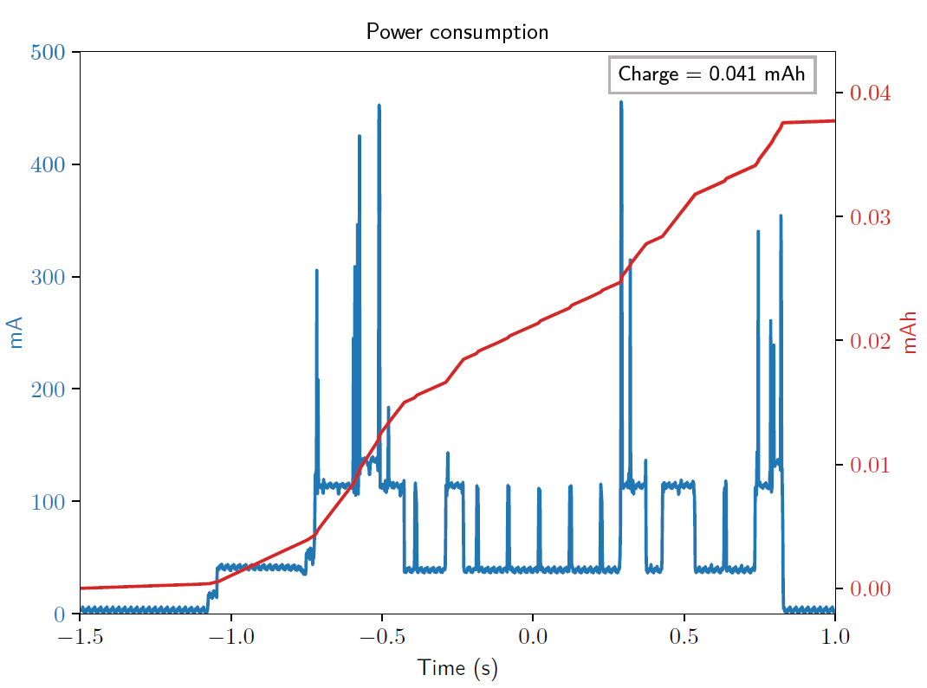
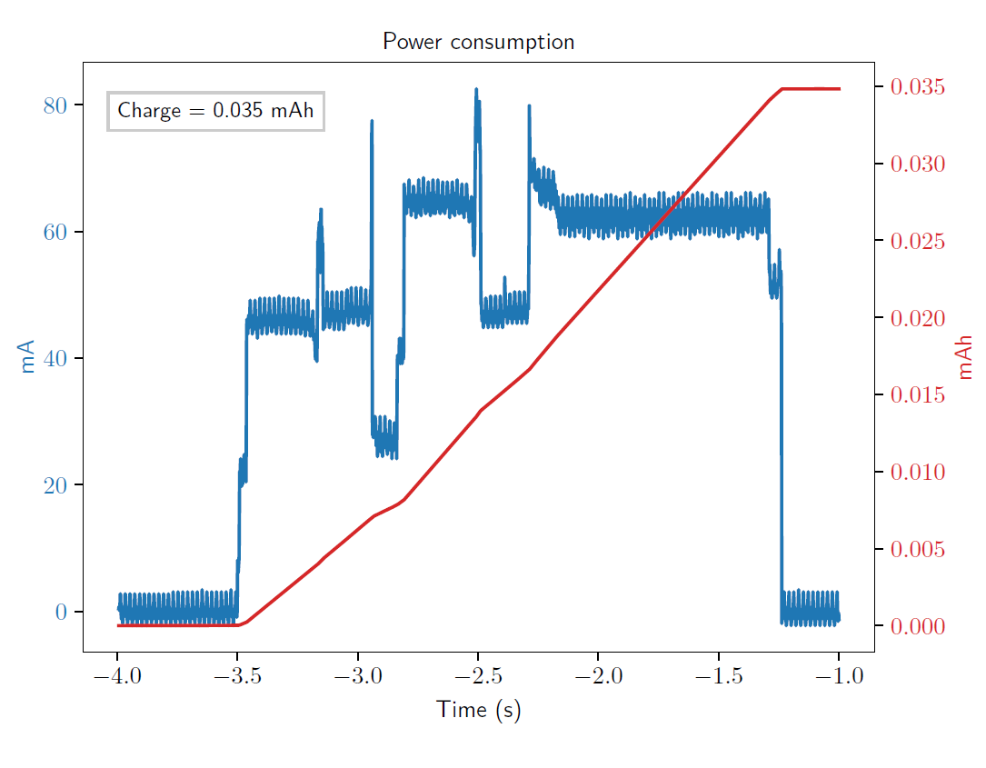
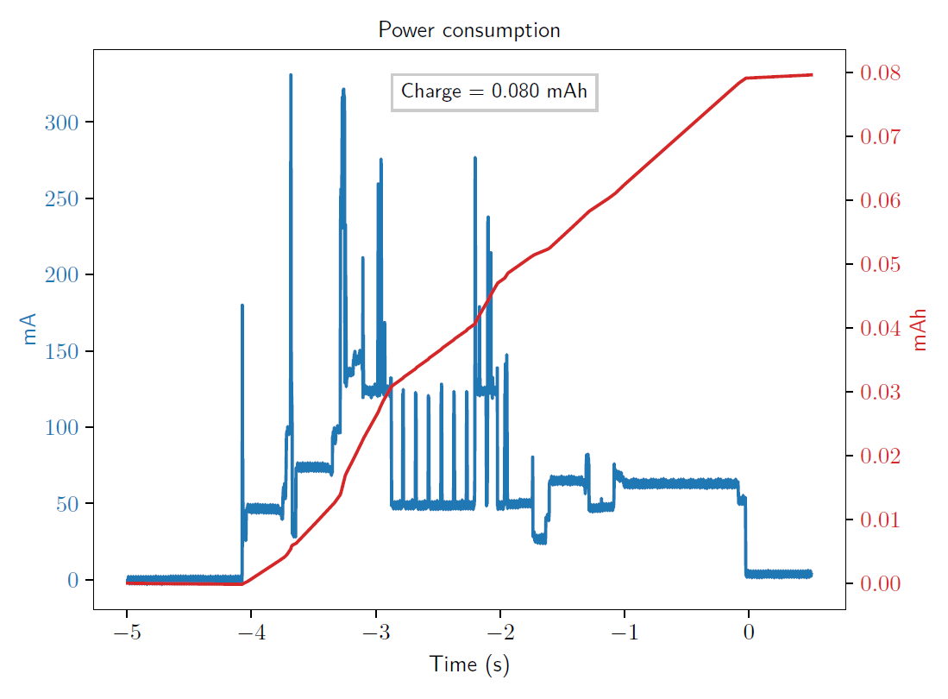
Power consumption
Consumption sources
Wi-Fi communication
Sensor measurement
NTP synchronisation
Standby consumption during daytime
Standby consumption during night-time

Slide 15
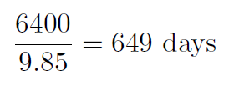
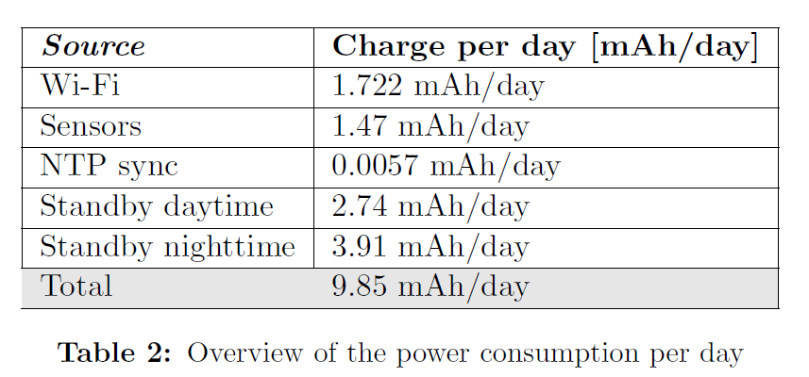
Power consumption
Power consumption per day:
Not taken into account:
9.85 mAh/day
=> Battery life =
Self discharge battery
quiescent current voltage regulator
quiescent current load switches

Slide 16
Dashboard
Completed:
To do:
Basic functionality for 1 type
Data base design
Data base implementation
Functional heatmap
Test on raspberry pi
Use real sensor data
Make it look good
Add the other sensors
Main page

Slide 17
Validation and testing
Equipment:
ESP32-DEVKitC
AMG8833 break-out board
CCS811 break-out board
Raspberry Pi to host the server, database and website

Slide 18
Validation and testing
Successfully validated:
To validate:
Software
AMG8833
CCS811
Hardware: power management, load switches, sensor board, ESP32 board
=> Software is fully functional
Notes:
The correct functionality of the software has been tested by uploading the code in the development kit.
The sensor data of the ir sensor and the airquality sensor was succesfully updated every ten minutes.
Then the sensor data was succesfully transmitted to the server that was running on the raspberry pi, the values in the sql
Database were succesfully updated.
The only sensor that couldnt be tested is the microphone, because no break-out board was availible. However, the microphone produces an analog signal that
Has to be captured with the adc of the esp32 this was tested by connecting an analog ouput of the esp32 to the adc.
Next to the sensors and the datatransfer, the system was tested for 1 full day to verify the timing that is used. The system could perform the ntp synchronisation
Succesfully and went to deepsleep once it was past 4 pm

Slide 19
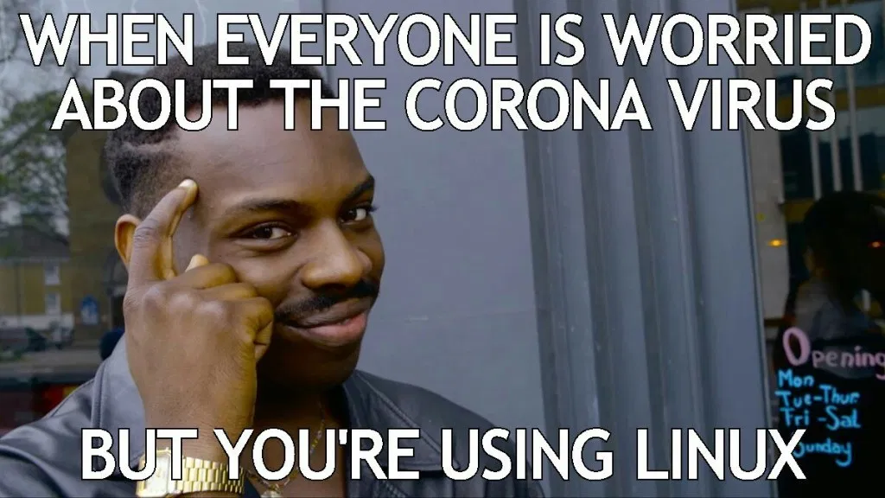
Conclusion
Despite corona fully functional end product
Final test on developed hardware necessary
Notes:
Fully functional end product that was tested on devkits and break-out boards

