Slide 1
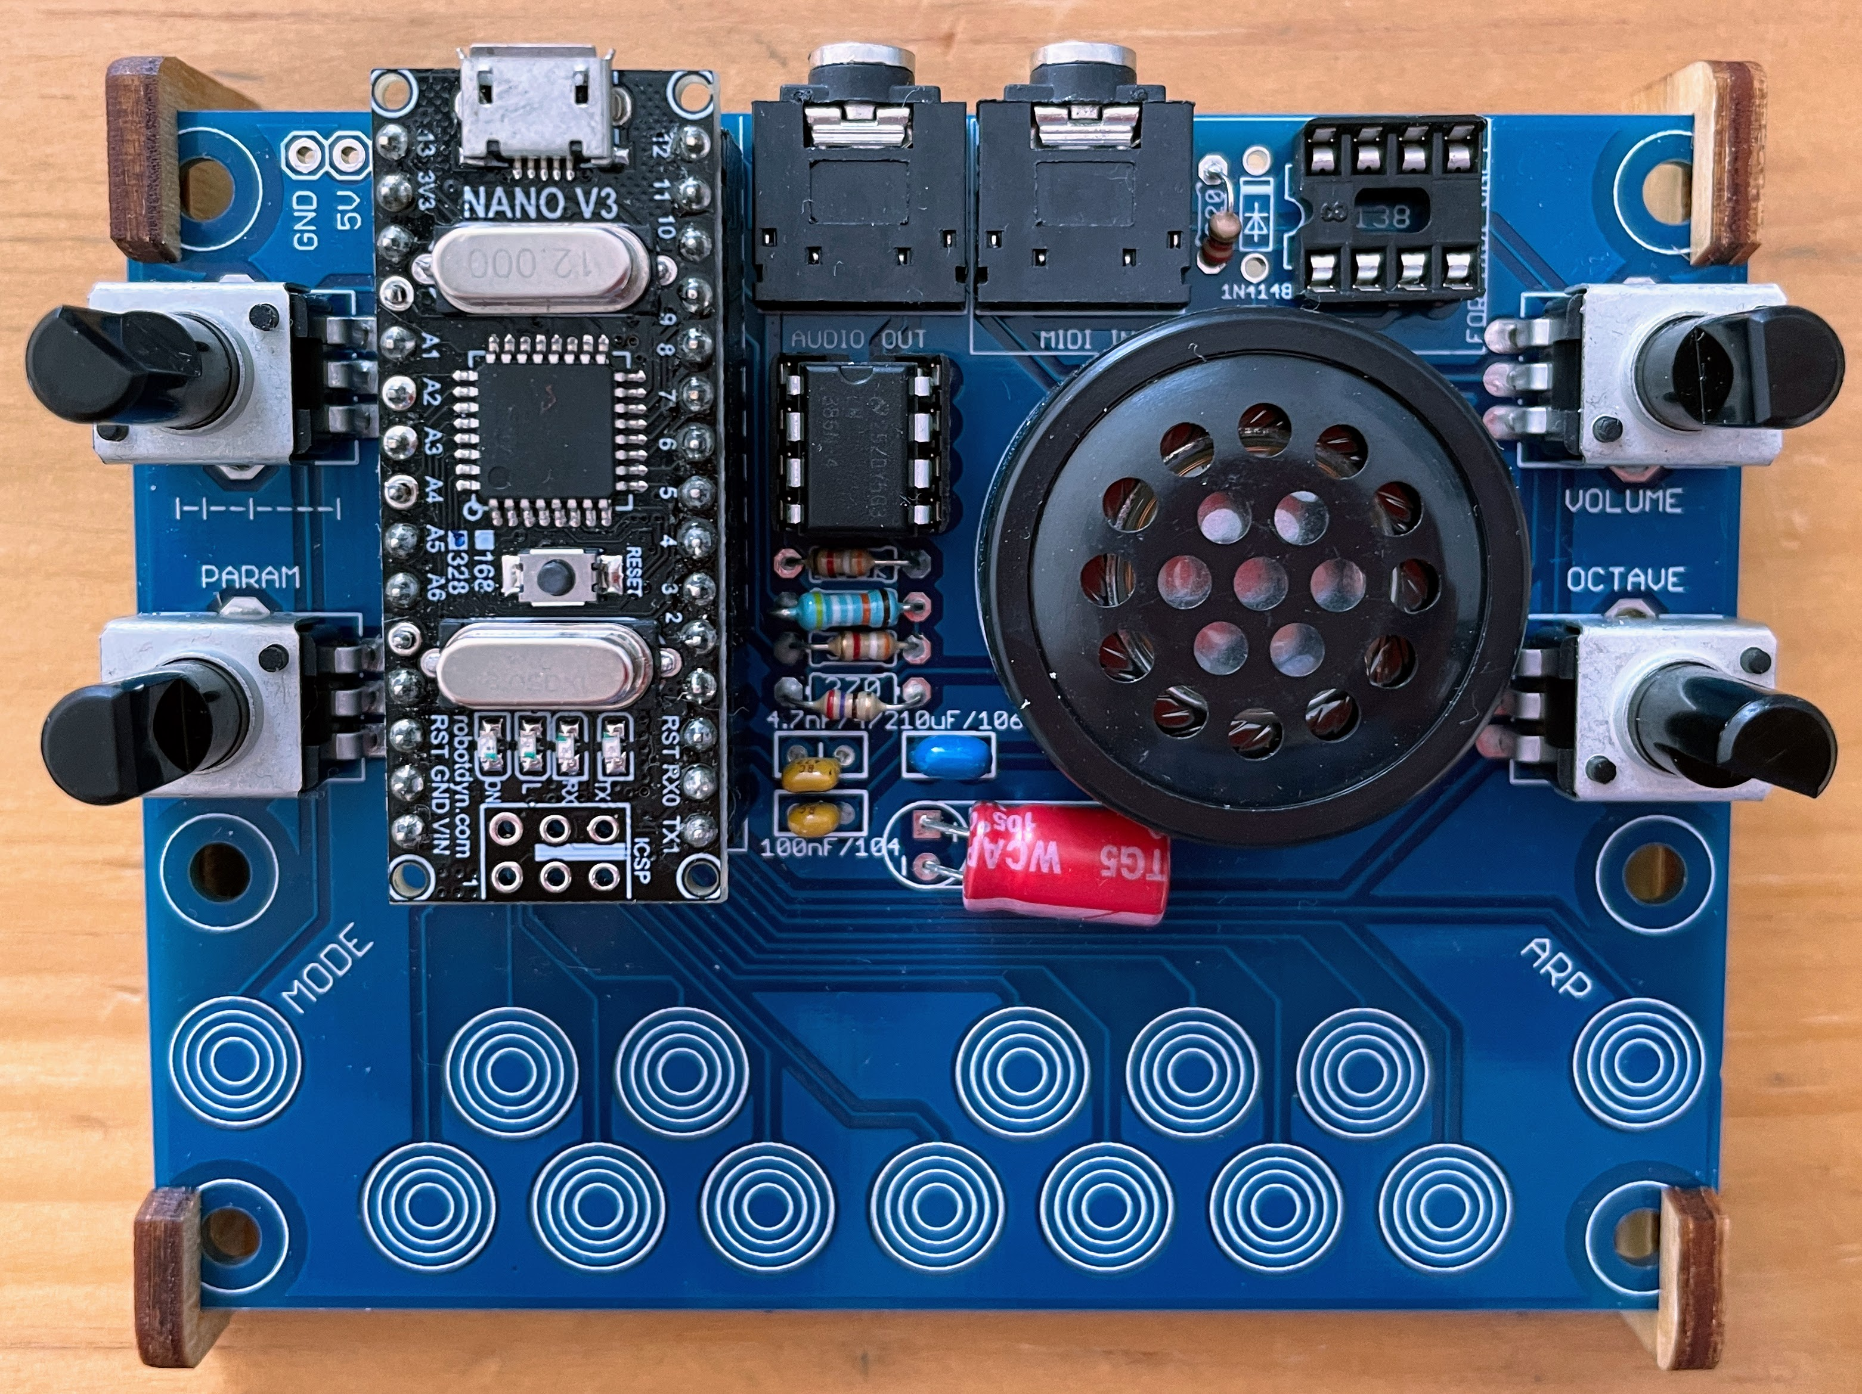
ARPEGGIATOR DEACTIVATED
Power
Audio out
MIDI in
Note Release time
Output volume
Change sound algorithm parameter
Octave
Synth sound algorithm
Activate arpeggiator
Press keys to trigger notes

Slide 2
ARPEGGIATOR ACTIVATED
Power
Audio out
MIDI in
Arpeggiator note interval
Output volume
Change sound algorithm parameter
Octave
Synth sound algorithm
Activate arpeggiator
Press keys to add notes to the arpeggiator. The keys are held even when not pressed anymore. If all keys are released and a new key is pressed, the arpeggiator is cleared and only the new key will play.

