Slide 1
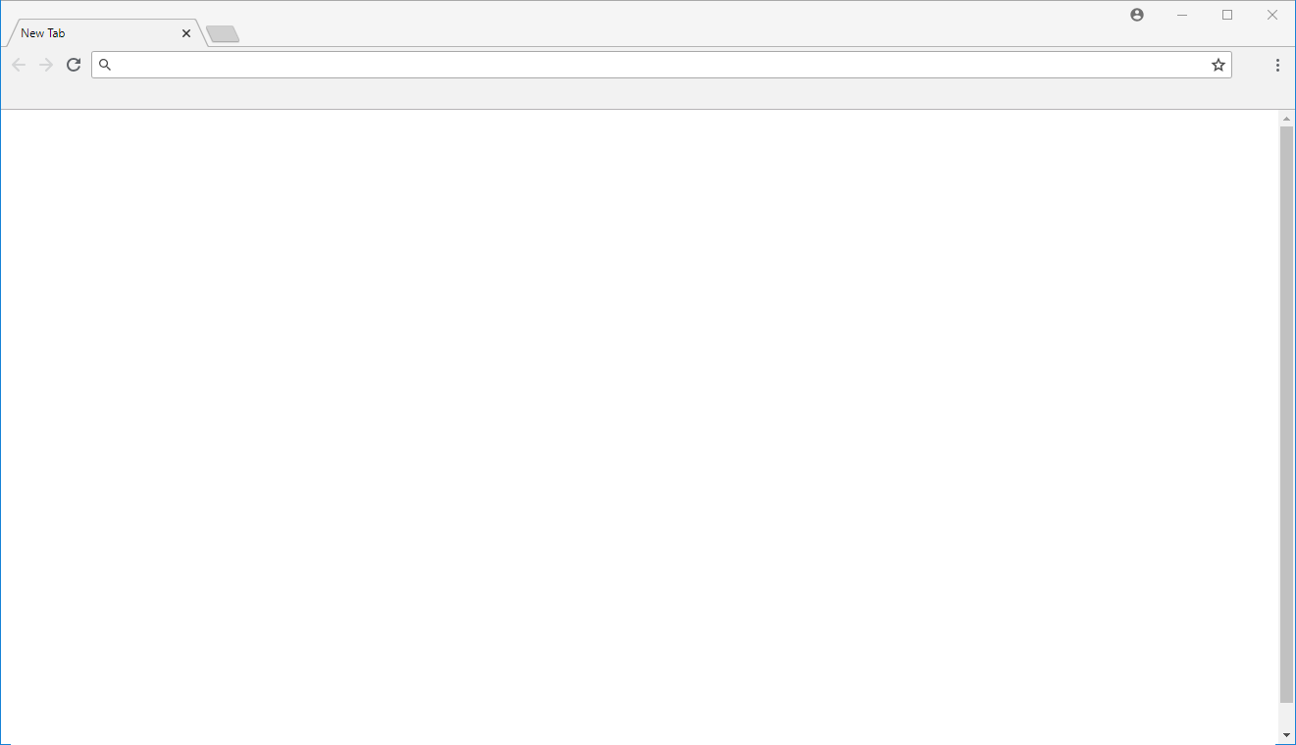
Example 1: Pager
Item 1
PagingInfo
CurrentPage: 1
ItemsPerPage: 5
SortBy: "Name"
Reverse: false
Search: "Item"
Item 2
Item 3
Item 4
Item 5
Page #1
Page #2
Item 6
PagingInfo
CurrentPage: 2
ItemsPerPage: 5
SortBy: "Name"
Reverse: false
Search: "Item"
Item 7
Item 8
Item 9
Item 10
Page #1
Page #2

Slide 2
Example 2: Infinite Scrolling
Item 1
PagingInfo
CurrentPage: 1
ItemsPerPage: 5
SortBy: "Name"
Reverse: false
Search: "Item"
Item 2
Item 3
Item 4
Item 5
Item 6
PagingInfo
CurrentPage: 2
ItemsPerPage: 5
SortBy: "Name"
Reverse: false
Search: "Item"
Item 7
Item 8
Item 9
Item 10

