Slide 1


CES 520 Embedded Systems Project
Presented By : Geoff Thomas, Manthan Gajjar
Guided By: Dr. Farid Farahmand
Digital Clapper

Slide 2

Abstract
Clapperboards have been essential to filmmaking since the earliest sound films. It is a device used in filmmaking and video production to assist in synchronizing of picture and sound, and to designate and mark the various scenes and takes as they are filmed and audio-recorded. The clapperboard combines a chalkboard slate with a clapstick. The slate displays the name of the production, the scene and "take" about to be performed, and similar information, an assistant holds the clapperboard, so the slate is in view of the cameras, speaks out information for the benefit of the audio recording, then opens the clapstick and claps it shut. In this project we are designing a digital prototype of it with the help of STM32F401RE microcontroller.

Slide 3
Features
There are Four basic Features:
LCD display shows Movie and Director Name
Bluetooth to Set Display from Phone or Terminal
Seven Segments for displaying the Scenes and Takes operated on Interrupts
Switches to Increase Scene and Takes and a reset Button to reset, and a Potentiometer to increase the brightness of a LCD.

Slide 4
How It works
There will be two seven segments one for Take and another for Scene. Every time clapstick claps, it increases the take, and there will be a switch to increment Seven segments for Scene and whenever scene is being increased, take will be reset to zero with the use of interrupts. There will be another switch to reset both seven segments with the use of interrupts. LCD are used to display the information for Movie name and Director Name, and there will be a potentiometer to change movie name. There will be a Bluetooth module to connect it to the phone and to display over the screen.

Slide 5
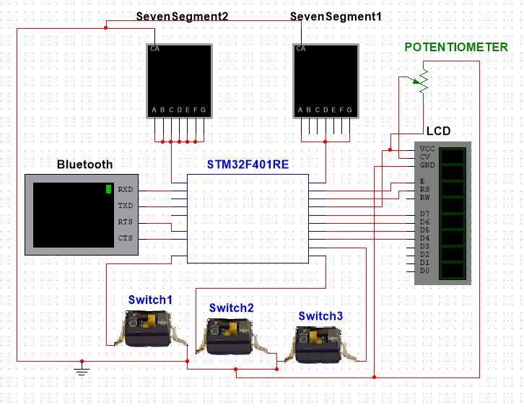
Project Diagram

Slide 6
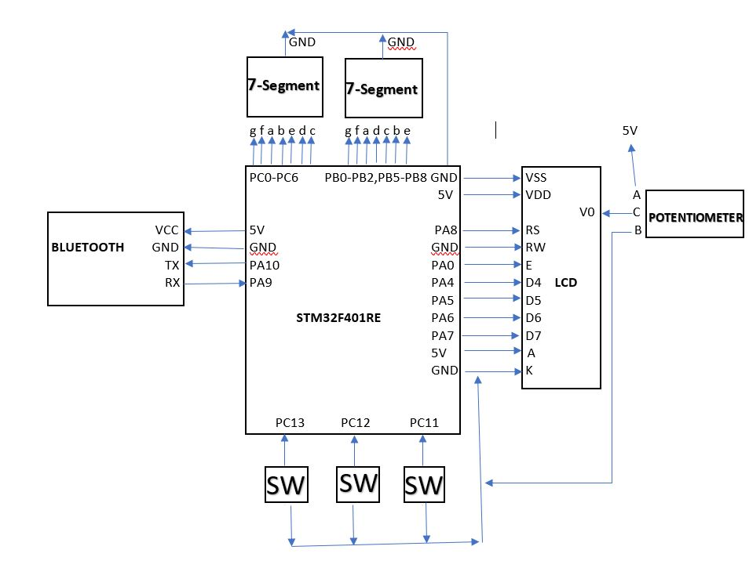
High Level Schematic

Slide 7
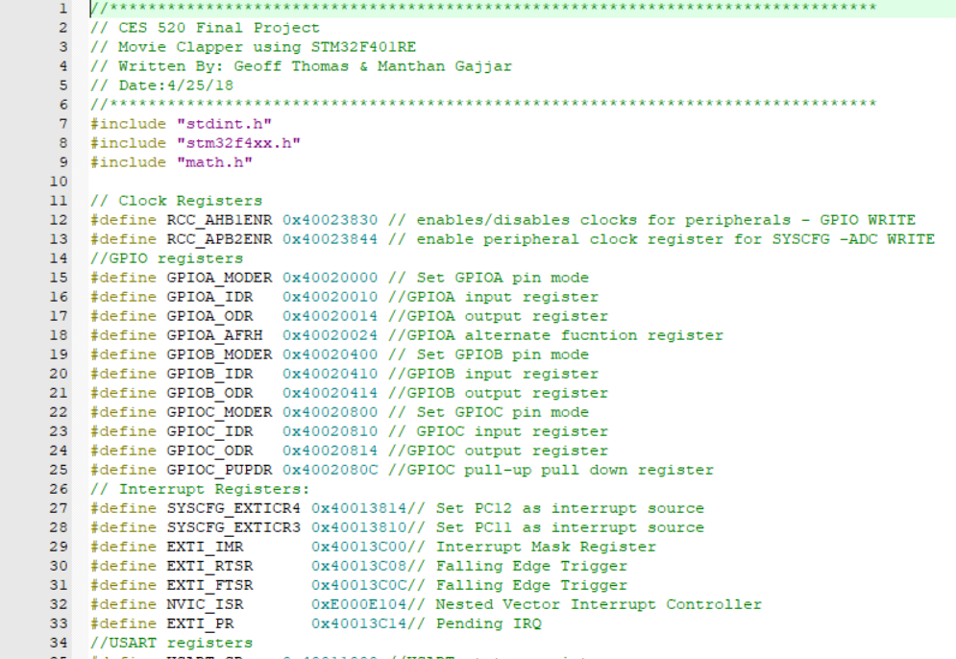
Video & Code
Youtube Link: https://youtu.be/n2gPZAcUAv8
GitHub Link: https://github.com/mann44/Digital-Clapper.git

Slide 8
Cost Estimation
Items | Quantity | Cost
Potentiometer | 1 | $ 4.00
Switches | 3 | $ 0.50
Seven Segments | 2 | $ 1.00
Wires | 60 | $ 1.00
STM32F401RE | 1 | $ 13.00
Bluetooth | 1 | $ 9.00
LCD | 1 | $ 6.00
Total |  | $ 24.50

Slide 9
Thank You!!
Light!! Camera!! Action!!

