Slide 1
DISCORD.JS
v14
<p> Thomas & Jacques </p>

Slide 2
GLOSSARY
Guild
Client
User
Means: a Discord server
Means: The bot
Means: YOU

Slide 3
TABLE OF CONTENTS.
01
02
03
04
05
06
Discord
Discord Bots
Interactions
Events
Slash Commands
Distube

Slide 4
DISCORD
01
<p> Discord is a widely-used app for voice, video, and text chat. </p>

Slide 5
SOME FACTS ABOUT DISCORD.
19m
150m
78%
Active servers weekly
Active users monthly
Use it for things other than gaming.

Slide 6
DISCORD BOTS
02
<p> Discord bots are programs that can interact with users in a Discord server </p>

Slide 7
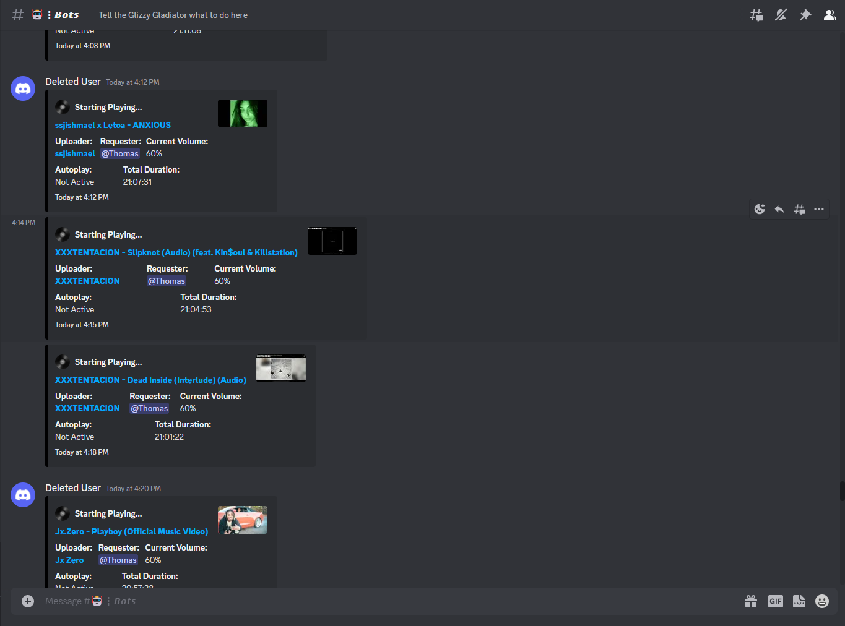
BOTS DON’T SLEEP.
Bots are servers that are constantly running, waiting for a user or guild interaction.

Slide 8
WHAT’S AN INTERACTION?!

Slide 9
DISCORD INTERACTIONS
03
<p> Interactions are just requests </p>

Slide 10
INTERACTIONS
<p> Interactions can be anything. </p>
Anytime the user uses an application command or message component, it’s sent to the bot as a message. The bot can then process this information, and use it as needed.
<p> Interactions power our bot </p>
Interactions are how we power slash commands and buttons. Everytime a user uses a slash command/button, an interaction is sent to the bot that contains the command information and options.

Slide 11
DISCORD EVENTS
04
<p> Events are notifications that Discord sends when a user performs an action, such as sending a message, or joining a server. </p>

Slide 12
EVENTS
<p> Bots can listen for all kinds of events </p>
For instance, they can send a welcome message to new users, or execute a command when a message is sent.
<p> Events we will focus on </p>
interactionCreate:
Triggered when a user interacts with a bot (slash commands, buttons, etc)
addSong:
Triggered when a song is added to the queue
playSong:
Triggered when a song is played

Slide 13
NPM DisTube
05
<p> DisTube is a node module used for fetching & playing songs from YouTube. </p>

Slide 14
DISTUBE
<p> DisTube is powerful. </p>
DisTube is what powers our music player. It provides an API to interact with YouTube and allows for music searches, flexible queueing, volume control and so much more!
Huge shout out to the creator - Skick

Slide 15
SLASH COMMANDS
06
<p> Slash commands are a user-friendly system to send interactions to bots.</p>

Slide 16
COMMANDS USED TO BE FRUSTRATING
― Thomas Graham

Slide 17
BEFORE
NOW
Commands used to be done by using a set prefix.
A bot owner would manually set a prefix such as “!”.
ALSO! You had to know EVERY command.
Now, all a user has to do is type “/”, a commonly used command prefix in other applications.
And now, a user is greeted with a UI, as well as a way to list ALL commands!!!

Slide 18
LET’S REVIEW SOME FACTS.
Discord
Bots
Interactions
Is a voice and messaging application
Are applications that handle requests
Are requests
Events
Slash Commands
DisTube
Are listeners, constantly waiting for activity
Are WAYY better than prefixes
Is awesome

Slide 19
