Slide 1
example-Presentation
Thomas Gredig

Slide 2
R Markdown
Example Presentation explaing on how to use:
Image and Caption
2 Images on one Slide
use of template

Slide 3
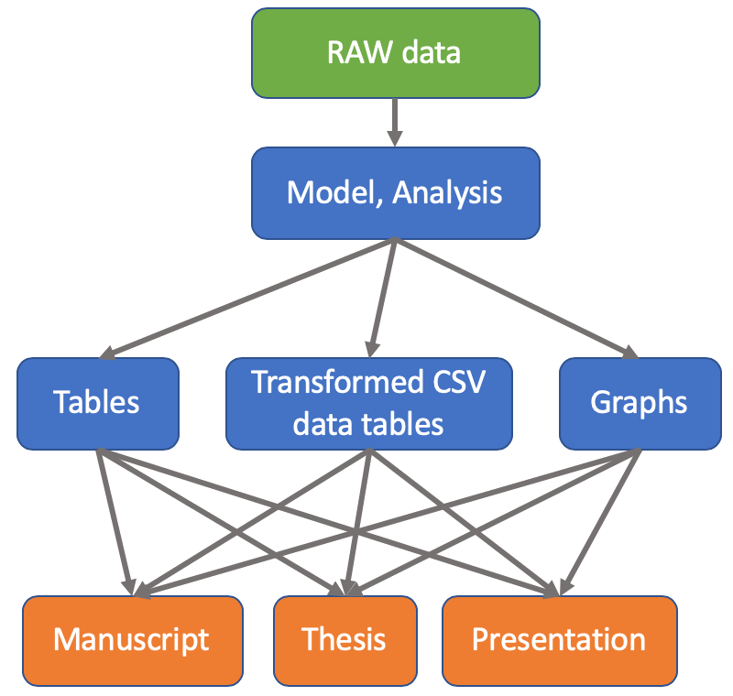
Slide with Images
RAW data is coverted into graphs and tables using a Model. The figures and tables are then integrated into the Presentation.

Slide 4
Slide with 2 Images
RAW data is coverted into graphs and tables using a Model. The figures and tables are then integrated into the Presentation.
RAW data is coverted into graphs and tables using a Model. The figures and tables are then integrated into the Presentation.

