Slide 1
Chapter 10
Limits and the Derivative
Section 1
Introduction to Limits

Slide 2

Learning Objectives for Section 10.1
Introduction to Limits
The student will learn about:
Functions and graphs
Limits: a graphical approach
Limits: an algebraic approach
Limits of difference quotients
Barnett/Ziegler/Byleen College Mathematics 12e

Slide 3
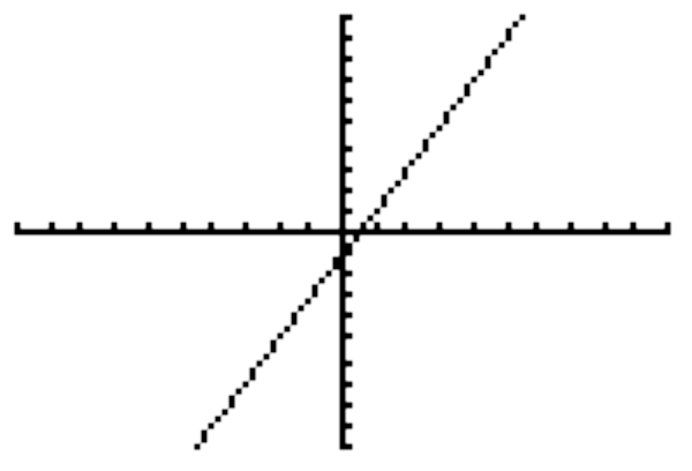
Functions and Graphs
A Brief Review
The graph of a function is the graph of the set of all ordered pairs that satisfy the function. As an example, the following graph and table represent the function f (x) = 2x – 1.
x | f (x)
-2 | -5
-1 | -3
0 | -1
1 | 1
2 | ?
3 | ?
We will use this point on the next slide.
Barnett/Ziegler/Byleen College Mathematics 12e

Slide 4
Analyzing a Limit
We can examine what occurs at a particular point by the limit ideas presented in the previous chapter. Using the function
f (x) = 2x – 1, let’s examine what happens near x = 2 through the following chart:
x | 1.5 | 1.9 | 1.99 | 1.999 | 2 | 2.001 | 2.01 | 2.1 | 2.5
f (x) | 2 | 2.8 | 2.98 | 2.998 | ? | 3.002 | 3.02 | 3.2 | 4
We see that as x approaches 2, f (x) approaches 3.
Barnett/Ziegler/Byleen College Mathematics 12e

Slide 5
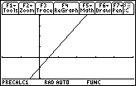
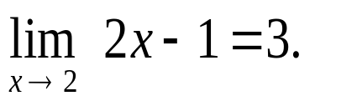
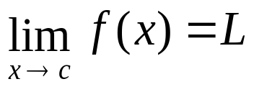
Limits
In limit notation we have
3
Definition: We write
2
or
as x → c, then f (x) → L,
if the functional value of f (x) is close to the single real number L whenever x is close to, but not equal to, c (on either side of c).
Barnett/Ziegler/Byleen College Mathematics 12e

Slide 6
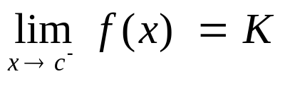
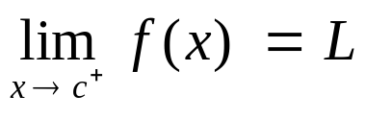
One-Sided Limits
We write
and call K the limit from the left (or left-hand limit) if
f (x) is close to K whenever x is close to c, but to the left
of c on the real number line.
We write
and call L the limit from the right (or right-hand limit) if f (x) is close to L whenever x is close to c, but to the right of c on the real number line.
In order for a limit to exist, the limit from the left and the limit from the right must exist and be equal.
Barnett/Ziegler/Byleen College Mathematics 12e

Slide 7
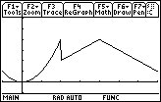
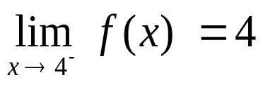
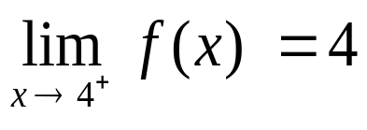

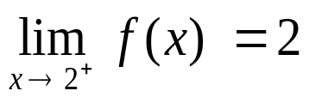
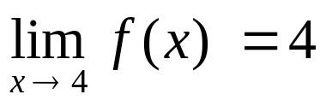
Example 1
On the other hand:
4
2
2
4
Since the limit from the left and the limit from the right both exist and are equal, the limit exists at 4:
Since these two are not the same, the limit does not exist at 2.
Barnett/Ziegler/Byleen College Mathematics 12e

Slide 8
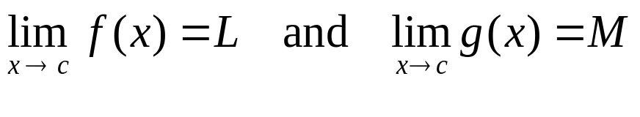
Limit Properties
Let f and g be two functions, and assume that the following two limits exist and are finite:
Then
the limit of a constant is the constant.
the limit of x as x approaches c is c.
the limit of the sum of the functions is equal to the sum of the limits.
the limit of the difference of the functions is equal to the difference of the limits.
Barnett/Ziegler/Byleen College Mathematics 12e

Slide 9
Limit Properties
(continued)
the limit of a constant times a function is equal to the constant times the limit of the function.
the limit of the product of the functions is the product of the limits of the functions.
the limit of the quotient of the functions is the quotient of the limits of the functions, provided M ≠ 0.
the limit of the n^{th} root of a function is the n^{th} root of the limit of that function.
Barnett/Ziegler/Byleen College Mathematics 12e

Slide 10
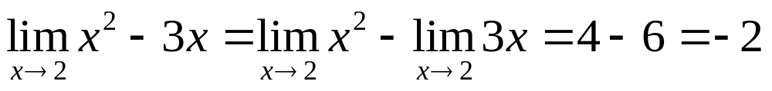
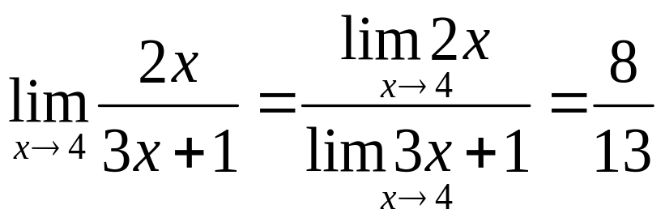
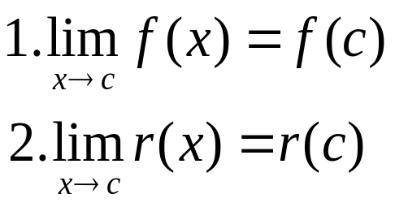
Examples 2, 3
From these examples we conclude that
f any polynomial function
r any rational function with a nonzero denominator at x = c
Barnett/Ziegler/Byleen College Mathematics 12e

Slide 11
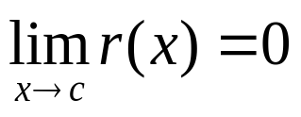
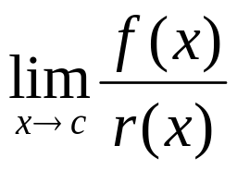
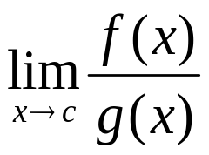
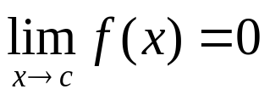
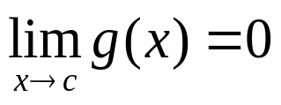
Indeterminate Forms
It is important to note that there are restrictions on some of the limit properties. In particular if
then finding may present difficulties, since the denominator is 0.
If and , then
is said to be indeterminate.
The term “indeterminate” is used because the limit may or may not exist.
Barnett/Ziegler/Byleen College Mathematics 12e

Slide 12
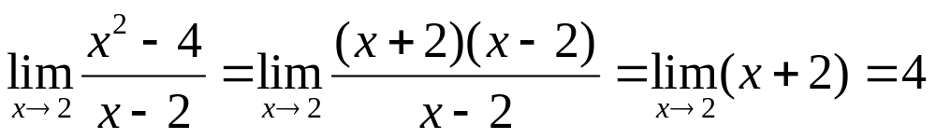
Example 4
This example illustrates some techniques that can be useful for indeterminate forms.
Algebraic simplification is often useful when the numerator and denominator are both approaching 0.
Barnett/Ziegler/Byleen College Mathematics 12e

Slide 13
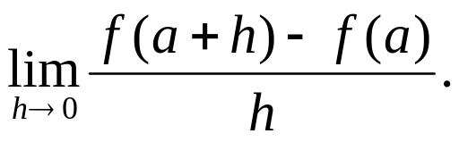
Difference Quotients
Let f (x) = 3x - 1. Find
Barnett/Ziegler/Byleen College Mathematics 12e

Slide 14
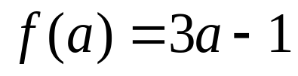
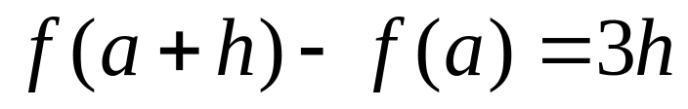
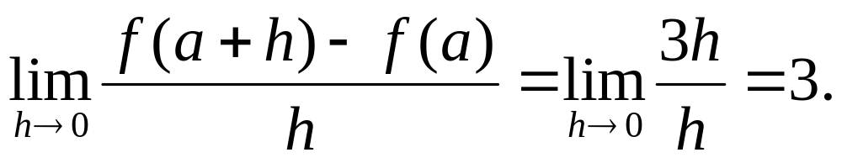
Difference Quotients
Let f (x) = 3x - 1. Find
Solution:
Barnett/Ziegler/Byleen College Mathematics 12e

Slide 15
Summary
We started by using a table to investigate the idea of a limit. This was an intuitive way to approach limits.
We saw that if the left and right limits at a point were the same, we had a limit at that point.
We saw that we could add, subtract, multiply, and divide limits.
We now have some very powerful tools for dealing with limits and can go on to our study of calculus.
Barnett/Ziegler/Byleen College Mathematics 12e

