Slide 1
Chapter 10
Limits and the Derivative
Section 2
Infinite Limits and Limits at Infinity

Slide 2

Objectives for Section 10.2
Infinite Limits and Limits at Infinity
The student will understand the concept of infinite limits.
The student will be able to locate vertical asymptotes.
The student will be able to calculate limits at infinity.
The student will be able to find horizontal asymptotes.
Barnett/Ziegler/Byleen College Mathematics 12e

Slide 3
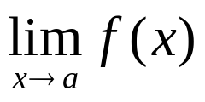
Infinite Limits
There are various possibilities under which
does not exist. For example, if the one-sided limits are different at x = a, then the limit does not exist.
Another situation where a limit may fail to exist involves functions whose values become very large as x approaches a. The special symbol ∞ (infinity) is used to describe this type of behavior.
Barnett/Ziegler/Byleen College Mathematics 12e

Slide 4
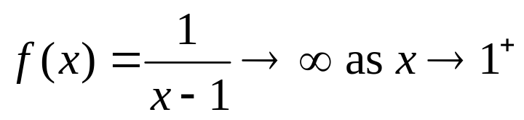
Example
To illustrate this case, consider the function f (x) = 1/(x–1), which is discontinuous at x = 1. As x approaches 1 from the right, the values of f (x) are positive and become larger and larger. That is, f (x) increases without bound. We write this symbolically as
Since ∞ is not a real number, the limit above does not actually exist. We are using the symbol ∞ (infinity) to describe the manner in which the limit fails to exist, and we call this an infinite limit.
Barnett/Ziegler/Byleen College Mathematics 12e

Slide 5
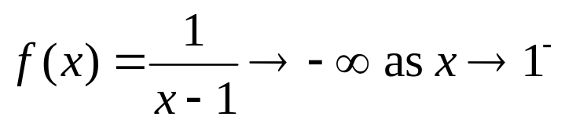
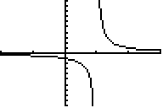
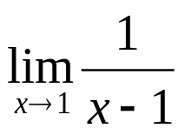
Example
(continued)
As x approaches 1 from the left, the values of f (x) are negative and become larger and larger in absolute value. That is, f (x) decreases through negative values without bound. We write this symbolically as
The graph of this function is as shown:
Note that does not exist.
Barnett/Ziegler/Byleen College Mathematics 12e

Slide 6
Infinite Limits and
Vertical Asymptotes
Definition:
The vertical line x = a is a vertical asymptote for the graph of y = f (x) if f (x) → ∞ or f (x) → –∞ as x → a⁺ or x → a–.
That is, f (x) either increases or decreases without bound as x approaches a from the right or from the left.
Note: If any one of the four possibilities is satisfied, this makes x = a a vertical asymptote. Most of the time, the limit will be infinite (+ or –) on both sides, but it does not have to be.
Barnett/Ziegler/Byleen College Mathematics 12e

Slide 7
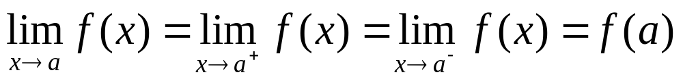
Vertical Asymptotes of Polynomials
How do we locate vertical asymptotes? If a function f is continuous at x = a, then
Since all of the above limits exist and are finite, f cannot have a vertical asymptote at x = a. In order for f to have a vertical asymptote at x = a, at least one of the limits above must be an infinite limit, and f must be discontinuous at
x = a. We know that polynomial functions are continuous for all real numbers, so a polynomial has no vertical asymptotes.
Barnett/Ziegler/Byleen College Mathematics 12e

Slide 8
Vertical Asymptotes of
Rational Functions
Since a rational function is discontinuous only at the zeros of its denominator, a vertical asymptote of a rational function can occur only at a zero of its denominator. The following is a simple procedure for locating the vertical asymptotes of a rational function:
If f (x) = n(x)/d(x) is a rational function, d(c) = 0 and n(c) ≠ 0, then the line x = c is a vertical asymptote of the graph of f.
However, if both d(c) = 0 and n(c) = 0, there may or may not be a vertical asymptote at x = c.
Barnett/Ziegler/Byleen College Mathematics 12e

Slide 9
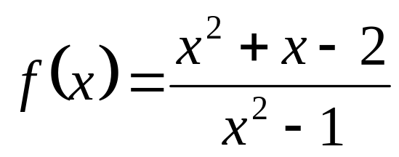
Example
Let
Describe the behavior of f at each point of discontinuity. Use ∞ and –∞ when appropriate. Identify all vertical asymptotes.
Barnett/Ziegler/Byleen College Mathematics 12e

Slide 10
Example
(continued)
Let
Describe the behavior of f at each point of discontinuity. Use ∞ and –∞ when appropriate. Identify all vertical asymptotes.
Solution: Let n(x) = x² + x – 2 and d(x) = x² – 1. Factoring the denominator, we see that d(x) = x² – 1 = (x+1)(x–1) has two zeros, x = –1 and x = 1. These are the points of discontinuity of f.
Barnett/Ziegler/Byleen College Mathematics 12e

Slide 11
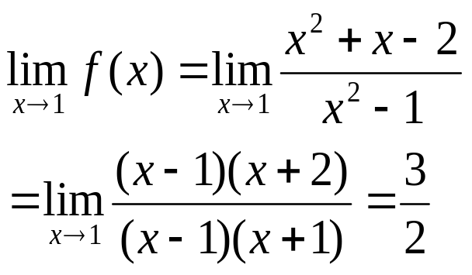
Example
(continued)
Since d(–1) = 0 and n(–1) = –2 ≠ 0, the theorem tells us that the line x = –1 is a vertical asymptote.
Now we consider the other zero of d(x), x = 1. This time
n(1) = 0 and the theorem does not apply. We use algebraic simplification to investigate the behavior of the function at
x = 1:
Since the limit exists as x approaches 1, f does not have a vertical asymptote at x = 1. The graph of f is shown on the next slide.
Barnett/Ziegler/Byleen College Mathematics 12e

Slide 12
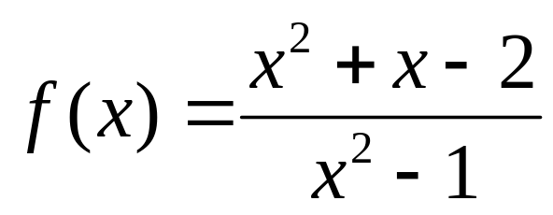
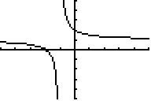
Example
(continued)
Vertical Asymptote
Point of discontinuity
Barnett/Ziegler/Byleen College Mathematics 12e

Slide 13

Limits at Infinity
∞ is a symbol used to describe the behavior of limits that do not exist. The symbol ∞ can also be used to indicate that an independent variable is increasing or decreasing without bound. We will write x → ∞ to indicate that x is increasing through positive values without bound and x → –∞ to indicate that x is decreasing without bound through negative values.
Barnett/Ziegler/Byleen College Mathematics 12e

Slide 14

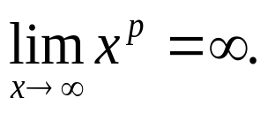
Limits at Infinity of
Power Functions
We begin our consideration of limits at infinity by considering power functions of the form x ^{p} and 1/x ^{p}, where p is a positive real number.
If p is a positive real number, then x ^{p} increases as x increases, and it can be shown that there is no upper bound on the values of x ^{p}. We indicate this by writing
or
Barnett/Ziegler/Byleen College Mathematics 12e

Slide 15
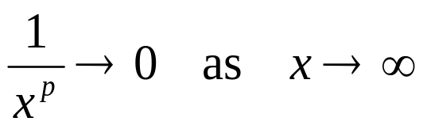
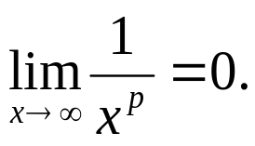
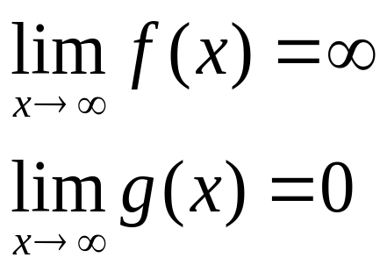
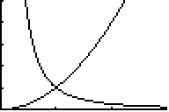
Power Functions
(continued)
Since the reciprocals of very large numbers are very small numbers, it follows that 1/x ^{p} approaches 0 as x increases without bound. We indicate this behavior by writing
or
This figure illustrates this behavior for f (x) = x² and g(x) = 1/x^{2.}
Barnett/Ziegler/Byleen College Mathematics 12e

Slide 16
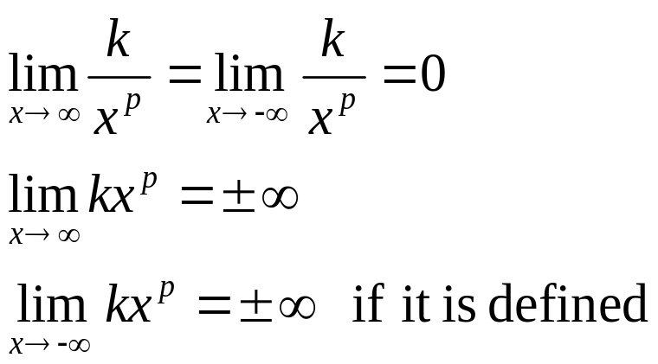
Power Functions
(continued)
In general, if p is a positive real number and k is a nonzero real number, then
Note: k and p determine whether the limit at ∞ is ∞ or –∞.
The last limit is only defined if the p^{th} power of a negative number is defined. This means that p has to be an integer, or a rational number with odd denominator.
Barnett/Ziegler/Byleen College Mathematics 12e

Slide 17
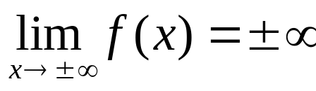
Limits at Infinity of
Polynomial Functions
What about limits at infinity for polynomial functions?
As x increases without bound in either the positive or the negative direction, the behavior of the polynomial graph will be determined by the behavior of the leading term (the highest degree term). The leading term will either become very large in the positive sense or in the negative sense (assuming that the polynomial has degree at least 1). In the first case the function will approach ∞ and in the second case the function will approach –∞.
In mathematical shorthand, we write this as
This covers all possibilities.
Barnett/Ziegler/Byleen College Mathematics 12e

Slide 18
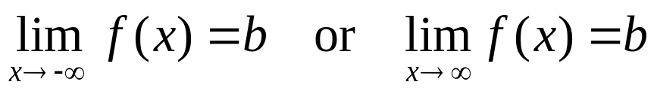
Limits at Infinity and
Horizontal Asymptotes
A line y = b is a horizontal asymptote for the graph of y = f (x) if f (x) approaches b as either x increases without bound or decreases without bound. Symbolically, y = b is a horizontal asymptote if
In the first case, the graph of f will be close to the horizontal line y = b for large (in absolute value) negative x.
In the second case, the graph will be close to the horizontal line y = b for large positive x.
Note: It is enough if one of these conditions is satisfied, but frequently they both are.
Barnett/Ziegler/Byleen College Mathematics 12e

Slide 19
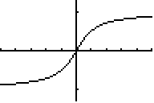
Example
This figure shows the graph of a function with two horizontal asymptotes, y = 1 and y = –1.
Barnett/Ziegler/Byleen College Mathematics 12e

Slide 20
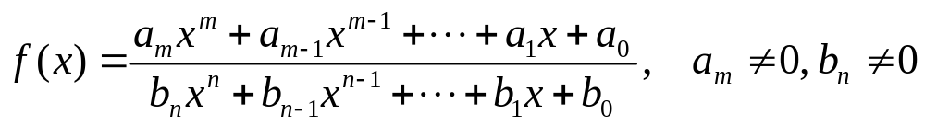
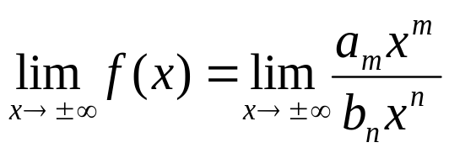
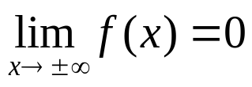
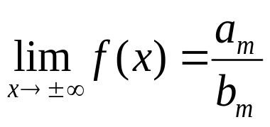
Horizontal Asymptotes of Rational Functions
If
then
There are three possible cases for these limits.
If m < n, then
The line y = 0 (x axis) is a horizontal asymptote for f (x).
2. If m = n, then
The line y = a_{m}/b_{n} is a horizontal asymptote for f (x) .
3. If m > n, f (x) does not have a horizontal asymptote.
Barnett/Ziegler/Byleen College Mathematics 12e

Slide 21
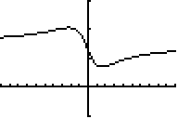
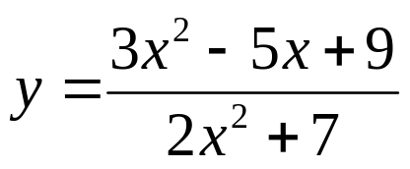
Horizontal Asymptotes of Rational Functions (continued)
Notice that in cases 1 and 2 on the previous slide that the limit is the same if x approaches ∞ or –∞. Thus a rational function can have at most one horizontal asymptote. (See figure). Notice that the numerator and denominator have the same degree in this example, so the horizontal asymptote is the ratio of the leading coefficients of the numerator and denominator.
y = 1.5
Barnett/Ziegler/Byleen College Mathematics 12e

Slide 22
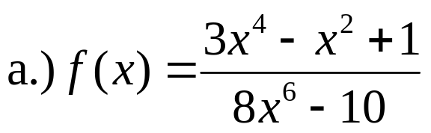
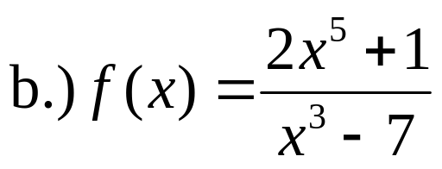
Example
Find the horizontal asymptotes of each function.
Barnett/Ziegler/Byleen College Mathematics 12e

Slide 23
Example
Solution
Find the horizontal asymptotes of each function.
Since the degree of the numerator is less than the degree of the denominator in this example, the horizontal asymptote is y = 0 (the x axis).
Since the degree of the numerator is greater than the degree of the denominator in this example, there is no horizontal asymptote.
Barnett/Ziegler/Byleen College Mathematics 12e

Slide 24
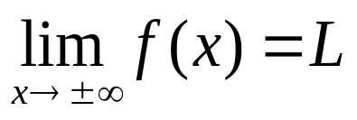
Summary
An infinite limit is a limit of the form
(y goes to infinity). It is the same as a vertical asymptote (as long as a is a finite number).
A limit at infinity is a limit of the form
(x goes to infinity). It is the same as a horizontal asymptote (as long as L is a finite number).
Barnett/Ziegler/Byleen College Mathematics 12e

