Slide 1
Chapter 10
Limits and the Derivative
Section 3
Continuity

Slide 2

Learning Objectives for Section 10.3
Continuity
The student will understand the concept of continuity
The student will be able to apply the continuity properties
The student will be able to solve inequalities using continuity properties
Barnett/Ziegler/Byleen College Mathematics 12e

Slide 3

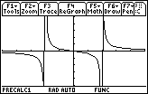
Continuity
As we have seen, some graphs have holes in them, some have breaks and some have other irregularities. We wish to study each of these oddities.
Then, through a study of limits we will examine the instantaneous rate of change.
Barnett/Ziegler/Byleen College Mathematics 12e

Slide 4
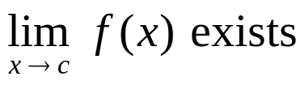
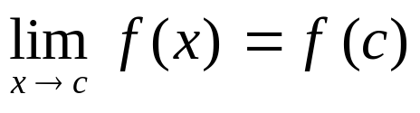
Definition of Continuity
A function f is continuous at a point x = c if
1.
2. f (c) exists
3.
A function f is continuous on the open interval (a,b)
if it is continuous at each point on the interval.
If a function is not continuous, it is discontinuous.
Barnett/Ziegler/Byleen College Mathematics 12e

Slide 5
Example 1
f (x) = x – 1 at x = 2.
Barnett/Ziegler/Byleen College Mathematics 12e

Slide 6
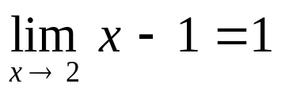
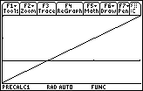
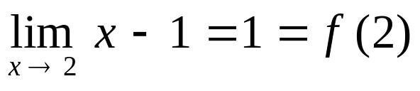
Example 1
f (x) = x – 1 at x = 2.
1. The limit exists!
2. f(2) = 1
3.
Therefore this function is continuous at x = 2.
1
2
Barnett/Ziegler/Byleen College Mathematics 12e

Slide 7
Example 2
f (x) = (x² – 9)/(x + 3) at x = –3
Barnett/Ziegler/Byleen College Mathematics 12e

Slide 8
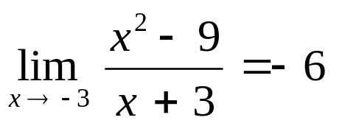
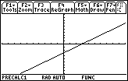
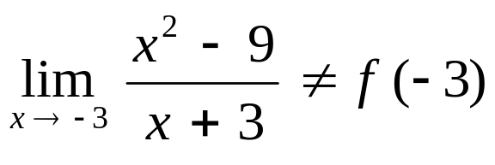
Example 2
f (x) = (x² – 9)/(x + 3) at x = –3
1.
The limit exists (reduce the fraction).
2. f (-3) = 0/0 is undefined!
3.
The function is not continuous at x = -3. (Graph should have an open circle there.)
-3
-6
Barnett/Ziegler/Byleen College Mathematics 12e

Slide 9
Example 3
f (x) = |x|/x at x = 0 and at x = 1.
Barnett/Ziegler/Byleen College Mathematics 12e

Slide 10
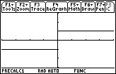
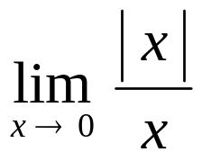
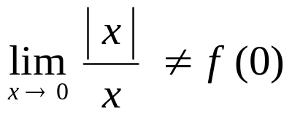
Example 3
f (x) = |x|/x at x = 0 and at x = 1.
1. Does not exist!
2. f (0) = 0/0 Undefined!
3.
The function is not continuous at x = 0.
This function is continuous at x = 1.
0
Barnett/Ziegler/Byleen College Mathematics 12e

Slide 11
Continuity Properties
If two functions are continuous on the same interval, then their sum, difference, product, and quotient are continuous on the same interval, except for values of x that make the denominator 0.
Barnett/Ziegler/Byleen College Mathematics 12e

Slide 12
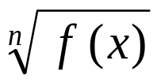
Examples of
Continuous Functions
A constant function is continuous for all x.
For integer n > 0, f (x) = x^{n} is continuous for all x.
A polynomial function is continuous for all x.
A rational function is continuous for all x, except those values that make the denominator 0.
For n an odd positive integer, is continuous wherever f (x) is continuous.
For n an even positive integer, is continuous wherever f (x) is continuous and nonnegative.
Barnett/Ziegler/Byleen College Mathematics 12e

Slide 13

Sign Charts
A tool for analyzing graphs of functions, or for solving inequalities, is the sign chart. We find where the function is zero or undefined, then partition the number line into intervals at these points. We then test each interval to determine if the function is positive (above the x axis) or negative (below the x axis) in those intervals.
Barnett/Ziegler/Byleen College Mathematics 12e

Slide 14
Constructing Sign Charts
Find all numbers which are:
  a. Points of discontinuity – where the denominator is 0.
  b. Points where the function is zero – where the numerator is zero but the denominator is not.
Plot these partition numbers on the number line, dividing the line into intervals.
Select a test number in each interval and determine if f (x) is positive (+) or negative (–) there.
4. Complete your sign chart by showing the sign of f (x) on each open interval.
Barnett/Ziegler/Byleen College Mathematics 12e

Slide 15
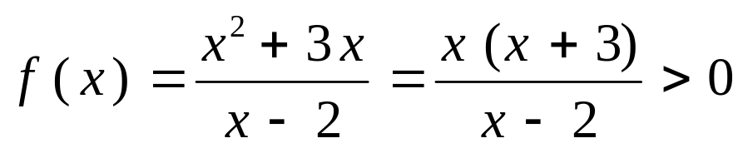
Sign Chart Example
a. Points of discontinuity:
  b. Points where f (x) = 0:
2. Place these partition values on a number line.
Barnett/Ziegler/Byleen College Mathematics 12e

Slide 16
Sign Chart Example
a. Points of discontinuity:
Where the denominator is zero: x = 2.
  b. Points where f (x) = 0:
  Where the numerator is zero: x = 0, x = -3.
2. Place these partition values on a number line.
- 3
0
2
Barnett/Ziegler/Byleen College Mathematics 12e

Slide 17
Sign Chart Example
(continued)
3. Select test numbers and determine if f (x) is positive or negative.
x | –10 | –2 | 1 | 3
f (x)
4. Complete the sign chart.
–3
0
2
Barnett/Ziegler/Byleen College Mathematics 12e

Slide 18
Sign Chart Example
(continued)
3. Select test numbers and determine if f (x) is positive or negative.
x | –10 | –2 | 1 | 3
f (x) | – | + | – | +
4. Complete the sign chart.
- - - - - - - + + + + - - - - + + + + + + +
–3
0
2
Barnett/Ziegler/Byleen College Mathematics 12e

Slide 19
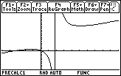
Sign Chart Example
(continued)
- - - - - - - + + + + - - - - + + + + + + +
–3
0
2
Remember the plus signs mean the function is above the x axis, while the minus signs mean the function is below the x axis.
We can check this with a graphing calculator:
Barnett/Ziegler/Byleen College Mathematics 12e

Slide 20
Sign Chart Example
(continued)
- - - - - - - + + + + - - - - + + + + + + +
–3
0
2
The “> 0” in the original problem means the solution is the intervals where the function is greater than 0, or positive.
The answer to the problem is then: – 3 < x < 0 or x > 2,
or in interval notation: (–3,0) ∪ (2,∞).
Barnett/Ziegler/Byleen College Mathematics 12e

Slide 21
Summary
We have developed a definition for determining if a function is continuous. That is, the function has no holes or oddities.
We have developed a set of properties for limits.
We have used sign charts to solve inequalities.
Barnett/Ziegler/Byleen College Mathematics 12e

