Slide 1
Chapter 10
Limits and the Derivative
Section 4
The Derivative

Slide 2

Learning Objectives for Section 10.4
The Derivative
The student will be able to calculate rate of change.
The student will be able to calculate slope of the tangent line.
The student will be able to interpret the meaning of the derivative.
The student will be able to identify the nonexistence of the derivative.
Barnett/Ziegler/Byleen College Mathematics 12e

Slide 3
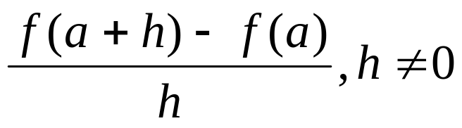
The Rate of Change
For y = f (x), the average rate of change from x = a to x = a + h is
The above expression is also called a difference quotient. It can be interpreted as the slope of a secant.
See the picture on the next slide for illustration.
Barnett/Ziegler/Byleen College Mathematics 12e

Slide 4
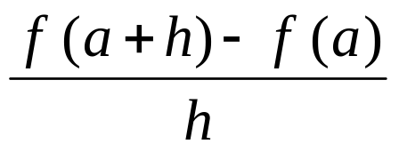
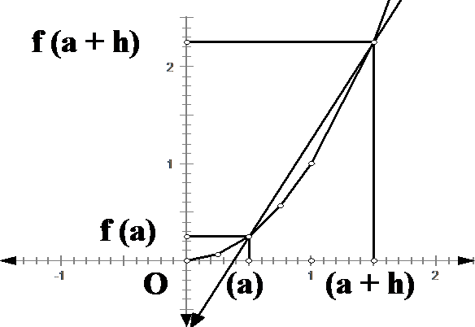
Visual Interpretation
Q
slope
f (a + h) – f (a)
Average rate of change = slope of the secant line through P and Q
P
h
Barnett/Ziegler/Byleen College Mathematics 12e

Slide 5

Example 1
The revenue generated by producing and selling widgets is given by R(x) = x (75 – 3x) for 0 ≤ x ≤ 20.
What is the change in revenue if production changes from 9 to 12?
Barnett/Ziegler/Byleen College Mathematics 12e

Slide 6
Example 1
The revenue generated by producing and selling widgets is given by R(x) = x (75 – 3x) for 0 ≤ x ≤ 20.
What is the change in revenue if production changes from 9 to 12?
R(12) – R(9) = $468 – $432 = $36.
Increasing production from 9 to 12 will increase revenue by $36.
Barnett/Ziegler/Byleen College Mathematics 12e

Slide 7
Example 1
(continued)
The revenue is R(x) = x (75 – 3x) for 0 ≤ x ≤ 20.
What is the average rate of change in revenue (per unit change in x) if production changes from 9 to 12?
Barnett/Ziegler/Byleen College Mathematics 12e

Slide 8
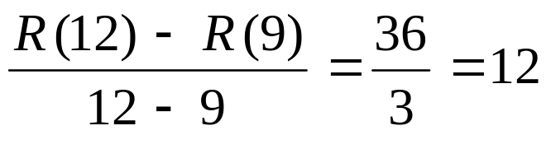
Example 1
(continued)
The revenue is R(x) = x (75 – 3x) for 0 ≤ x ≤ 20.
What is the average rate of change in revenue (per unit change in x) if production changes from 9 to 12?
To find the average rate of change we divide the change in revenue by the change in production:
Thus the average change in revenue is $12 when production is increased from 9 to 12.
Barnett/Ziegler/Byleen College Mathematics 12e

Slide 9
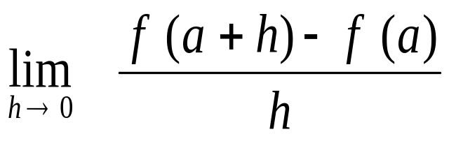
The Instantaneous
Rate of Change
Consider the function y = f (x) only near the point P = (a, f (a)).
The difference quotient
gives the average rate of change of f over the interval [a, a+h].
If we make h smaller and smaller, in the limit we obtain the instantaneous rate of change of the function at the point P:
Barnett/Ziegler/Byleen College Mathematics 12e

Slide 10
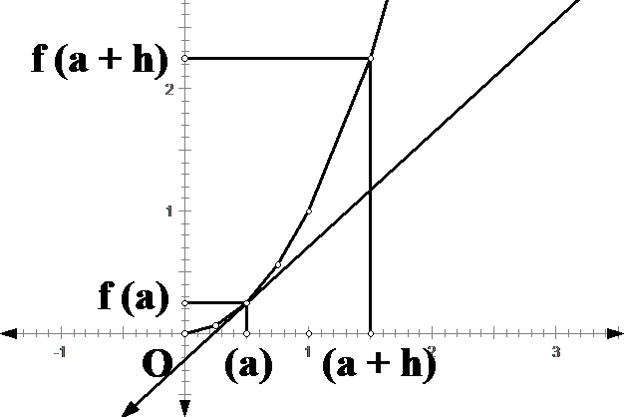
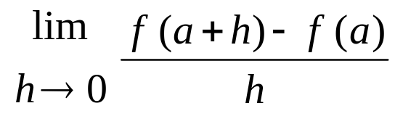
Visual Interpretation
Q
Tangent
Slope of tangent =
instantaneous rate of change.
f (a + h) – f (a)
P
Let h approach 0
h
Barnett/Ziegler/Byleen College Mathematics 12e

Slide 11
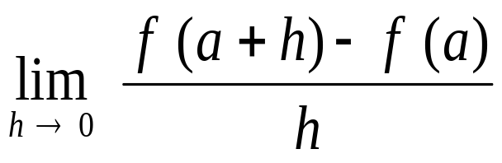
Instantaneous Rate of Change
Given y = f (x), the instantaneous rate of change at x = a is
provided that the limit exists. It can be interpreted as the slope of the tangent at the point (a, f (a)). See illustration on previous slide.
Barnett/Ziegler/Byleen College Mathematics 12e

Slide 12
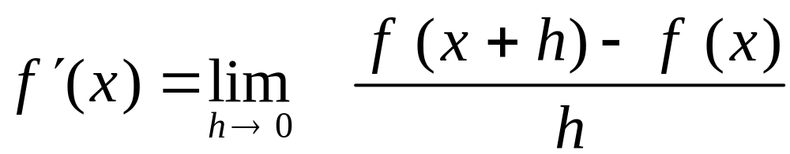
The Derivative
For y = f (x), we define the derivative of f at x, denoted
f ′(x), to be
if the limit exists.
If f ′(a) exists, we call f differentiable at a.
If f ′(x) exist for each x in the open interval (a, b), then f is said to be differentiable over (a, b).
Barnett/Ziegler/Byleen College Mathematics 12e

Slide 13
Interpretations of the Derivative
If f is a function, then f ′ is a new function with the following interpretations:
For each x in the domain of f ′, f ′(x) is the slope of the line tangent to the graph of f at the point (x, f (x)).
For each x in the domain of f ′, f ′(x) is the instantaneous rate of change of y = f (x) with respect to x.
If f (x) is the position of a moving object at time x, then
v = f ′(x) is the velocity of the object at that time.
Barnett/Ziegler/Byleen College Mathematics 12e

Slide 14
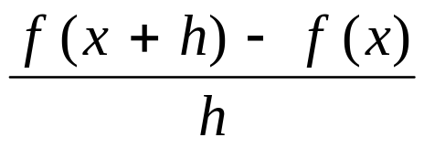
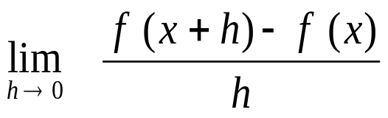
Finding the Derivative
To find f ′ (x), we use a four-step process:
Step 1. Find f (x + h)
Step 2. Find f (x + h) – f (x)
Step 3. Find
Step 4. Find
Barnett/Ziegler/Byleen College Mathematics 12e

Slide 15
Example 2
Find the derivative of f (x) = x ² – 3x.
Barnett/Ziegler/Byleen College Mathematics 12e

Slide 16
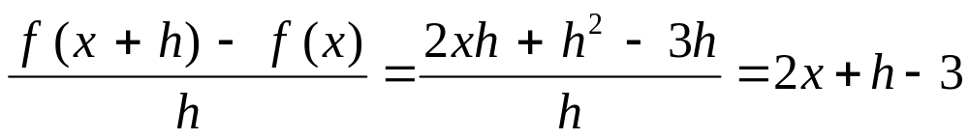
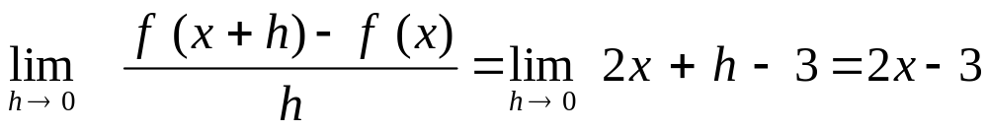
Example 2
Find the derivative of f (x) = x ² – 3x.
Step 1. f (x + h) = (x + h)² – 3(x + h) = x² + 2xh + h² – 3x – 3h
Step 2. Find f (x + h) – f (x) = 2xh + h² – 3h
Step 3. Find
Step 4. Find
Barnett/Ziegler/Byleen College Mathematics 12e

Slide 17
Example 3
Find the slope of the tangent to the graph of f (x) = x ² – 3x at x = 0, x = 2, and x = 3.
Barnett/Ziegler/Byleen College Mathematics 12e

Slide 18
Example 3
Find the slope of the tangent to the graph of f (x) = x ² – 3x at x = 0, x = 2, and x = 3.
Solution: In example 2 we found the derivative of this function at x to be
f ′(x) = 2x – 3
Hence
f ′(0) = -3
f ′(2) = 1, and
f ′(3) = 3
Barnett/Ziegler/Byleen College Mathematics 12e

Slide 19

Graphing Calculators
Most graphing calculators have a built-in numerical differentiation routine that will approximate numerically the values of f ′(x) for any given value of x.
Some graphing calculators have a built-in symbolic differentiation routine that will find an algebraic formula for the derivative, and then evaluate this formula at indicated values of x.
Barnett/Ziegler/Byleen College Mathematics 12e

Slide 20
Example 4
We know that the derivative of f (x) = x ² – 3x is f ′(x) = 2x – 3.
Verify this for x = 2 using a graphing calculator.
Barnett/Ziegler/Byleen College Mathematics 12e

Slide 21


Example 4
We know that the derivative of f (x) = x ² – 3x is f ′(x) = 2x – 3.
Verify this for x = 2 using a graphing calculator.
Using dy/dx under the “calc” menu.
Using tangent under the “draw” menu.
slope
tangent equation
Barnett/Ziegler/Byleen College Mathematics 12e

Slide 22
Example 5
Find the derivative of f (x) = 2x – 3x² using a graphing calculator with a symbolic differentiation routine.
Barnett/Ziegler/Byleen College Mathematics 12e

Slide 23
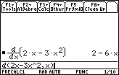
Example 5
Find the derivative of f (x) = 2x – 3x² using a graphing calculator with a symbolic differentiation routine.
Using algebraic differentiation under the home calc menu.
derivative
Barnett/Ziegler/Byleen College Mathematics 12e

Slide 24
Example 6
Find the derivative of f (x) = 2x – 3x² using the four-step process.
Barnett/Ziegler/Byleen College Mathematics 12e

Slide 25
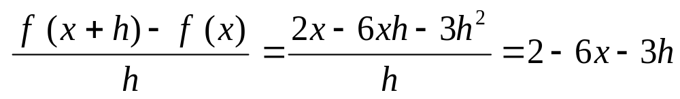
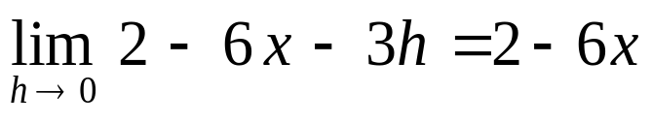
Example 6
Find the derivative of f (x) = 2x – 3x² using the four-step process.
Step 1. f (x + h) = 2(x + h) – 3(x + h)²
Step 2. f (x + h) – f (x) = 2h – 6xh - 3h²
Step 3.
Step 4.
Barnett/Ziegler/Byleen College Mathematics 12e

Slide 26
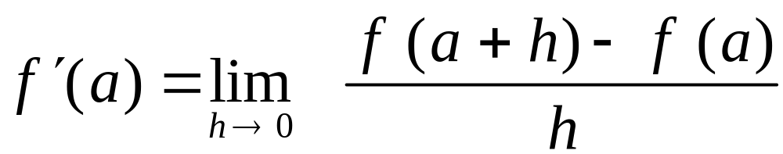
Nonexistence of the Derivative
The existence of a derivative at x = a depends on the existence of the limit
If the limit does not exist, we say that the function is nondifferentiable at x = a, or f ′(a) does not exist.
Barnett/Ziegler/Byleen College Mathematics 12e

Slide 27
Nonexistence of the Derivative
(continued)
Some of the reasons why the derivative of a function may not exist at x = a are
The graph of f has a hole or break at x = a, or
The graph of f has a sharp corner at x = a, or
The graph of f has a vertical tangent at x = a.
Barnett/Ziegler/Byleen College Mathematics 12e

Slide 28
Summary
For y = f (x), we defined the derivative of f at x, denoted
f ′(x), to be
if the limit exists.
We have seen how to find the derivative algebraically, using the four-step process.
Barnett/Ziegler/Byleen College Mathematics 12e

