Slide 1
Chapter 10
Limits and the Derivative
Section 5
Basic Differentiation Properties

Slide 2

Objectives for Section 10.5
Power Rule and Differentiation Properties
The student will be able to calculate the derivative of a constant function.
The student will be able to apply the power rule.
The student will be able to apply the constant multiple and sum and difference properties.
The student will be able to solve applications.
Barnett/Ziegler/Byleen College Mathematics 12e

Slide 3
Derivative Notation
In the preceding section we defined the derivative of a function. There are several widely used symbols to represent the derivative. Given y = f (x), the derivative of f at x may be represented by any of the following:
f ′(x)
y′
dy/dx
Barnett/Ziegler/Byleen College Mathematics 12e

Slide 4
Example 1
What is the slope of a constant function?
Barnett/Ziegler/Byleen College Mathematics 12e

Slide 5
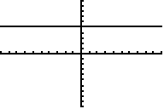
Example 1
(continued)
What is the slope of a constant function?
The graph of f (x) = C is a horizontal line with slope 0, so we would expect f ’(x) = 0.
Theorem 1. Let y = f (x) = C be a constant function, then
y′ = f ′(x) = 0.
Barnett/Ziegler/Byleen College Mathematics 12e

Slide 6
Power Rule
A function of the form f (x) = x^{n} is called a power function. This includes f (x) = x (where n = 1) and radical functions (fractional n).
Theorem 2. (Power Rule) Let y = x^{n} be a power function, then
y′ = f ′(x) = dy/dx = n x^{n – 1}.
THEOREM 2 IS VERY IMPORTANT.
IT WILL BE USED A LOT!
Barnett/Ziegler/Byleen College Mathematics 12e

Slide 7
Example 2
Differentiate f (x) = x⁵.
Barnett/Ziegler/Byleen College Mathematics 12e

Slide 8
Example 2
Differentiate f (x) = x⁵.
Solution:
By the power rule, the derivative of x^{n} is n x^{n–1}.
In our case n = 5, so we get f ′(x) = 5 x⁴.
Barnett/Ziegler/Byleen College Mathematics 12e

Slide 9
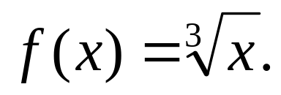
Example 3
Differentiate
Barnett/Ziegler/Byleen College Mathematics 12e

Slide 10
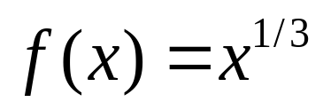
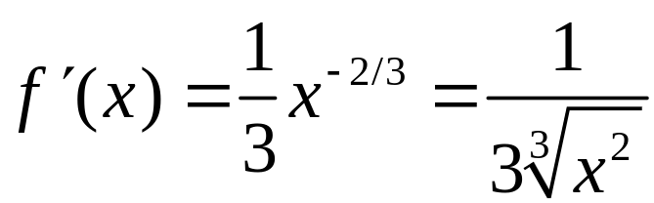
Example 3
Differentiate
Solution:
Rewrite f (x) as a power function, and apply the power rule:
Barnett/Ziegler/Byleen College Mathematics 12e

Slide 11
Constant Multiple Property
Theorem 3. Let y = f (x) = k⋅ u(x) be a constant k times a function u(x). Then
y′ = f ′(x) = k ⋅ u ′(x).
In words: The derivative of a constant times a function is the constant times the derivative of the function.
Barnett/Ziegler/Byleen College Mathematics 12e

Slide 12
Example 4
Differentiate f (x) = 7x⁴.
Barnett/Ziegler/Byleen College Mathematics 12e

Slide 13
Example 4
Differentiate f (x) = 7x⁴.
Solution:
Apply the constant multiple property and the power rule.
f ′(x) = 7⋅(4x³) = 28 x³.
Barnett/Ziegler/Byleen College Mathematics 12e

Slide 14
Sum and Difference Properties
Theorem 5. If
y = f (x) = u(x) ± v(x),
then
y′ = f ′(x) = u′(x) ± v′(x).
In words:
The derivative of the sum of two differentiable functions is the sum of the derivatives.
The derivative of the difference of two differentiable functions is the difference of the derivatives.
Barnett/Ziegler/Byleen College Mathematics 12e

Slide 15
Example 5
Differentiate f (x) = 3x⁵ + x⁴ – 2x³ + 5x² – 7x + 4.
Barnett/Ziegler/Byleen College Mathematics 12e

Slide 16
Example 5
Differentiate f (x) = 3x⁵ + x⁴ – 2x³ + 5x² – 7x + 4.
Solution:
Apply the sum and difference rules, as well as the constant multiple property and the power rule.
f ′(x) = 15x⁴ + 4x³ – 6x² + 10x – 7.
Barnett/Ziegler/Byleen College Mathematics 12e

Slide 17
Applications
Remember that the derivative gives the instantaneous rate of change of the function with respect to x. That might be:
Instantaneous velocity.
Tangent line slope at a point on the curve of the function.
Marginal Cost. If C(x) is the cost function, that is, the total cost of producing x items, then C′(x) approximates the cost of producing one more item at a production level of x items. C′(x) is called the marginal cost.
Barnett/Ziegler/Byleen College Mathematics 12e

Slide 18
Tangent Line Example
Let f (x) = x⁴ – 6x² + 10.
(a) Find f ′(x)
(b) Find the equation of the tangent line at x = 1
Barnett/Ziegler/Byleen College Mathematics 12e

Slide 19
Tangent Line Example
(continued)
Let f (x) = x⁴ – 6x² + 10.
(a) Find f ′(x)
(b) Find the equation of the tangent line at x = 1
Solution:
f ′(x) = 4x³ - 12x
Slope: f ′(1) = 4(1³) – 12(1) = -8.
Point: If x = 1, then y = f (1) = 1 – 6 + 10 = 5. Point-slope form: y – y₁ = m(x – x₁)
y – 5 = –8(x –1)
y = –8x + 13
Barnett/Ziegler/Byleen College Mathematics 12e

Slide 20

Application Example
The total cost (in dollars) of producing x portable radios per day is
C(x) = 1000 + 100x – 0.5x²
for 0 ≤ x ≤ 100.
Find the marginal cost at a production level of x radios.
Barnett/Ziegler/Byleen College Mathematics 12e

Slide 21
Example
(continued)
The total cost (in dollars) of producing x portable radios per day is
C(x) = 1000 + 100x – 0.5x²
for 0 ≤ x ≤ 100.
Find the marginal cost at a production level of x radios.
Solution: The marginal cost will be
C′(x) = 100 – x.
Barnett/Ziegler/Byleen College Mathematics 12e

Slide 22
Example
(continued)
Find the marginal cost at a production level of 80 radios and interpret the result.
Barnett/Ziegler/Byleen College Mathematics 12e

Slide 23
Example
(continued)
Find the marginal cost at a production level of 80 radios and interpret the result.
Solution: C′(80) = 100 – 80 = 20.
It will cost approximately $20 to produce the 81st radio.
Find the actual cost of producing the 81st radio and compare this with the marginal cost.
Barnett/Ziegler/Byleen College Mathematics 12e

Slide 24
Example
(continued)
Find the marginal cost at a production level of 80 radios and interpret the result.
Solution: C′(80) = 100 – 80 = 20.
It will cost approximately $20 to produce the 81st radio.
Find the actual cost of producing the 81st radio and compare this with the marginal cost.
Solution: The actual cost of the 81st radio will be
C(81) – C(80) = $5819.50 – $5800 = $19.50.
This is approximately equal to the marginal cost.
Barnett/Ziegler/Byleen College Mathematics 12e

Slide 25
Summary
If f (x) = C, then f ′(x) = 0
If f (x) = x^{n}, then f ′(x) = n x^{n-1}
If f (x) = k⋅u(x), then f ′(x) = k⋅u′(x)
If f (x) = u(x) ± v(x), then f ′(x) = u′(x) ± v′(x).
Barnett/Ziegler/Byleen College Mathematics 12e

