Slide 1
Chapter 10
Limits and the Derivative
Section 6
Differentials

Slide 2

Learning Objectives for Section 10.6 Differentials
The student will be able to apply the concept of increments.
The student will be able to compute differentials.
The student will be able to calculate approximations using differentials.
Barnett/Ziegler/Byleen College Mathematics 12e

Slide 3
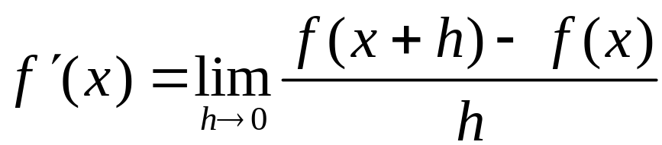
Increments
In a previous section we defined the derivative of f at x as the limit of the difference quotient:
Increment notation will enable us to interpret the numerator and the denominator of the difference quotient separately.
Barnett/Ziegler/Byleen College Mathematics 12e

Slide 4
Example
Let y = f (x) = x³. If x changes from 2 to 2.1, then y will change from y = f (2) = 8 to y = f (2.1) = 9.261.
We can write this using increment notation. The change in x is called the increment in x and is denoted by Δx. Δ is the Greek letter “delta”, which often stands for a difference or change. Similarly, the change in y is called the increment in y and is denoted by Δy.
In our example,
Δx = 2.1 – 2 = 0.1
Δy = f (2.1) – f (2) = 9.261 – 8 = 1.261.
Barnett/Ziegler/Byleen College Mathematics 12e

Slide 5
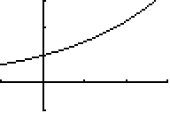
Graphical Illustration of Increments
For y = f (x)
Δx = x₂ - x₁ Δy = y₂ - y₁
x₂ = x₁ + Δx = f (x₂) – f (x₁) = f (x₁ + Δx) – f (x₁)
(x₂, f (x₂))
Δy represents the change in y corresponding to a Δx change in x.
Δx can be either positive or negative.
(x₁, f (x₁))
Δy
x₁
x₂
Δx
Barnett/Ziegler/Byleen College Mathematics 12e

Slide 6
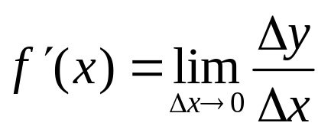
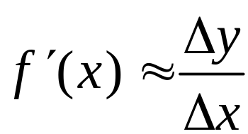
Differentials
Assume that the limit exists.
For small Δx,
Multiplying both sides of this equation by Δx gives us
Δy ≈ f ′(x) Δx.
Here the increments Δx and Δy represent the actual changes in x and y.
Barnett/Ziegler/Byleen College Mathematics 12e

Slide 7
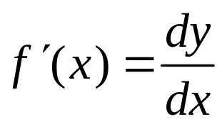

Differentials
(continued)
One of the notations for the derivative is
If we pretend that dx and dy are actual quantities, we get
We treat this equation as a definition, and call dx and dy differentials.
Barnett/Ziegler/Byleen College Mathematics 12e

Slide 8

Interpretation of Differentials
Δx and dx are the same, and represent the change in x.
The increment Δy stands for the actual change in y resulting from the change in x.
The differential dy stands for the approximate change in y, estimated by using derivatives.
In applications, we use dy (which is easy to calculate) to estimate Δy (which is what we want).
Barnett/Ziegler/Byleen College Mathematics 12e

Slide 9
Example 1
Find dy for f (x) = x² + 3x and evaluate dy for x = 2 and dx = 0.1.
Barnett/Ziegler/Byleen College Mathematics 12e

Slide 10
Example 1
Find dy for f (x) = x² + 3x and evaluate dy for x = 2 and dx = 0.1.
Solution:
dy = f ′(x) dx = (2x + 3) dx
When x = 2 and dx = 0.1, dy = [2(2) + 3] 0.1 = 0.7.
Barnett/Ziegler/Byleen College Mathematics 12e

Slide 11
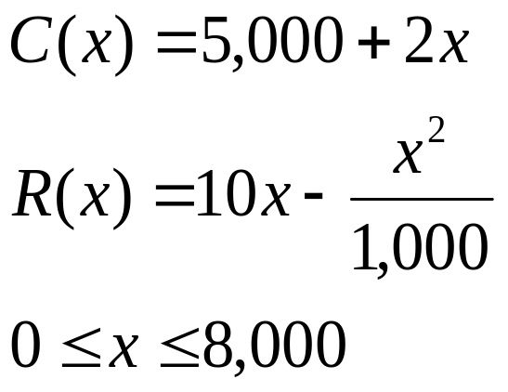

Example 2
Cost-Revenue
A company manufactures and sells x transistor radios per week. If the weekly cost and revenue equations are
find the approximate changes in revenue and profit if production is increased from 2,000 to 2,010 units/week.
Barnett/Ziegler/Byleen College Mathematics 12e

Slide 12
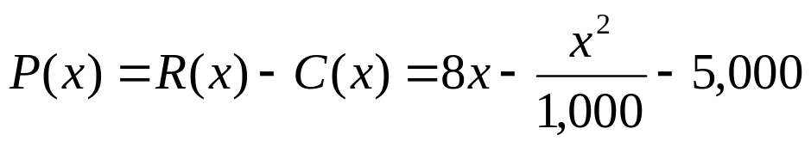
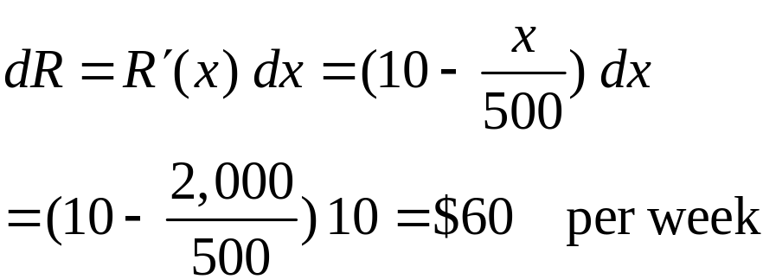
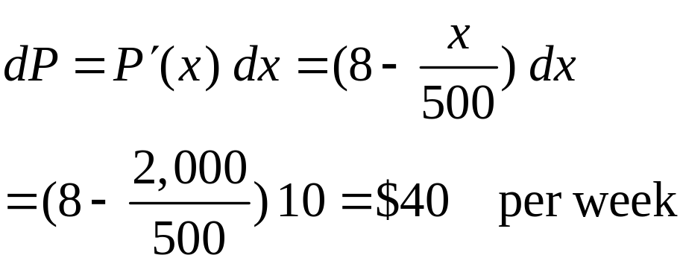
Example 2
Solution
The profit is
We will approximate ΔR and ΔP with dR and dP, respectively, using x = 2,000 and dx = 2,010 – 2,000 = 10.
Barnett/Ziegler/Byleen College Mathematics 12e

