Slide 1
Chapter 10
Limits and the Derivative
Section 7
Marginal Analysis in Business and Economics

Slide 2

Objectives for Section 10.7
Marginal Analysis
The student will be able to compute:
Marginal cost, revenue and profit
Marginal average cost, revenue and profit
The student will be able to solve applications
Barnett/Ziegler/Byleen College Mathematics 12e

Slide 3
Marginal Cost
Remember that marginal refers to an instantaneous rate of change, that is, a derivative.
Definition:
If x is the number of units of a product produced in some time interval, then
Total cost = C(x)
Marginal cost = C′(x)
Barnett/Ziegler/Byleen College Mathematics 12e

Slide 4

Marginal Revenue and
Marginal Profit
Definition:
If x is the number of units of a product sold in some time interval, then
Total revenue = R(x)
Marginal revenue = R′(x)
If x is the number of units of a product produced and sold in some time interval, then
Total profit = P(x) = R(x) – C(x)
Marginal profit = P′(x) = R′(x) – C′(x)
Barnett/Ziegler/Byleen College Mathematics 12e

Slide 5
Marginal Cost and Exact Cost
Assume C(x) is the total cost of producing x items. Then the exact cost of producing the (x + 1)st item is
C(x + 1) – C(x).
The marginal cost is an approximation of the exact cost.
C′(x) ≈ C(x + 1) – C(x).
Similar statements are true for revenue and profit.
Barnett/Ziegler/Byleen College Mathematics 12e

Slide 6

Example 1
The total cost of producing x electric guitars is
C(x) = 1,000 + 100x – 0.25x².
Find the exact cost of producing the 51st guitar.
Use the marginal cost to approximate the cost of producing the 51st guitar.
Barnett/Ziegler/Byleen College Mathematics 12e

Slide 7
Example 1
(continued)
The total cost of producing x electric guitars is
C(x) = 1,000 + 100x – 0.25x².
Find the exact cost of producing the 51st guitar.
The exact cost is C(x + 1) – C(x).
C(51) – C(50) = 5,449.75 – 5375 = $74.75.
Use the marginal cost to approximate the cost of producing the 51st guitar.
The marginal cost is C′(x) = 100 – 0.5x
C′(50) = $75.
Barnett/Ziegler/Byleen College Mathematics 12e

Slide 8
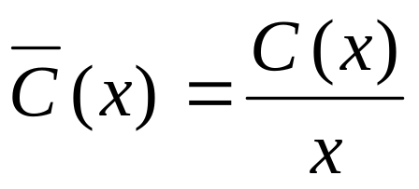
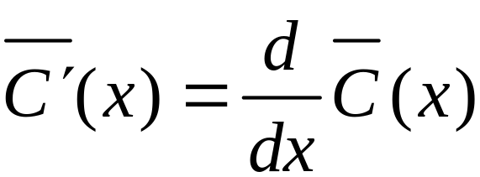
Marginal Average Cost
Definition:
If x is the number of units of a product produced in some time interval, then
Average cost per unit =
Marginal average cost =
Barnett/Ziegler/Byleen College Mathematics 12e

Slide 9
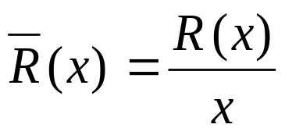
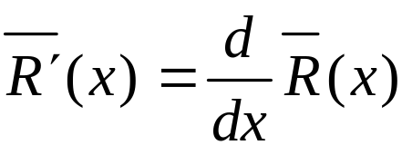
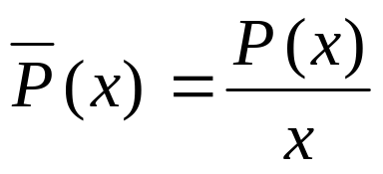
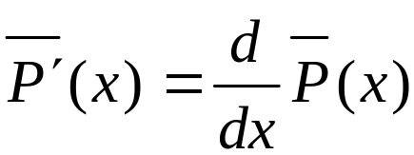
Marginal Average Revenue
Marginal Average Profit
If x is the number of units of a product sold in some time interval, then
Average revenue per unit =
Marginal average revenue =
If x is the number of units of a product produced and sold in some time interval, then
Average profit per unit =
Marginal average profit =
Barnett/Ziegler/Byleen College Mathematics 12e

Slide 10

Warning!
To calculate the marginal averages you must calculate the average first (divide by x), and then the derivative. If you change this order you will get no useful economic interpretations.
STOP
Barnett/Ziegler/Byleen College Mathematics 12e

Slide 11

Example 2
The total cost of printing x dictionaries is
C(x) = 20,000 + 10x
1. Find the average cost per unit if 1,000 dictionaries are produced.
Barnett/Ziegler/Byleen College Mathematics 12e

Slide 12
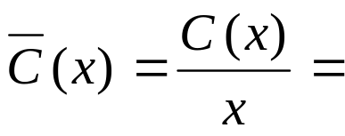
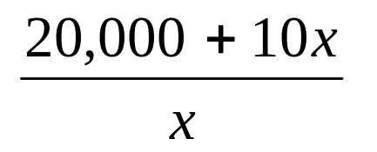
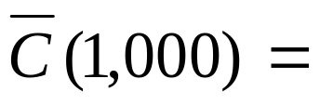
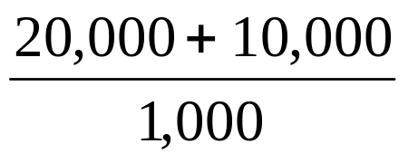
Example 2
(continued)
The total cost of printing x dictionaries is
C(x) = 20,000 + 10x
1. Find the average cost per unit if 1,000 dictionaries are produced.
= $30
Barnett/Ziegler/Byleen College Mathematics 12e

Slide 13
Example 2
(continued)
Find the marginal average cost at a production level of 1,000 dictionaries, and interpret the results.
Barnett/Ziegler/Byleen College Mathematics 12e

Slide 14
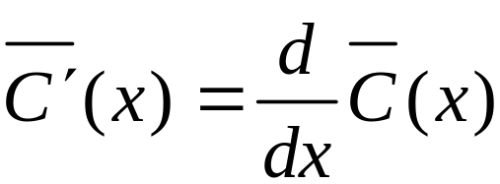
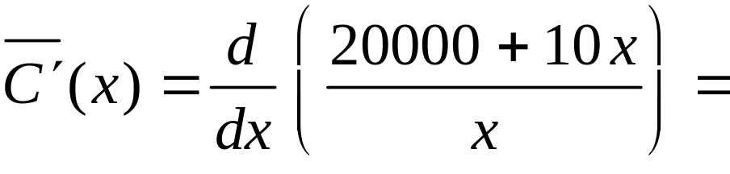
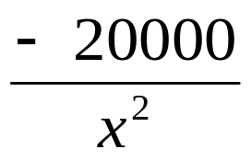
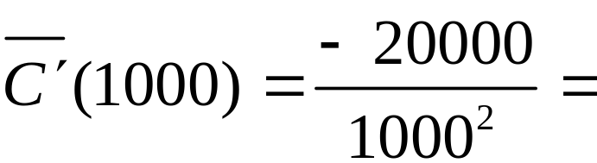

Example 2
(continued)
Find the marginal average cost at a production level of 1,000 dictionaries, and interpret the results.
Marginal average cost =
This means that if you raise production from 1,000 to 1,001 dictionaries, the price per book will fall approximately 2 cents.
Barnett/Ziegler/Byleen College Mathematics 12e

Slide 15
Example 2
(continued)
3. Use the results from above to estimate the average cost per dictionary if 1,001 dictionaries are produced.
Barnett/Ziegler/Byleen College Mathematics 12e

Slide 16
Example 2
(continued)
3. Use the results from above to estimate the average cost per dictionary if 1,001 dictionaries are produced.
Average cost for 1000 dictionaries = $30.00
Marginal average cost = - 0.02
The average cost per dictionary for 1001 dictionaries would be the average for 1000, plus the marginal average cost, or
$30.00 + $(- 0.02) = $29.98
Barnett/Ziegler/Byleen College Mathematics 12e

Slide 17

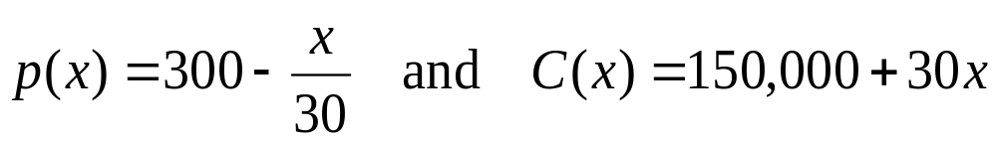

Example 3
The price-demand equation and the cost function for the production of television sets are given by
where x is the number of sets that can be sold at a price of $p per set, and C(x) is the total cost of producing x sets.
Find the marginal cost.
Barnett/Ziegler/Byleen College Mathematics 12e

Slide 18
Example 3
(continued)
The price-demand equation and the cost function for the production of television sets are given by
where x is the number of sets that can be sold at a price of $p per set, and C(x) is the total cost of producing x sets.
Find the marginal cost.
Solution: The marginal cost is C′(x) = $30.
Barnett/Ziegler/Byleen College Mathematics 12e

Slide 19
Example 3
(continued)
Find the revenue function in terms of x.
Barnett/Ziegler/Byleen College Mathematics 12e

Slide 20
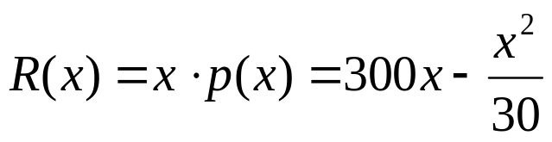
Example 3
(continued)
Find the revenue function in terms of x.
The revenue function is
3. Find the marginal revenue.
Barnett/Ziegler/Byleen College Mathematics 12e

Slide 21
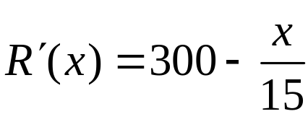
Example 3
(continued)
Find the revenue function in terms of x.
The revenue function is
3. Find the marginal revenue.
The marginal revenue is
Find R′(1500) and interpret the results.
Barnett/Ziegler/Byleen College Mathematics 12e

Slide 22
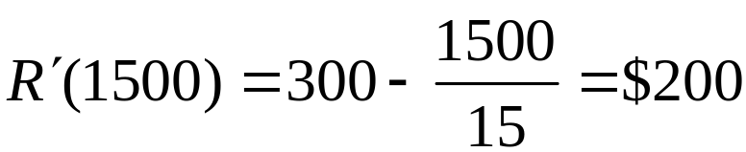
Example 3
(continued)
Find the revenue function in terms of x.
The revenue function is
3. Find the marginal revenue.
The marginal revenue is
Find R′(1500) and interpret the results.
At a production rate of 1,500, each additional set increases revenue by approximately $200.
Barnett/Ziegler/Byleen College Mathematics 12e

Slide 23
Example 3
(continued)
5. Graph the cost function and the revenue function on the same coordinate. Find the break-even point.
0 < x < 9,000
0 < y < 700,000
Barnett/Ziegler/Byleen College Mathematics 12e

Slide 24
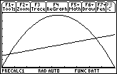
Example 3
(continued)
5. Graph the cost function and the revenue function on the same coordinate. Find the break-even point.
0 < x < 9,000
0 < y < 700,000
R(x)
Solution: There are two break-even points.
C(x)
(600,168,000)
(7500, 375,000)
Barnett/Ziegler/Byleen College Mathematics 12e

Slide 25
Example 3
(continued)
Find the profit function in terms of x.
Barnett/Ziegler/Byleen College Mathematics 12e

Slide 26
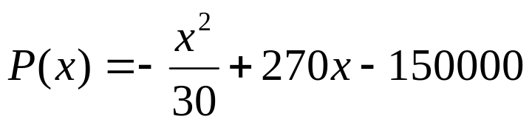
Example 3
(continued)
Find the profit function in terms of x.
The profit is revenue minus cost, so
Find the marginal profit.
Barnett/Ziegler/Byleen College Mathematics 12e

Slide 27
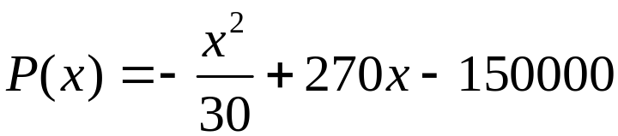
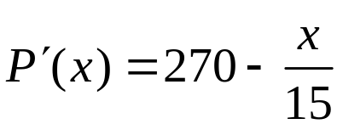
Example 3
(continued)
Find the profit function in terms of x.
The profit is revenue minus cost, so
Find the marginal profit.
8. Find P′(1500) and interpret the results.
Barnett/Ziegler/Byleen College Mathematics 12e

Slide 28
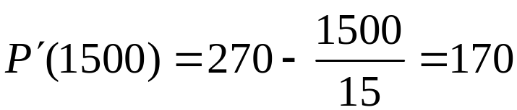
Example 3
(continued)
Find the profit function in terms of x.
The profit is revenue minus cost, so
Find the marginal profit.
8. Find P’(1500) and interpret the results.
At a production level of 1500 sets, profit is increasing at a rate of about $170 per set.
Barnett/Ziegler/Byleen College Mathematics 12e

