Slide 1
Chapter 10
Limits and the Derivative
Section R
Review

Slide 2
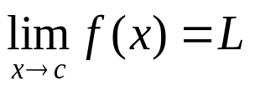
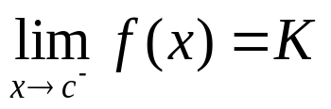
Chapter 10 Review
Important Terms, Symbols, Concepts
10.1. Introduction to Limits
  The graph of the function y = f (x) is the graph of the set of all ordered pairs (x, f (x)).
  The limit of the function y = f (x) as x approaches c is L, written as , if the functional value f (x) is close to the single real number L whenever x is close to, but not equal to, c (on either side of c).
  The limit of the function y = f (x) as x approaches c from the left is K, written as , if f (x) is close to K whenever x is close to c, but to the left of c on the real number line.
Barnett/Ziegler/Byleen College Mathematics 12e

Slide 3
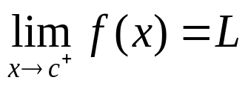
Chapter 10 Review
10.1. Introduction to Limits (continued)
  The limit of the function y = f (x) as x approaches c from the right is L, written as , if f (x) is close to L whenever x is close to c, but to the right of c on the real number line.
  Limit properties are useful for evaluating limits.
  The limit of the difference quotient [ f (a+h) – f (a)]/h always results in a 0/0 indeterminate form. Algebraic simplification is required to evaluate this type of limit.
Barnett/Ziegler/Byleen College Mathematics 12e

Slide 4
Chapter 10 Review
10.2. Infinite Limits and Limits at Infinity
  If f (x) increases or decreases without bound as x approaches a from one side of a, then the line x = a is a vertical asymptote for the graph of y = f (x).
  If f (x) gets close to L as x increases without bound or decreases without bound, then L is called the limit of f at ∞ or -∞.
Barnett/Ziegler/Byleen College Mathematics 12e

Slide 5
Chapter 10 Review
10.2. Infinite Limits and Limits at Infinity (continued)
  The behavior of a polynomial is described in terms of limits at infinity.
  If f (x) approaches L as x → ∞ or as x → -∞, then the line y = L is a horizontal asymptote for the graph of y = f (x). Polynomial functions never have a horizontal asymptote. A rational function can have at most one horizontal asymptote.
Barnett/Ziegler/Byleen College Mathematics 12e

Slide 6
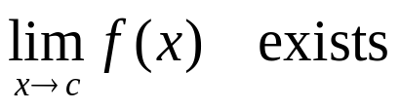
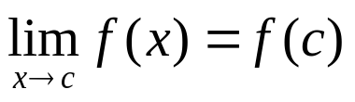
Chapter 10 Review
10.3. Continuity
  Intuitively, the graph of a continuous function can be drawn without lifting a pen off the paper. Algebraically, a function f is continuous at c if
    f (c) exists
  Continuity properties are useful for determining where a function is continuous and where it is not.
  Continuity properties are also useful for solving inequalities.
Barnett/Ziegler/Byleen College Mathematics 12e

Slide 7
Chapter 10 Review
10.4. The Derivative
  Given a function y = f (x), the average rate of change is the ratio of the change in y to the change in x.
  The instantaneous rate of change is the limit of the average rate of change as the change in x approaches 0.
  The slope of the secant line through two points on the graph of a function y = f (x) is the ratio of the change in y to the change in x. The slope of the tangent line at the point (a, f (a)) is the limit of the slope of the secant line through the points (a, f (a)) and (a+h, f (a+h)) as h → 0.
Barnett/Ziegler/Byleen College Mathematics 12e

Slide 8
Chapter 10 Review
10.4 The Derivative (continued)
  The derivative of y = f (x) at x, denoted by f ’(x), is the limit of the difference quotient [ f (x+h) - f (x)]/h as h → 0 (if the limit exists).
  The four-step method is used to find derivatives.
  If the limit of the difference quotient does not exist at x = a, then f is nondifferentiable at a and f ’(a) does not exist.
Barnett/Ziegler/Byleen College Mathematics 12e

Slide 9
Chapter 10 Review
10.5. Basic Differentiation Properties
  The derivative of a constant function is 0.
  For any real number n, the derivative of f (x) = x^{n} is nx^{n-1}.
  If f is a differentiable function, then the derivative of
  k f (x) is k f ′(x).
  The derivative of the sum or difference of two differentiable functions is the sum or difference of their derivatives.
Barnett/Ziegler/Byleen College Mathematics 12e

Slide 10
Chapter 10 Review
10.6. Differentials
  Given the function y = f (x), the change in x is also called the increment of x and is denoted by Δx. The corresponding change in y is called the increment of y and is given by Δy = f (x + Δx) – f (x).
  If y = f (x) is differentiable at x, then the differential of x is dx = Δx and the differential of y is dy = f ′(x) dx or
  df = f ′(x) dx. In this context, x and dx are both independent variables.
Barnett/Ziegler/Byleen College Mathematics 12e

Slide 11
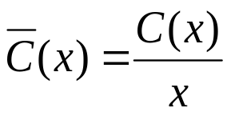
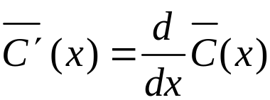
Chapter 10 Review
10.7 Marginal Analysis
  If y = C(x) is the total cost of producing x items, then
  y = C′(x) is the marginal cost of producing item x, and C(x+1) – C(x) ≈ C′(x) is the exact cost of producing item x. Similar statements can be made regarding total revenue and total profit functions.
  The average cost, or cost per unit, is
  and the marginal average cost is
  Similar statements can be made about total revenue and total profit functions.
Barnett/Ziegler/Byleen College Mathematics 12e

