Slide 1
Chapter 11
Additional Derivative Topics
Section 1
The Constant e and Continuous Compound Interest

Slide 2

Objectives for Section 11.1 e and Continuous Compound Interest
The student will be able to work with problems involving the irrational number e
The student will be able to solve problems involving continuous compound interest.
Barnett/Ziegler/Byleen College Mathematics 12e

Slide 3

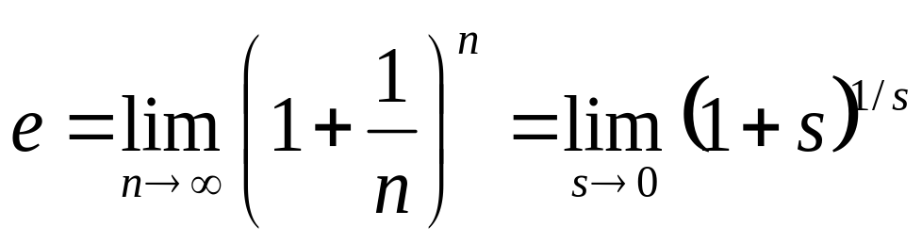
The Constant e
Reminder:
By definition, e = 2.718 281 828 459 …
Do you remember how to find this on a calculator?
e is also defined as either one of the following limits:
Barnett/Ziegler/Byleen College Mathematics 12e

Slide 4

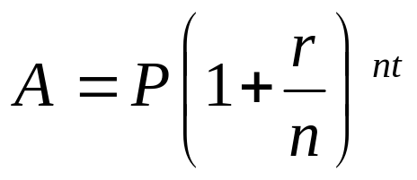
Compound Interest
Let P = principal, r = annual interest rate,
t = time in years, n = number of compoundings per year, and A = amount realized at the end of the time period.
Simple Interest: A = P (1 + r) t
Compound interest:
Continuous compounding: A = P e^{rt}.
Barnett/Ziegler/Byleen College Mathematics 12e

Slide 5

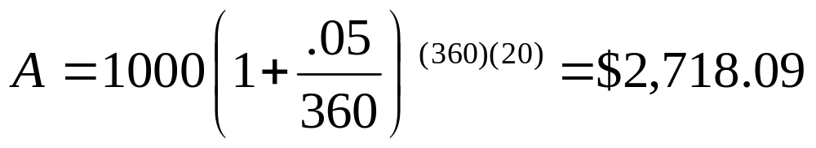
Example
Generous Grandma
Your Grandma puts $1,000 in a bank for you, at 5% interest. Calculate the amount after 20 years.
Simple interest:
A = 1000 (1 + 0.05⋅20) = $2,000.00
Compounded annually:
A = 1000 (1 + .05)²⁰ =$2,653.30
Compounded daily:
Compounded continuously:
A = 1000 e^{(.05)(20)} = $2,718.28
Barnett/Ziegler/Byleen College Mathematics 12e

Slide 6
Example
IRA
After graduating from Barnett College, Sam Spartan landed a great job with Springettsbury Manufacturing, Inc. His first year he bought a $3,000 Roth IRA and invested it in a stock sensitive mutual fund that grows at 12% a year, compounded continuously. He plans to retire in 35 years.
What will be its value at the end of the time period?
The second year he repeated the purchase of an identical Roth IRA. What will be its value in 34 years?
Barnett/Ziegler/Byleen College Mathematics 12e

Slide 7
Example
(continued)
After graduating from Barnett College, Sam Spartan landed a great job with Springettsbury Manufacturing, Inc. His first year he bought a $3,000 Roth IRA and invested it in a stock sensitive mutual fund that grows at 12% a year, compounded continuously. He plans to retire in 35 years.
What will be its value at the end of the time period?
A = Pe^{rt} = 3000 e^{(.12)(35)} =$200,058.99
The second year he repeated the purchase of an identical Roth IRA. What will be its value in 34 years?
$177,436.41
Barnett/Ziegler/Byleen College Mathematics 12e

Slide 8
Example
Computing Growth Time
How long will it take an investment of $5,000 to grow to $8,000 if it is invested at 5% compounded continuously?
Barnett/Ziegler/Byleen College Mathematics 12e

Slide 9
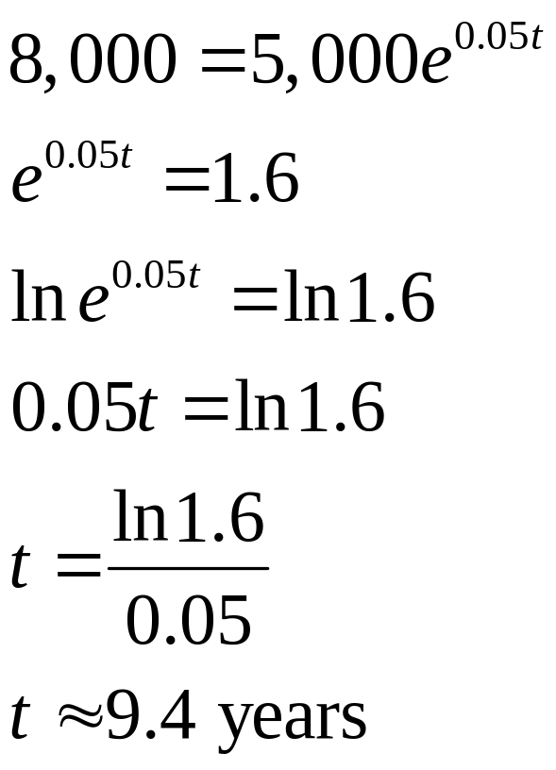
Example
(continued)
How long will it take an investment of $5,000 to grow to $8,000 if it is invested at 5% compounded continuously?
Solution: Use A = Pe^{rt}.
Barnett/Ziegler/Byleen College Mathematics 12e

