Slide 1
Chapter 11
Additional Derivative Topics
Section 2
Derivatives of Exponential and Logarithmic Functions

Slide 2

Objectives for Section 11.2
Derivatives of Exp/Log Functions
The student will be able to calculate the derivative of e^{x} and of ln x.
The student will be able to compute the derivatives of other logarithmic and exponential functions.
The student will be able to derive and use exponential and logarithmic models.
Barnett/Ziegler/Byleen College Mathematics 12e

Slide 3
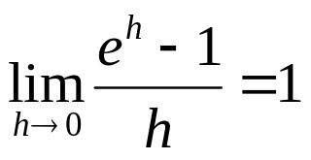
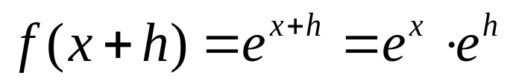
The Derivative of e^{x}
We will use (without proof) the fact that
We now apply the four-step process from a previous section to the exponential function.
Step 1: Find f (x+h)
Step 2: Find f (x+h) – f (x+h)
Barnett/Ziegler/Byleen College Mathematics 12e

Slide 4
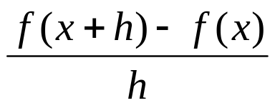
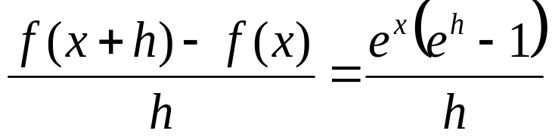
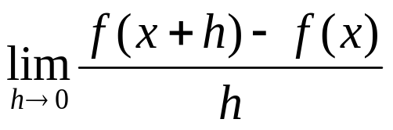
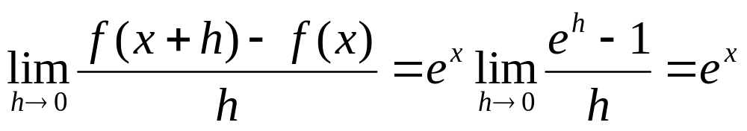
The Derivative of e^{x}
(continued)
Step 3: Find
Step 4: Find
Barnett/Ziegler/Byleen College Mathematics 12e

Slide 5
The Derivative of e^{x}
(continued)
Result: The derivative of f (x) = e^{x} is f ′(x) = e^{x}.
This result can be combined with the power rule, product rule, quotient rule, and chain rule to find more complicated derivatives.
Caution: The derivative of e^{x} is not x e^{x-1}
The power rule cannot be used to differentiate the exponential function. The power rule applies to exponential forms x^{n}, where the exponent is a constant and the base is a variable. In the exponential form e^{x}, the base is a constant and the exponent is a variable.
Barnett/Ziegler/Byleen College Mathematics 12e

Slide 6
Examples
Find derivatives for
f (x) = e^{x}/2
f (x) = e^{x/2}
f (x) = 2e^{x} +x²
f (x) = –7x^{e} – 2e^{x} + e²
Barnett/Ziegler/Byleen College Mathematics 12e

Slide 7
Examples
(continued)
Find derivatives for
f (x) = e^{x}/2 f ′(x) = e^{x}/2
f (x) = e^{x/2} f ′(x) = (1/2) e^{x/2}
f (x) = 2e^{x} +x² f ′(x) = 2e^{x} + 2x
f (x) = –7x^{e} – 2e^{x} + e² f ′(x) = –7ex^{e-1} – 2e^{x}
Remember that e is a real number, so the power rule is used to find the derivative of x^{e}. The derivative of the exponential function e^{x}, on the other hand, is e^{x}. Note also that e² ≈ 7.389 is a constant, so its derivative is 0.
Barnett/Ziegler/Byleen College Mathematics 12e

Slide 8
The Natural Logarithm Function ln x
We summarize important facts about logarithmic functions from a previous section:
Recall that the inverse of an exponential function is called a logarithmic function. For b > 0 and b ≠ 1
Logarithmic form is equivalent to Exponential form
y = log_{b} x x = b^{y}
Domain (0, ∞) Domain (–∞ , ∞)
Range (–∞ , ∞) Range (0, ∞)
The base we will be using is e. ln x = log_{e} x
Barnett/Ziegler/Byleen College Mathematics 12e

Slide 9

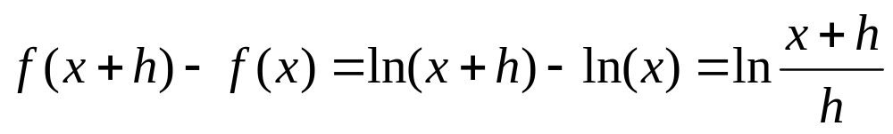
The Derivative of ln x
We are now ready to use the definition of derivative and the four step process to find a formula for the derivative of ln x. Later we will extend this formula to include log_{b} x for any base b. Let f (x) = ln x, x > 0.
Step 1: Find f (x+h)
Step 2: Find f (x+h) – f (x)
Barnett/Ziegler/Byleen College Mathematics 12e

Slide 10
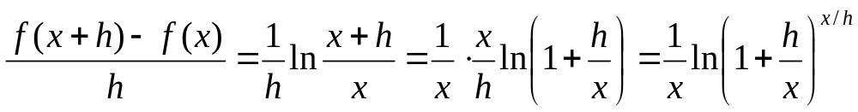
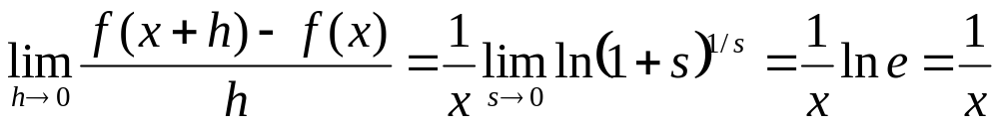
The Derivative of ln x
(continued)
Step 3: Find
Step 4: Find . Let s = x/h.
Barnett/Ziegler/Byleen College Mathematics 12e

Slide 11
Examples
Find derivatives for
f (x) = 5 ln x
f (x) = x² + 3 ln x
f (x) = 10 – ln x
f (x) = x⁴ – ln x⁴
Barnett/Ziegler/Byleen College Mathematics 12e

Slide 12
Examples
(continued)
Find derivatives for
f (x) = 5 ln x f ′(x) = 5/x
f (x) = x² + 3 ln x f ′(x) = 2x + 3/x
f (x) = 10 – ln x f ′(x) = – 1/x
f (x) = x⁴ – ln x⁴ f ′(x) = 4 x³ – 4/x
Before taking the last derivative, we rewrite f (x) using a property of logarithms:
ln x⁴ = 4 ln x
Barnett/Ziegler/Byleen College Mathematics 12e

Slide 13
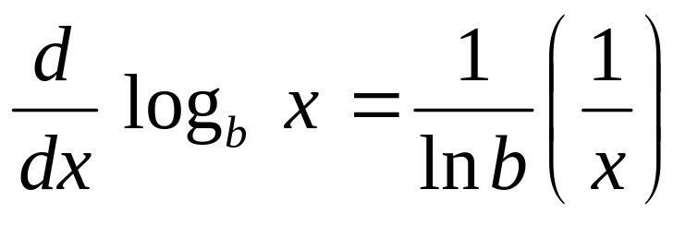
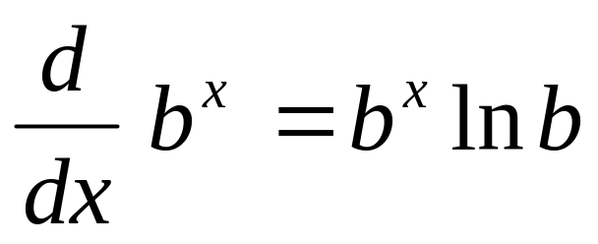
Other Logarithmic and
Exponential Functions
Logarithmic and exponential functions with bases other than e may also be differentiated.
Barnett/Ziegler/Byleen College Mathematics 12e

Slide 14
Examples
Find derivatives for
f (x) = log₅ x
f (x) = 2^{x} – 3^{x}
f (x) = log₅ x⁴
Barnett/Ziegler/Byleen College Mathematics 12e

Slide 15
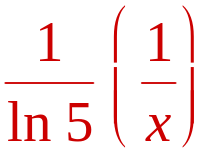
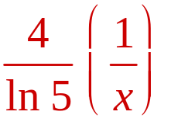
Examples
(continued)
Find derivatives for
f (x) = log₅ x f ′(x) =
f (x) = 2^{x} – 3^{x} f ′(x) = 2^{x} ln 2 – 3^{x} ln 3
f (x) = log₅ x⁴ f ′(x) =
For the last example, use
log₅ x⁴ = 4 log₅ x
Barnett/Ziegler/Byleen College Mathematics 12e

Slide 16
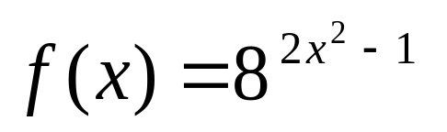
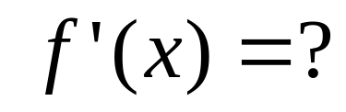
Example
Barnett/Ziegler/Byleen College Mathematics 12e

Slide 17
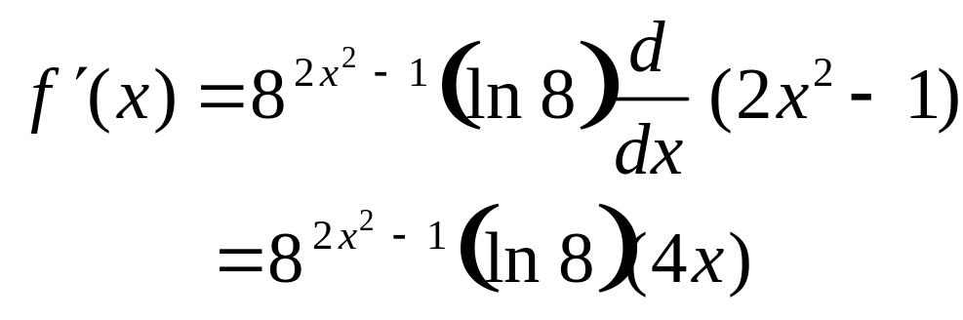
Example
(continued)
Barnett/Ziegler/Byleen College Mathematics 12e

Slide 18
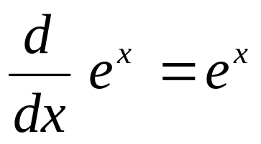
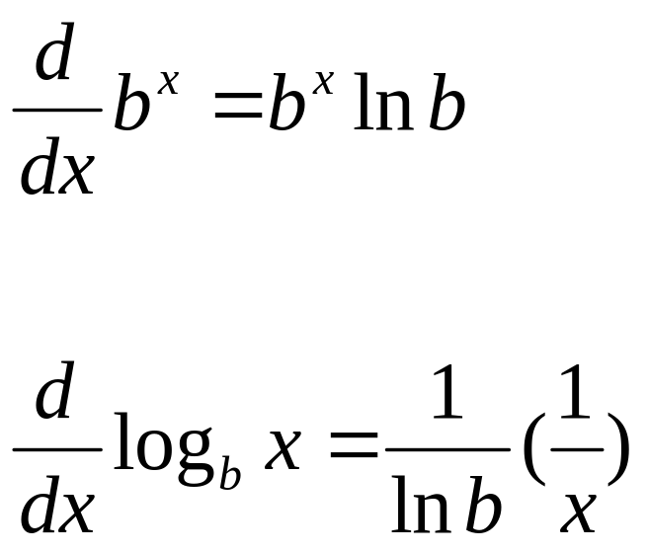
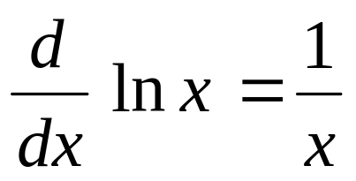
Summary
For b > 0, b ≠ 1
Exponential Rule
Log Rule
Barnett/Ziegler/Byleen College Mathematics 12e

Slide 19

Application
On a national tour of a rock band, the demand
for T-shirts is given by
p(x) = 10(0.9608)^{x}
where x is the number of T-shirts (in thousands) that can be sold during a single concert at a price of $p.
1. Find the production level that produces
the maximum revenue,
and the maximum revenue.
Barnett/Ziegler/Byleen College Mathematics 12e

Slide 20

Application
(continued)
On a national tour of a rock band, the demand
for T-shirts is given by
p(x) = 10(0.9608)^{x}
where x is the number of T-shirts (in thousands) that can be sold during a single concert at a price of $p.
1. Find the production level that produces
the maximum revenue,
and the maximum revenue.
R(x) = xp(x) = 10x(0.9608)^{x}
Graph on calculator and find maximum.
Barnett/Ziegler/Byleen College Mathematics 12e

Slide 21
Application
(continued)
2. Find the rate of change of price with respect to demand when demand is 25,000.
Barnett/Ziegler/Byleen College Mathematics 12e

Slide 22
Application
(continued)
2. Find the rate of change of price with respect to demand when demand is 25,000.
p′(x) = 10(0.9608)^{x}(ln(0.9608)) = –0.39989(0.9608)^{x}
Substituting x = 25:
p′(25) = -0.39989(0.9608)²⁵ = –0.147.
This means that when demand is 25,000 shirts, in order to sell an additional 1,000 shirts the price needs to drop 15 cents. (Remember that p is measured in thousands of shirts).
Barnett/Ziegler/Byleen College Mathematics 12e

