Slide 1
Chapter 11
Additional Derivative Topics
Section 3
Derivatives of Products and Quotients

Slide 2

Objectives for Section 11.3
Derivatives of Products and Quotients
The student will be able to calculate:
the derivative of a product of two functions, and
the derivative of a quotient of two functions.
Barnett/Ziegler/Byleen College Mathematics 12e

Slide 3
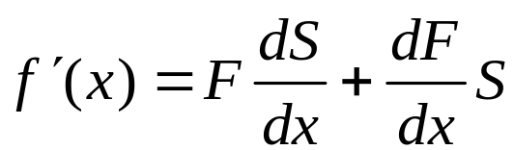
Derivatives of Products
Theorem 1 (Product Rule)
If f (x) = F(x) ⋅ S(x), and if F ′(x) and S ′(x) exist, then
f ′(x) = F(x) ⋅ S ′(x) + F ′(x) ⋅ S(x),
or
In words: The derivative of the product of two functions is the first function times the derivative of the second function plus the second function times the derivative of the first function.
Barnett/Ziegler/Byleen College Mathematics 12e

Slide 4
Example
Find the derivative of y = 5x²(x³ + 2).
Barnett/Ziegler/Byleen College Mathematics 12e

Slide 5
Example
Find the derivative of y = 5x²(x³ + 2).
Solution:
Let F(x) = 5x², so F ’(x) = 10x
Let S(x) = x³ + 2, so S ’(x) = 3x².
Then
f ′(x) = F(x) ⋅ S ’(x) + F ’(x) ⋅ S(x)
= 5x² ⋅ 3x² + 10x ⋅ (x³ + 2)
= 15x⁴ + 10x⁴ + 20x = 25x⁴ + 20x.
Barnett/Ziegler/Byleen College Mathematics 12e

Slide 6
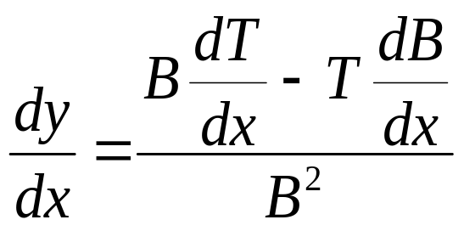
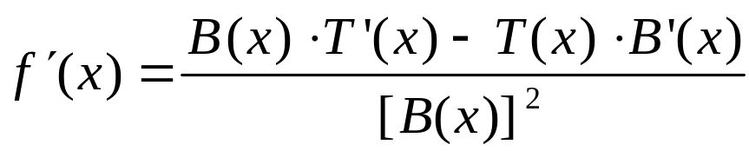
Derivatives of Quotients
Theorem 2 (Quotient Rule)
If f (x) = T (x) / B(x), and if T ′(x) and B ′(x) exist, then
or
In words: The derivative of the quotient of two functions is the bottom function times the derivative of the top function minus the top function times the derivative of the bottom function, all over the bottom function squared.
Barnett/Ziegler/Byleen College Mathematics 12e

Slide 7
Example
Find the derivative of y = 3x / (2x + 5).
Barnett/Ziegler/Byleen College Mathematics 12e

Slide 8
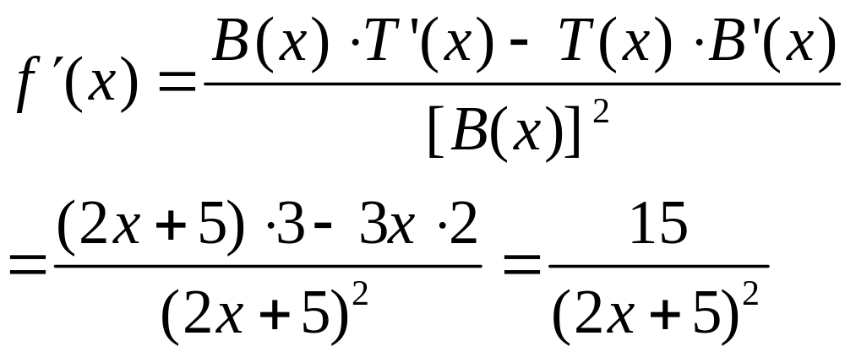
Example
Find the derivative of y = 3x / (2x + 5).
Solution:
Let T(x) = 3x, so T ’(x) = 3
Let B(x) = 2x + 5, so B ′(x) = 2.
Then
Barnett/Ziegler/Byleen College Mathematics 12e

Slide 9
Tangent Lines
Let f (x) = (2x - 9)(x² + 6). Find the equation of the line tangent to the graph of f (x) at x = 3.
Barnett/Ziegler/Byleen College Mathematics 12e

Slide 10
Tangent Lines
Let f (x) = (2x – 9)(x² + 6). Find the equation of the line tangent to the graph of f (x) at x = 3.
Solution: First, find f ′(x):
f ′(x) = (2x – 9) (2x) + (2) (x² + 6)
Then find f (3) and f ′(3):
f (3) = –45 f ’(3) = 12
The tangent has slope 12 and goes through the point (3, –45).
Using the point-slope form y – y₁ = m(x – x₁), we get
y – (–45) = 12(x – 3) or y = 12x – 81
Barnett/Ziegler/Byleen College Mathematics 12e

Slide 11
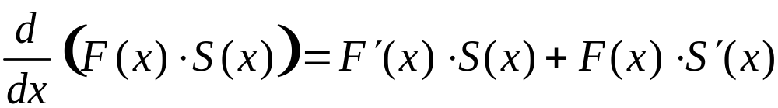
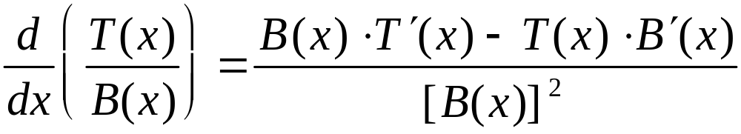
Summary
Product Rule:
Quotient Rule:
Barnett/Ziegler/Byleen College Mathematics 12e

