Slide 1
Chapter 11
Additional Derivative Topics
Section 4
The Chain Rule

Slide 2

Learning Objectives for Section 11.4
The Chain Rule
The student will be able to form the composition of two functions.
The student will be able to apply the general power rule.
The student will be able to apply the chain rule.
Barnett/Ziegler/Byleen College Mathematics 12e

Slide 3
Composite Functions
Definition: A function m is a composite of functions f and g if
m(x) = f [g(x)]
The domain of m is the set of all numbers x such that x is in the domain of g and g(x) is in the domain of f.
Barnett/Ziegler/Byleen College Mathematics 12e

Slide 4
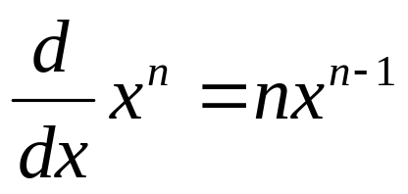
General Power Rule
We have already made extensive use of the power rule:
Now we want to generalize this rule so that we can differentiate composite functions of the form [u(x)]^{n}, where u(x) is a differentiable function. Is the power rule still valid if we replace x with a function u(x)?
Barnett/Ziegler/Byleen College Mathematics 12e

Slide 5
Example
Let u(x) = 2x² and f (x) = [u(x)]³ = 8x⁶. Which of the following is f ′(x)?
(a) 3[u(x)]² (b) 3[u′(x)]² (c) 3[u(x)]² u′(x)
Barnett/Ziegler/Byleen College Mathematics 12e

Slide 6
Example
Let u(x) = 2x² and f (x) = [u(x)]³ = 8x⁶. Which of the following is f ′(x)?
(a) 3[u(x)]² (b) 3[u′(x)]² (c) 3[u(x)]² u′(x)
We know that f ′(x) = 48x⁵.
(a) 3[u(x)]² = 3(2x²)² = 3(4x⁴) = 12 x⁴. This is not correct.
(b) 3[u′(x)]² = 3(4x)² = 3(16x²) = 48x². This is not correct.
(c) 3[u(x)]² u′(x) = 3[2x²]²(4x) = 3(4x⁴)(4x) = 48x⁵. This is the correct choice.
Barnett/Ziegler/Byleen College Mathematics 12e

Slide 7
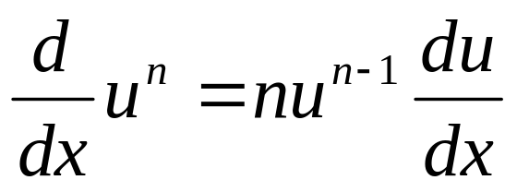
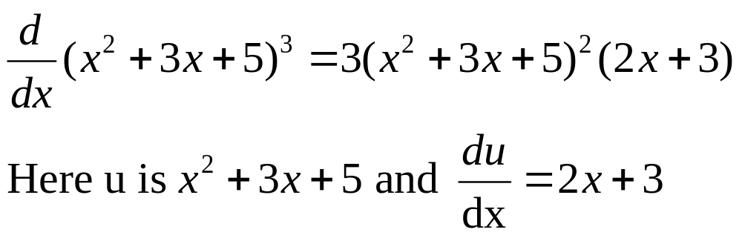
Generalized Power Rule
What we have seen is an example of the generalized power rule: If u is a function of x, then
For example,
Barnett/Ziegler/Byleen College Mathematics 12e

Slide 8
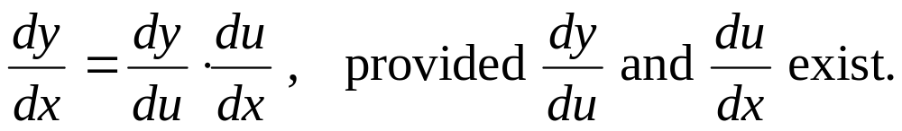
Chain Rule
We have used the generalized power rule to find derivatives of composite functions of the form f (g(x)) where f (u) = u^{n} is a power function. But what if f is not a power function? It is a more general rule, the chain rule, that enables us to compute the derivatives of many composite functions of the form f(g(x)).
Chain Rule: If y = f (u) and u = g(x) define the composite function y = f (u) = f [g(x)], then
Barnett/Ziegler/Byleen College Mathematics 12e

Slide 9
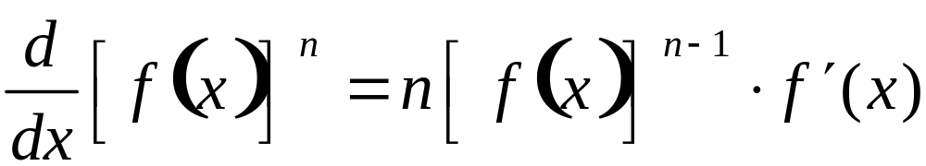
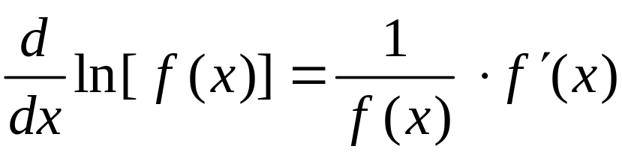
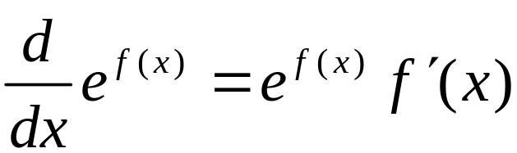
Generalized Derivative Rules
If y = u ^{n} , then
y ′ = nu ^{n - 1} ⋅ du/dx
1.
If y = ln u, then
y ′ = 1/u ⋅ du/dx
2.
If y = e ^{u}, then
y ′ = e ^{u} ⋅ du/dx
3.
Barnett/Ziegler/Byleen College Mathematics 12e

Slide 10
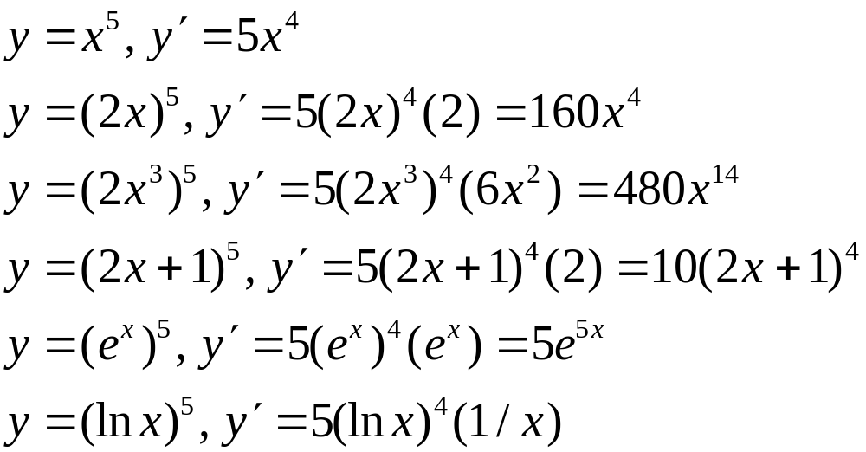
Examples for the Power Rule
Chain rule terms are marked:
Barnett/Ziegler/Byleen College Mathematics 12e

Slide 11
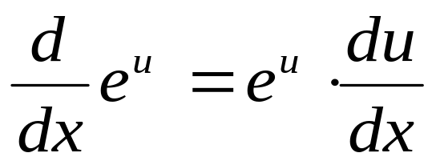
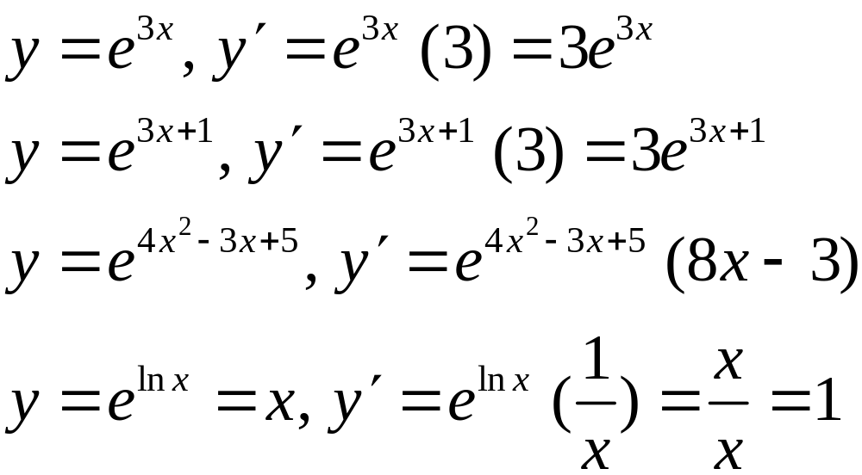
Examples for
Exponential Derivatives
Barnett/Ziegler/Byleen College Mathematics 12e

Slide 12
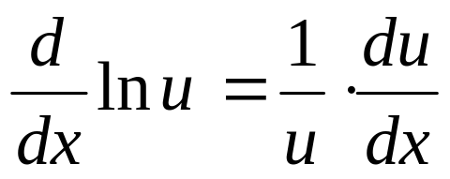
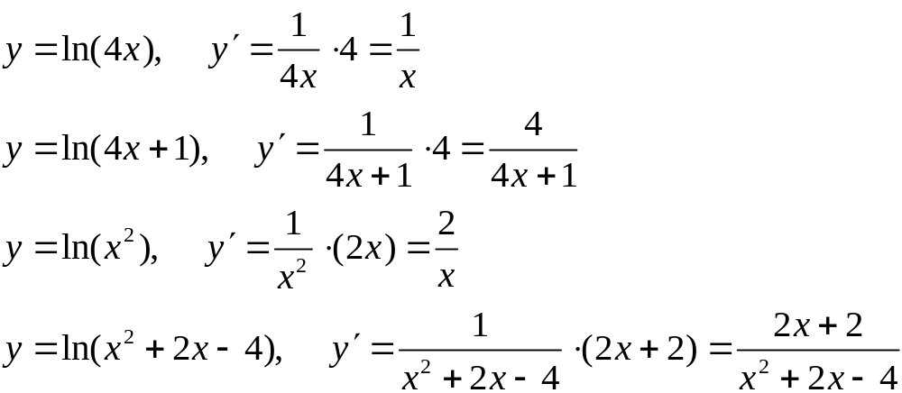
Examples for
Logarithmic Derivatives
Barnett/Ziegler/Byleen College Mathematics 12e

