Slide 1
Chapter 11
Additional Derivative Topics
Section 5
Implicit Differentiation

Slide 2

Learning Objectives for Section 11.5
Implicit Differentiation
The student will be able to
Use special functional notation, and
Carry out implicit differentiation.
Barnett/Ziegler/Byleen College Mathematics 12e

Slide 3
Function Review and
New Notation
So far, the equation of a curve has been specified in the form y = x² – 5x or f (x) = x² – 5x (for example).
This is called the explicit form. y is given as a function of x.
However, graphs can also be specified by equations of the form F(x, y) = 0, such as
F(x, y) = x² + 4xy – 3y² +7.
This is called the implicit form. You may or may not be able to solve for y.
Barnett/Ziegler/Byleen College Mathematics 12e

Slide 4
Explicit and Implicit
Differentiation
Consider the equation y = x² – 5x.
To compute the equation of a tangent line, we can use the derivative y ′ = 2x – 5. This is called explicit differentiation.
We can also rewrite the original equation as
F(x, y) = x² – 5x – y = 0
and calculate the derivative of y from that. This is called implicit differentiation.
Barnett/Ziegler/Byleen College Mathematics 12e

Slide 5
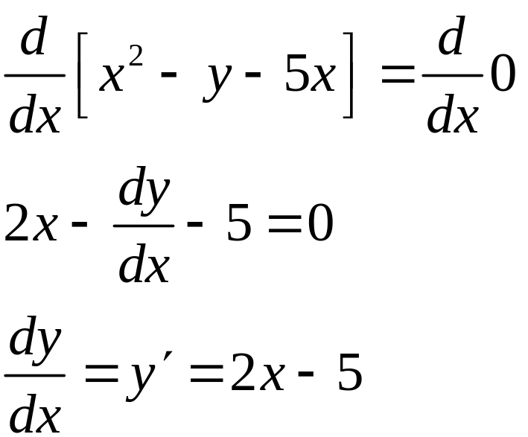
Example 1
Consider the equation x² – y – 5x = 0.
We will now differentiate both sides of the equation with respect to x, and keep in mind that y is supposed to be a function of x.
This is the same answer we got by explicit differentiation on the previous slide.
Barnett/Ziegler/Byleen College Mathematics 12e

Slide 6
Example 2
Consider x² – 3xy + 4y = 0 and differentiate implicitly.
Barnett/Ziegler/Byleen College Mathematics 12e

Slide 7
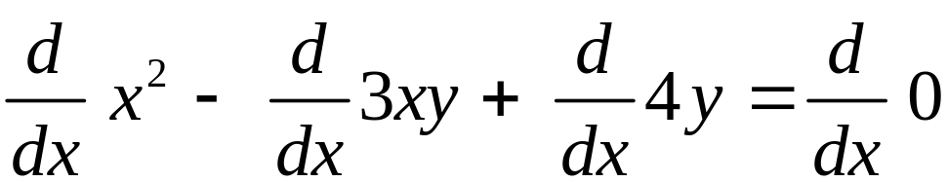

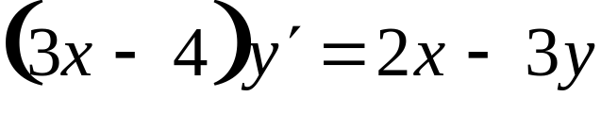
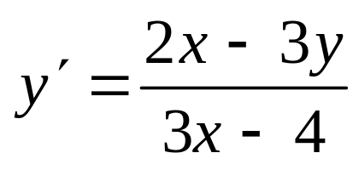
Example 2
Consider x² – 3xy + 4y = 0 and differentiate implicitly.
Notice we used the product rule for the xy term.
Solve for y ′ :
Barnett/Ziegler/Byleen College Mathematics 12e

Slide 8
Example 3
Consider x² – 3xy + 4y = 0.
Find the equation of the tangent at (1, –1).
Solution:
Confirm that (1, –1) is a point on the graph.
2. Use the derivative from example 2 to find the slope of the tangent.
3. Use the point slope formula for the tangent.
Barnett/Ziegler/Byleen College Mathematics 12e

Slide 9
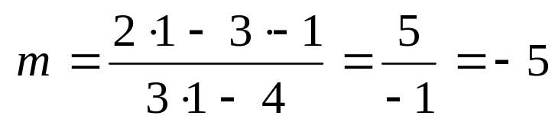
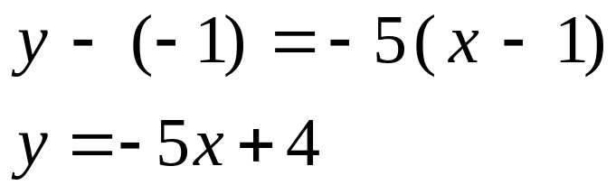
Example 3
Consider x² – 3xy + 4y = 0.
Find the equation of the tangent at (1, -1).
Solution:
Confirm that (1, –1) is a point on the graph.
12 – 3⋅1⋅(–1) + 4⋅(–1) = 1 + 3 – 4 = 0
2. Use the derivative from example 2 to find the slope of the tangent.
3. Use the point slope formula for the tangent.
Barnett/Ziegler/Byleen College Mathematics 12e

Slide 10
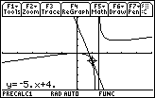
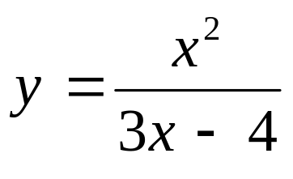
Example 3
(continued)
This problem can also be done with the graphing calculator by solving the equation for y and using the draw tangent subroutine.
The equation solved for y is
Barnett/Ziegler/Byleen College Mathematics 12e

Slide 11
Example 4
Consider xe^{x} + ln y – 3y = 0 and differentiate implicitly.
Barnett/Ziegler/Byleen College Mathematics 12e

Slide 12
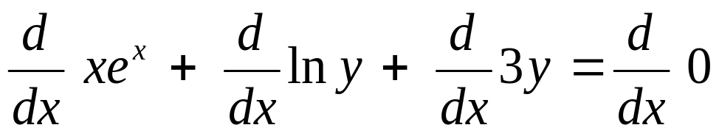
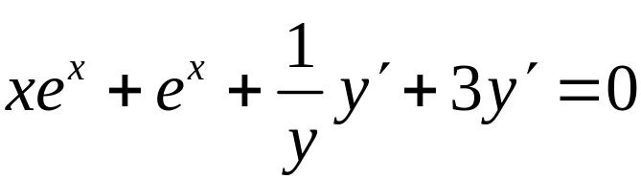
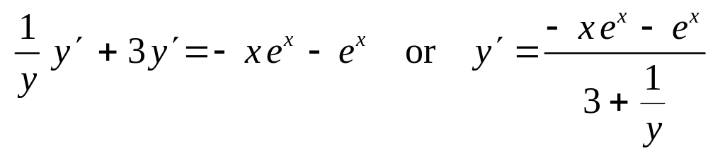
Example 4
Consider xe^{x} + ln y + 3y = 0 and differentiate implicitly.
Notice we used both the product rule (for the xe^{x} term) and the chain rule (for the ln y term)
Solve for y’:
Barnett/Ziegler/Byleen College Mathematics 12e

Slide 13

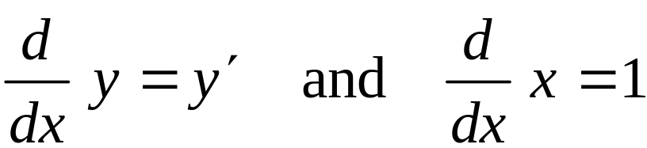
Notes
Why are we interested in implicit differentiation? Why don’t we just solve for y in terms of x and differentiate directly? The answer is that there are many equations of the form F(x, y) = 0 that are either difficult or impossible to solve for y explicitly in terms of x, so to find y’ under these conditions, we differentiate implicitly. Also, observe that:
Barnett/Ziegler/Byleen College Mathematics 12e

