Slide 1
Chapter 11
Additional Derivative Topics
Section 6
Related Rates

Slide 2

Learning Objective for Section 11.6
Related Rates
The student will be able to solve related rate problems and applications.
Barnett/Ziegler/Byleen College Mathematics 12e

Slide 3
Introduction
Related rate problems involve three variables: an independent variable (often t = time), and two dependent variables.
The goal is to find a formula for the rate of change of one of the independent variables in terms of the rate of change of the other one.
These problems are solved by using a relationship between the variables, differentiating it, and solving for the term you want.
Barnett/Ziegler/Byleen College Mathematics 12e

Slide 4
Example 1
A weather balloon is rising vertically at the rate of 5 meters per second. An observer is standing on the ground 300 meters from the point where the balloon was released. At what rate is the distance between the observer and the balloon changing when the balloon is 400 meters high?
Barnett/Ziegler/Byleen College Mathematics 12e

Slide 5
Example 1
A weather balloon is rising vertically at the rate of 5 meters per second. An observer is standing on the ground 300 meters from the point where the balloon was released. At what rate is the distance between the observer and the balloon changing when the balloon is 400 meters high?
Solution: Make a drawing.
The independent variable is time t. Which quantities that change with time are mentioned in the problem?
We use x = distance from observer to balloon, and y = height of balloon.
y
x
300
Barnett/Ziegler/Byleen College Mathematics 12e

Slide 6
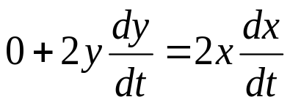
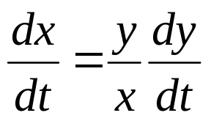
Example 1
dy/dt is given as 5 meters per second. dx/dt is the unknown.
We need a relationship between x and y:
300² + y² = x² (Pythagoras)
Differentiate the equation with respect to t:
We are looking for dx/dt, so we solve for that:
y
x
300
Barnett/Ziegler/Byleen College Mathematics 12e

Slide 7
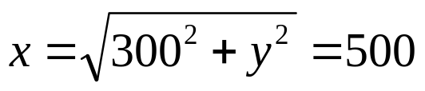
Example 1
Now we need values for x, y and dy/dt. Go back to the problem statement:
y = 400
dy/dt = 5
dx/dt = (400/500)⋅5 = 4 m/sec
y
x
300
Barnett/Ziegler/Byleen College Mathematics 12e

Slide 8
Solving Related Rate Problems
Step 1. Make a sketch.
Step 2. Identify all variables, including those that are given and those to be found.
Step 3. Express all rates as derivatives.
Step 4. Find an equation connecting variables.
Step 5. Differentiate this equation.
Step 6. Solve for the derivative that will give the unknown rate.
Barnett/Ziegler/Byleen College Mathematics 12e

Slide 9
Example 2
A rock is thrown into a still pond and causes a circular ripple. If the radius of the ripple is increasing at 2 feet per second, how fast is the area changing when the radius is 10 feet? [Use A = π R² ]
Barnett/Ziegler/Byleen College Mathematics 12e

Slide 10
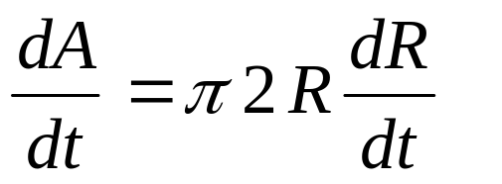
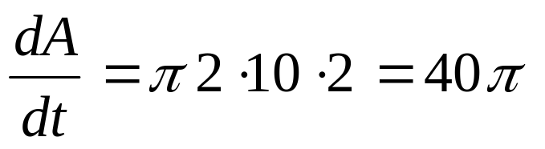
Example 2
A rock is thrown into a still pond and causes a circular ripple. If the radius of the ripple is increasing at 2 feet per second, how fast is the area changing when the radius is 10 feet? [Use A = π R² ]
Solution: Make a drawing. Let R = radius, A = area.
Note dR/dt = 2 and R = 10 are given. Find dA/dt.
Differentiate A = π R².
R
Barnett/Ziegler/Byleen College Mathematics 12e

Slide 11

Related Rates in Business
Suppose that for a company manufacturing transistor radios, the cost and revenue equations are given by
C = 5,000 + 2x
and
R = 10x – 0.001x²,
where the production output in 1 week is x radios.
If production is increasing at the rate of 500 radios per week when production is 2,000 radios, find the rate of increase in (a) Cost (b) Revenue
Barnett/Ziegler/Byleen College Mathematics 12e

Slide 12
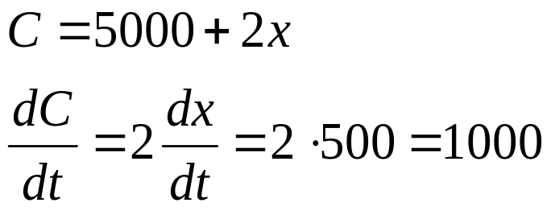
Related Rates in Business
(continued)
Solution:
These are really two related rates problems, one involving C, x and time t, and one involving R, x, and t.
Differentiate the equations for C and R with respect to time.
(a)
Cost is increasing at the rate of $1,000 per week.
Barnett/Ziegler/Byleen College Mathematics 12e

Slide 13
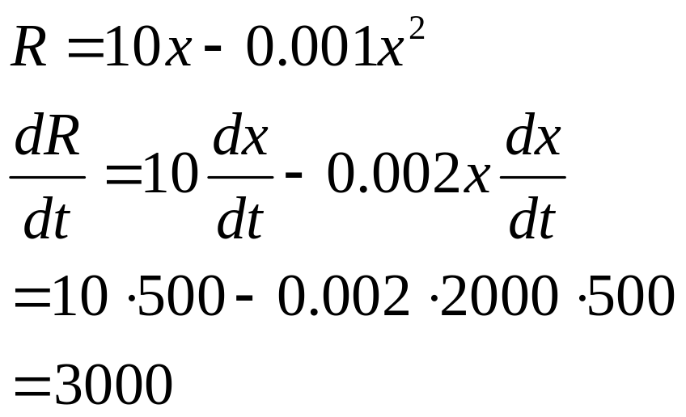
Related Rates in Business
(continued)
(b)
Revenue is increasing at the rate of $3,000 per week.
Barnett/Ziegler/Byleen College Mathematics 12e

