Slide 1
Chapter 11
Additional Derivative Topics
Section 7
Elasticity of Demand

Slide 2

Objectives for Section 11.7
Elasticity of Demand
The student will be able to solve problems involving
Relative rate of change, and
Elasticity of demand
Barnett/Ziegler/Byleen College Mathematics 12e

Slide 3
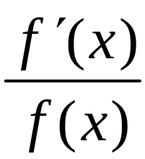
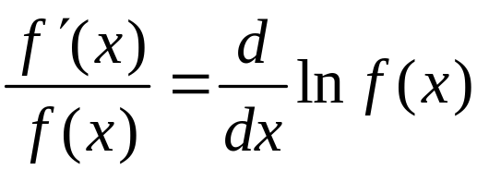
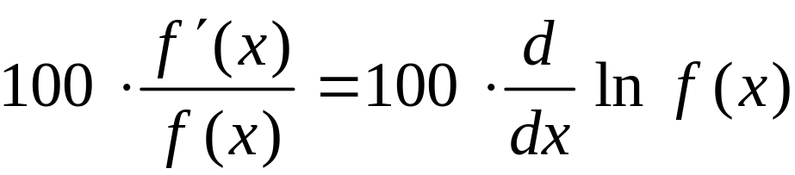
Relative and Percentage
Rates of Change
Remember that f ′(x) represents the rate of change of f (x).
The relative rate of change is defined as
By the chain rule, this equals the derivative of the logarithm
of f (x):
The percentage rate of change of a function f (x) is
Barnett/Ziegler/Byleen College Mathematics 12e

Slide 4
Example 1
Find the relative rate of change of
f (x) = 50x – 0.01x²
Barnett/Ziegler/Byleen College Mathematics 12e

Slide 5
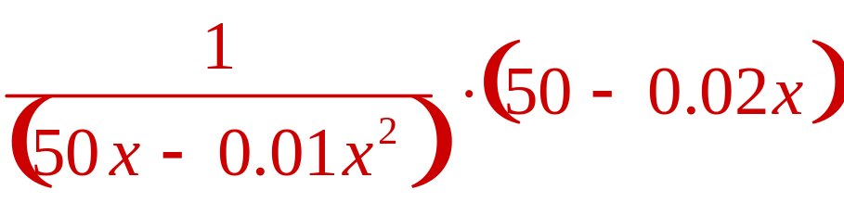
Example 1
(continued)
Find the relative rate of change of
f (x) = 50x – 0.01x²
Solution: The derivative of
ln (50x – 0.01x²)
is
Barnett/Ziegler/Byleen College Mathematics 12e

Slide 6
Example 2
A model for the real GDP (gross domestic product expressed in billions of 1996 dollars) from 1995 to 2002 is given by
f (t) = 300t + 6,000,
where t is years since 1990. Find the percentage rate of change of f (t) for 5 < t < 12.
Barnett/Ziegler/Byleen College Mathematics 12e

Slide 7
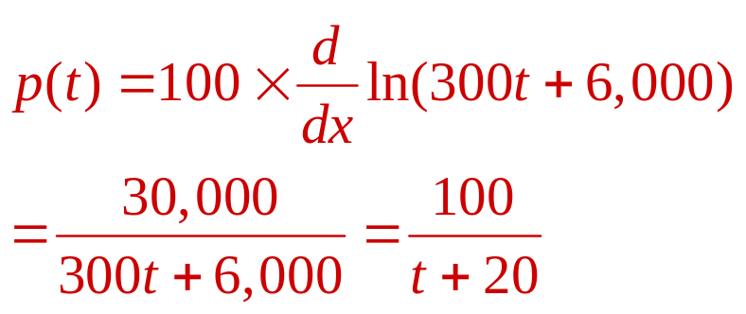
Example 2
(continued)
A model for the real GDP (gross domestic product expressed in billions of 1996 dollars) from 1995 to 2002 is given by
f (t) = 300t + 6,000,
where t is years since 1990. Find the percentage rate of change of f (t) for 5 < t < 12.
Solution: If p(t) is the percentage rate of change of f (t), then
The percentage rate of change in 1995 (t = 5) is 4%
Barnett/Ziegler/Byleen College Mathematics 12e

Slide 8
Elasticity of Demand
Elasticity of demand describes how a change in the price of a product affects the demand. Assume that f (p) describes the demand at price p. Then we define
relative rate of change in demand
Elasticity of Demand =
relative rate of change in price
Notice the minus sign. f and p are always positive, but
f ′ is negative (higher cost means less demand). The minus sign makes the quantity come out positive.
Barnett/Ziegler/Byleen College Mathematics 12e

Slide 9
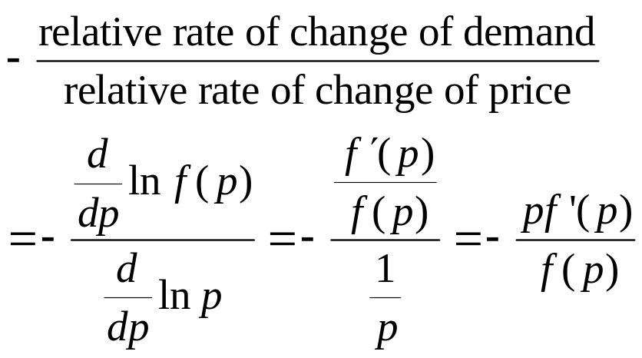
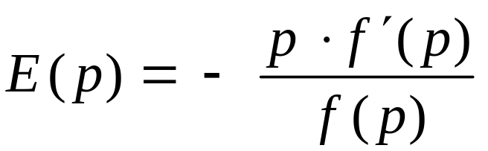
Elasticity of Demand
Formula
Elasticity of Demand =
Given a price-demand equation x = f (p) (that is, we can sell amount x of product at price p), the elasticity of demand is given by the formula
Barnett/Ziegler/Byleen College Mathematics 12e

Slide 10
Elasticity of Demand
Interpretation
E(p) | Demand | Interpretation
E(p) < 1 | Inelastic | Demand is not sensitive to changes in price. A change in price produces a small change in demand.
E(p) > 1 | Elastic | Demand is sensitive to changes in price. A change in price produces a large change in demand.
E(p) = 1 | Unit | A change in price produces the same change in demand.
Barnett/Ziegler/Byleen College Mathematics 12e

Slide 11
Example
For the price-demand equation
x = f (p) = 1875 - p²,
determine whether demand is elastic, inelastic, or unit for
p = 15, 25, and 40.
Barnett/Ziegler/Byleen College Mathematics 12e

Slide 12
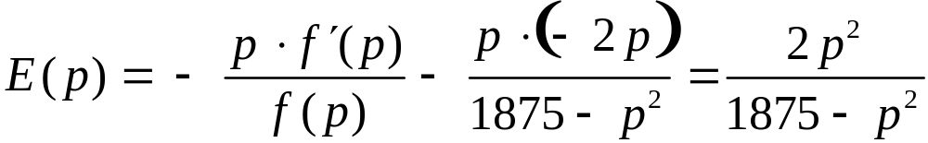
Example
(continued)
For the price-demand equation
x = f (p) = 1875 - p²,
determine whether demand is elastic, inelastic, or unit for
p = 15, 25, and 40.
If p = 15, then E(15) = 0.27 < 1; demand is inelastic
If p = 25, then E(25) = 1; demand has unit elasticity
If p = 40, then E(40) = 11.64; demand is elastic
Barnett/Ziegler/Byleen College Mathematics 12e

Slide 13
Revenue and Elasticity of Demand
If demand is inelastic, then consumers will tend to continue to buy even if there is a price increase, so a price increase will increase revenue and a price decrease will decrease revenue.
If demand is elastic, then consumers will be more likely to cut back on purchases if there is a price increase. This means a price increase will decrease revenue and a price decrease will increase revenue.
Barnett/Ziegler/Byleen College Mathematics 12e

Slide 14

Elasticity of Demand for Different Products
Different products have different elasticities. If there are close substitutes for a product, or if the product is a luxury rather than a necessity, the demand tends to be elastic. Examples of products with high elasticities are jewelry, furs, or furniture.
On the other hand, if there are no close substitutes or the product is a necessity, the demand tends to be inelastic. Examples of products with low elasticities are milk, sugar, and light bulbs.
Barnett/Ziegler/Byleen College Mathematics 12e

Slide 15
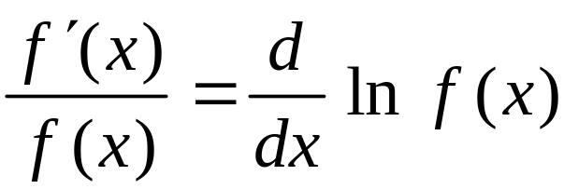
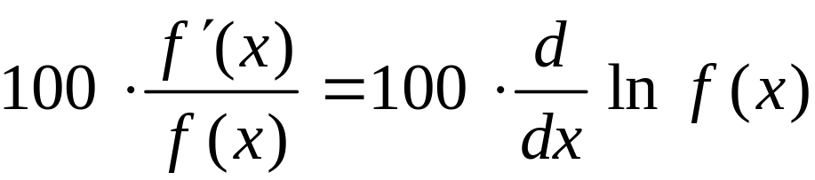
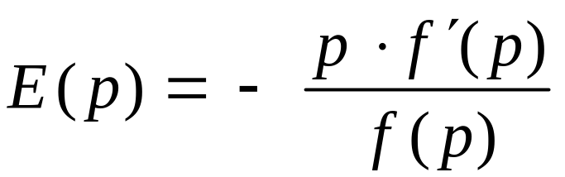
Summary
The relative rate of change of a function f (x) is
The percentage rate of change of a function f (x) is
Elasticity of demand is
Barnett/Ziegler/Byleen College Mathematics 12e

