Slide 1
Chapter 11
Additional Derivative Topics
Section R
Review

Slide 2
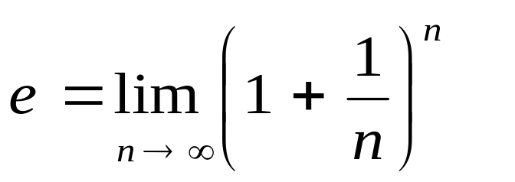
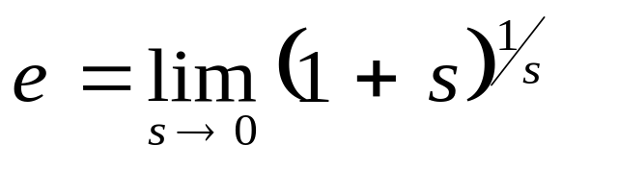
Chapter 11 Review
Important Terms, Symbols, Concepts
11.1. The Constant e and Continuous Compound Interest
  The number e is defined as either one of the limits
  If the number of compounding periods in one year is increased without limit, we obtain the compound interest formula A = Pe^{rt}, where P = principal, r = annual interest rate compounded continuously, t = time in years, and A = amount at time t.
Barnett/Ziegler/Byleen College Mathematics 12e

Slide 3
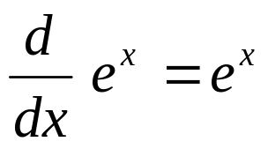
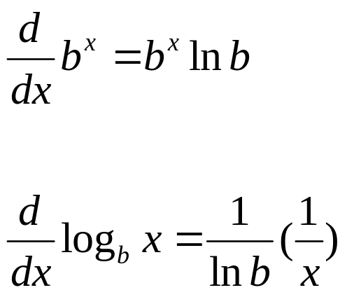
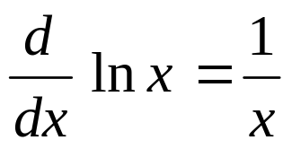
Chapter 11 Review
11.2. Derivatives of Exponential and Logarithmic Functions
  For b > 0, b ≠ 1
  The change of base formulas allow conversion from base e to any base b > 0, b ≠ 1: b^{x} = e^{x} ln b, log_{b} x = ln x/ln b.
Barnett/Ziegler/Byleen College Mathematics 12e

Slide 4
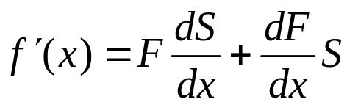
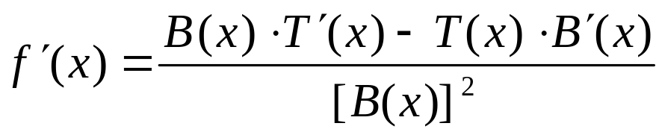
Chapter 11 Review
11.3. Derivatives of Products and Quotients
  Product Rule: If f (x) = F(x) ⋅ S(x), then
  Quotient Rule: If f (x) = T (x) / B(x), then
11.4. Chain Rule
  If m(x) = f [g(x)], then m′(x) = f ′[g(x)] g ′(x)
Barnett/Ziegler/Byleen College Mathematics 12e

Slide 5
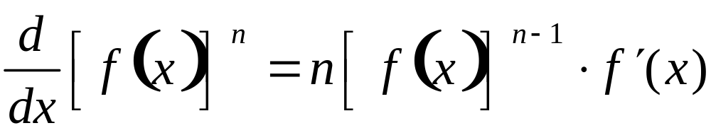
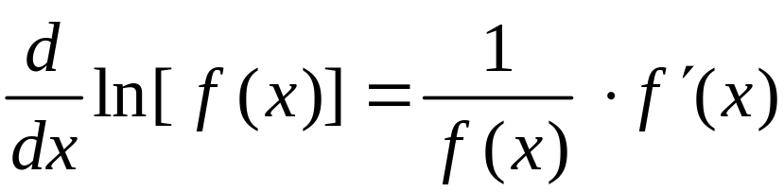
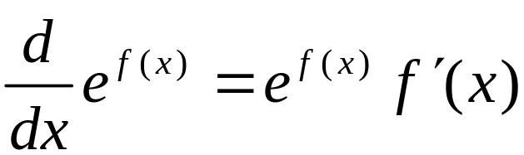
Chapter 11 Review
11.4. Chain Rule (continued)
  A special case of the chain rule is the general power rule:
  Other special cases of the chain rule are the following general derivative rules:
Barnett/Ziegler/Byleen College Mathematics 12e

Slide 6
Chapter 11 Review
11.5. Implicit Differentiation
  If y = y(x) is a function defined by an equation of the form F(x, y) = 0, we can use implicit differentiation to find y ′ in terms of x, y.
11.6. Related Rates
  If x and y represent quantities that are changing with respect to time and are related by an equation of the form F(x, y) = 0, then implicit differentiation produces an equation that relates x, y, dy/dt and dx/dt. Problems of this type are called related rates problems.
Barnett/Ziegler/Byleen College Mathematics 12e

Slide 7
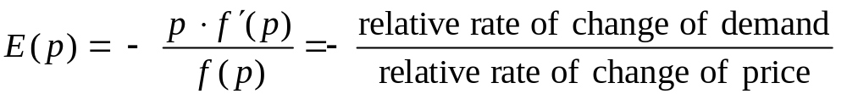
Chapter 11 Review
11.7. Elasticity of Demand
  The relative rate of change, or the logarithmic derivative, of a function f (x) is f ′(x) / f (x), and the percentage rate of change is 100 × (f ′(x) / f (x).
  If price and demand are related by x = f (p), then the elasticity of demand is given by
  Demand is inelastic if 0 < E(p) < 1. (Demand is not sensitive to changes in price). Demand is elastic if
  E(p) > 1. (Demand is sensitive to changes in price).
Barnett/Ziegler/Byleen College Mathematics 12e

