Slide 1
Chapter 12
Graphing and Optimization
Section 1
First Derivative
and Graphs

Slide 2

Objectives for Section 12.1
First Derivative and Graphs
The student will be able to identify increasing and decreasing functions, and local extrema.
The student will be able to apply the first derivative test.
The student will be able to apply the theory to applications in economics.
Barnett/Ziegler/Byleen College Mathematics 12e

Slide 3
Increasing and Decreasing Functions
Theorem 1. (Increasing and decreasing functions)
On the interval (a,b)
f ’(x) | f (x) | Graph of f
+ | increasing | rising
– | decreasing | falling
Barnett/Ziegler/Byleen College Mathematics 12e

Slide 4
Example 1
Find the intervals where f (x) = x² + 6x + 7 is rising and falling.
Barnett/Ziegler/Byleen College Mathematics 12e

Slide 5
Example 1
Find the intervals where f (x) = x² + 6x + 7 is rising and falling.
Solution: From the previous table, the function will be rising when the derivative is positive.
f ′(x) = 2x + 6.
2x + 6 > 0 when 2x > -6, or x > –3.
The graph is rising when x > –3.
2x + 6 < 6 when x < –3, so the graph is falling when x < –3.
Barnett/Ziegler/Byleen College Mathematics 12e

Slide 6
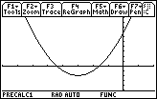
Example 1
(continued )
f (x) = x² + 6x + 7, f ′(x) = 2x+6
A sign chart is helpful:
(–∞, –3) (–3, ∞)
f ′(x) - - - - - - 0 + + + + + +
f (x) Decreasing –3 Increasing
Barnett/Ziegler/Byleen College Mathematics 12e

Slide 7
Partition Numbers and
Critical Values
A partition number for the sign chart is a place where the derivative could change sign. Assuming that f ′ is continuous wherever it is defined, this can only happen where f itself is not defined, where f ′ is not defined, or where f ′ is zero.
Definition. The values of x in the domain of f where
f ′(x) = 0 or does not exist are called the critical values of f.
Insight: All critical values are also partition numbers, but there may be partition numbers that are not critical values (where f itself is not defined).
If f is a polynomial, critical values and partition numbers are both the same, namely the solutions of f ′(x) = 0.
Barnett/Ziegler/Byleen College Mathematics 12e

Slide 8
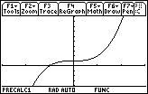
Example 2
f (x) = 1 + x³, f ′(x) = 3x²
Critical value and partition point at x = 0.
(–∞, 0) (0, ∞)
f ’(x) + + + + + 0 + + + + + +
f (x) Increasing 0 Increasing
0
Barnett/Ziegler/Byleen College Mathematics 12e

Slide 9
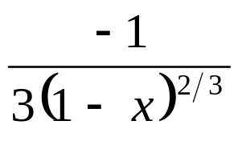
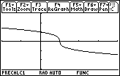
Example 3
f (x) = (1 – x)^{1/3} , f ‘(x) = Critical value and
partition point at x = 1
(–∞, 1) (1, ∞)
f ′(x) - - - - - - ND - - - - - -
f (x) Decreasing 1 Decreasing
Barnett/Ziegler/Byleen College Mathematics 12e

Slide 10
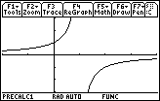
Example 4
f (x) = 1/(1 – x), f ′(x) =1/(1 – x)² Partition point at x = 1,
but not critical point
(–∞, 1) (1, ∞)
f ’(x) + + + + + ND + + + + +
f (x) Increasing 1 Increasing
Note that x = 1 is not a critical point because it is not in the domain of f.
This function has no critical values.
Barnett/Ziegler/Byleen College Mathematics 12e

Slide 11
Local Extrema
When the graph of a continuous function changes from rising to falling, a high point or local maximum occurs.
When the graph of a continuous function changes from falling to rising, a low point or local minimum occurs.
Theorem. If f is continuous on the interval (a, b), c is a number in (a, b), and f (c) is a local extremum, then either
f ′(c) = 0 or f ′(c) does not exist. That is, c is a critical point.
Barnett/Ziegler/Byleen College Mathematics 12e

Slide 12
First Derivative Test
Let c be a critical value of f . That is, f (c) is defined, and either f ′(c) = 0 or f ′(c) is not defined. Construct a sign chart for f ′(x) close to and on either side of c.
f (x) left of c | f (x) right of c | f (c)
Decreasing | Increasing | local minimum at c
Increasing | Decreasing | local maximum at c
Decreasing | Decreasing | not an extremum
Increasing | Increasing | not an extremum
Barnett/Ziegler/Byleen College Mathematics 12e

Slide 13
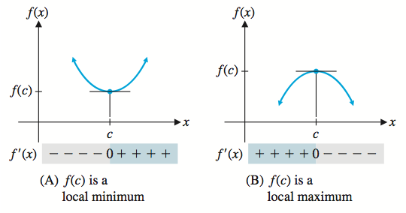
First Derivative Test
f ′(c) = 0: Horizontal Tangent
Barnett/Ziegler/Byleen College Mathematics 12e

Slide 14
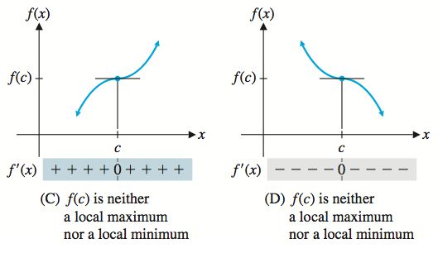
First Derivative Test
f ′(c) = 0: Horizontal Tangent
Barnett/Ziegler/Byleen College Mathematics 12e

Slide 15
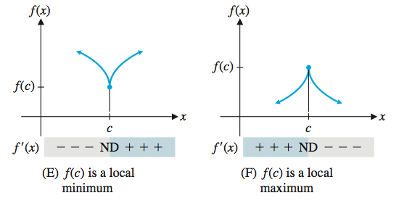
First Derivative Test
f ′(c) is not defined but f ′(c) is defined
Barnett/Ziegler/Byleen College Mathematics 12e

Slide 16
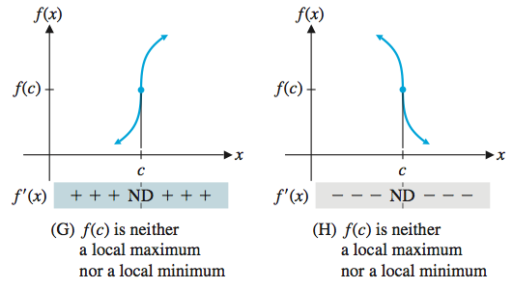
First Derivative Test
f ′(c) is not defined but f ′(c) is defined
Barnett/Ziegler/Byleen College Mathematics 12e

Slide 17

First Derivative Test
Graphing Calculators
Local extrema are easy to recognize on a graphing calculator.
Method 1. Graph the derivative and use built-in root approximations routines to find the critical values of the first derivative. Use the zeros command under 2nd calc.
Method 2. Graph the function and use built-in routines that approximate local maxima and minima. Use the MAX or MIN subroutine.
Barnett/Ziegler/Byleen College Mathematics 12e

Slide 18
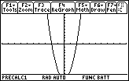
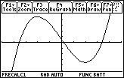
Example 5
f (x) = x³ – 12x + 2.
Method 1
Graph f ′(x) = 3x² – 12 and look for critical values (where f ′(x) = 0)
Method 2
Graph f (x) and look for maxima and minima.
f ′(x) + + + + + 0 - - - 0 + + + + +
f (x) increases decrs increases
increases decreases increases f (x)
–10 < x < 10 and –10 < y < 10
–5 < x < 5 and –20 < y < 20
Maximum at –2 and minimum at 2.
Critical values at –2 and 2
Barnett/Ziegler/Byleen College Mathematics 12e

Slide 19
Polynomial Functions
Theorem 3. If
f (x) = a_{n} x^{n} + a_{n-1} x^{n-1} + … + a₁ x + a₀, a_{n} ≠ 0,
is an n^{th}-degree polynomial, then f has at most n x-intercepts and at most (n – 1) local extrema.
In addition to providing information for hand-sketching graphs, the derivative is also an important tool for analyzing graphs and discussing the interplay between a function and its rate of change. The next example illustrates this process in the context of an application to economics.
Barnett/Ziegler/Byleen College Mathematics 12e

Slide 20
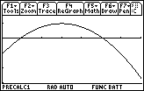
Application to Economics
The graph in the figure approximates the rate of change of the price of eggs over a 70 month period, where E(t) is the price of a dozen eggs (in dollars), and t is the time in months.
Determine when the price of eggs was rising or falling, and sketch a possible graph of E(t).
10
50
0 < x < 70 and –0.03 < y < 0.015
Note: This is the graph of the derivative of E(t)!
Barnett/Ziegler/Byleen College Mathematics 12e
Notes:
The function graphed is y = -0.00025x^2 + 0.0015x – 0.0125

Slide 21
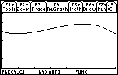
Application to Economics
For t < 10, E ′(t) is negative, so E(t)
is decreasing.
E ′(t) changes sign from negative to positive at t = 10, so that is a local minimum.
The price then increases for the next 40 months to a local max at
t = 50, and then decreases for the remaining time.
To the right is a possible graph.
E’(t)
E(t)
Barnett/Ziegler/Byleen College Mathematics 12e
Notes:
The function graphed is y = -0.00025x^2 + 0.0015x – 0.0125

Slide 22
Summary
We have examined where functions are increasing or decreasing.
We examined how to find critical values.
We studied the existence of local extrema.
We learned how to use the first derivative test.
We saw some applications to economics.
Barnett/Ziegler/Byleen College Mathematics 12e

