Slide 1
Chapter 12
Graphing and Optimization
Section 3
L’Hopital’s Rule

Slide 2

Objectives for Section 12.3
L’Hôpital’s Rule
The student will be able to apply L’Hôpital’s Rule to the Indeterminate Form 0/0.
The student will be able to evaluate one-sided limits and limits at ∞.
The student will be able to apply L’Hôpital’s Rule to the Indeterminate Form ∞/ ∞.
Barnett/Ziegler/Byleen College Mathematics 12e

Slide 3
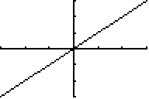
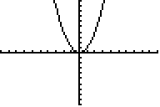
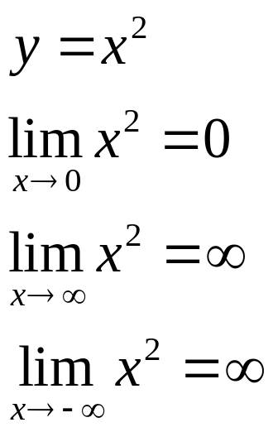
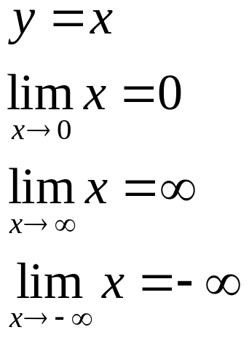
Limits involving Powers of x
In this section we will develop a powerful technique for evaluating limits of quotients called L’Hôpital’s Rule. To use this rule, it is necessary to be familiar with the limit properties of some basic functions which follow.
Barnett/Ziegler/Byleen College Mathematics 12e

Slide 4
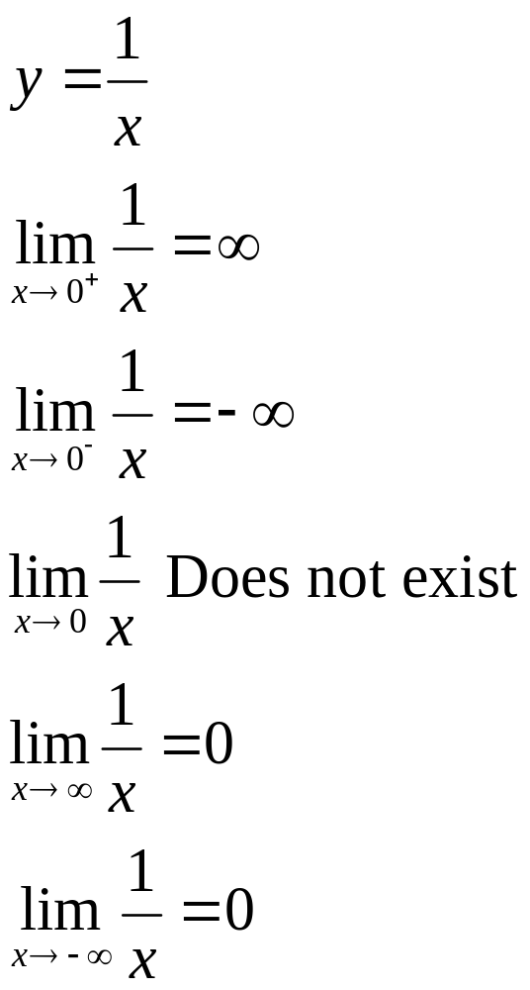
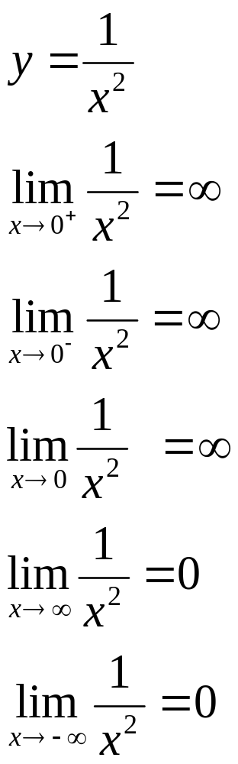
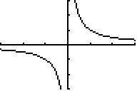
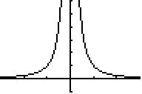
Limits Involving Powers of x
(continued)
Barnett/Ziegler/Byleen College Mathematics 12e

Slide 5
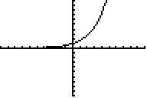
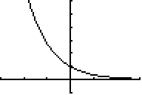
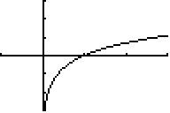
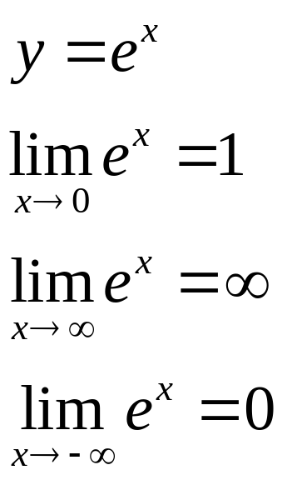
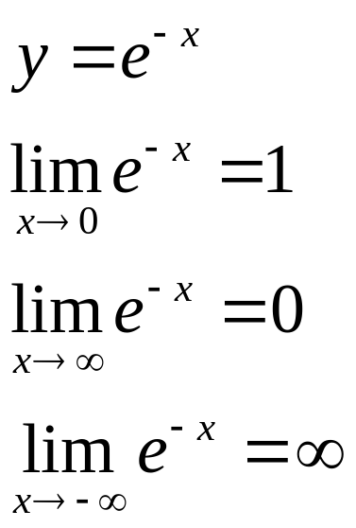
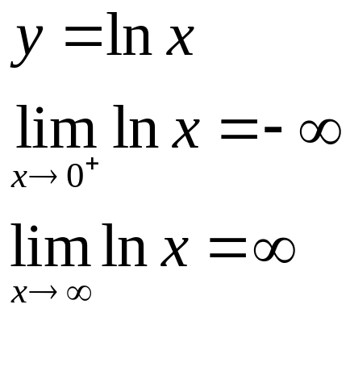
Limits Involving Exponential and Logarithmic Functions
Barnett/Ziegler/Byleen College Mathematics 12e

Slide 6
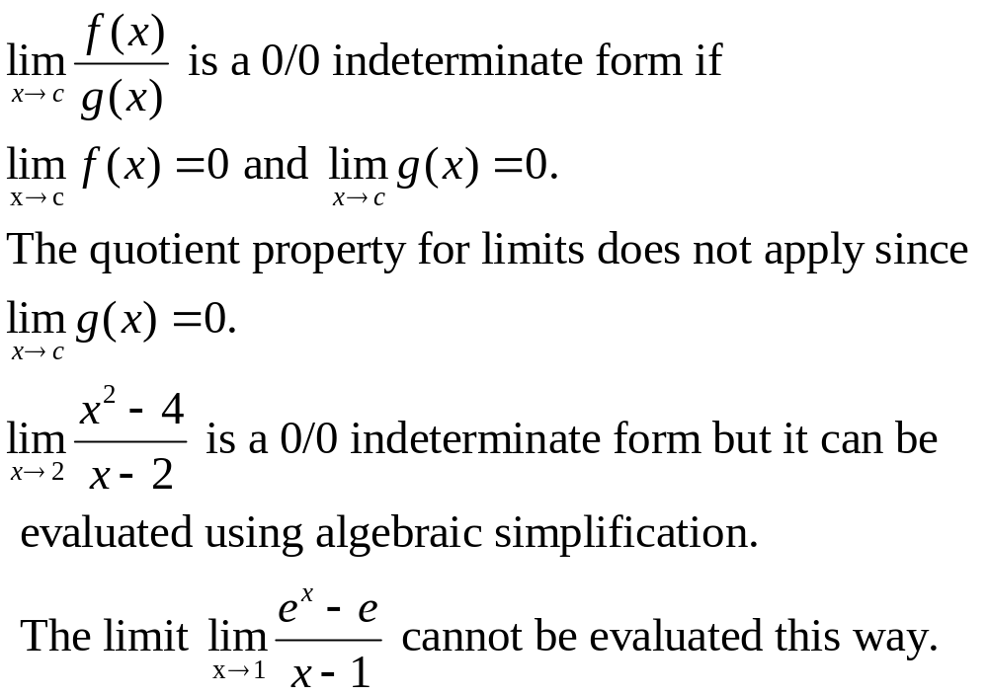
L’Hôpital’s Rule and the
Indeterminate Form 0/0
Barnett/Ziegler/Byleen College Mathematics 12e

Slide 7
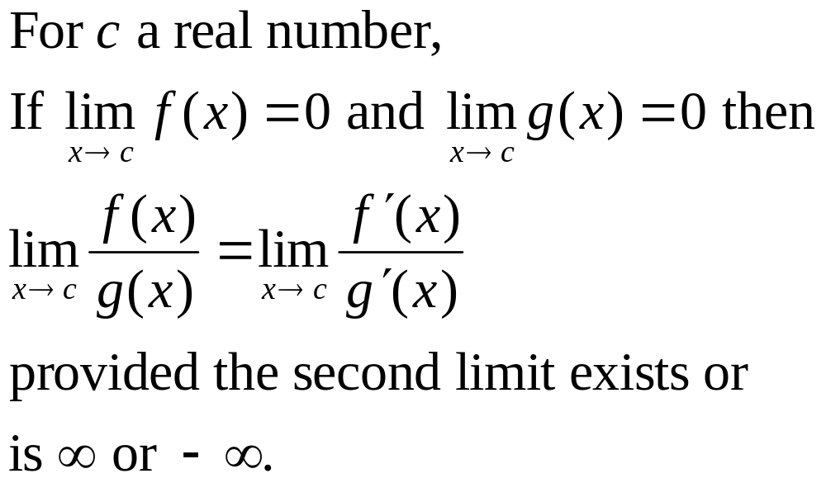
L’Hôpital’s Rule and 0/0
(continued)
Limits such as the one on the previous slide can be evaluated using L’Hôpital’s Rule :
Barnett/Ziegler/Byleen College Mathematics 12e

Slide 8
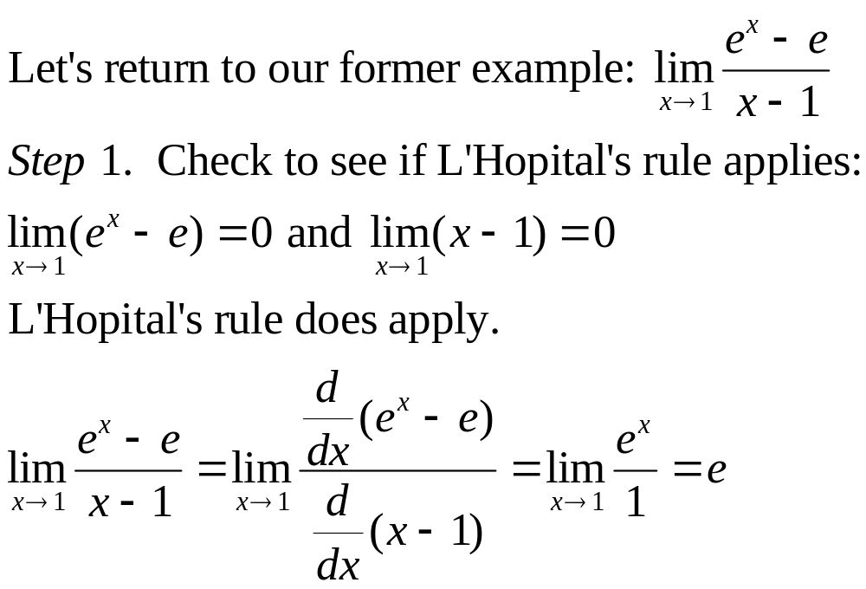
Example
Barnett/Ziegler/Byleen College Mathematics 12e

Slide 9
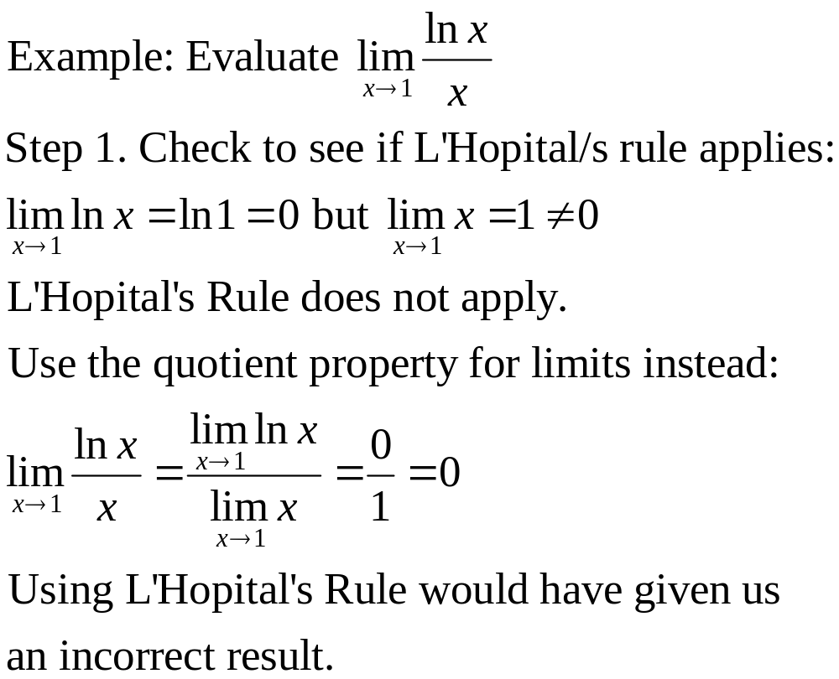
Cautionary Example
Barnett/Ziegler/Byleen College Mathematics 12e

Slide 10
One-Sided Limits and Limits at ∞
Theorem 2. (L’Hôpital’s Rule, Version 2 )
The first version of L’Hôpital’s Rule remains valid if the symbol x → c is replaced everywhere it occurs with one of the following symbols:
x → c⁺ x → c– x → ∞ x → –∞
Barnett/Ziegler/Byleen College Mathematics 12e

Slide 11
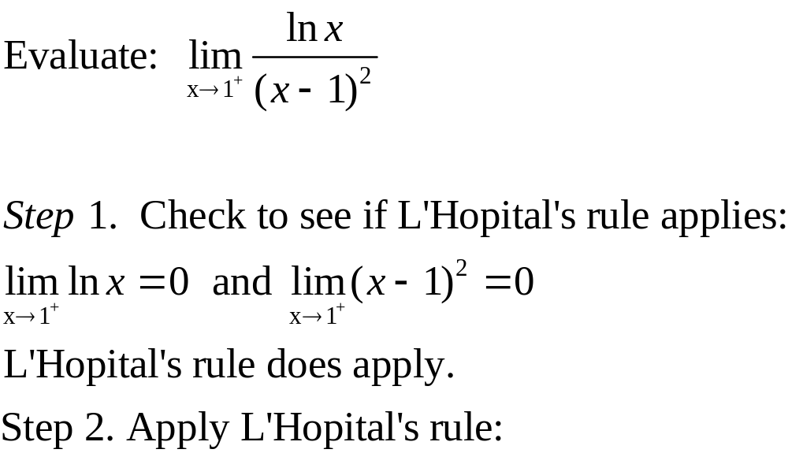
Example
Barnett/Ziegler/Byleen College Mathematics 12e

Slide 12
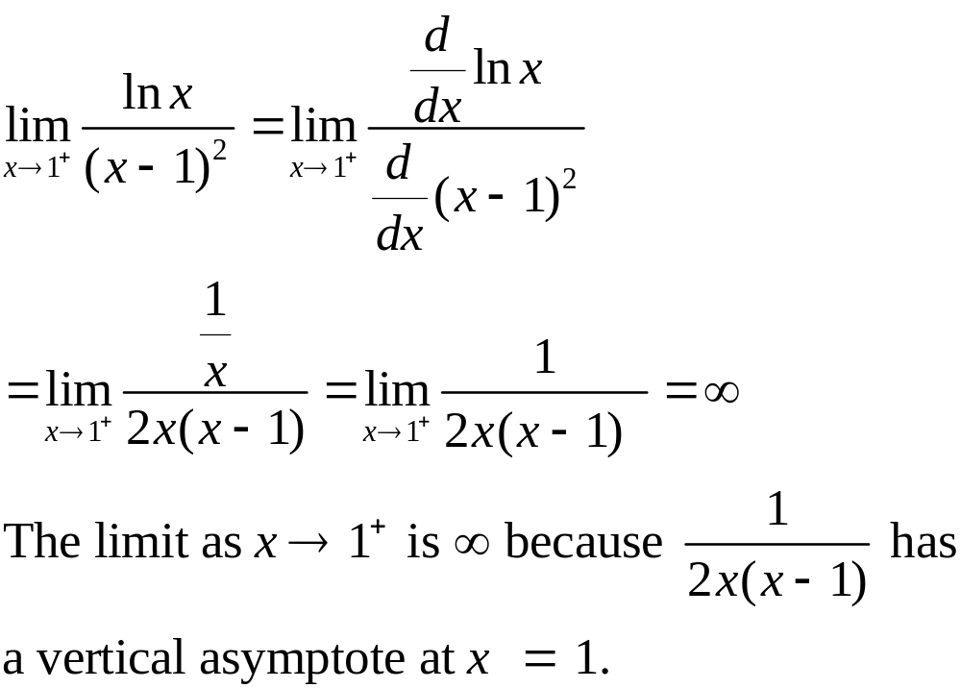
Example
Barnett/Ziegler/Byleen College Mathematics 12e

Slide 13
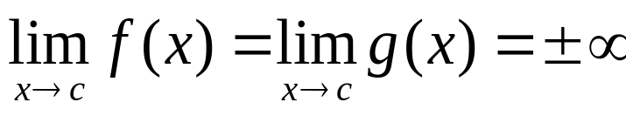
L’Hôpital’s Rule and the
Indeterminate Form ∞/∞
Theorem 3. (L’Hôpital’s Rule, version 3)
Versions 1 and 2 of L’Hôpital’s Rule are also valid if
Barnett/Ziegler/Byleen College Mathematics 12e

Slide 14
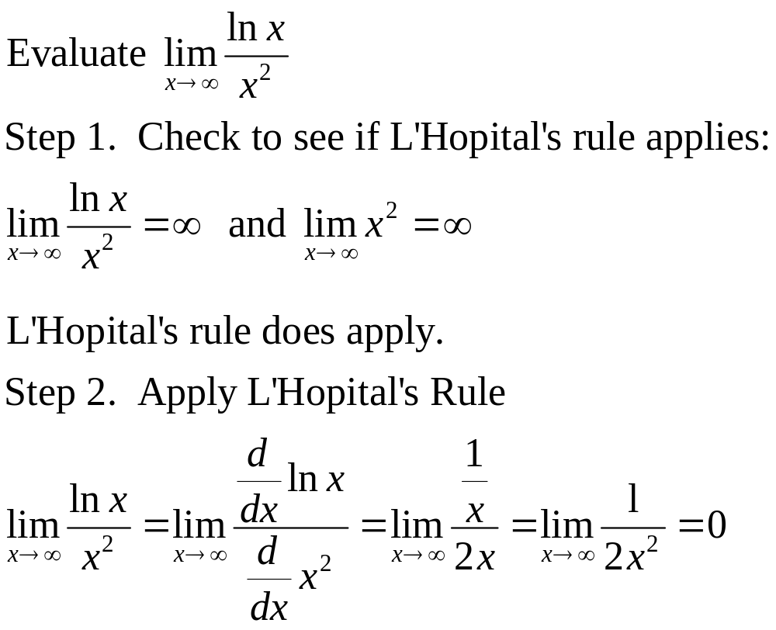
Example
Barnett/Ziegler/Byleen College Mathematics 12e

