Slide 1
Chapter 12
Graphing and Optimization
Section 4
Curve Sketching Techniques

Slide 2

Objectives for Section 12.4
Curve Sketching Techniques
The student will modify his/her graphing strategy by including information about asymptotes.
The student will be able to solve problems involving modeling average cost.
Barnett/Ziegler/Byleen College Mathematics 12e

Slide 3
Modifying the Graphing Strategy
When we summarized the graphing strategy in a previous section, we omitted one very important topic: asymptotes. Since investigating asymptotes always involves limits, we can now use L’Hôpital’s rule as a tool for finding asymptotes for many different types of functions. The final version of the graphing strategy is as follows on the next slide.
Barnett/Ziegler/Byleen College Mathematics 12e

Slide 4

Graphing Strategy
Step 1. Analyze f (x)
  Find the domain of f.
  Find the intercepts.
  Find asymptotes
Step 2. Analyze f ′(x)
  Find the partition numbers and critical values of f ′(x).
  Construct a sign chart for f ′(x).
  Determine the intervals where f is increasing and decreasing
  Find local maxima and minima
Barnett/Ziegler/Byleen College Mathematics 12e

Slide 5
Graphing Strategy
(continued)
Step 3. Analyze f ′′(x).
  Find the partition numbers of f ′′(x).
  Construct a sign chart for f ′′(x).
  Determine the intervals where the graph of f is concave upward and concave downward.
  Find inflection points.
Step 4. Sketch the graph of f.
  Draw asymptotes and locate intercepts, local max and min, and inflection points.
  Plot additional points as needed and complete the sketch
Barnett/Ziegler/Byleen College Mathematics 12e

Slide 6
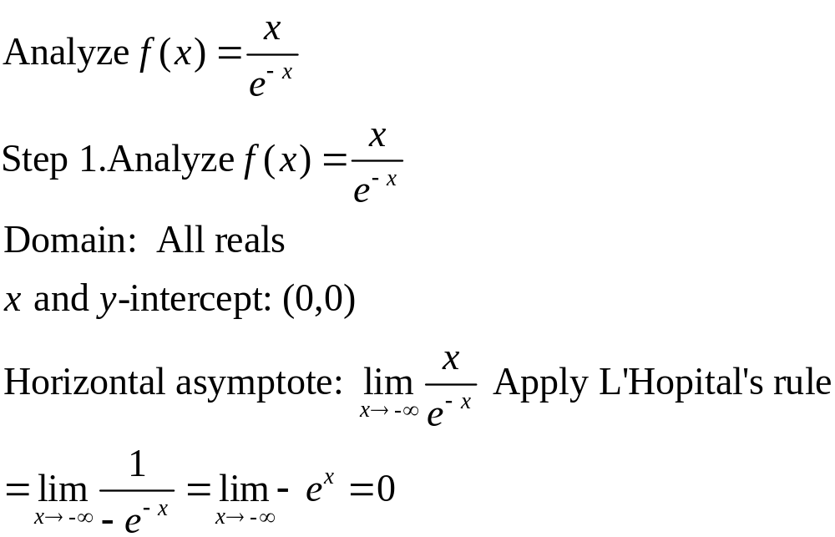
Example
So y = 0 is a horizontal asymptote as x →–∞ .
There is no vertical asymptote.
Barnett/Ziegler/Byleen College Mathematics 12e

Slide 7
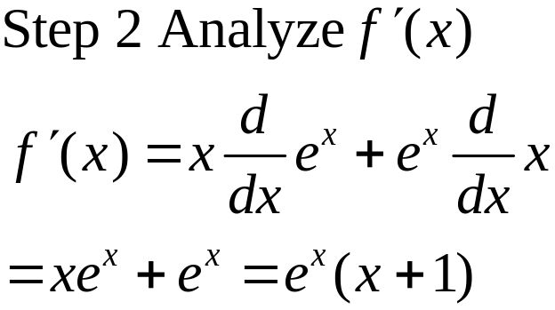
Example
(continued)
Critical value for f (x): –1
Partition number for f ′(x): –1
A sign chart reveals that f (x) decreases on (–∞, –1), has a local min at x = –1, and increases on (–1, ∞)
Barnett/Ziegler/Byleen College Mathematics 12e

Slide 8
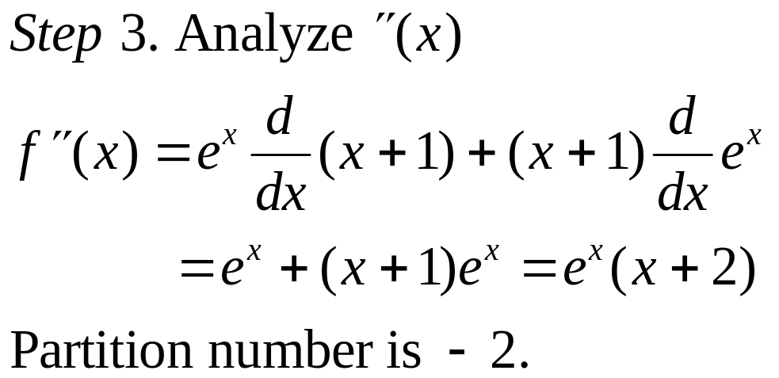
Example
(continued)
A sign chart reveals that the graph of f is concave downward on (–∞, –2), has an inflection point at x = –2, and is concave upward on (–2, ∞).
Barnett/Ziegler/Byleen College Mathematics 12e

Slide 9
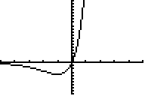
Example
(continued)
Step 4. Sketch the graph of f using the information from steps 1-3.
Barnett/Ziegler/Byleen College Mathematics 12e

Slide 10
Application Example
If x CD players are produced in one day, the cost per day is
C (x) = x² + 2x + 2000
and the average cost per unit is C(x) / x.
Use the graphing strategy to analyze the average cost function.
Barnett/Ziegler/Byleen College Mathematics 12e

Slide 11
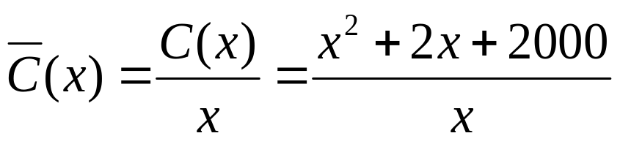

Example
(continued)
Step 1. Analyze
A. Domain: Since negative values of x do not make sense and is not defined, the domain is the set of positive real numbers.
B. Intercepts: None
C. Horizontal asymptote: None
D. Vertical Asymptote: The line x = 0 is a vertical asymptote.
Barnett/Ziegler/Byleen College Mathematics 12e

Slide 12
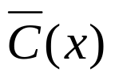
Example
(continued)
Oblique asymptotes: If a graph approaches a line that is neither horizontal nor vertical as x approaches ∞ or –∞, that line is called an oblique asymptote.
If x is a large positive number, then 2000/x is very small and the graph of approaches the line y = x + 2.
This is the oblique asymptote.
Barnett/Ziegler/Byleen College Mathematics 12e

Slide 13

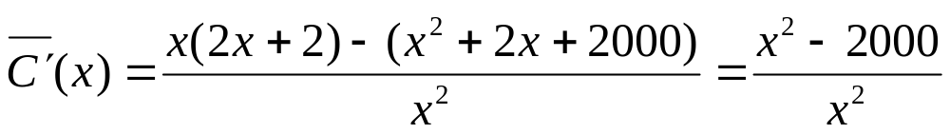


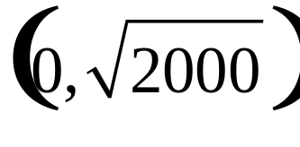
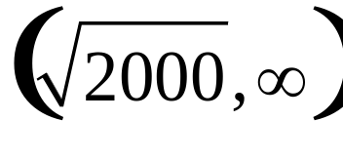

Example
(continued)
Step 2. Analyze
Critical value for . If we test values to the left and right of the critical point, we find that is decreasing on , and increasing on and has a local minimum at
Barnett/Ziegler/Byleen College Mathematics 12e

Slide 14
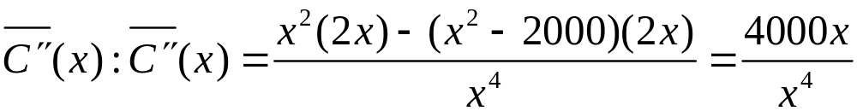
Example
(continued)
Step 3. Analyze
Since this is positive for all positive x, the graph of the average cost function is concave upward on (0, ∞)
Barnett/Ziegler/Byleen College Mathematics 12e

Slide 15
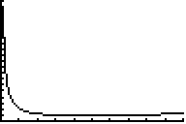
Example
(continued)
Step 4. Sketch the graph. The graph of the average cost function is shown below.
2000
Min at ~45
100
Barnett/Ziegler/Byleen College Mathematics 12e

Slide 16
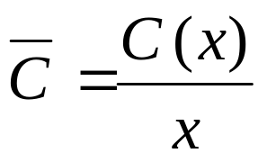
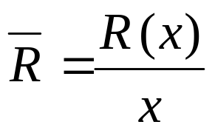
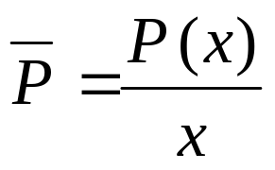
Average Cost
We just had an application involving average cost. Note it was
the total cost divided by x, or
This is the average cost to produce one item.
There are similar formulae for calculating average revenue and average profit. Know how to use all of these functions!
Barnett/Ziegler/Byleen College Mathematics 12e

