Slide 1
Chapter 12
Graphing and Optimization
Section 5
Absolute Maxima and Minima

Slide 2

Objectives for Section 12.5
Absolute Maxima and Minima
The student will be able to identify absolute maxima and minima.
The student will be able to use the second derivative test to classify extrema.
Barnett/Ziegler/Byleen College Mathematics 12e

Slide 3
Absolute Maxima and Minima
Definition:
f (c) is an absolute maximum of f if f (c) > f (x) for all x in the domain of f.
f (c) is an absolute minimum of f if f (c) < f (x) for all x in the domain of f.
Barnett/Ziegler/Byleen College Mathematics 12e

Slide 4
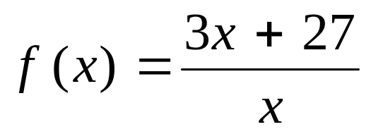
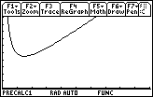
Example 1
Find the absolute minimum value of
using a graphing calculator.
Window 0 ≤ x ≤ 20
0 ≤ y ≤ 40.
Using the graph utility
“minimum”
to get x = 3 and y = 18.
Barnett/Ziegler/Byleen College Mathematics 12e

Slide 5
Extreme Value Theorem
Theorem 1. (Extreme Value Theorem)
A function f that is continuous on a closed interval [a, b] has both an absolute maximum value and an absolute minimum value on that interval.
Barnett/Ziegler/Byleen College Mathematics 12e

Slide 6
Finding Absolute Maximum and Minimum Values
Theorem 2. Absolute extrema (if they exist) must always occur at critical values of the derivative, or at end points.
Check to make sure f is continuous over [a, b] .
Find the critical values in the interval [a, b].
Evaluate f at the end points a and b and at the critical values found in step b.
The absolute maximum on [a, b] is the largest of the values found in step c.
The absolute minimum on [a, b] is the smallest of the values found in step c.
Barnett/Ziegler/Byleen College Mathematics 12e

Slide 7
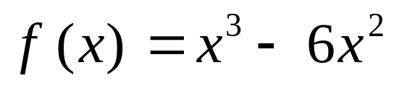
Example 2
Find the absolute maximum and absolute minimum value of
on [–1, 7].
Barnett/Ziegler/Byleen College Mathematics 12e

Slide 8

Example 2
Find the absolute maximum and absolute minimum value of
on [–1, 7].
The function is continuous.
b. f ′(x) = 3x² – 12x = 3x (x – 4).
Critical values are 0 and 4.
c. f (–1) = –7, f (0) = 0,
f (4) = –32, f (7) = 49
The absolute maximum is 49.
The absolute minimum is –32.
Barnett/Ziegler/Byleen College Mathematics 12e

Slide 9
Second Derivative Test
Theorem 3. Let f be continuous on interval I with only one critical value c in I.
If f ′(c) = 0 and f ′′(c) > 0, then f (c) is the absolute minimum of f on I.
If f ′(c) = 0 and f ′′(c) < 0, then f (c) is the absolute maximum of f on I.
Barnett/Ziegler/Byleen College Mathematics 12e

Slide 10
Second Derivative and Extrema
f ′(c) | f ′′(c) | graph of f is | f (c) is
0 | + | concave up | local minimum
0 | – | concave down | local maximum
0 | 0 | ? | test fails
Barnett/Ziegler/Byleen College Mathematics 12e

Slide 11
Example 2
(continued)
Find the local maximum and minimum values
of on [–1, 7].
Barnett/Ziegler/Byleen College Mathematics 12e

Slide 12
Example 2
(continued)
Find the local maximum and minimum values
of on [–1, 7].
a. f ′(x) = 3x² – 12x = 3x (x – 4).
f ′′(x) = 6x – 12 = 6 (x – 2)
b. Critical values of 0 and 4.
f ′′(0) = –12, hence f (0) local maximum.
f ′′(4) = 12, hence f (4) local minimum.
Barnett/Ziegler/Byleen College Mathematics 12e

Slide 13
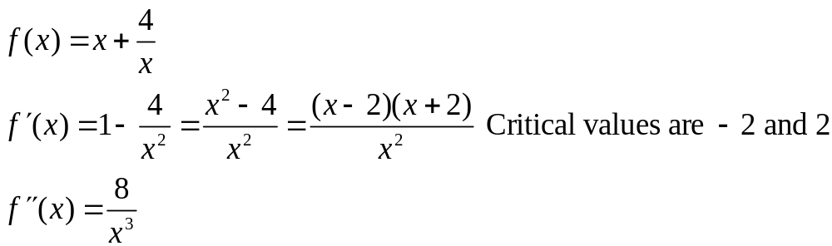
Finding an Absolute Extremum on an Open Interval
Example: Find the absolute minimum value of
f (x) = x + 4/x on (0, ∞).
Solution:
The only critical value in the interval (0, ∞) is x = 2. Since
f ′′(2) = 1 > 0, f (2) is the absolute minimum value of f on (0, ∞)
Barnett/Ziegler/Byleen College Mathematics 12e

Slide 14
Summary
All continuous functions on closed and bounded intervals have absolute maximum and minimum values.
These absolute extrema will be found either at critical values or at end points of the intervals on which the function is defined.
Local maxima and minima may also be found using these methods.
Barnett/Ziegler/Byleen College Mathematics 12e

