Slide 1
Chapter 12
Graphing and Optimization
Section 6
Optimization

Slide 2

Objectives for Section 12.6
Optimization
The student will be able to calculate:
Area and perimeter
Revenue and profit
Inventory control.
Barnett/Ziegler/Byleen College Mathematics 12e

Slide 3
Area and Perimeter
Example 1
The techniques used to solve optimization problems are best illustrated through examples. Let’s begin with a geometric example.
Find the dimensions of a rectangular area of 225 square meters that has the least perimeter.
Hint: Drawing a figure might help.
Barnett/Ziegler/Byleen College Mathematics 12e

Slide 4
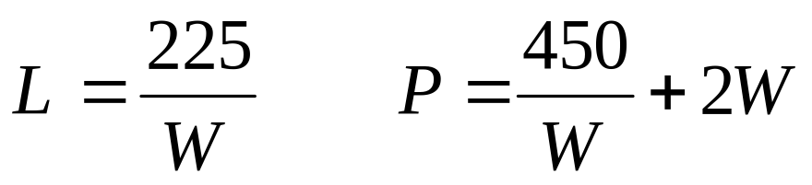
Area and Perimeter
Example 1
Let L = length, W = width.
The formulas for area and perimeter are
A = L · W = 225
P = 2 · L + 2 · W
From the area equation solve for L and substitute that value of L into the perimeter equation to get an equation in one unknown:
L
W
Barnett/Ziegler/Byleen College Mathematics 12e

Slide 5
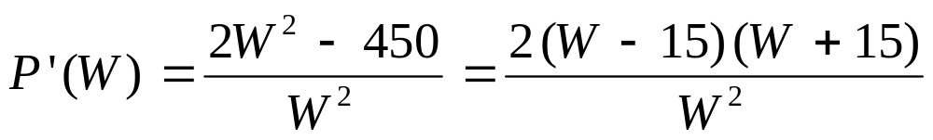
Example 1
(continued)
We wish to minimize P, so we take the derivative and look at the critical values.
There is a critical value at 15. (Disregard W = –15 since the width cannot be negative.)
Barnett/Ziegler/Byleen College Mathematics 12e

Slide 6
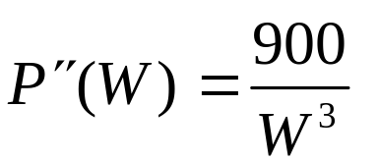
Example 1
(continued)
P ′′(15) > 0, so this is a local minimum. The least perimeter occurs when W = 15.
For this value, L is also 15, so the shape is a square of side 15 meters, with minimum perimeter of 60.
Barnett/Ziegler/Byleen College Mathematics 12e

Slide 7
Optimization Strategies
Introduce variables, look for relationships among these variables, and construct a math model of the form: Maximize (minimize) f (x) on the interval I.
Find the critical values of f (x).
Find the maximum (minimum) value of f (x) on the interval I.
Use the solution to the mathematical model to answer all the questions asked in the problem.
Barnett/Ziegler/Byleen College Mathematics 12e

Slide 8
Example 2
A company manufactures and sells x television sets per month. The monthly cost and price-demand equations are:
C(x) = 60,000 + 60x
p(x) = 200 – x/50 for 0 ≤ x ≤ 6,000
Find the production level that will maximize the revenue, the maximum revenue, and the price that the company needs to charge at that level.
Find the production level that will maximize the profit, the maximum profit, and the price that the company needs to charge at that level.
Barnett/Ziegler/Byleen College Mathematics 12e

Slide 9
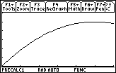
Example 2
(continued)
The monthly revenue is
  R(x) = x ⋅ p(x) = 200x – x²/50.
  Differentiate and set to zero:
  R′(x) = 200 – x/25 = 0
  x = 5000
  R(5000) = $500,000
  p(5000) = $100
0 ≤ x ≤ 6,000
0 ≤ y ≤ 600,000.
R(x)
Barnett/Ziegler/Byleen College Mathematics 12e

Slide 10
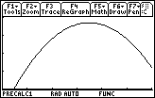
Example 2
(continued)
Profit = Revenue – Cost
P(x) = 200x – x²/50 – (60000 + 60x) = –x²/50 + 140x – 60000
P′(x) = –x/25 + 140
x = 3500
P(3500) = $185,000
p(3500) = $130
and out of curiosity:
R(3500) = $455,000
P(5000) = $140,000
P(x)
3500
0 ≤ x ≤ 6,000
0 ≤ y ≤ 200,000.
Barnett/Ziegler/Byleen College Mathematics 12e

Slide 11
Example 2
(continued)
Summary:
The maximum revenue of $500,000 is achieved at a production level of 5000 sets per month, which are sold at $100 each. (The profit is $140,000.)
The maximum profit of $185,000 is achieved at a production level of 3500 sets per month, which are sold at $130 each. (The revenue is $455,000).
Barnett/Ziegler/Byleen College Mathematics 12e

Slide 12

Example 3
A 300 room hotel in Las Vegas is filled to capacity every night at $80 per room. For each additional $1 increase in rent, 3 fewer rooms are rented. If each rented room cost $10 to service per day, how much should the management charge for each room to maximize gross profit? What is the maximum gross profit?
Barnett/Ziegler/Byleen College Mathematics 12e

Slide 13
Example 3
(continued)
Solution: Let x be the amount over $80 for a room.
When x = 0, the hotel rents 300 rooms.
When x = 1, the hotel rents 300 – 3 = 297 rooms
When x = 2, the hotel rents 297 – 3 = 294 rooms
What is the general formula?
Barnett/Ziegler/Byleen College Mathematics 12e

Slide 14
Example 3
(continued)
Solution: Let x be the amount over $80 for a room.
When x = 0, the hotel rents 300 rooms.
When x = 1, the hotel rents 300 – 3 = 297 rooms
When x = 2, the hotel rents 297 – 3 = 294 rooms
What is the general formula?
Number of rooms rented = N(x) = 300 – 3x
Profit per room = (rent earned) – (cleaning costs)
R(x) = (80 + x) – 10 = 70 + x
Total Profit = P(x) = N(x) R(x) = (300 – 3x)(70 + x)
P(x) = –3x² + 90x + 21000
Barnett/Ziegler/Byleen College Mathematics 12e

Slide 15
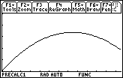
Example 3
(continued)
P(x) = –3x² + 90x + 21000
P′(x) = –6x + 90
Set P’(x) = 0
to find x = 15.
The room charge should be $95.
Number of rooms rented
= 300 – 3(15) = 265
Total profit P(15) = $21675.
21,675
P (x)
15
0 ≤ x ≤ 25
21,000 ≤ y ≤ 22,000.
Barnett/Ziegler/Byleen College Mathematics 12e

Slide 16
Inventory Control
A pharmacy has a uniform annual demand for 200 bottles of a certain antibiotic. It costs $10 per year for a storage place for one bottle, and $40 to place an order. How many times during the year should the pharmacy order the antibiotic in order to minimize total cost?
Example: If you use 4 orders of 50 bottles each, you need 50 storage places. If you use 10 orders of 20 bottles each, you only need 20 storage places, but it costs more to order.
Further Hint: Use $5 per storage place instead of $10. The reasoning is that some bottles will get used right away, and some need to be stored the full time.
Barnett/Ziegler/Byleen College Mathematics 12e

Slide 17
Inventory Control
(continued)
Solution:
Let x = number of bottles per order, and
y = number of orders.
The total annual cost is C = 40y + 5x.
The total number of bottles is xy = 200, so y = 200/x, and
C(x) = 8000/x + 5x.
C ′(x) = –8000/x² + 5 = 0 → x = 40, y = 5.
The clinic should place 5 orders of 40 bottles each.
Barnett/Ziegler/Byleen College Mathematics 12e

Slide 18
Summary.
We saw how to optimize geometric problems.
We saw how to optimize revenue and profit problems.
We saw how to optimize inventory control problems.
Barnett/Ziegler/Byleen College Mathematics 12e

