Slide 1
Chapter 1
Linear Equations and Graphs
Section 1
Linear Equations and Inequalities

Slide 2
Learning Objectives for Section 1.1 Linear Equations and Inequalities
The student will be able to solve linear equations.
The student will be able to solve linear inequalities.
The student will be able to solve applications involving linear equations and inequalities.
Barnett/Ziegler/Byleen College Mathematics 12e

Slide 3

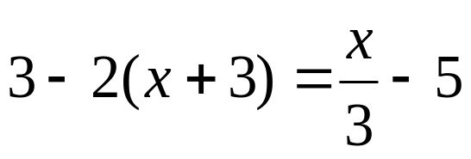
Linear Equations, Standard Form
In general, a first-degree, or linear, equation in one variable is any equation that can be written in the form
where a is not equal to zero. This is called the standard form of the linear equation.
For example, the equation
is a linear equation because it can be converted to standard form by clearing of fractions and simplifying.
Barnett/Ziegler/Byleen College Mathematics 12e

Slide 4
Equivalent Equations
Two equations are equivalent if one can be transformed into the other by performing a series of operations which are one of two types:
1. The same quantity is added to or subtracted from each side of a given equation.
2. Each side of a given equation is multiplied by or divided by the same nonzero quantity.
To solve a linear equation, we perform these operations on the equation to obtain simpler equivalent forms, until we obtain an equation with an obvious solution.
Barnett/Ziegler/Byleen College Mathematics 12e

Slide 5
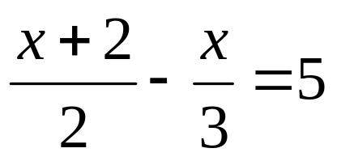

Example of Solving a
Linear Equation
Example: Solve
Barnett/Ziegler/Byleen College Mathematics 12e

Slide 6
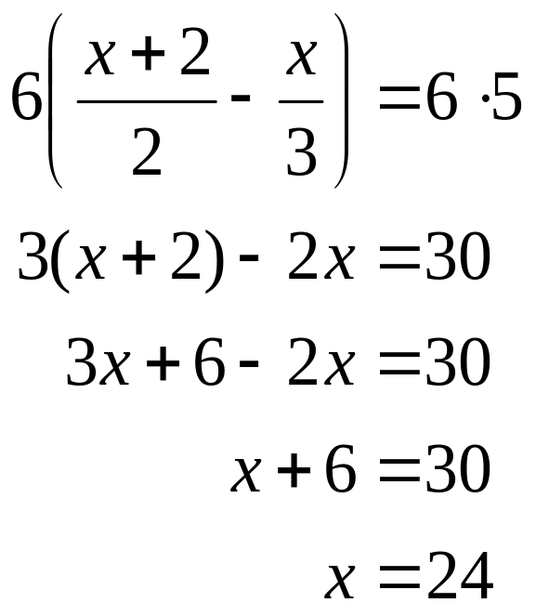
Example of Solving a
Linear Equation
Example: Solve
Solution: Since the LCD of 2 and 3 is 6, we multiply both sides of the equation by 6 to clear of fractions.
Cancel the 6 with the 2 to obtain a factor of 3, and cancel the 6 with the 3 to obtain a factor of 2.
Distribute the 3.
Combine like terms.
Barnett/Ziegler/Byleen College Mathematics 12e

Slide 7

Solving a Formula for a
Particular Variable
Example: Solve M =Nt +Nr for N.
Barnett/Ziegler/Byleen College Mathematics 12e

Slide 8
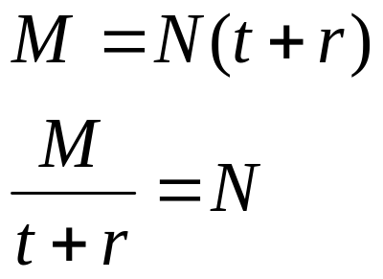
Solving a Formula for a
Particular Variable
Example: Solve M=Nt+Nr for N.
Factor out N:
Divide both sides by (t + r):
Barnett/Ziegler/Byleen College Mathematics 12e

Slide 9
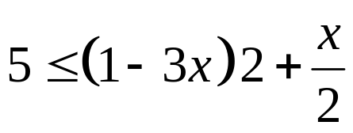
Linear Inequalities
If the equality symbol = in a linear equation is replaced by an inequality symbol (<, >, ≤, or ≥), the resulting expression is called a first-degree, or linear, inequality. For example
is a linear inequality.
Barnett/Ziegler/Byleen College Mathematics 12e

Slide 10
Solving Linear Inequalities
We can perform the same operations on inequalities that we perform on equations, except that the sense of the inequality reverses if we multiply or divide both sides by a negative number. For example, if we start with the true statement –2 > –9 and multiply both sides by 3, we obtain
–6 > –27.
The sense of the inequality remains the same.
If we multiply both sides by -3 instead, we must write
6 < 27
to have a true statement. The sense of the inequality reverses.
Barnett/Ziegler/Byleen College Mathematics 12e

Slide 11
Example for Solving a
Linear Inequality
Solve the inequality 3(x – 1) < 5(x + 2) – 5
Barnett/Ziegler/Byleen College Mathematics 12e

Slide 12
Example for Solving a
Linear Inequality
Solve the inequality 3(x – 1) < 5(x + 2) – 5
Solution:
3(x –1) < 5(x + 2) – 5
3x – 3 < 5x + 10 – 5 Distribute the 3 and the 5
3x – 3 < 5x + 5 Combine like terms.
–2x < 8 Subtract 5x from both sides,
and add 3 to both sides
x > -4 Notice that the sense of the inequality reverses when we divide both sides by -2.
Barnett/Ziegler/Byleen College Mathematics 12e

Slide 13
Interval and Inequality Notation
If a < b, the double inequality a < x < b means that a < x and
x < b. That is, x is between a and b.
Interval notation is also used to describe sets defined by single or double inequalities, as shown in the following table.
Interval | Inequality | Interval | Inequality
[a,b] | a ≤ x ≤ b | (–∞,a] | x ≤ a
[a,b) | a ≤ x < b | (–∞,a) | x < a
(a,b] | a < x ≤ b | [b,∞) | x ≥ b
(a,b) | a < x < b | (b,∞) | x > b
Barnett/Ziegler/Byleen College Mathematics 12e

Slide 14
Interval and Inequality Notation and Line Graphs
(A) Write [–5, 2) as a double inequality and graph .
(B) Write x ≥ –2 in interval notation and graph.
Barnett/Ziegler/Byleen College Mathematics 12e

Slide 15
Interval and Inequality Notation and Line Graphs
(A) Write [–5, 2) as a double inequality and graph .
(B) Write x ≥ –2 in interval notation and graph.
(A) [–5, 2) is equivalent to –5 ≤ x < 2
[ ) x
-5
2
(B) x ≥ –2 is equivalent to [–2, ∞)
[ x
-2
Barnett/Ziegler/Byleen College Mathematics 12e

Slide 16
Procedure for Solving
Word Problems
Read the problem carefully and introduce a variable to represent an unknown quantity in the problem.
Identify other quantities in the problem (known or unknown) and express unknown quantities in terms of the variable you introduced in the first step.
Write a verbal statement using the conditions stated in the problem and then write an equivalent mathematical statement (equation or inequality.)
Solve the equation or inequality and answer the questions posed in the problem.
Check the solutions in the original problem.
Barnett/Ziegler/Byleen College Mathematics 12e

Slide 17
Example: Break-Even Analysis
A recording company produces compact disk (CDs). One-time fixed costs for a particular CD are $24,000; this includes costs such as recording, album design, and promotion. Variable costs amount to $6.20 per CD and include the manufacturing, distribution, and royalty costs for each disk actually manufactured and sold to a retailer. The CD is sold to retail outlets at $8.70 each. How many CDs must be manufactured and sold for the company to break even?
Barnett/Ziegler/Byleen College Mathematics 12e

Slide 18
Break-Even Analysis
(continued)
Solution
Step 1. Let x = the number of CDs manufactured and sold.
Step 2. Fixed costs = $24,000
Variable costs = $6.20x
C = cost of producing x CDs
= fixed costs + variable costs
= $24,000 + $6.20x
R = revenue (return) on sales of x CDs
= $8.70x
Barnett/Ziegler/Byleen College Mathematics 12e

Slide 19
Break-Even Analysis
(continued)
Step 3. The company breaks even if R = C, that is if
$8.70x = $24,000 + $6.20x
Step 4. 8.7x = 24,000 + 6.2x Subtract 6.2x from both sides
2.5x = 24,000 Divide both sides by 2.5
x = 9,600
The company must make and sell 9,600 CDs
to break even.
Barnett/Ziegler/Byleen College Mathematics 12e

Slide 20
Break-Even Analysis
(continued)
Step 5. Check:
Costs = $24,000 + $6.2 ∙ 9,600 = $83,520
Revenue = $8.7 ∙ 9,600 = $83,520
Barnett/Ziegler/Byleen College Mathematics 12e

