Slide 1
Chapter 1
Linear Equations and Graphs
Section 2
Graphs and Lines

Slide 2
Learning Objectives for Section 1.2
Graphs and Lines
The student will be able to identify and work with the Cartesian coordinate system.
The student will be able to draw graphs for equations of the form Ax + By = C.
The student will be able to calculate the slope of a line.
The student will be able to graph special forms of equations of lines.
The student will be able to solve applications of linear equations.
Barnett/Ziegler/Byleen College Mathematics 12e

Slide 3
The Cartesian Coordinate System
The Cartesian coordinate system was named after René Descartes. It consists of two real number lines, the horizontal axis (x-axis) and the vertical axis (y-axis) which meet in a right angle at a point called the origin. The two number lines divide the plane into four areas called quadrants.
The quadrants are numbered using Roman numerals as shown on the next slide. Each point in the plane corresponds to one and only one ordered pair of numbers (x,y). Two ordered pairs are shown.
Barnett/Ziegler/Byleen College Mathematics 12e

Slide 4
The Cartesian Coordinate System
(continued)
II
I
Two points, (–1,–1) and (3,1), are plotted. Four quadrants are as labeled.
(3,1)
x
(–1,–1)
III
IV
y
Barnett/Ziegler/Byleen College Mathematics 12e

Slide 5
Linear Equations in Two Variables
A linear equation in two variables is an equation that can be written in the standard form Ax + By = C, where A, B, and C are constants (A and B not both 0), and x and y are variables.
A solution of an equation in two variables is an ordered pair of real numbers that satisfy the equation. For example, (4,3) is a solution of 3x - 2y = 6.
The solution set of an equation in two variables is the set of all solutions of the equation.
The graph of an equation is the graph of its solution set.
Barnett/Ziegler/Byleen College Mathematics 12e

Slide 6
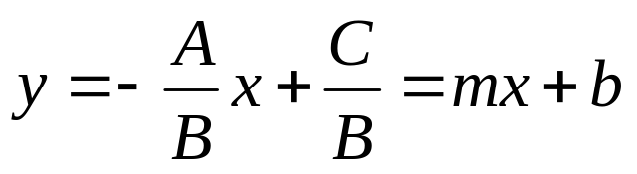
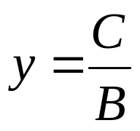
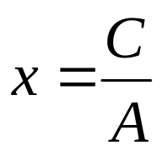
Linear Equations in Two Variables (continued)
If A is not equal to zero and B is not equal to zero, then
Ax + By = C can be written as
This is known as
slope-intercept form.
If A = 0 and B is not equal to zero,
then the graph is a horizontal line
If A is not equal to zero and B = 0,
then the graph is a vertical line
Barnett/Ziegler/Byleen College Mathematics 12e

Slide 7
Using Intercepts to Graph a Line
Graph 2x – 6y = 12.
Barnett/Ziegler/Byleen College Mathematics 12e

Slide 8
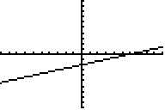
Using Intercepts to Graph a Line
Graph 2x – 6y = 12.
x | y
0 | –2 | y-intercept
6 | 0 | x-intercept
3 | –1 | check point
Barnett/Ziegler/Byleen College Mathematics 12e

Slide 9
Using a Graphing Calculator
Graph 2x – 6y = 12 on a graphing calculator and find the intercepts.
Barnett/Ziegler/Byleen College Mathematics 12e

Slide 10
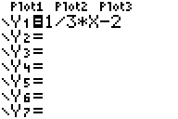
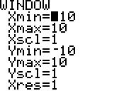
Using a Graphing Calculator
Graph 2x – 6y = 12 on a graphing calculator and find the intercepts.
Solution: First, we solve the equation for y.
2x – 6y = 12 Subtract 2x from each side.
–6y = –2x + 12 Divide both sides by –6
y = (1/3)x – 2
Now we enter the right side of this equation in a calculator, enter values for the window variables, and graph the line.
Barnett/Ziegler/Byleen College Mathematics 12e

Slide 11
Special Cases
The graph of x = k is the graph of a vertical line k units from the y-axis.
The graph of y = k is the graph of the horizontal line k units from the x-axis.
Examples:
1. Graph x = –7
2. Graph y = 3
Barnett/Ziegler/Byleen College Mathematics 12e

Slide 12
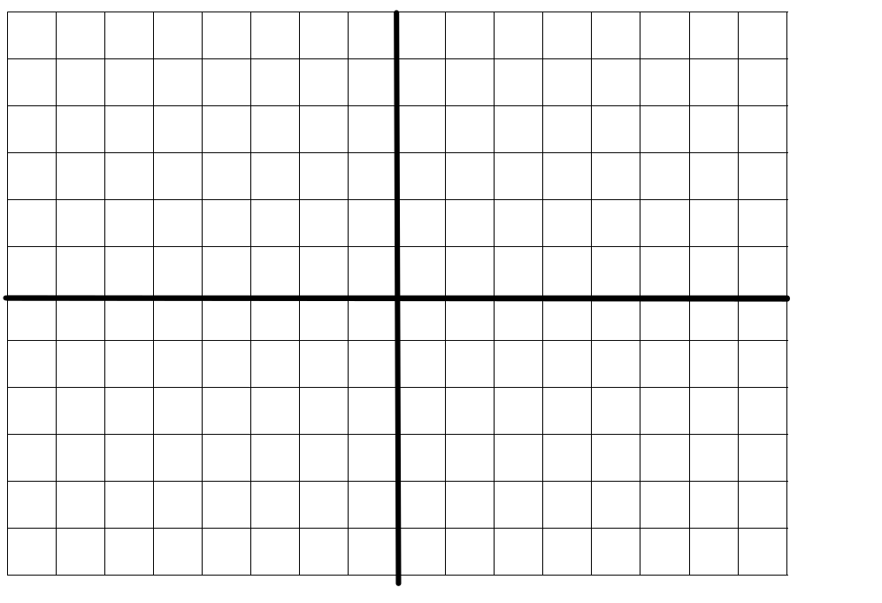
Solutions
x = –7
y = 4
Barnett/Ziegler/Byleen College Mathematics 12e

Slide 13
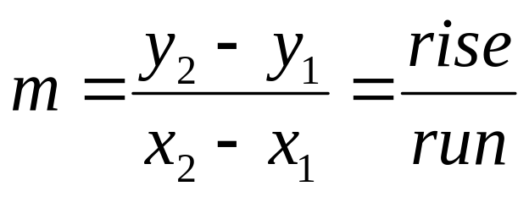
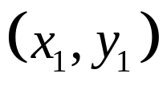

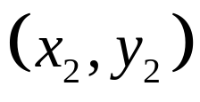
Slope of a Line
Slope of a line:
rise
run
Barnett/Ziegler/Byleen College Mathematics 12e

Slide 14
Slope-Intercept Form
The equation
y = mx+b
is called the slope-intercept form of an equation of a line.
The letter m represents the slope and b represents the
y-intercept.
Barnett/Ziegler/Byleen College Mathematics 12e

Slide 15
Find the Slope and Intercept from the Equation of a Line
Example: Find the slope and y intercept of the line
whose equation is 5x – 2y = 10.
Barnett/Ziegler/Byleen College Mathematics 12e

Slide 16
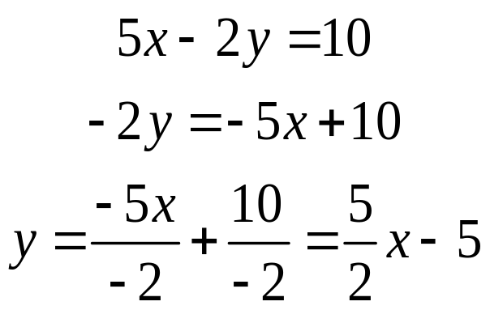
Find the Slope and Intercept from the Equation of a Line
Example: Find the slope and y intercept of the line
whose equation is 5x – 2y = 10.
Solution: Solve the equation for y in terms of x. Identify the coefficient of x as the slope and the y intercept as the constant term.
Therefore: the slope is 5/2 and the y intercept is –5.
Barnett/Ziegler/Byleen College Mathematics 12e

Slide 17
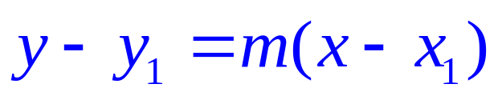
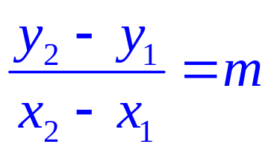
Point-Slope Form
The point-slope form of the equation of a line is
where m is the slope and (x₁, y₁) is a given point.
It is derived from the definition of the slope of a line:
Cross-multiply and substitute the more general x for x₂
Barnett/Ziegler/Byleen College Mathematics 12e

Slide 18
Example
Find the equation of the line through the points (–5, 7) and (4, 16).
Barnett/Ziegler/Byleen College Mathematics 12e

Slide 19
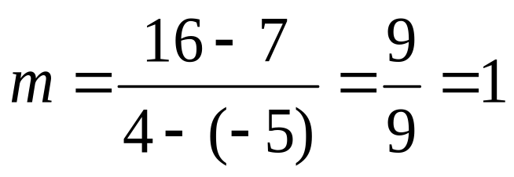
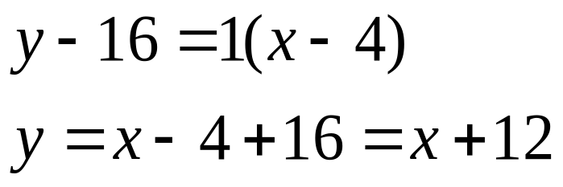
Example
Find the equation of the line through the points (–5, 7) and (4, 16).
Solution:
Now use the point-slope form with m = 1 and (x₁, x₂) = (4, 16). (We could just as well have used (–5, 7)).
Barnett/Ziegler/Byleen College Mathematics 12e

Slide 20
Application
Office equipment was purchased for $20,000 and will have a scrap value of $2,000 after 10 years. If its value is depreciated linearly, find the linear equation that relates value (V) in dollars to time (t) in years:
Barnett/Ziegler/Byleen College Mathematics 12e

Slide 21
Application
Office equipment was purchased for $20,000 and will have a scrap value of $2,000 after 10 years. If its value is depreciated linearly, find the linear equation that relates value (V) in dollars to time (t) in years:
Solution: When t = 0, V = 20,000 and when t = 10, V = 2,000. Thus, we have two ordered pairs (0, 20,000) and (10, 2000). We find the slope of the line using the slope formula.
The y intercept is already known (when t = 0, V = 20,000, so
the y intercept is 20,000).
The slope is (2000 – 20,000)/(10 – 0) = –1,800.
Therefore, our equation is V(t) = –1,800t + 20,000.
Barnett/Ziegler/Byleen College Mathematics 12e

Slide 22
Supply and Demand
In a free competitive market, the price of a product is determined by the relationship between supply and demand. The price tends to stabilize at the point of intersection of the demand and supply equations.
This point of intersection is called the equilibrium point.
The corresponding price is called the equilibrium price.
The common value of supply and demand is called the equilibrium quantity.
Barnett/Ziegler/Byleen College Mathematics 12e

Slide 23
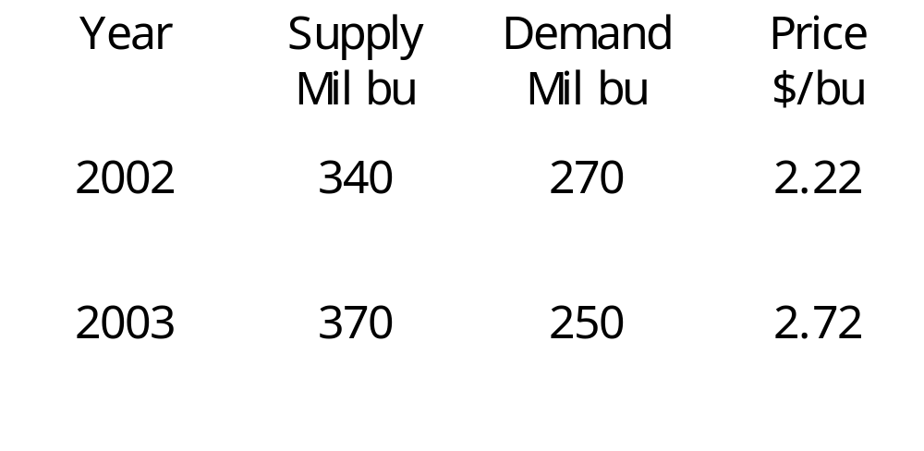
Supply and Demand
Example
Use the barley market data in the following table to find: (a) A linear supply equation of the form p = mx + b (b) A linear demand equation of the form p = mx + b
(c) The equilibrium point.
Barnett/Ziegler/Byleen College Mathematics 12e

Slide 24
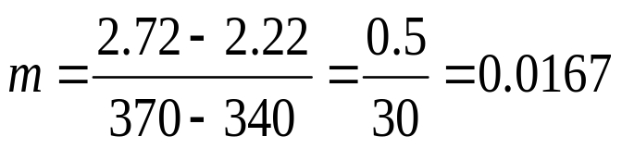
Supply and Demand
Example (continued)
(a) To find a supply equation in the form p = mx + b, we must first find two points of the form (x, p) on the supply line. From the table, (340, 2.22) and (370, 2.72) are two such points. The slope of the line is
Now use the point-slope form to find the equation of the line:
p – p₁ = m(x – x₁)
p – 2.22 = 0.0167(x – 340)
p – 2.22 = 0.0167x – 5.678
p = 0.0167x – 3.458 Price-supply equation.
Barnett/Ziegler/Byleen College Mathematics 12e

Slide 25
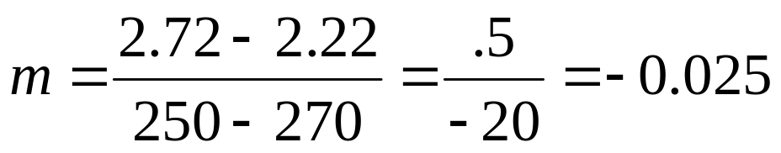
Supply and Demand
Example (continued)
(b) From the table, (270, 2.22) and (250, 2.72) are two points on the demand equation. The slope is
p – p₁ = m(x – x₁)
p – 2.22 = –0.025(x – 270)
p – 2.22 = –0.025x + 6.75
p = –0.025x + 8.97 Price-demand equation
Barnett/Ziegler/Byleen College Mathematics 12e

Slide 26
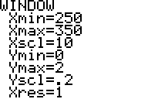
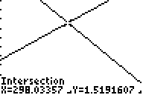
Supply and Demand
Example (continued)
(c) If we graph the two equations on a graphing calculator, set the window as shown, then use the intersect operation, we obtain:
The equilibrium point is approximately (298, 1.52). This means that the common value of supply and demand is 298 million bushels when the price is $1.52.
Barnett/Ziegler/Byleen College Mathematics 12e

