Slide 1
Chapter 1
Linear Equations and Graphs
Section 3
Linear Regression

Slide 2

Learning Objectives for Section 1.3
Linear Regression
The student will be able to calculate slope as a rate of change.
The student will be able to calculate linear regression using a calculator.
Barnett/Ziegler/Byleen College Mathematics 12e

Slide 3
Mathematical Modeling
Mathematical modeling is the process of using mathematics to solve real-world problems. This process can be broken down into three steps:
1. Construct the mathematical model, a problem whose solution will provide information about the real-world problem.
2. Solve the mathematical model.
3. Interpret the solution to the mathematical model in terms of the original real-world problem.
In this section we will discuss one of the simplest mathematical models, a linear equation.
Barnett/Ziegler/Byleen College Mathematics 12e

Slide 4
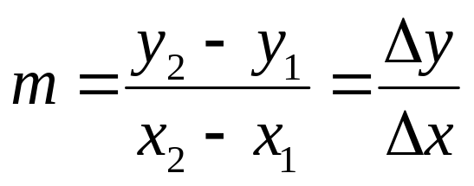
Slope as a Rate of Change
If x and y are related by the equation y = mx + b, where m and b are constants with m not equal to zero, then x and y are linearly related. If (x₁, y₁) and (x₂, y₂) are two distinct points on this line, then the slope of the line is
This ratio is called the rate of change of y with respect to x. Since the slope of a line is unique, the rate of change of two linearly related variables is constant. Some examples of familiar rates of change are miles per hour, price per pound, and revolutions per minute.
Barnett/Ziegler/Byleen College Mathematics 12e

Slide 5
Example of Rate of Change:
Rate of Descent
Parachutes are used to deliver cargo to areas that cannot be reached by other means of conveyance. The rate of descent of the cargo is the rate of change of altitude with respect to time. The absolute value of the rate of descent is called the speed of the cargo. At low altitudes, the altitude of the cargo and the time in the air are linearly related. If a linear model relating altitude a (in feet) and time in the air t (in seconds) is given by a = –14.1t +2,880, how fast is the cargo moving when it lands?
Barnett/Ziegler/Byleen College Mathematics 12e

Slide 6
Example of Rate of Change:
Rate of Descent
Parachutes are used to deliver cargo to areas that cannot be reached by other means of conveyance. The rate of descent of the cargo is the rate of change of altitude with respect to time. The absolute value of the rate of descent is called the speed of the cargo. At low altitudes, the altitude of the cargo and the time in the air are linearly related. If a linear model relating altitude a (in feet) and time in the air t (in seconds) is given by a = –14.1t +2,880, how fast is the cargo moving when it lands?
Answer: The rate of descent is the slope m = –14.1, so the speed of the cargo at landing is |–14.1| = 14.1 ft/sec.
Barnett/Ziegler/Byleen College Mathematics 12e

Slide 7
Linear Regression
In real world applications we often encounter numerical data in the form of a table. The powerful mathematical tool, regression analysis, can be used to analyze numerical data. In general, regression analysis is a process for finding a function that best fits a set of data points. In the next example, we use a linear model obtained by using linear regression on a graphing calculator.
Barnett/Ziegler/Byleen College Mathematics 12e

Slide 8
Example of Linear Regression
Prices for emerald-shaped diamonds taken from an on-line trader are given in the following table. Find the linear model that best fits this data.
Weight (carats) Price
0.5 $1,677
0.6 $2,353
0.7 $2,718
0.8 $3,218
0.9 $3,982
Barnett/Ziegler/Byleen College Mathematics 12e

Slide 9
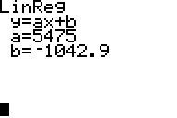
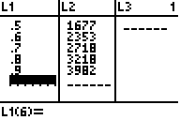
Example of Linear Regression
(continued)
Solution: If we enter these values into the lists in a graphing calculator as shown below, then choose linear regression from the statistics menu, we obtain the second screen, which gives the equation of best fit.
The linear equation of best fit is y = 5475x – 1042.9.
Barnett/Ziegler/Byleen College Mathematics 12e

Slide 10
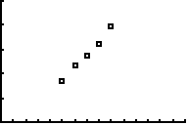
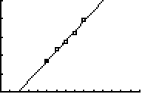
Scatter Plots
We can plot the data points in the previous example on a Cartesian coordinate plane, either by hand or using a graphing calculator. If we use the calculator, we obtain the following plot:
Price of emerald (thousands)
Weight (tenths of a carat)
We can plot the graph of our line of best fit on top of the scatter plot:
y = 5475x – 1042.9
Barnett/Ziegler/Byleen College Mathematics 12e

