Slide 1
Chapter 2
Functions and Graphs
Section 1
Functions

Slide 2
Learning Objectives for Section 2.1
Functions
The student will be able to do point-by-point plotting of equations in two variables.
The student will be able to give and apply the definition of a function.
The student will be able to identify domain and range of a function.
The student will be able to use function notation.
The student will be able to solve applications.
Barnett/Ziegler/Byleen College Mathematics 12e

Slide 3
Graphing an Equation
To sketch the graph an equation in x and y, we need to find ordered pairs that solve the equation and plot the ordered pairs on a grid. This process is called point-by-point plotting.
For example, let’s plot the graph of the equation
Barnett/Ziegler/Byleen College Mathematics 12e

Slide 4
Graphing an Equation:
Making a Table of Ordered Pairs
Make a table of ordered pairs that satisfy the equation
x | y
–3 | (–3)²+2 = 11
–2 | (–2)²+2 = 6
–1 | (–1)²+2 = 6
0 | (0)²+2 = 2
1 | (1)²+2 = 3
2 | (2)²+2 = 6
Barnett/Ziegler/Byleen College Mathematics 12e

Slide 5
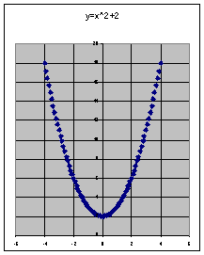
Graphing an Equation:
Plotting the points
Next, plot the points and connect them with a smooth curve. You may need to plot additional points to see the pattern formed.
Barnett/Ziegler/Byleen College Mathematics 12e

Slide 6
Functions
The previous graph is the graph of a function. The idea of a function is this: a correspondence between two sets D and R such that to each element of the first set, D, there corresponds one and only one element of the second set, R.
The first set is called the domain, and the set of corresponding elements in the second set is called the range.
For example, the cost of a pizza (C) is related to the size of the pizza. A 10 inch diameter pizza costs $9.00, while a 16 inch diameter pizza costs $12.00.
Barnett/Ziegler/Byleen College Mathematics 12e

Slide 7
Function Definition
You can visualize a function by the following diagram which shows a correspondence between two sets: D, the domain of the function, gives the diameter of pizzas, and R, the range of the function gives the cost of the pizza.
10
9.00
12
10.00
16
12.00
domain D
range R
Barnett/Ziegler/Byleen College Mathematics 12e

Slide 8
Functions Specified by Equations
If in an equation in two variables, we get exactly one output (value for the dependent variable) for each input (value for the independent variable), then the equation specifies a function. The graph of such a function is just the graph of the specifying equation.
If we get more than one output for a given input, the equation does not specify a function.
Barnett/Ziegler/Byleen College Mathematics 12e

Slide 9
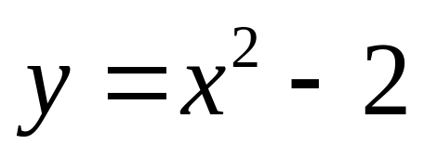
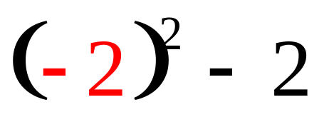
Functions Specified by Equations
Consider the equation that was graphed on a previous slide
Input:
x = –2
–2
Process:
square (–2),
then subtract 2
(–2,2) is an ordered pair of the function.
Output:
result is 2
2
Barnett/Ziegler/Byleen College Mathematics 12e

Slide 10
Vertical Line Test for a Function
If you have the graph of an equation, there is an easy way to determine if it is the graph of an function. It is called the vertical line test which states that:
An equation specifies a function if each vertical line in the coordinate system passes through at most one point on the graph of the equation.
If any vertical line passes through two or more points on the graph of an equation, then the equation does not specify a function.
Barnett/Ziegler/Byleen College Mathematics 12e

Slide 11
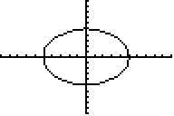
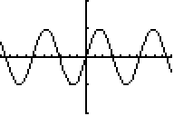
Vertical Line Test for a Function
(continued)
This graph is not the graph of a function because you can draw a vertical line which crosses it twice.
This is the graph of a function because any vertical line crosses only once.
Barnett/Ziegler/Byleen College Mathematics 12e

Slide 12
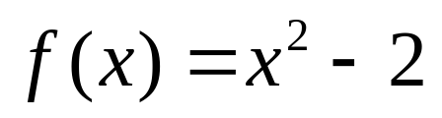
Function Notation
The following notation is used to describe functions. The variable y will now be called f (x).
This is read as “ f of x” and simply means the y coordinate of the function corresponding to a given x value.
Our previous equation
can now be expressed as
Barnett/Ziegler/Byleen College Mathematics 12e

Slide 13
Function Evaluation
Consider our function
What does f (–3) mean?
Barnett/Ziegler/Byleen College Mathematics 12e

Slide 14
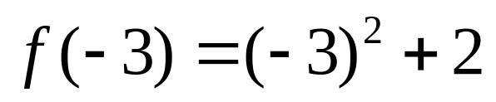
Function Evaluation
Consider our function
What does f (–3) mean?
Replace x with the value –3 and evaluate the expression
The result is 11 . This means that the point (–3,11) is on the graph of the function.
Barnett/Ziegler/Byleen College Mathematics 12e

Slide 15
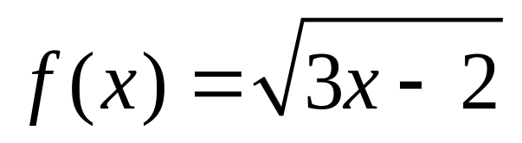
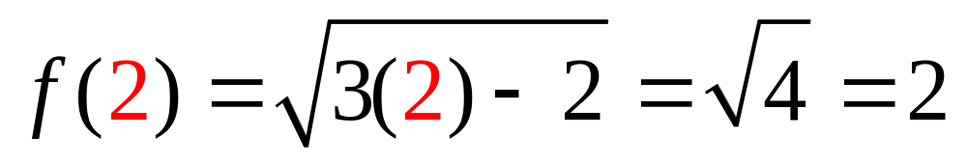
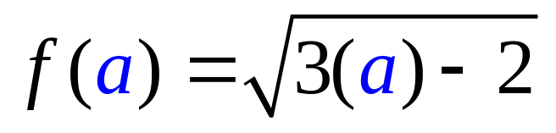
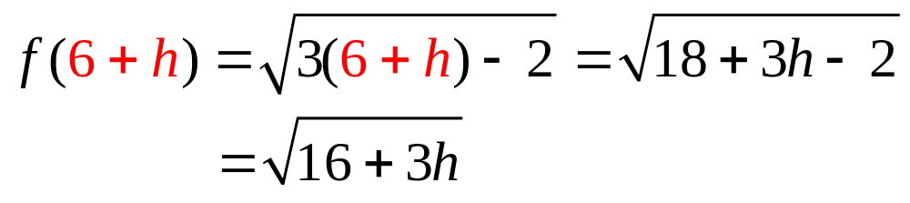
Some Examples
1.
Barnett/Ziegler/Byleen College Mathematics 12e

Slide 16
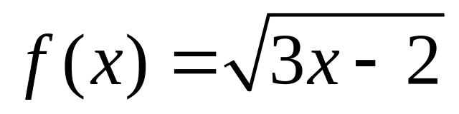
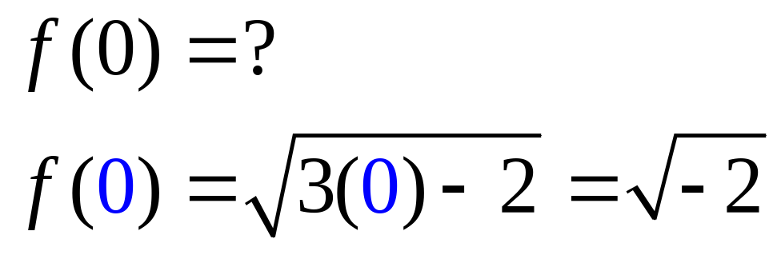
Domain of a Function
Consider
which is not a real number.
Question: for what values of x is the function defined?
Barnett/Ziegler/Byleen College Mathematics 12e

Slide 17
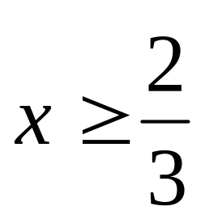
Domain of a Function
Answer:
is defined only when the radicand (3x – 2) is equal to or greater than zero. This implies that
Barnett/Ziegler/Byleen College Mathematics 12e

Slide 18
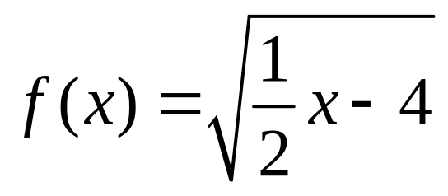
Domain of a Function
(continued)
Therefore, the domain of our function is the set of real numbers that are greater than or equal to 2/3.
Example: Find the domain of the function
Barnett/Ziegler/Byleen College Mathematics 12e

Slide 19
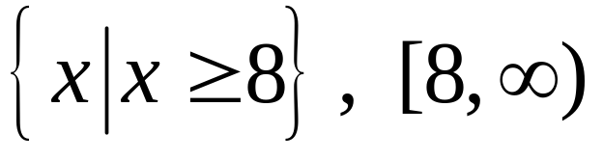
Domain of a Function
(continued)
Therefore, the domain of our function is the set of real numbers that are greater than or equal to 2/3.
Example: Find the domain of the function
Answer:
Barnett/Ziegler/Byleen College Mathematics 12e

Slide 20
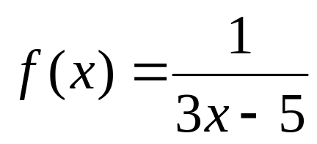
Domain of a Function:
Another Example
Find the domain of
Barnett/Ziegler/Byleen College Mathematics 12e

Slide 21
Domain of a Function:
Another Example
Find the domain of
In this case, the function is defined for all values of x except where the denominator of the fraction is zero. This means all real numbers x except 5/3.
Barnett/Ziegler/Byleen College Mathematics 12e

Slide 22
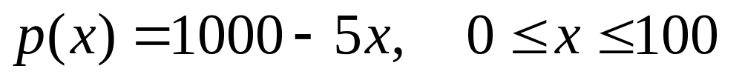
Mathematical Modeling
The price-demand function for a company is given by
where x represents the number of items and P(x) represents the price of the item. Determine the revenue function and find the revenue generated if 50 items are sold.
Barnett/Ziegler/Byleen College Mathematics 12e

Slide 23

Solution
Revenue = Price ∙ Quantity, so
R(x)= p(x) ∙ x = (1000 – 5x) ∙ x
When 50 items are sold, x = 50, so we will evaluate the revenue function at x = 50:
The domain of the function has already been specified. We are told that
Barnett/Ziegler/Byleen College Mathematics 12e

Slide 24
Break-Even and Profit-Loss Analysis
Any manufacturing company has costs C and revenues R.
The company will have a loss if R < C, will break even
if R = C, and will have a profit if R > C.
Costs include fixed costs such as plant overhead, etc. and variable costs, which are dependent on the number of items produced.
C = a + bx
(x is the number of items produced)
Barnett/Ziegler/Byleen College Mathematics 12e

Slide 25
Break-Even and Profit-Loss Analysis
(continued)
Price-demand functions, usually determined by financial departments, play an important role in profit-loss analysis.
p = m – nx
(x is the number of items than can be sold at $p per item.)
The revenue function is
R = (number of items sold) ∙ (price per item)
= xp = x(m – nx)
The profit function is
P = R – C = x(m – nx) – (a + bx)
Barnett/Ziegler/Byleen College Mathematics 12e

Slide 26
Example of Profit-Loss Analysis
A company manufactures notebook computers. Its marketing research department has determined that the data is modeled by the price-demand function
p(x) = 2,000 – 60x, when 1 < x < 25, (x is in thousands).
What is the company’s revenue function and what is its domain?
Barnett/Ziegler/Byleen College Mathematics 12e

Slide 27
Answer to Revenue Problem
Since Revenue = Price ∙ Quantity,
The domain of this function is the same as the domain of the price-demand function, which is 1 ≤ x ≤ 25 (in thousands.)
Barnett/Ziegler/Byleen College Mathematics 12e

Slide 28
Profit Problem
The financial department for the company in the preceding problem has established the following cost function for producing and selling x thousand notebook computers:
C(x) = 4,000 + 500x (x is in thousand dollars).
Write a profit function for producing and selling x thousand notebook computers, and indicate the domain of this function.
Barnett/Ziegler/Byleen College Mathematics 12e

Slide 29
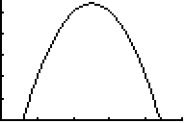
Answer to Profit Problem
Since Profit = Revenue – Cost, and our revenue function from the preceding problem was R(x) = 2000x – 60x²,
P(x) = R(x) – C(x) = 2000x – 60x² – (4000 + 500x)
= –60x² + 1500x – 4000.
The domain of this function is the same as the domain of the original price-demand function, 1< x < 25 (in thousands.)
5000
Thousand dollars
25
Thousand cameras
Barnett/Ziegler/Byleen College Mathematics 12e

