Slide 1
Chapter 2
Functions and Graphs
Section 2
Elementary Functions: Graphs and Transformations

Slide 2
Learning Objectives for Section 2.2
Elementary Functions;
Graphs and Transformations
The student will become familiar with a beginning library of elementary functions.
The student will be able to transform functions using vertical and horizontal shifts.
The student will be able to transform functions using reflections, stretches, and shrinks.
The student will be able to graph piecewise-defined functions.
Barnett/Ziegler/Byleen College Mathematics 12e

Slide 3
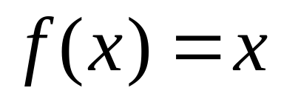
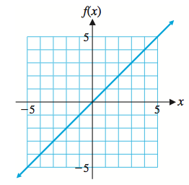
Identity Function
Domain: R
Range: R
Barnett/Ziegler/Byleen College Mathematics 12e

Slide 4
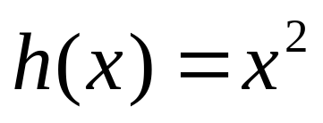
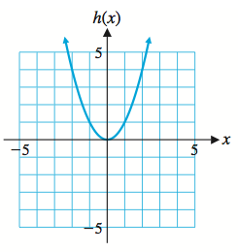
Square Function
Domain: R
Range: [0, ∞)
Barnett/Ziegler/Byleen College Mathematics 12e

Slide 5
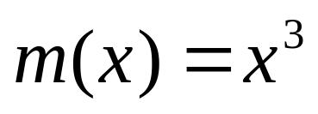
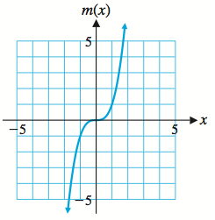
Cube Function
Domain: R
Range: R
Barnett/Ziegler/Byleen College Mathematics 12e

Slide 6
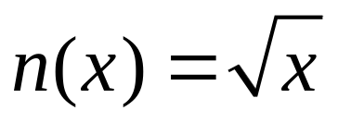
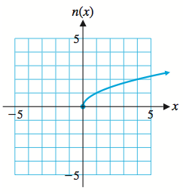
Square Root Function
Domain: [0, ∞)
Range: [0, ∞)
Barnett/Ziegler/Byleen College Mathematics 12e

Slide 7
Square Root Function
Domain: [0, ∞)
Range: [0, ∞)
Barnett/Ziegler/Byleen College Mathematics 12e

Slide 8
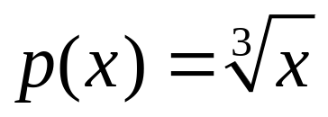
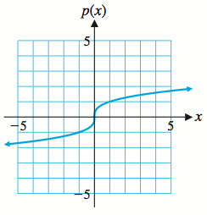
Cube Root Function
Domain: R
Range: R
Barnett/Ziegler/Byleen College Mathematics 12e

Slide 9
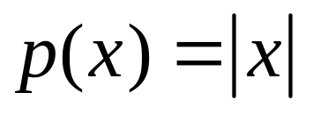
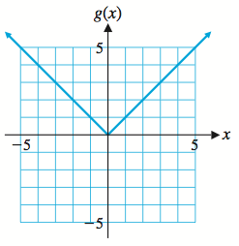
Absolute Value Function
Domain: R
Range: [0, ∞)
Barnett/Ziegler/Byleen College Mathematics 12e

Slide 10
Vertical Shift
The graph of y = f(x) + k can be obtained from the graph of y = f(x) by vertically translating (shifting) the graph of the latter upward k units if k is positive and downward |k| units if k is negative.
Graph y = |x|, y = |x| + 4, and y = |x| – 5.
Barnett/Ziegler/Byleen College Mathematics 12e

Slide 11
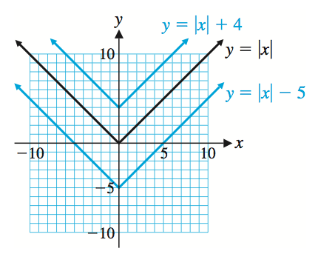
Vertical Shift
Barnett/Ziegler/Byleen College Mathematics 12e

Slide 12
Horizontal Shift
The graph of y = f(x + h) can be obtained from the graph of y = f(x) by horizontally translating (shifting) the graph of the latter h units to the left if h is positive and |h| units to the right if h is negative.
Graph y = |x|, y = |x + 4|, and y = |x – 5|.
Barnett/Ziegler/Byleen College Mathematics 12e

Slide 13
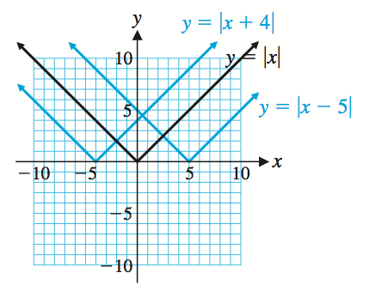
Horizontal Shift
Barnett/Ziegler/Byleen College Mathematics 12e

Slide 14
Reflection, Stretches and Shrinks
The graph of y = Af(x) can be obtained from the graph of
y = f(x) by multiplying each ordinate value of the latter by A.
If A > 1, the result is a vertical stretch of the graph of y = f(x).
If 0 < A < 1, the result is a vertical shrink of the graph of y = f(x).
If A = –1, the result is a reflection in the x axis.
Graph y = |x|, y = 2|x|, y = 0.5|x|, and y = –2|x|.
Barnett/Ziegler/Byleen College Mathematics 12e

Slide 15
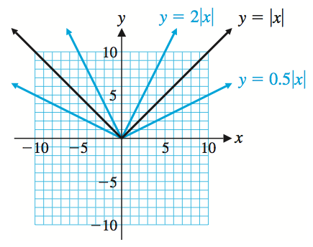
Reflection, Stretches and Shrinks
Barnett/Ziegler/Byleen College Mathematics 12e

Slide 16
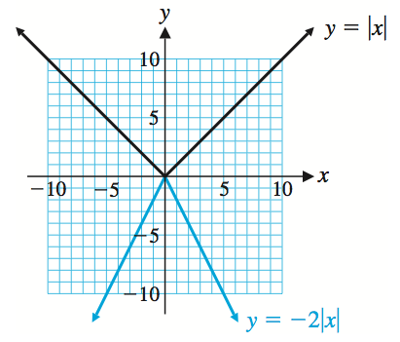
Reflection, Stretches and Shrinks
Barnett/Ziegler/Byleen College Mathematics 12e

Slide 17
Summary of
Graph Transformations
Vertical Translation: y = f (x) + k
  k > 0 Shift graph of y = f (x) up k units.
  k < 0 Shift graph of y = f (x) down |k| units.
Horizontal Translation: y = f (x + h)
  h > 0 Shift graph of y = f (x) left h units.
  h < 0 Shift graph of y = f (x) right |h| units.
Reflection: y = –f (x)
Reflect the graph of y = f (x) in the x axis.
Vertical Stretch and Shrink: y = Af (x)
  A > 1: Stretch graph of y = f (x) vertically by multiplying
  each ordinate value by A.
  0 < A < 1: Shrink graph of y = f (x) vertically by multiplying
  each ordinate value by A.
Barnett/Ziegler/Byleen College Mathematics 12e

Slide 18
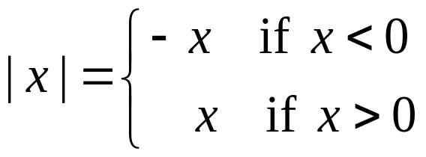
Piecewise-Defined Functions
Earlier we noted that the absolute value of a real number x can be defined as
Notice that this function is defined by different rules for different parts of its domain. Functions whose definitions involve more than one rule are called piecewise-defined functions.
Graphing one of these functions involves graphing each rule over the appropriate portion of the domain.
Barnett/Ziegler/Byleen College Mathematics 12e

Slide 19
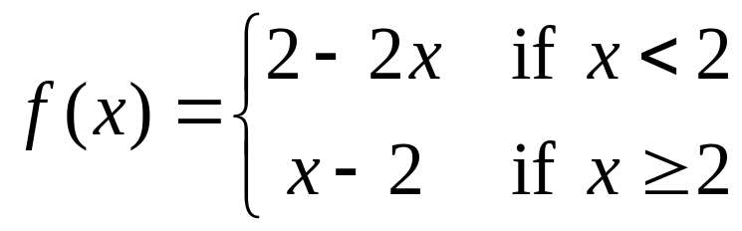
Example of a
Piecewise-Defined Function
Graph the function
Barnett/Ziegler/Byleen College Mathematics 12e

Slide 20
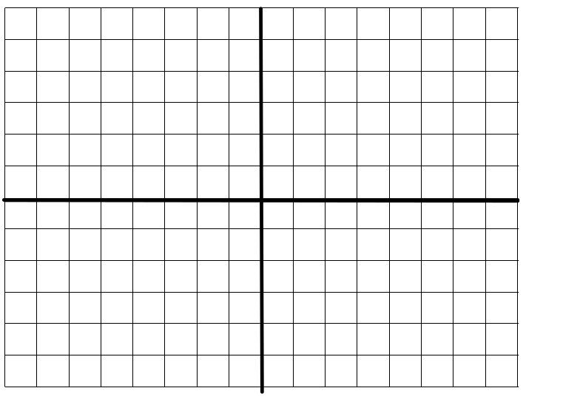
Example of a
Piecewise-Defined Function
Graph the function
Notice that the point (2,0) is included but the point (2, –2) is not.
Barnett/Ziegler/Byleen College Mathematics 12e

