Slide 1
Chapter 2
Functions and Graphs
Section 3
Quadratic Functions

Slide 2
Learning Objectives for Section 2.3
Quadratic Functions
The student will be able to identify and define quadratic functions, equations, and inequalities.
The student will be able to identify and use properties of quadratic functions and their graphs.
The student will be able to solve applications of quadratic functions.
Barnett/Ziegler/Byleen College Mathematics 12e

Slide 3
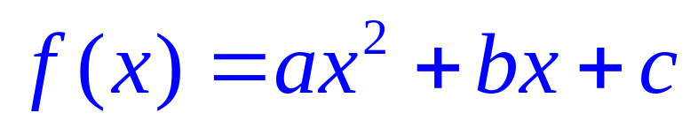
Quadratic Functions
If a, b, c are real numbers with a not equal to zero, then the function
is a quadratic function and its graph is a parabola.
Barnett/Ziegler/Byleen College Mathematics 12e

Slide 4
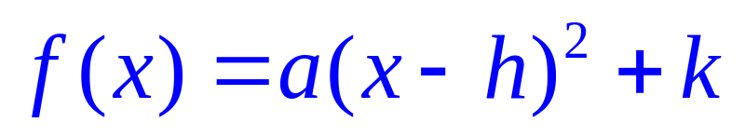
Vertex Form of the
Quadratic Function
It is convenient to convert the general form of a quadratic equation
to what is known as the vertex form:
Barnett/Ziegler/Byleen College Mathematics 12e

Slide 5

Completing the Square to Find the Vertex of a Quadratic Function
The example below illustrates the procedure:
Consider
Complete the square to find the vertex.
Barnett/Ziegler/Byleen College Mathematics 12e

Slide 6
Completing the Square to Find the Vertex of a Quadratic Function
The example below illustrates the procedure:
Consider
Complete the square to find the vertex.
Solution:
Factor the coefficient of x² out of the first two terms:
f (x) = –3(x² – 2x) –1
Barnett/Ziegler/Byleen College Mathematics 12e

Slide 7
Completing the square
(continued)
Add 1 to complete the square inside the parentheses. Because of the –3 outside the parentheses, we have actually added –3, so we must add +3 to the outside.
f (x) = –3(x² – 2x +1) –1+3
f (x) = –3(x – 1)² + 2
The vertex is (1, 2)
The quadratic function opens down since the coefficient of the x² term is –3, which is negative.
Barnett/Ziegler/Byleen College Mathematics 12e

Slide 8
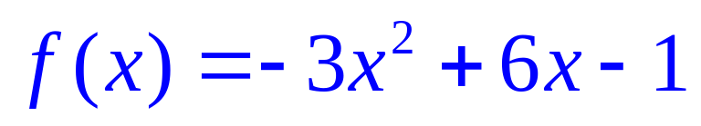
Intercepts of a Quadratic Function
Find the x and y intercepts of
Barnett/Ziegler/Byleen College Mathematics 12e

Slide 9
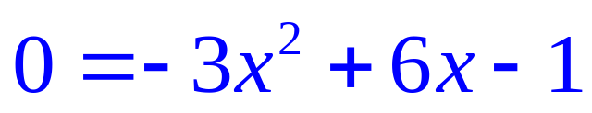
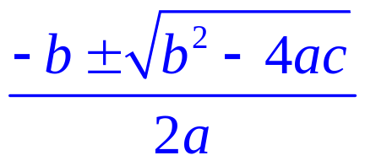
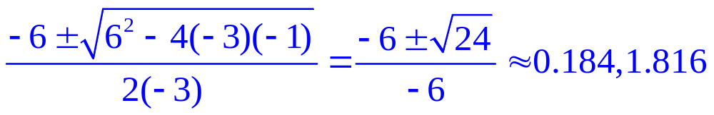
Intercepts of a Quadratic Function
Find the x and y intercepts of
x intercepts: Set f (x) = 0:
Use the quadratic formula:
x = =
Barnett/Ziegler/Byleen College Mathematics 12e

Slide 10
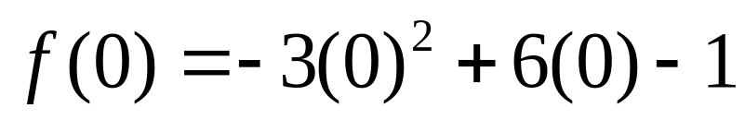
Intercepts of a Quadratic Function
y intercept: Let x = 0. If x = 0, then y = –1, so (0, –1) is the y intercept.
Barnett/Ziegler/Byleen College Mathematics 12e

Slide 11
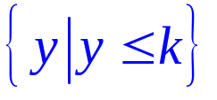
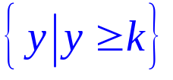
Generalization
For
If a ≠ 0, then the graph of f is a parabola.
  If a > 0, the graph opens upward.
  If a < 0, the graph opens downward. Vertex is (h , k)
Axis of symmetry: x = h
f (h) = k is the minimum if a > 0, otherwise the maximum
Domain = set of all real numbers
Range: if a < 0. If a > 0, the range is
Barnett/Ziegler/Byleen College Mathematics 12e

Slide 12
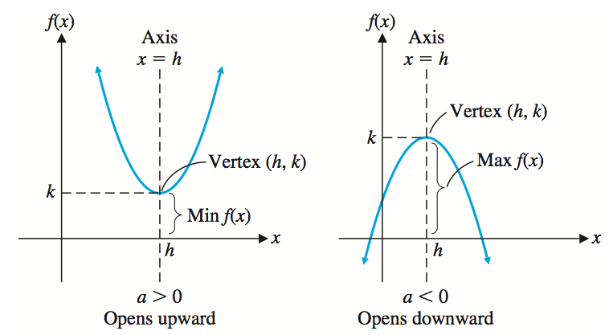
Generalization
Barnett/Ziegler/Byleen College Mathematics 12e

Slide 13
Solving Quadratic Inequalities
Solve the quadratic inequality –x² + 5x + 3 > 0 .
Barnett/Ziegler/Byleen College Mathematics 12e

Slide 14
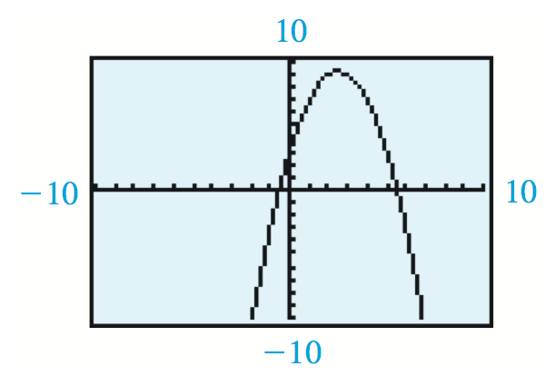
Solving Quadratic Inequalities
Solve the quadratic inequality –x² + 5x + 3 > 0 .
Answer: This inequality holds for those values of x for which the graph of f (x) is at or above the x axis. This
happens for x between the two x intercepts, including the intercepts. Thus, the solution set for the quadratic inequality is
– 0.5414 < x < 5.5414 or
[– 0.5414, 5.5414 ] .
Barnett/Ziegler/Byleen College Mathematics 12e

Slide 15
Application of Quadratic Functions
A Macon, Georgia, peach orchard farmer now has 20 trees per acre. Each tree produces, on the average, 300 peaches. For each additional tree that the farmer plants, the number of peaches per tree is reduced by 10. How many more trees should the farmer plant to achieve the maximum yield of peaches? What is the maximum yield?
Barnett/Ziegler/Byleen College Mathematics 12e

Slide 16
Solution
Solution:
Yield = (number of peaches per tree) × (number of trees)
Yield = 300 × 20 = 6000 (currently)
Plant one more tree: Yield = ( 300 – 1(10)) × ( 20 + 1) =
290 × 21 = 6090 peaches.
Plant two more trees:
Yield = ( 300 – 2(10) × ( 20 + 2) = 280 x 22 = 6160
Barnett/Ziegler/Byleen College Mathematics 12e

Slide 17

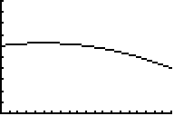
Solution
(continued)
Let x represent the number of additional trees.
Then Yield =( 300 – 10x) (20 + x)=
To find the maximum yield, note that the Y (x) function is a quadratic function opening downward. Hence, the vertex of the function will be the maximum value of the yield. Graph is below, with the y value in thousands.
Barnett/Ziegler/Byleen College Mathematics 12e

Slide 18
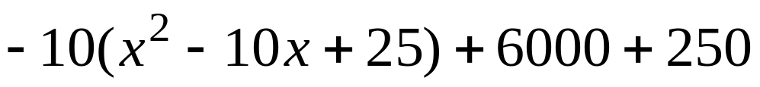
Solution
(continued)
Complete the square to find the vertex of the parabola:
Y (x) =
We have to add 250 on the outside since we multiplied –10 by 25 = –250.
Barnett/Ziegler/Byleen College Mathematics 12e

Slide 19
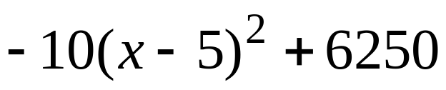
Solution
(continued)
Y (x) =
Thus, the vertex of the quadratic function is (5 , 6250) . So, the farmer should plant 5 additional trees and obtain a yield of 6250 peaches. We know this yield is the maximum of the quadratic function since the the value of a is –10. The function opens downward, so the vertex must be the maximum.
Barnett/Ziegler/Byleen College Mathematics 12e

Slide 20
Break-Even Analysis
The financial department of a company that produces digital cameras has the revenue and cost functions for x million cameras are as follows:
R(x) = x(94.8 – 5x)
C(x) = 156 + 19.7x. Both have domain 1 < x < 15
Break-even points are the production levels at which
R(x) = C(x). Find the break-even points algebraically to the nearest thousand cameras.
Barnett/Ziegler/Byleen College Mathematics 12e

Slide 21
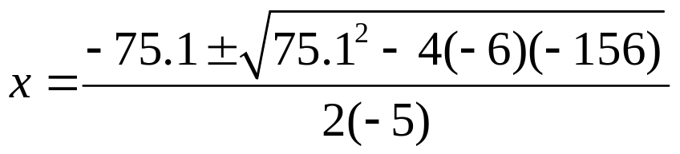
Solution to Break-Even Problem
Set R(x) equal to C(x):
x(94.8 – 5x) = 156 + 19.7x
–5x² + 75.1x – 156 = 0
x = 2.490 or 12.530
The company breaks even at
x = 2.490 and 12.530 million cameras.
Barnett/Ziegler/Byleen College Mathematics 12e

Slide 22
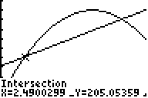
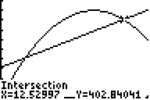
Solution to Break-Even Problem
(continued)
If we graph the cost and revenue functions on a graphing utility, we obtain the following graphs, showing the two intersection points:
Barnett/Ziegler/Byleen College Mathematics 12e

