Slide 1
Chapter 2
Functions and Graphs
Section 4
Polynomial and Rational Functions

Slide 2
Learning Objectives for Section 2.4
Polynomial and Rational Functions
The student will be able to graph and identify properties of polynomial functions.
The student will be able to calculate polynomial regression using a calculator.
The student will be able to graph and identify properties of rational functions.
The student will be able to solve applications of polynomial and rational functions.
Barnett/Ziegler/Byleen College Mathematics 12e

Slide 3
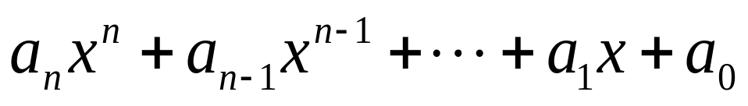
Polynomial Functions
A polynomial function is a function that can be written in the form
for n a nonnegative integer, called the degree of the polynomial. The domain of a polynomial function is the set of all real numbers.
A polynomial of degree 0 is a constant. A polynomial of degree 1 is a linear function. A polynomial of degree 2 is a quadratic function.
Barnett/Ziegler/Byleen College Mathematics 12e

Slide 4
Shapes of Polynomials
A polynomial is called odd if it only contains odd powers of x
It is called even if it only contains even powers of x
Let’s look at the shapes of some even and odd polynomials
Look for some of the following properties:
  Symmetry
  Number of x axis intercepts
  Number of local maxima/minima
  What happens as x goes to +∞ or -∞?
Barnett/Ziegler/Byleen College Mathematics 12e

Slide 5
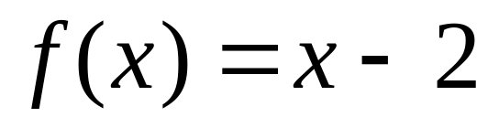
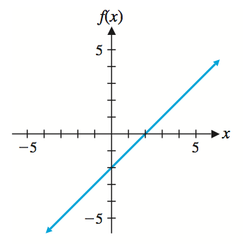
Graphs of Polynomials
Barnett/Ziegler/Byleen College Mathematics 12e

Slide 6
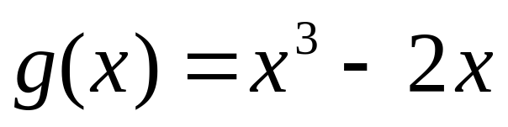
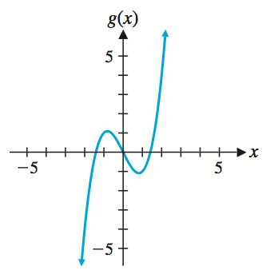
Graphs of Polynomials
Barnett/Ziegler/Byleen College Mathematics 12e

Slide 7
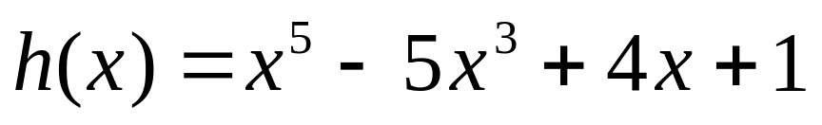
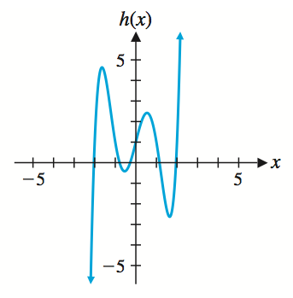
Graphs of Polynomials
Barnett/Ziegler/Byleen College Mathematics 12e

Slide 8
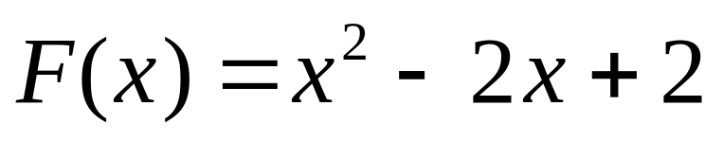
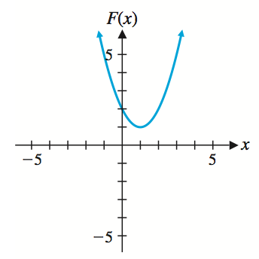
Graphs of Polynomials
Barnett/Ziegler/Byleen College Mathematics 12e

Slide 9
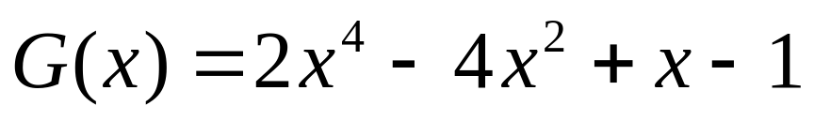
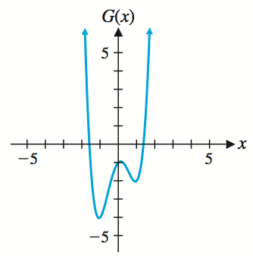
Graphs of Polynomials
Barnett/Ziegler/Byleen College Mathematics 12e

Slide 10
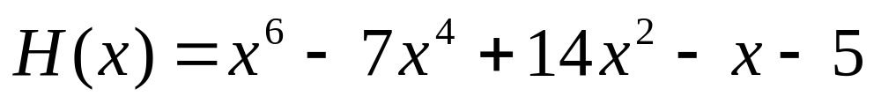
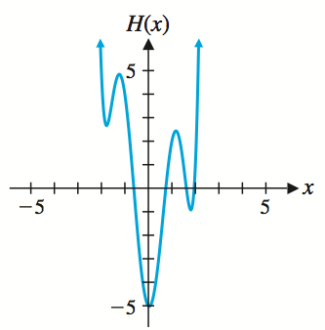
Graphs of Polynomials
Barnett/Ziegler/Byleen College Mathematics 12e

Slide 11
Observations
Odd Polynomials
For an odd polynomial,
  the graph is symmetric about the origin
  the graphs starts negative, ends positive, or vice versa, depending on whether the leading coefficient is positive or negative
  either way, a polynomial of degree n crosses the x axis at least once, at most n times.
Barnett/Ziegler/Byleen College Mathematics 12e

Slide 12
Observations
Even Polynomials
For an even polynomial,
  the graph is symmetric about the y axis
  the graphs starts negative, ends negative, or starts and ends positive, depending on whether the leading coefficient is positive or negative
  either way, a polynomial of degree n crosses the x axis at most n times. It may or may not cross at all.
Barnett/Ziegler/Byleen College Mathematics 12e

Slide 13
Characteristics of Polynomials
Graphs of polynomials are continuous. One can sketch the graph without lifting up the pencil.
Graphs of polynomials have no sharp corners.
Graphs of polynomials usually have turning points, which is a point that separates an increasing portion of the graph from a decreasing portion.
A polynomial of degree n can have at most n linear factors. Therefore, the graph of a polynomial function of positive degree n can intersect the x axis at most n times.
A polynomial of degree n may intersect the x axis fewer than n times.
Barnett/Ziegler/Byleen College Mathematics 12e

Slide 14
Quadratic Regression
A visual inspection of the plot of a data set might indicate that a parabola would be a better model of the data than a straight line. In that case, rather than using linear regression to fit a linear model to the data, we would use quadratic regression on a graphing calculator to find the function of the form y = ax² + bx + c that best fits the data.
Barnett/Ziegler/Byleen College Mathematics 12e

Slide 15
Example of Quadratic Regression
An automobile tire manufacturer collected the data in the table relating tire pressure x (in pounds per square inch) and mileage (in thousands of miles.)
x Mileage
28 45
30 52
32 55
34 51
36 47
Using quadratic regression on a graphing calculator, find the quadratic function that best fits the data.
Barnett/Ziegler/Byleen College Mathematics 12e

Slide 16
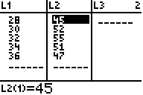
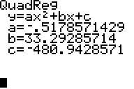
Example of Quadratic Regression
(continued)
Enter the data in a graphing calculator and obtain the lists below.
Choose quadratic regression from the statistics menu and obtain the coefficients as shown:
This means that the equation that best fits the data is: y = -0.517857x² + 33.292857x- 480.942857
Barnett/Ziegler/Byleen College Mathematics 12e

Slide 17
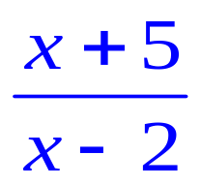
Rational Functions
A rational function f(x) is a quotient of two polynomials, n(x) and d(x), for all x such that d(x) is not equal to zero.
Example: Let n(x) = x + 5 and d(x) = x – 2, then
f(x) =
is a rational function whose domain is all real values of x with the exception of 2 (Why?)
Barnett/Ziegler/Byleen College Mathematics 12e

Slide 18
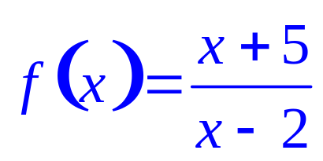
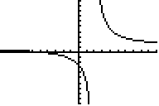
Vertical Asymptotes of
Rational Functions
x values at which the function is undefined represent vertical asymptotes to the graph of the function. A vertical asymptote is a line of the form x = k which the graph of the function approaches but does not cross. In the figure below, which is the graph of
the line x = 2 is a vertical asymptote.
Barnett/Ziegler/Byleen College Mathematics 12e

Slide 19

Horizontal Asymptotes of
Rational Functions
A horizontal asymptote of a function is a line of the form y = k which the graph of the function approaches as x approaches
For example, in the graph of
the line y = 1 is a horizontal asymptote.
Barnett/Ziegler/Byleen College Mathematics 12e

Slide 20
Generalizations about
Asymptotes of Rational Functions
Vertical Asymptotes:
Case1: Suppose n(x) and d(x) have no real zero in common. The line x = c is a vertical asymptote if d(c) = 0.
Case 2: If n(x) and d(x) have one or more real zeros in common, cancel the linear factors. Then apply Case 1.
Barnett/Ziegler/Byleen College Mathematics 12e

Slide 21
Generalizations about
Asymptotes of Rational Functions
Horizontal Asymptotes:
Case1: If degree of n(x) < degree of d(x) then y = 0 is the horizontal asymptote.
Case 2: If degree of n(x) = degree of d(x) then y = a/b is the horizontal asymptote, where a is the leading coefficient of n(x) and b is the leading coefficient of d(x).
Case 3: If degree of n(x) > degree of d(x) there is no horizontal asymptote.
Barnett/Ziegler/Byleen College Mathematics 12e

Slide 22
Bounded
A function f is bounded if the entire graph of f lies between two horizontal lines.
The only polynomials that are bounded are the constant functions, but there are many rational functions that are bounded.
Barnett/Ziegler/Byleen College Mathematics 12e

Slide 23
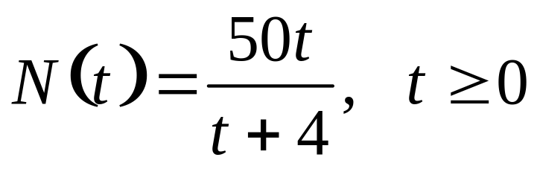
Application of Rational Functions
A company that manufactures computers has established that, on the average, a new employee can assemble N(t) components per day after t days of on-the-job training, as given by
Sketch a graph of N, 0 ≤ t ≤ 100, including any vertical or horizontal asymptotes. What does N(t) approach as t increases without bound?
Barnett/Ziegler/Byleen College Mathematics 12e

Slide 24
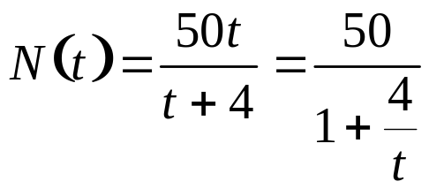
Application of Rational Functions
Vertical asymptote: None for t ≥ 0.
Horizontal asymptote:
N(t) approaches 50 (the leading coefficient of 50t divided by the leading coefficient of (t + 4) as t increases without bound. So y = 50 is a horizontal asymptote.
Barnett/Ziegler/Byleen College Mathematics 12e

Slide 25
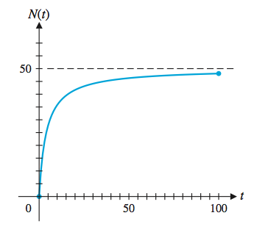
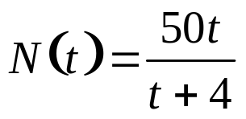
Application of Rational Functions
N(t) approaches 50 as t increases without bound. It appears that 50 components per day would be the upper limit that an employee would be expected to assemble.
Barnett/Ziegler/Byleen College Mathematics 12e

