Slide 1
Chapter 2
Functions and Graphs
Section 5
Exponential Functions

Slide 2
Objectives for Section 2.5
Exponential Functions
The student will be able to graph and identify the properties of exponential functions.
The student will be able to graph and identify the properties of base e exponential functions.
The student will be able to apply base e exponential functions, including growth and decay applications.
The student will be able to solve compound interest problems.
Barnett/Ziegler/Byleen College Mathematics 12e

Slide 3
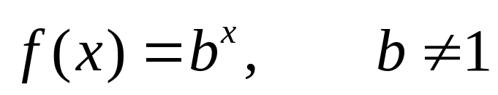
Exponential Function
The equation
defines an exponential function for each different constant b, called the base. The domain of f is the set of all real numbers, while the range of f is the set of all positive real numbers.
Barnett/Ziegler/Byleen College Mathematics 12e

Slide 4
Riddle
Here is a problem related to exponential functions:
Suppose you received a penny on the first day of December, two pennies on the second day of December, four pennies on the third day, eight pennies on the fourth day and so on. How many pennies would you receive on December 31 if this pattern continues?
Would you rather take this amount of money or receive a lump sum payment of $10,000,000?
Barnett/Ziegler/Byleen College Mathematics 12e

Slide 5
Solution
Complete the table:
Day | No. pennies
1 | 1
2 | 2 | 2^1
3 | 4 | 2^2
4 | 8 | 2^3
5 | 16 | ...
6 | 32
7 | 64
Barnett/Ziegler/Byleen College Mathematics 12e

Slide 6
Solution
(continued)
Now, if this pattern continued, how many pennies would you have on Dec. 31?
Your answer should be 2³⁰ (two raised to the thirtieth power). The exponent on two is one less than the day of the month. See the preceding slide.
What is 2³⁰?
1,073,741,824 pennies!!! Move the decimal point two places to the left to find the amount in dollars. You should get: $10,737,418.24
Barnett/Ziegler/Byleen College Mathematics 12e

Slide 7
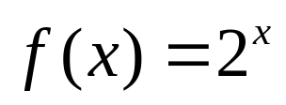
Solution
(continued)
The obvious answer to the question is to take the number of pennies on December 31 and not a lump sum payment of $10,000,000
(although I would not mind having either amount!)
This example shows how an exponential function grows extremely rapidly. In this case, the exponential function
is used to model this problem.
Barnett/Ziegler/Byleen College Mathematics 12e

Slide 8
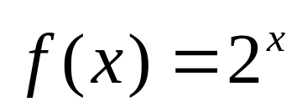

Graph of
Use a table to graph the exponential function above. Note: x is a real number and can be replaced with numbers such as as well as other irrational numbers. We will use integer values for x in the table:
Barnett/Ziegler/Byleen College Mathematics 12e

Slide 9
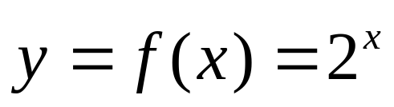
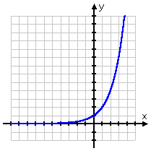
Table of values
x | y
–4 | 2^{–4} = 1/2⁴ = 1/16
–3 | 2^{–3} = 1/8
–2 | 2^{–2} = 1/4
–1 | 2^{–1} = 1/2
0 | 2⁰ = 1
1 | 2¹ = 2
2 | 2² = 4
Barnett/Ziegler/Byleen College Mathematics 12e

Slide 10
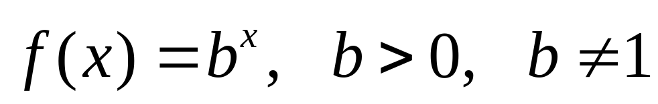
Basic Properties of the Graph of
All graphs will pass through (0,1) (y intercept)
All graphs are continuous curves, with no holes of jumps.
The x axis is a horizontal asymptote.
If b > 1, then b^{x} increases as x increases.
If 0 < b < 1, then b^{x} decreases as x increases.
Barnett/Ziegler/Byleen College Mathematics 12e

Slide 11
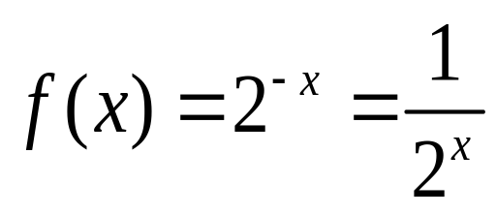

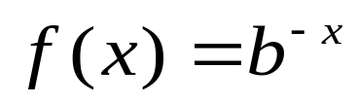
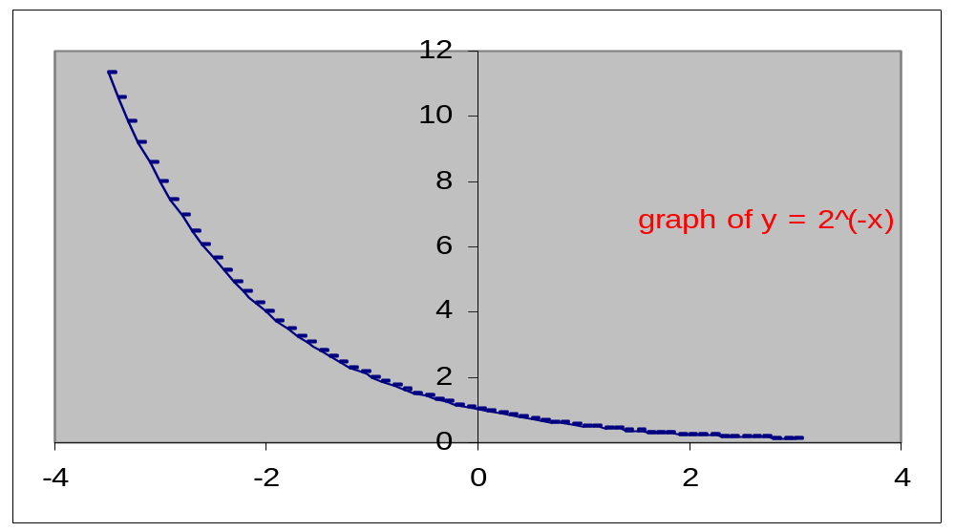
Graph of
Using a table of values, you will obtain the following graph. The graphs of and will be reflections of each other about the y-axis, in general.
Barnett/Ziegler/Byleen College Mathematics 12e

Slide 12
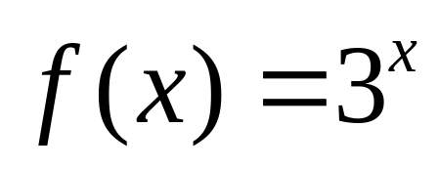
Graphing Other
Exponential Functions
Now, let’s graph
Proceeding as before, we construct a table of values and plot a few points. Be careful not to assume that the graph crosses the negative x-axis. Remember, it gets close to the x-axis, but never intersects it.
Barnett/Ziegler/Byleen College Mathematics 12e

Slide 13
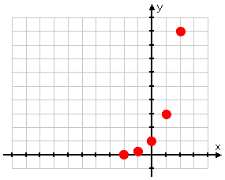
Preliminary Graph of
Barnett/Ziegler/Byleen College Mathematics 12e

Slide 14
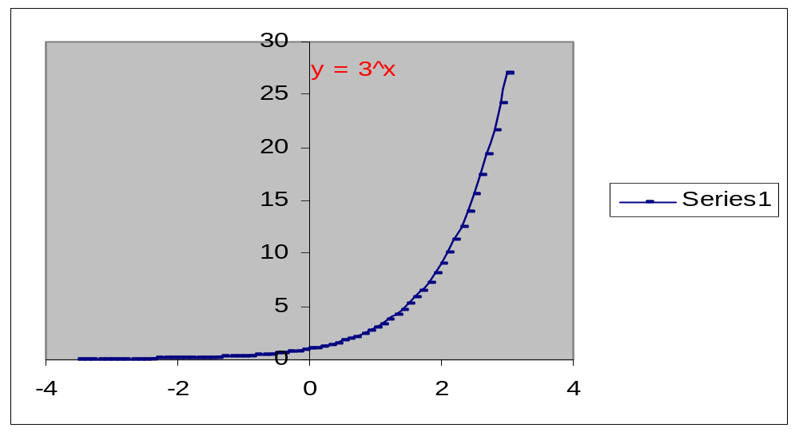
Complete Graph
Barnett/Ziegler/Byleen College Mathematics 12e

Slide 15
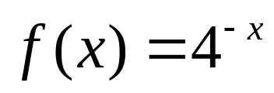
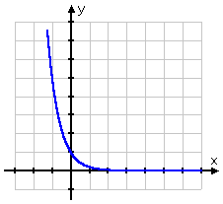
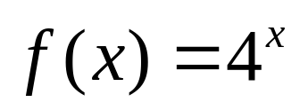
Other Exponential Graphs
This is the graph of
It is a reflection of the graph of
about the y axis
It is always decreasing.
It passes through (0,1).
Barnett/Ziegler/Byleen College Mathematics 12e

Slide 16
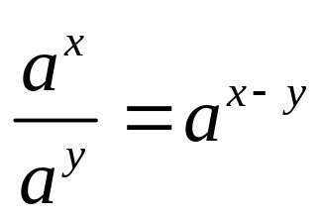
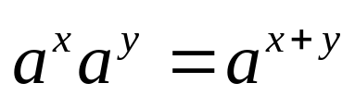
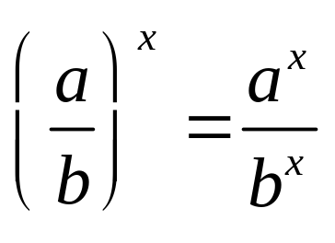
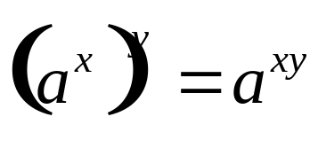
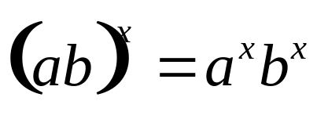
Properties of Exponential Functions
For a and b positive, a ≠ 1, b ≠ 1, and x and y real,
1. Exponent laws:
2. a^{x} = a^{y} if and only if x = y
3. For x ≠ 0, a^{x} = b^{x} if and only if a = b.
Barnett/Ziegler/Byleen College Mathematics 12e

Slide 17
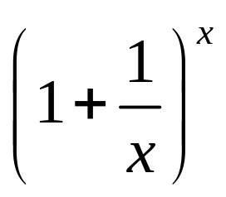
Base e Exponential Functions
Of all the possible bases b we can use for the exponential function y = b^{x}, probably the most useful one is the exponential function with base e.
The base e is an irrational number, and, like π, cannot be represented exactly by any finite decimal fraction.
However, e can be approximated as closely as we like by evaluating the expression
Barnett/Ziegler/Byleen College Mathematics 12e

Slide 18
Exponential Function With Base e
x
1 | 2
10 | 2.59374246
100 | 2.704813829
1000 | 2.716923932
10000 | 2.718145927
1000000 | 2.718280469
The table to the left illustrates what happens to the expression
as x gets increasingly larger. As we can see from the table, the values approach a number whose approximation is 2.718
Barnett/Ziegler/Byleen College Mathematics 12e

Slide 19
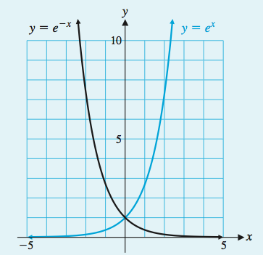
Exponential Function With Base e
y = e^{x} and y = e^{–x}
Domain: (–∞, ∞)
Range: (0, ∞)
Barnett/Ziegler/Byleen College Mathematics 12e

Slide 20
Relative Growth Rates
Functions of the form y = ce^{kt}, where c and k are constants and the independent variable t represents time, are often used to model population growth and radioactive decay.
Note that if t = 0, then y = c. So, the constant c represents the initial population (or initial amount.)
The constant k is called the relative growth rate. If the relative growth rate is k = 0.02, then at any time t, the population is growing at a rate of 0.02y persons (2% of the population) per year.
We say that population is growing continuously at relative growth rate k to mean that the population y is given by the model y = ce^{kt}.
Barnett/Ziegler/Byleen College Mathematics 12e

Slide 21
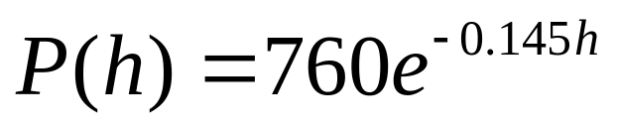
Growth and Decay Applications:
Atmospheric Pressure
The atmospheric pressure p decreases with increasing height. The pressure is related to the number of kilometers h above the sea level by the formula:
  Find the pressure at sea level (h = 0)
  Find the pressure at a height of 7 kilometers.
Barnett/Ziegler/Byleen College Mathematics 12e

Slide 22
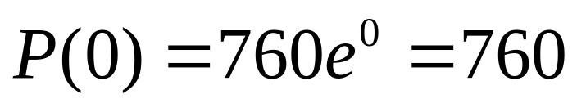
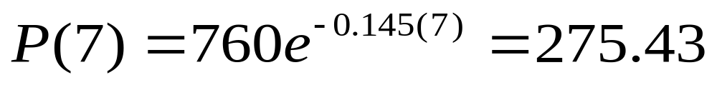
Solution
  Find the pressure at sea level (h = 0)
  Find the pressure at a height of 7 kilometers
Barnett/Ziegler/Byleen College Mathematics 12e

Slide 23
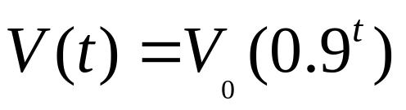
Depreciation of a Machine
A machine is initially worth V₀ dollars but loses 10% of its value each year. Its value after t years is given by the formula
Find the value after 8 years of a machine whose initial value is $30,000.
Barnett/Ziegler/Byleen College Mathematics 12e

Slide 24
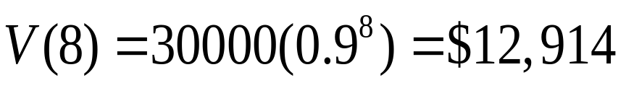
Depreciation of a Machine
A machine is initially worth V₀ dollars but loses 10% of its value each year. Its value after t years is given by the formula
Find the value after 8 years of a machine whose initial value is $30,000.
Solution:
Barnett/Ziegler/Byleen College Mathematics 12e

Slide 25
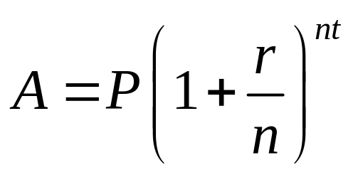
Compound Interest
The compound interest formula is
Here, A is the future value of the investment, P is the initial amount (principal or future value), r is the annual interest rate as a decimal, n represents the number of compounding periods per year, and t is the number of years
Barnett/Ziegler/Byleen College Mathematics 12e

Slide 26
Compound Interest Problem
Find the amount to which $1500 will grow if deposited in a bank at 5.75% interest compounded quarterly for 5 years.
Barnett/Ziegler/Byleen College Mathematics 12e

Slide 27
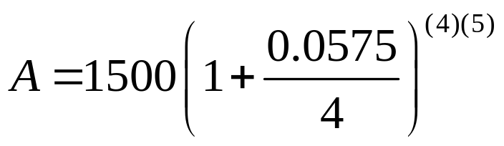
Compound Interest Problem
Find the amount to which $1500 will grow if deposited in a bank at 5.75% interest compounded quarterly for 5 years.
Solution: Use the compound interest formula:
Substitute P = 1500, r = 0.0575, n = 4 and t = 5 to obtain
=$1995.55
Barnett/Ziegler/Byleen College Mathematics 12e

