Slide 1
Chapter 2
Functions and Graphs
Section 6
Logarithmic Functions

Slide 2
Learning Objectives for Section 2.6
Logarithmic Functions
The student will be able to use and apply inverse functions.
The student will be able to use and apply logarithmic functions and properties of logarithmic functions.
The student will be able to evaluate logarithms.
The student will be able to solve applications involving logarithms.
Barnett/Ziegler/Byleen Finite Mathematics 12e

Slide 3
Logarithmic Functions
In this section, another type of function will be studied called the logarithmic function. There is a close connection between a logarithmic function and an exponential function. We will see that the logarithmic function and exponential functions are inverse functions. We will study the concept of inverse functions as a prerequisite for our study of logarithmic function.
Barnett/Ziegler/Byleen Finite Mathematics 12e

Slide 4
One to One Functions
We wish to define an inverse of a function. Before we do so, it is necessary to discuss the topic of one to one functions.
First of all, only certain functions are one to one.
Definition: A function f is said to be one-to-one if each range value corresponds to exactly one domain value.
Barnett/Ziegler/Byleen Finite Mathematics 12e

Slide 5
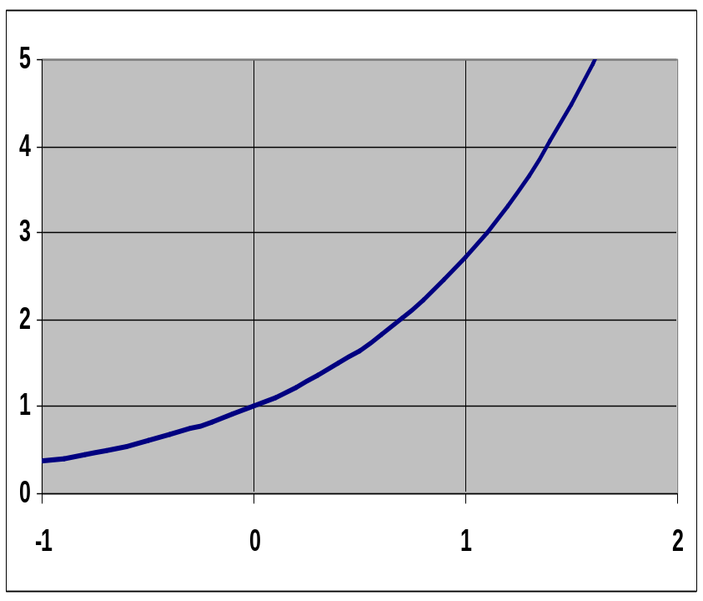
Graph of One to One Function
This is the graph of a one-to-one function. Notice that if we choose two different x values, the corresponding y values are different. Here, we see that if
x = 0, then y = 1, and if x = 1, then y is about 2.8.
Now, choose any other pair of x values. Do you see that the corresponding y values will always be different?
Barnett/Ziegler/Byleen Finite Mathematics 12e

Slide 6
Horizontal Line Test
Recall that for an equation to be a function, its graph must pass the vertical line test. That is, a vertical line that sweeps across the graph of a function from left to right will intersect the graph only once at each x value.
There is a similar geometric test to determine if a function is one to one. It is called the horizontal line test. Any horizontal line drawn through the graph of a one to one function will cross the graph only once. If a horizontal line crosses a graph more than once, then the function that is graphed is not one to one.
Barnett/Ziegler/Byleen Finite Mathematics 12e

Slide 7
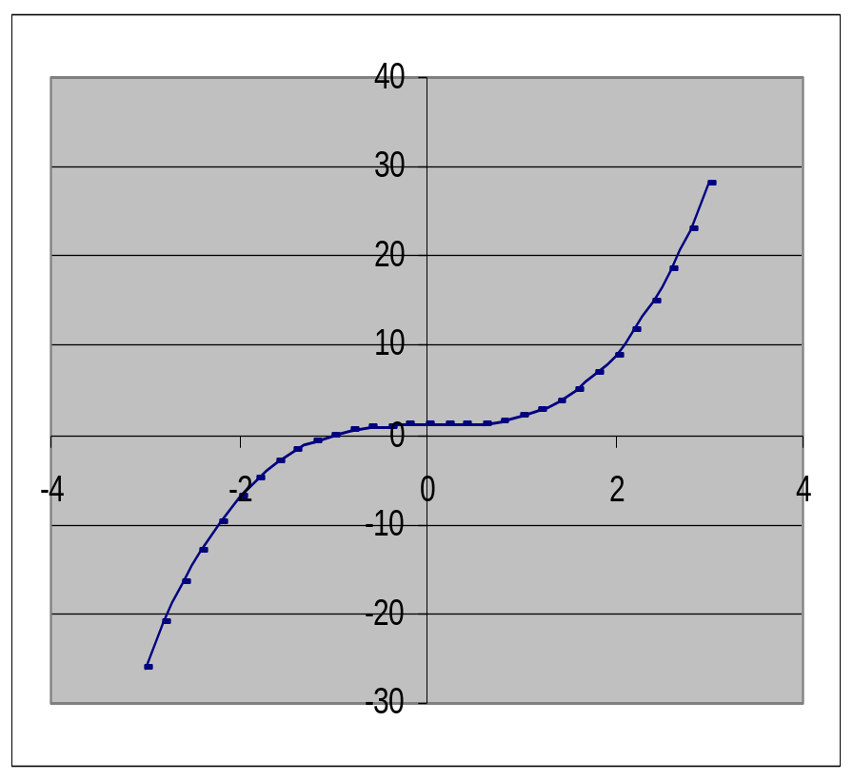
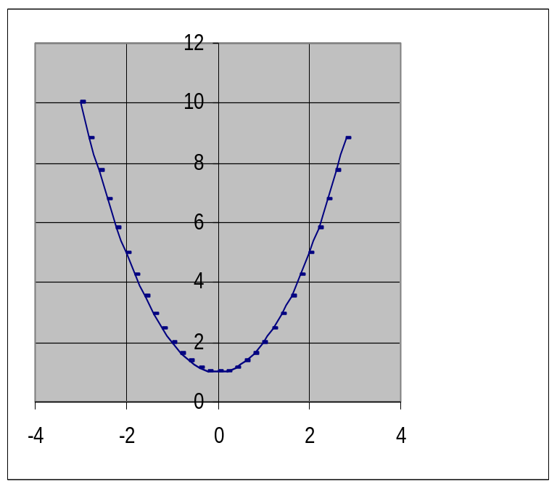
Which Functions Are One to One?
Barnett/Ziegler/Byleen Finite Mathematics 12e

Slide 8
Definition of Inverse Function
If f is a one-to-one function, then the inverse of f is the function formed by interchanging the independent and dependent variable for f. Thus, if (a, b) is a point on the graph of f, then (b, a) is a point on the graph of the inverse of f.
Note: If a function is not one-to-one (fails the horizontal line test) then f does not have an inverse.
Barnett/Ziegler/Byleen Finite Mathematics 12e

Slide 9
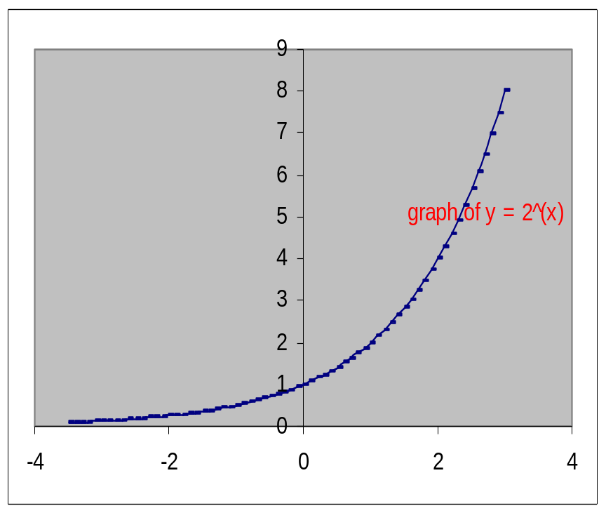
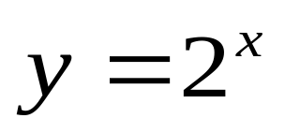
Logarithmic Functions
The logarithmic function with base two is defined to be the inverse of the one to one exponential function
Notice that the exponential
function
is one to one and therefore has
an inverse.
Barnett/Ziegler/Byleen Finite Mathematics 12e

Slide 10
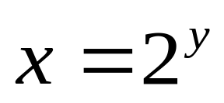
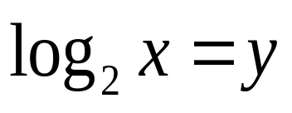
Inverse of an Exponential Function
Start with
Now, interchange x and y coordinates:
There are no algebraic techniques that can be used to solve for y, so we simply call this function y the logarithmic function
with base 2. The definition of this new function is:
if and only if
Barnett/Ziegler/Byleen Finite Mathematics 12e

Slide 11
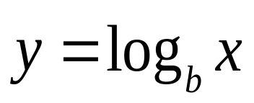
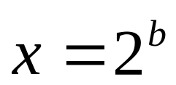
Logarithmic Function
The inverse of an exponential function is called a logarithmic function. For b > 0 and b ≠ 1,
is equivalent to
The log to the base b of x is the exponent to which b must be raised to obtain x. The domain of the logarithmic function is the set of all positive real numbers and the range of the logarithmic function is the set of all real numbers.
Barnett/Ziegler/Byleen Finite Mathematics 12e

Slide 12
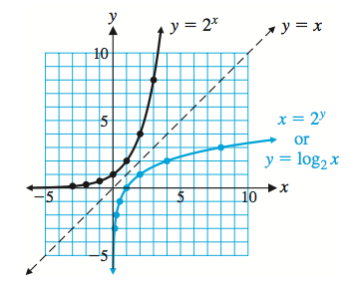
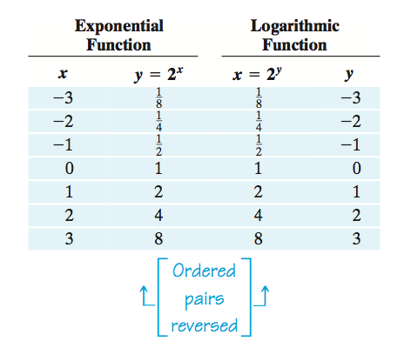
Logarithmic Function
Barnett/Ziegler/Byleen Finite Mathematics 12e

Slide 13
Graph, Domain, Range of Logarithmic Functions
The domain of the logarithmic function y = log₂x is the same as the range of the exponential function y = 2^{x}. Why?
The range of the logarithmic function is the same as the domain of the exponential function (Again, why?)
Another fact: If one graphs any one to one function and its inverse on the same grid, the two graphs will always be symmetric with respect to the line y = x.
Barnett/Ziegler/Byleen Finite Mathematics 12e

Slide 14
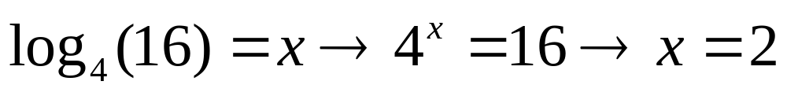
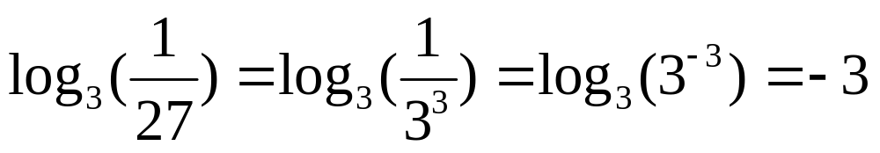
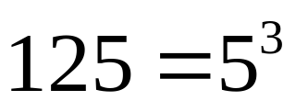
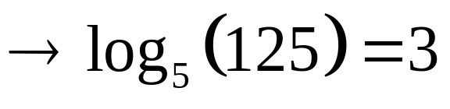
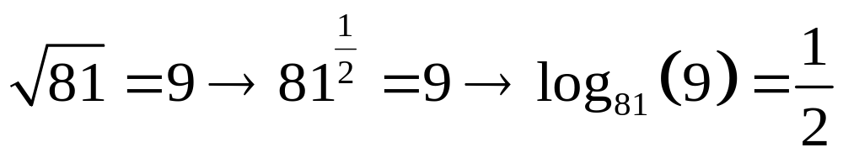
Logarithmic-Exponential Conversions
Study the examples below. You should be able to convert a logarithmic into an exponential expression and vice versa.
1.
2.
3.
4.
Barnett/Ziegler/Byleen Finite Mathematics 12e

Slide 15
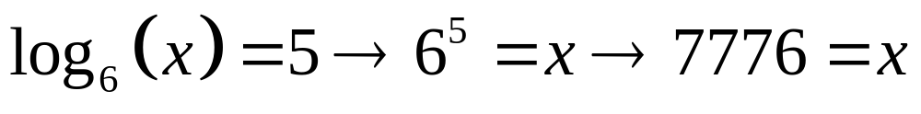
Solving Equations
Using the definition of a logarithm, you can solve equations involving logarithms. Examples:
In each of the above, we converted from log form to exponential form and solved the resulting equation.
Barnett/Ziegler/Byleen Finite Mathematics 12e

Slide 16
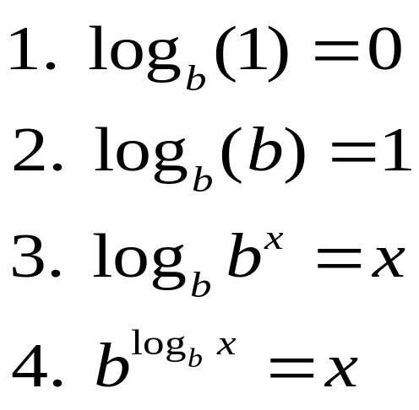
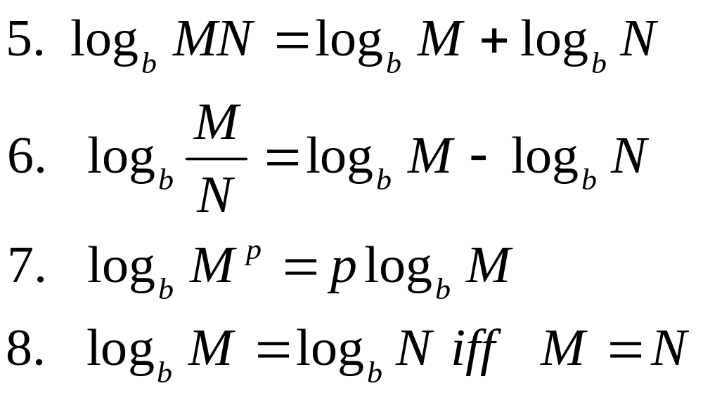
Properties of Logarithms
If b, M, and N are positive real numbers, b ≠ 1, and p and x are real numbers, then
Barnett/Ziegler/Byleen Finite Mathematics 12e

Slide 17
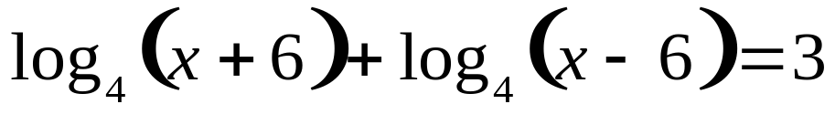
Solving Logarithmic Equations
Solve for x:
Barnett/Ziegler/Byleen Finite Mathematics 12e

Slide 18
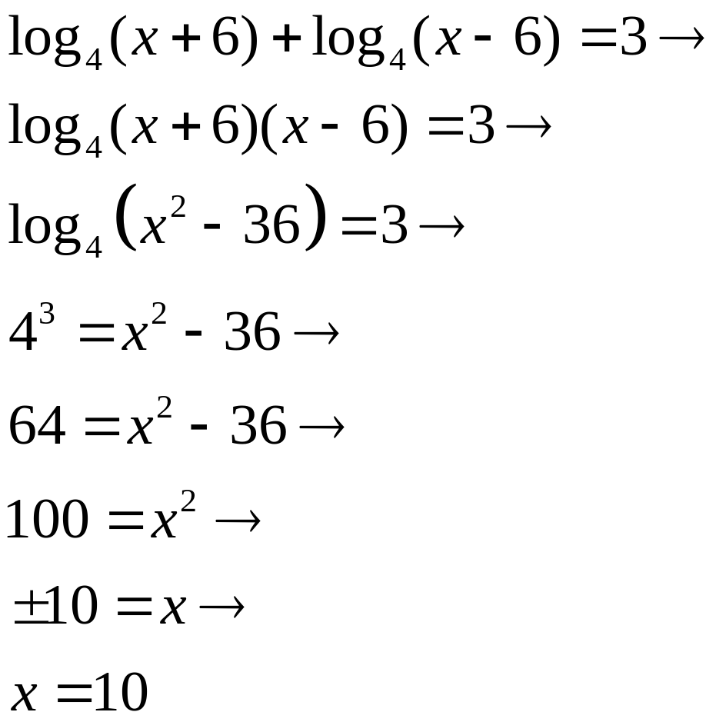
Solving Logarithmic Equations
Solve for x:
Product rule
Special product
Definition of log
x can be +10 only
Why?
Barnett/Ziegler/Byleen Finite Mathematics 12e

Slide 19
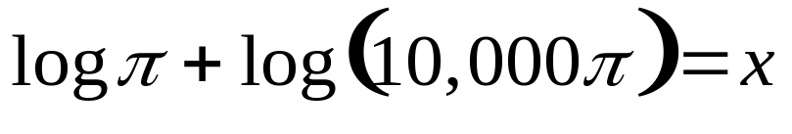
Another Example
Solve:
Barnett/Ziegler/Byleen Finite Mathematics 12e

Slide 20
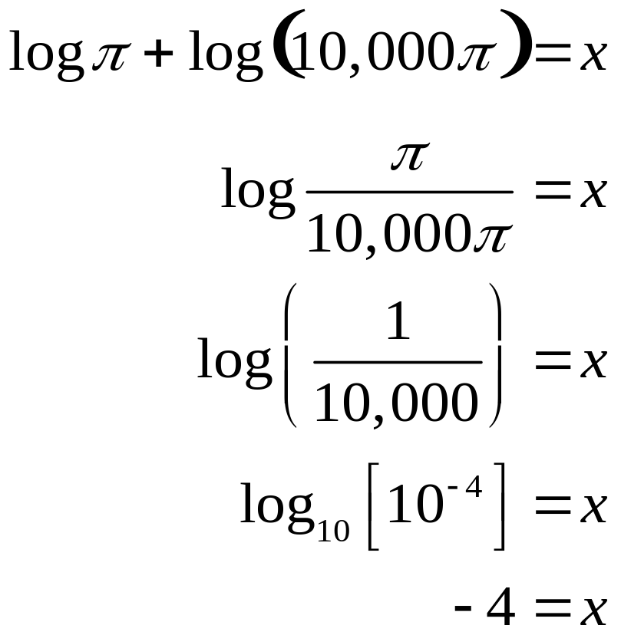
Another Example
Solve:
Quotient rule
Simplify
(divide out common factor π)
Rewrite
Property of logarithms
Barnett/Ziegler/Byleen Finite Mathematics 12e

Slide 21
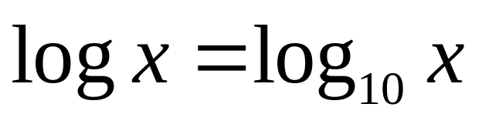
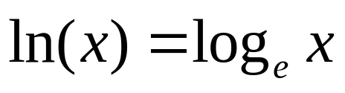

Common Logs and Natural Logs
Common log
Natural log
If no base is indicated, the logarithm is assumed to be base 10.
Barnett/Ziegler/Byleen Finite Mathematics 12e

Slide 22
Solving a Logarithmic Equation
Solve for x. Obtain the exact solution of this equation in terms of e (2.71828…)
ln (x + 1) – ln x = 1
Barnett/Ziegler/Byleen Finite Mathematics 12e

Slide 23
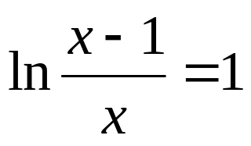
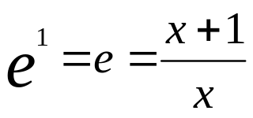
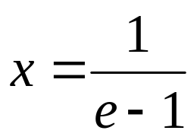
Solving a Logarithmic Equation
Solve for x. Obtain the exact solution of this equation in terms of e (2.71828…)
Quotient property of logs
Definition of (natural log)
Multiply both sides by x
Collect x terms on left side
Factor out common factor
Solve for x
ln (x + 1) – ln x = 1
e^{x} = x + 1
e^{x} - x = 1
x(e - 1) = 1
Barnett/Ziegler/Byleen Finite Mathematics 12e

Slide 24
Application
How long will it take money to double if compounded monthly at 4% interest?
Barnett/Ziegler/Byleen Finite Mathematics 12e

Slide 25
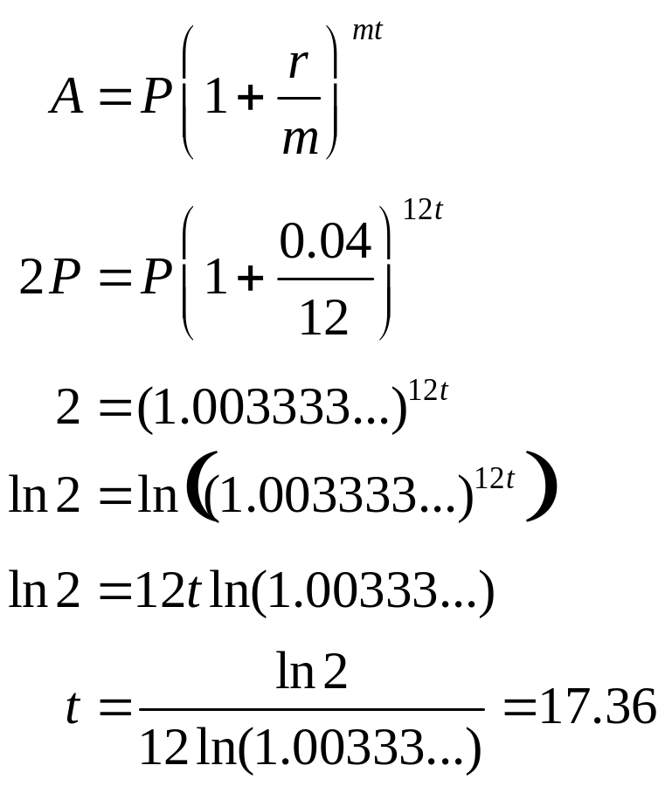
Application
How long will it take money to double if compounded monthly at 4% interest?
Compound interest formula
Replace A by 2P (double the amount)
Substitute values for r and m
Divide both sides by P
Take ln of both sides
Property of logarithms
Solve for t and evaluate expression
Barnett/Ziegler/Byleen Finite Mathematics 12e

Slide 26
Logarithmic Regression
Among increasing functions, the logarithmic functions with bases b > 1 increase much more slowly for large values of x than either exponential or polynomial functions. When a visual inspection of the plot of a data set indicates a slowly increasing function, a logarithmic function often provides a good model. We use logarithmic regression on a graphing calculator to find the function of the form y = a + b*ln(x) that best fits the data.
Barnett/Ziegler/Byleen Finite Mathematics 12e

Slide 27
Example of Logarithmic Regression
A cordless screwdriver is sold through a national chain of discount stores. A marketing company established the following price-demand table, where x is the number of screwdrivers people are willing to buy each month at a price of p dollars per screwdriver.
x p = D(x)
1,000 91
2,000 73
3,000 64
4,000 56
5,000 53
Barnett/Ziegler/Byleen Finite Mathematics 12e

Slide 28
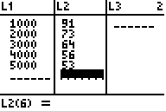
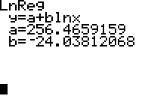
Example of Logarithmic Regression
To find the logarithmic regression equation, enter the data into lists on your calculator, as shown below.
Then choose LnReg from the statistics menu. This means that the regression equation is y = 256.4659 - 24.038 ln x
Barnett/Ziegler/Byleen Finite Mathematics 12e

