Slide 1
Chapter 2
Functions and Graphs
Section R
Review

Slide 2
Chapter 2 Review
Important Terms, Symbols, Concepts
2.1 Functions
  Point-by-point plotting may be used to sketch the graph of an equation in two variables: plot enough points from its solution set in a rectangular coordinate system so that the total graph is apparent and then connect these points with a smooth curve.
  A function is a correspondence between two sets of elements such that to each element in the first set there corresponds one and only one element in the second set. The first set is called the domain and the second set is called the range.
Barnett/Ziegler/Byleen Finite Mathematics 12e

Slide 3
Chapter 2 Review
2.1 Functions (continued)
  If x represents the elements in the domain of a function, then x is the independent variable or input. If y represents the elements in the range, then y is the dependent variable or output.
  If in an equation in two variables we get exactly one output for each input, then the equation specifies a function. The graph of such a function is just the graph of the equation. If we get more than one output for a given input, then the equation does not specify a function.
Barnett/Ziegler/Byleen Finite Mathematics 12e

Slide 4
Chapter 2 Review
2.1 Functions (continued)
  The vertical line test can be used to determine whether or not an equation in two variables specifies a function.
  The functions specified by equations of the form
  y = mx + b, where m is not equal to 0, are called linear functions. Functions specified by equations of the form
  y = b are called constant functions.
Barnett/Ziegler/Byleen Finite Mathematics 12e

Slide 5
Chapter 2 Review
2.1 Functions (continued)
  If a function is specified by an equation and the domain is not indicated, we agree to assume that the domain is the set of all inputs that produce outputs that are real numbers.
  The symbol f (x) represents the element in the range of f that corresponds to the element x of the domain.
  Break-even and profit-loss analysis uses a cost function C and a revenue function R to determine when a company will have a loss (R < C), break even (R = C) or a profit (R > C).
Barnett/Ziegler/Byleen Finite Mathematics 12e

Slide 6
Chapter 2 Review
2.2 Elementary Functions: Graphs and Transformations
  The six basic elementary functions are the identity function, the square and cube functions, the square root and cube root functions and the absolute value function.
  Performing an operation on a function produces a transformation of the graph of the function. The basic graph transformations are: vertical and horizontal translations (shifts), reflection in the x-axis, and vertical stretches and shrinks.
  A piecewise-defined function is a function whose definition involves more than one formula.
Barnett/Ziegler/Byleen Finite Mathematics 12e

Slide 7
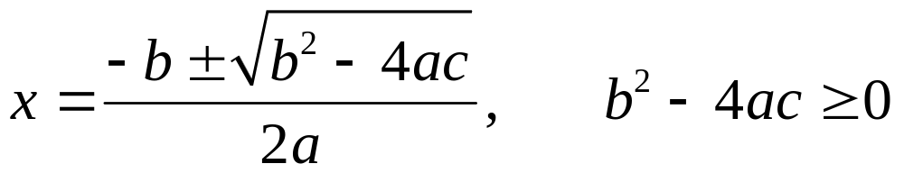
Chapter 2 Review
2.3 Quadratic Functions
  If a, b, and c are real numbers with a not equal to 0, then the function f (x) = ax² + bx + c is a quadratic function in standard form, and its graph is a parabola.
  The quadratic formula
  can be used to find the x intercepts.
  Completing the square in the standard form of a quadratic functions produces the vertex form f (x) = a(x – h)² + k
Barnett/Ziegler/Byleen Finite Mathematics 12e

Slide 8
Chapter 2 Review
2.3 Quadratic Functions (continued)
  From the vertex form of a quadratic function, we can read off the vertex, axis of symmetry, maximum or minimum, and range, and sketch the graph.
  If a revenue function R(x) and a cost function C(x) intersect at a point (x₀, y₀), then both this point and its coordinate x₀ are referred to as break-even points.
  Quadratic regression on a graphing calculator produces the function of the form y = ax² + bx + c that best fits a data set.
Barnett/Ziegler/Byleen Finite Mathematics 12e

Slide 9
Chapter 2 Review
2.4 Polynomial and Rational Functions
  A polynomial function is a function that can be written in the form
  f (x) = a_{n} x^{n} + a_{n–1} x^{n–1} + … + a₁ x + a₀
  n is the degree, a_{n} ≠ 0 is the leading coefficient. The domain is the set of all real numbers.
  The graph of a polynomial function of degree n can intersect the x axis at most n times. An x intercept is also called a zero or root.
Barnett/Ziegler/Byleen Finite Mathematics 12e

Slide 10
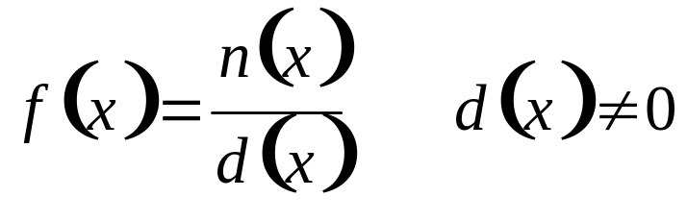
Chapter 2 Review
2.4 Polynomial and Rational Functions
  The graph of a polynomial function has no sharp corners and is continuous, that is, it has no holes or breaks.
  Polynomial regression produces a polynomial of specified degree that best fits a data set.
  A rational function is any function that can be written in the form
Barnett/Ziegler/Byleen Finite Mathematics 12e

Slide 11
Chapter 2 Review
2.4 Polynomial and Rational Functions
  A rational function is any function that can be written in the form
  where n(x) and are polynomials. The domain is the set of all real numbers such that d(x) ≠ 0.
  A rational function can have vertical asymptotes [but not more than the degree of the denominator d(x)] and at most one horizontal asymptote.
Barnett/Ziegler/Byleen Finite Mathematics 12e

Slide 12
Chapter 2 Review
2.5 Exponential Functions
  An exponential function is a function of the form
  f (x) = b^{x}, where b ≠ 1 is a positive constant called the base. The domain of f is the set of all real numbers and the range is the set of positive real numbers.
  The graph of an exponential function is continuous, passes through (0,1), and has the x axis as a horizontal asymptote.
  Exponential functions obey the familiar laws of exponents and satisfy additional properties.
Barnett/Ziegler/Byleen Finite Mathematics 12e

Slide 13
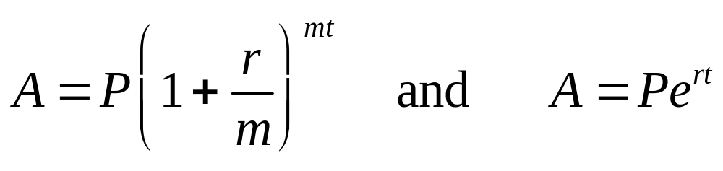
Chapter 2 Review
2.5 Exponential Functions (continued)
  The base that is used most frequently in mathematics is the irrational number e ≈ 2.7183.
  Exponential functions can be used to model population growth and radioactive decay.
  Exponential regression on a graphing calculator produces the function of the form y = ab^{x} that best fits a data set.
  Exponential functions are used in computations of compound interest:
Barnett/Ziegler/Byleen Finite Mathematics 12e

Slide 14
Chapter 2 Review
2.6 Logarithmic Functions
  A function is said to be one-to-one if each range value corresponds to exactly one domain value.
  The inverse of a one to one function f is the function formed by interchanging the independent and dependent variables of f. That is, (a,b) is a point on the graph of f if and only if (b,a) is a point on the graph of the inverse of f. A function that is not one to one does not have an inverse.
Barnett/Ziegler/Byleen Finite Mathematics 12e

Slide 15
Chapter 2 Review
2.6 Logarithmic Functions (continued)
  The inverse of the exponential function with base b is called the logarithmic function with base b, denoted
  y = log_{b} x. The domain of log_{b} x is the set of all positive real numbers and the range of is the set of all real numbers.
  Because y = log_{b} x is the inverse of the function y = b^{x},
  y = log_{b} x is equivalent to x = b^{y}.
  Properties of logarithmic functions can be obtained from corresponding properties of exponential functions.
Barnett/Ziegler/Byleen Finite Mathematics 12e

Slide 16
Chapter 2 Review
2.6 Logarithmic Functions (continued)
  Logarithms to base 10 are called common logarithms, denoted by log x. Logarithms to base e are called natural logarithms, denoted by ln x.
  Logarithms can be used to find an investment’s doubling time - the length of time it takes for the value of an investment to double.
  Logarithmic regression on a graphing calculator produces the function of the form y = a + b ln x that best fits a data set.
Barnett/Ziegler/Byleen Finite Mathematics 12e

