Slide 1
Chapter 4
Systems of Linear Equations; Matrices
Section 2
Systems of Linear Equations and Augmented Matrics

Slide 2
Learning Objectives for Section 4.2
Systems of Linear Equations and Augmented Matrices
The student will be able to use terms associated with matrices.
The student will be able to set up and solve the augmented matrix associated with a linear system in two variables.
The student will be able to identify the three possible matrix solution types for a linear system in two variables.
Barnett/Ziegler/Byleen College Mathematics 12e

Slide 3

Matrices
It is impractical to solve more complicated linear systems by hand. Computers and calculators now have built in routines to solve larger and more complex systems. Matrices, in conjunction with graphing utilities and or computers are used for solving more complex systems. In this section, we will develop certain matrix methods for solving two by two systems.
Barnett/Ziegler/Byleen College Mathematics 12e

Slide 4
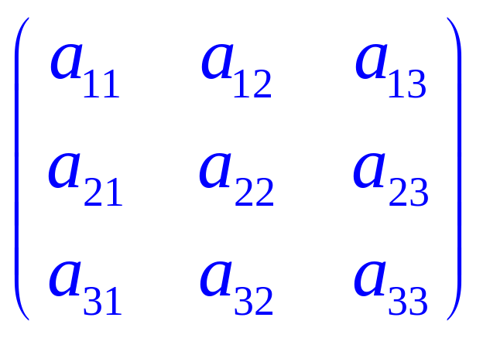
Matrices
A matrix is a rectangular array of numbers written within brackets. Here is an example of a matrix which has three rows and three columns: The subscripts give the “address” of each entry of the matrix. For example the entry a₂₃ is found in the second row and third column
Since this matrix has 3 rows and 3 columns, the dimensions of the matrix are 3 x 3.
Each number in the matrix is called an element.
Barnett/Ziegler/Byleen College Mathematics 12e

Slide 5
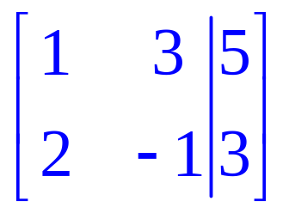
Matrix Solution of Linear Systems
When solving systems of linear equations, we can represent a linear system of equations by an augmented matrix, a matrix which stores the coefficients and constants of the linear system and then manipulate the augmented matrix to obtain the solution of the system.
Example:
x + 3y = 5
2x – y = 3
The augmented matrix associated with the above system is
Barnett/Ziegler/Byleen College Mathematics 12e

Slide 6
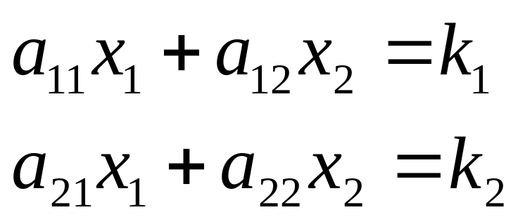
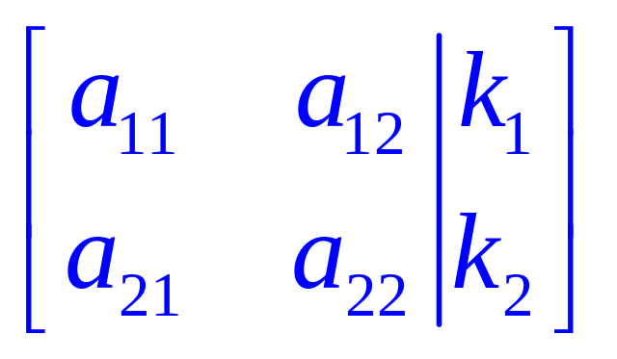
Generalization
Linear system:
Associated
augmented matrix:
Barnett/Ziegler/Byleen College Mathematics 12e

Slide 7
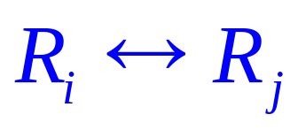
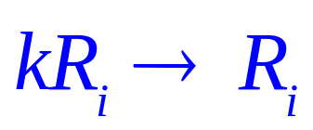
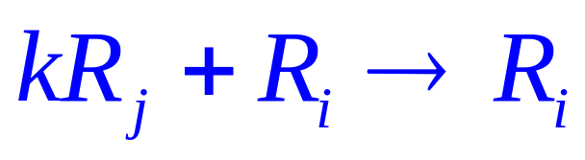

Operations that Produce
Row-Equivalent Matrices
1. Two rows are interchanged:
2. A row is multiplied by a nonzero constant:
3. A constant multiple of one row is added to another row:
Note: The arrow means “replaces.”
Barnett/Ziegler/Byleen College Mathematics 12e

Slide 8
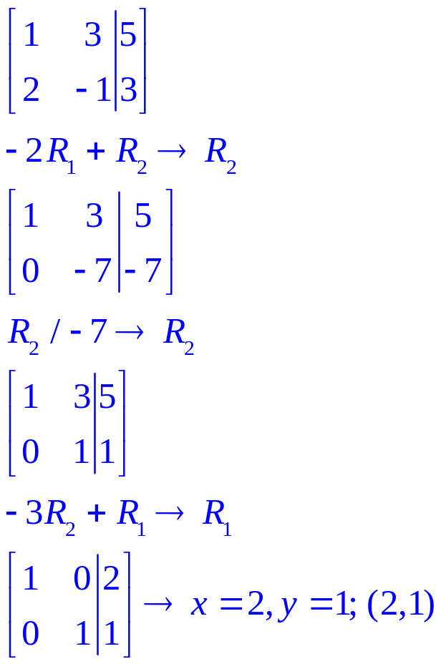
Augmented Matrix Method
Example 1
Solve
x + 3y = 5
2x – y = 3
1. Augmented system
2. Eliminate 2 in 2nd row by row operation
3. Divide row two by –7 to obtain a coefficient of 1.
4. Eliminate the 3 in first row, second position.
5. Read solution from matrix
:
Barnett/Ziegler/Byleen College Mathematics 12e

Slide 9
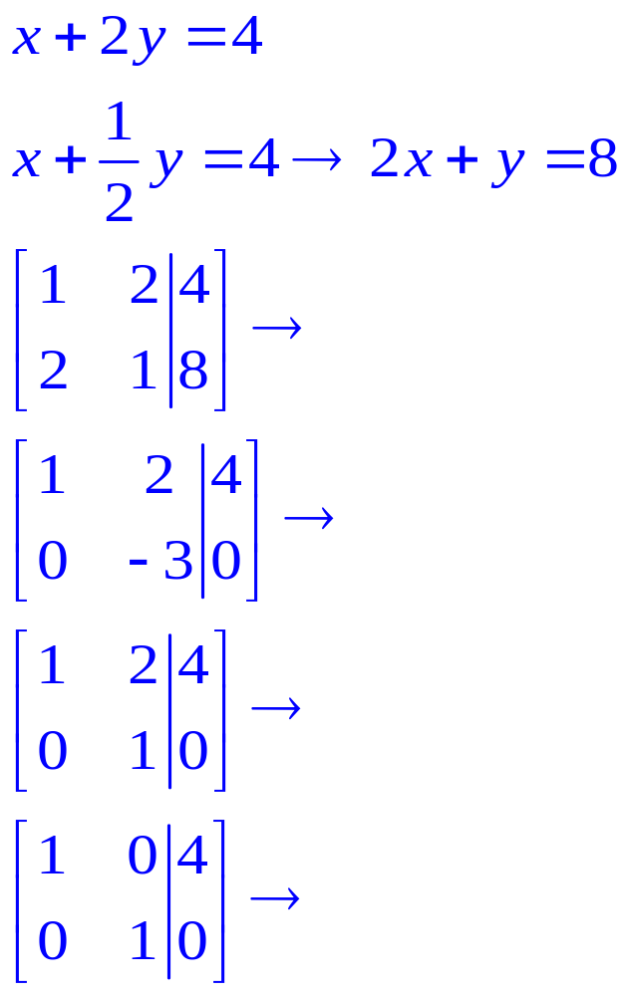
Augmented Matrix Method
Example 2
Solve
x + 2y = 4
x + (1/2)y = 4
Eliminate fraction in second equation
by multiplying by 2
Write system as augmented matrix.
Multiply row 1 by –2 and add to row 2
Divide row 2 by –3
Multiply row 2 by –2 and add to row 1.
Read solution : x = 4, y = 0
(4,0)
Barnett/Ziegler/Byleen College Mathematics 12e

Slide 10
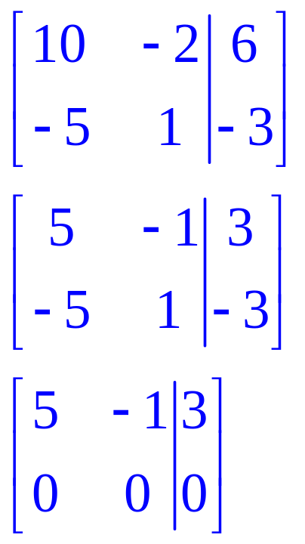
Augmented Matrix Method
Example 3
Solve
10x – 2y = 6
–5x + y = –3
1. Represent as augmented matrix.
2. Divide row 1 by 2
3. Add row 1 to row 2 and replace row 2 by sum
4. Since 0 = 0 is always true, we have a dependent system. The two equations are identical, and there are infinitely many solutions.
Barnett/Ziegler/Byleen College Mathematics 12e

Slide 11
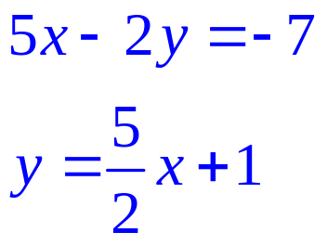
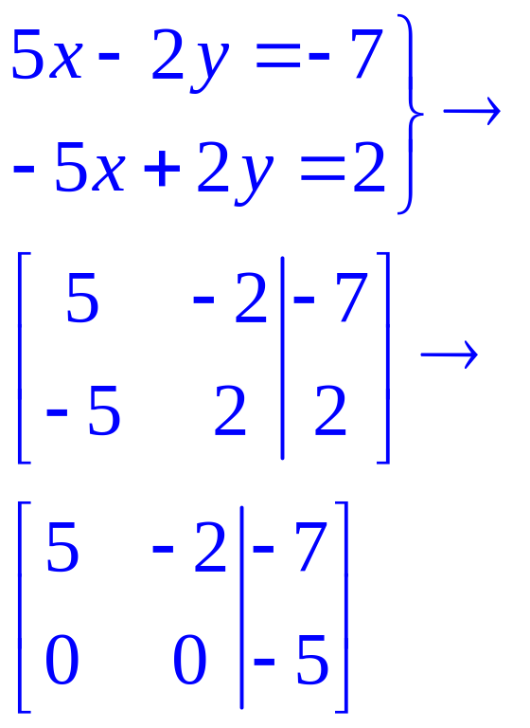
Augmented Matrix Method
Example 4
Solve
Rewrite second equation
Add first row to second row
The last row is the equivalent of 0x + 0y = -5
Since we have an impossible equation, there is no solution. The two lines are parallel and do not intersect.
Barnett/Ziegler/Byleen College Mathematics 12e

Slide 12
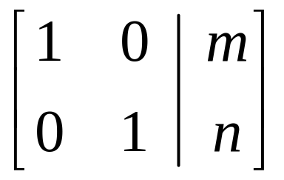
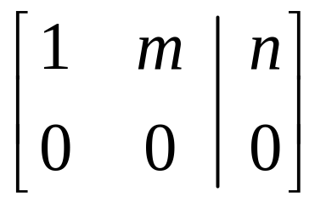
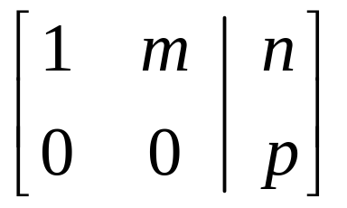
Possible Final Matrix Forms for a Linear System in Two Variables
Form 1: Unique Solution
(Consistent and Independent)
Form 2: Infinitely Many Solutions
(Consistent and Dependent)
Form 3: No Solution (Inconsistent)
Barnett/Ziegler/Byleen College Mathematics 12e

