Slide 1
Chapter 4
Systems of Linear Equations; Matrices
Section 3
Gauss-Jordan Elimination

Slide 2
Learning Objectives for Section 4.3
Gauss-Jordan Elimination
The student will be able to convert a matrix to reduced row echelon form.
The student will be able to solve systems by Gauss-Jordan elimination.
The student will be able to solve applications using Gauss-Jordan elimination.
Barnett/Ziegler/Byleen College Mathematics 12e

Slide 3
Gauss-Jordan Elimination
Any linear system must have exactly one solution, no solution, or an infinite number of solutions.
Previously we considered the 2 × 2 case, in which the term consistent is used to describe a system with a unique solution, inconsistent is used to describe a system with no solution, and dependent is used for a system with an infinite number of solutions. In this section we will consider larger systems with more variables and more equations, but the same three terms are used to describe them.
Barnett/Ziegler/Byleen College Mathematics 12e

Slide 4
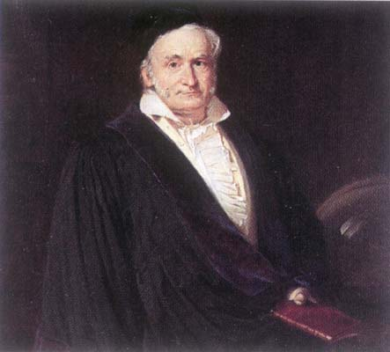
Carl Friedrich Gauss
1777-1855
At the age of seven, Carl Friedrich Gauss started elementary school, and his potential was noticed almost immediately. His teacher, Büttner, and his assistant, Martin Bartels, were amazed when Gauss summed the integers from 1 to 100 instantly by spotting that the sum was 50 pairs of numbers, each pair summing to 101.
Barnett/Ziegler/Byleen College Mathematics 12e

Slide 5
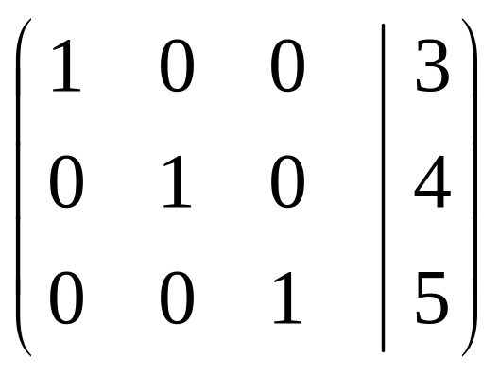
Matrix Representations of Consistent,
Inconsistent and Dependent Systems
The following matrix representations of three linear equations in three unknowns illustrate the three different cases:
Case I: consistent
From this matrix representation, you can determine that
x = 3
y = 4
z = 5
Barnett/Ziegler/Byleen College Mathematics 12e

Slide 6
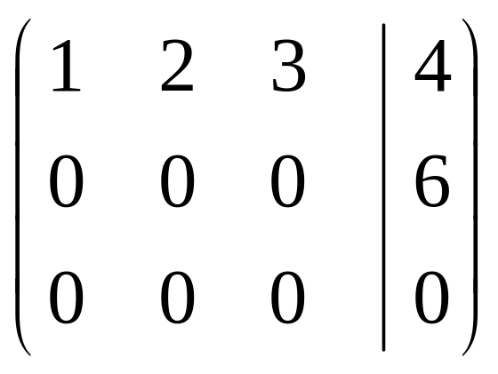
Matrix Representations
(continued)
Case 2: inconsistent
From the second row of the matrix, we find that
0x + 0y +0z =6
or
0 = 6,
an impossible equation. From this, we conclude that there are no solutions to the linear system.
Barnett/Ziegler/Byleen College Mathematics 12e

Slide 7

Matrix Representations
(continued)
Case 3: dependent
When there are fewer non-zero rows of a system than there are variables, there will be infinitely many solutions, and therefore the system is dependent.
Barnett/Ziegler/Byleen College Mathematics 12e

Slide 8
Reduced Row Echelon Form
A matrix is said to be in reduced row echelon form or, more simply, in reduced form, if
  Each row consisting entirely of zeros is below any row having at least one non-zero element.
  The leftmost nonzero element in each row is 1.
  All other elements in the column containing the leftmost 1 of a given row are zeros.
  The leftmost 1 in any row is to the right of the leftmost 1 in the row above.
Barnett/Ziegler/Byleen College Mathematics 12e

Slide 9
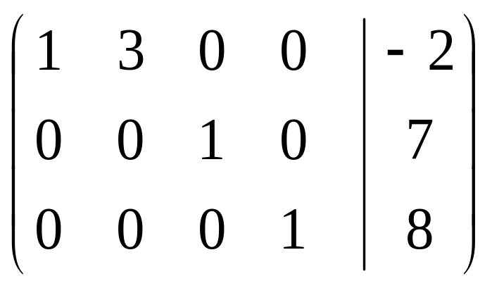
Examples of Reduced
Row Echelon Form
Barnett/Ziegler/Byleen College Mathematics 12e

Slide 10
Solving a System
Using Gauss-Jordan Elimination
Example: Solve
x + y – z = –2
2x – y + z = 5
–x + 2y + 2z = 1
Barnett/Ziegler/Byleen College Mathematics 12e

Slide 11

Solving a System
Using Gauss-Jordan Elimination
Example: Solve
x + y – z = –2
2x – y + z = 5
–x + 2y + 2z = 1
Solution:
We begin by writing the system as an augmented matrix
Barnett/Ziegler/Byleen College Mathematics 12e

Slide 12
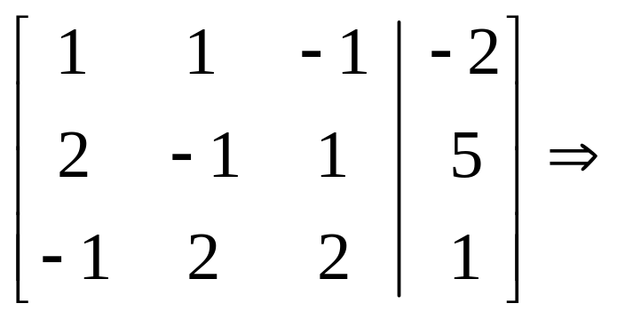

Example
(continued)
We already have a 1 in the diagonal position of first column. Now we want 0’s below the 1. The first 0 can be obtained by multiplying row 1 by –2 and adding the results to row 2:
Row 1 is unchanged
(–2) times Row 1 is added to Row 2
Row 3 is unchanged
Barnett/Ziegler/Byleen College Mathematics 12e

Slide 13

Example
(continued)
The second 0 can be obtained by adding row 1 to row 3:
Row 1 is unchanged
Row 2 is unchanged
Row 1 is added to Row 3
Barnett/Ziegler/Byleen College Mathematics 12e

Slide 14

Example
(continued)
Moving to the second column, we want a 1 in the diagonal position (where there was a –3). We get this by dividing every element in row 2 by -3:
Row 1 is unchanged
Row 2 is divided by –3
Row 3 is unchanged
Barnett/Ziegler/Byleen College Mathematics 12e

Slide 15

Example
(continued)
To obtain a 0 below the 1 , we multiply row 2 by –3 and add it to the third row:
Row 1 is unchanged
Row 2 is unchanged
(–3) times row 2 is added to row 3
Barnett/Ziegler/Byleen College Mathematics 12e

Slide 16

Example
(continued)
To obtain a 1 in the third position of the third row, we divide that row by 4. Rows 1 and 2 do not change.
Barnett/Ziegler/Byleen College Mathematics 12e

Slide 17
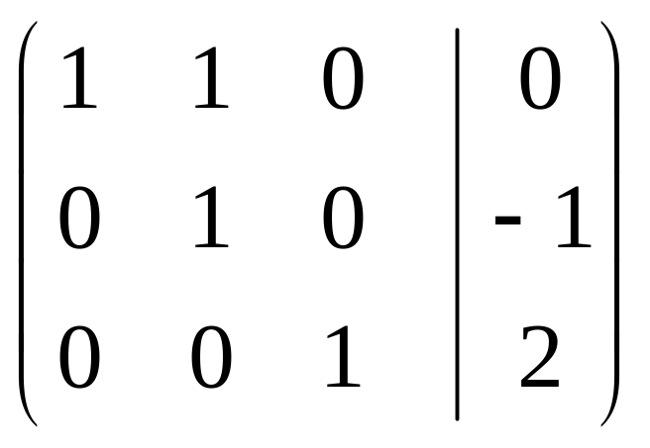
Example
(continued)
We can now work upwards to get zeros in the third column, above the 1 in the third row.
Add R3 to R2 and replace R2 with that sum
Add R3 to R1 and replace R1 with the sum.
Row 3 will not be changed.
All that remains to obtain reduced row echelon form is to eliminate the 1 in the first row, 2nd position.
Barnett/Ziegler/Byleen College Mathematics 12e

Slide 18
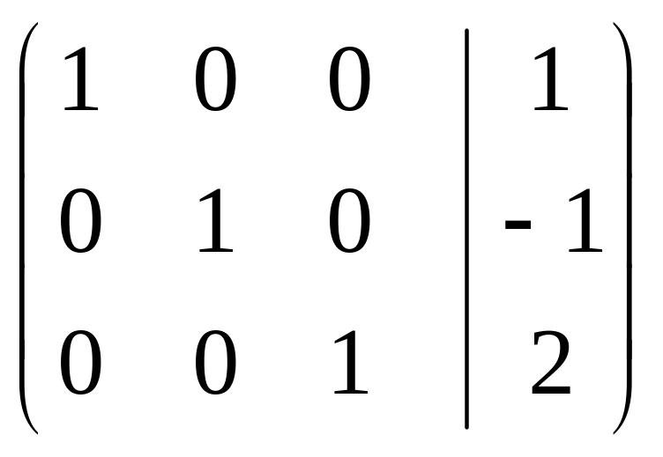
Example
(continued)
To get a zero in the first row and second position, we multiply row 2 by –1 and add the result to row 1 and replace row 1 by that result. Rows 2 and 3 remain unaffected.
Barnett/Ziegler/Byleen College Mathematics 12e

Slide 19
Final Result
We can now “read” our solution from this last matrix. We have
x = 1,
y = –1
z = 2.
Written as an ordered triple, we have (1, –1, 2). This is a consistent system with a unique solution.
Barnett/Ziegler/Byleen College Mathematics 12e

Slide 20
Example 2
Example: Solve the system
3x – 4y + 4z = 7
x – y – 2z = 2
2x – 3y + 6z = 5
Barnett/Ziegler/Byleen College Mathematics 12e

Slide 21
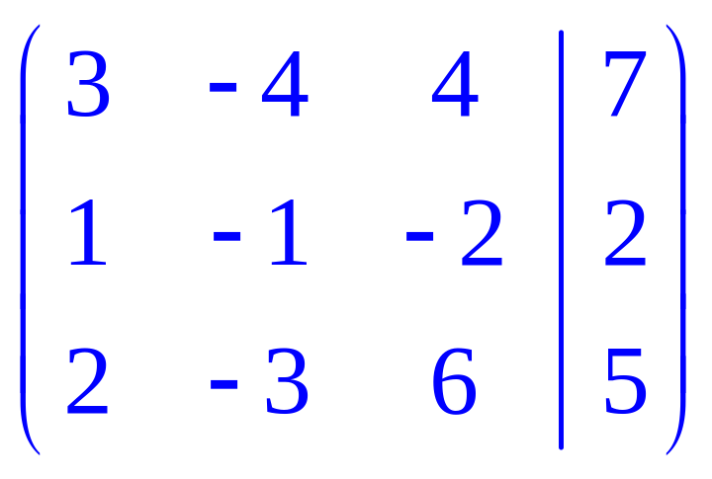
Example 2
Example: Solve the system
3x – 4y + 4z = 7
x – y – 2z = 2
2x – 3y + 6z = 5
Solution:
Begin by representing the system as an augmented matrix:
Barnett/Ziegler/Byleen College Mathematics 12e

Slide 22
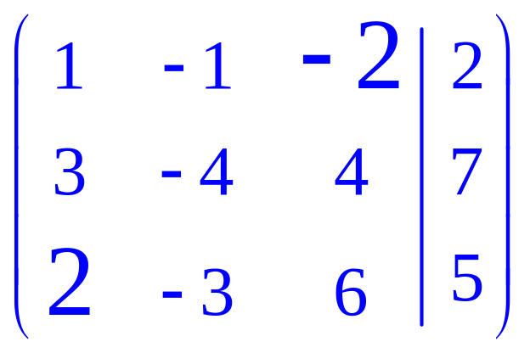
Example 2
(continued)
Since the first number in the second row is a 1, we interchange rows 1 and 2 and leave row 3 unchanged:
Barnett/Ziegler/Byleen College Mathematics 12e

Slide 23
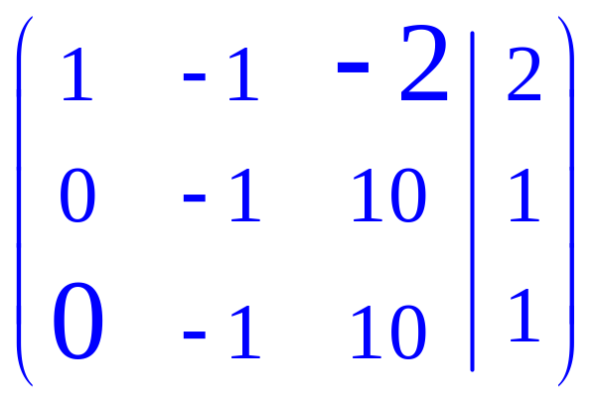
Example 2
(continued)
In this step, we will get zeros in the entries beneath the 1 in the first column:
Multiply row 1 by –3 , add to row 2 and replace row 2:
–3R1 + R2 → R2.
Multiply row 1 by –2, add to row 3 and replace row 3:
–2R1+R3 → R3.
Barnett/Ziegler/Byleen College Mathematics 12e

Slide 24
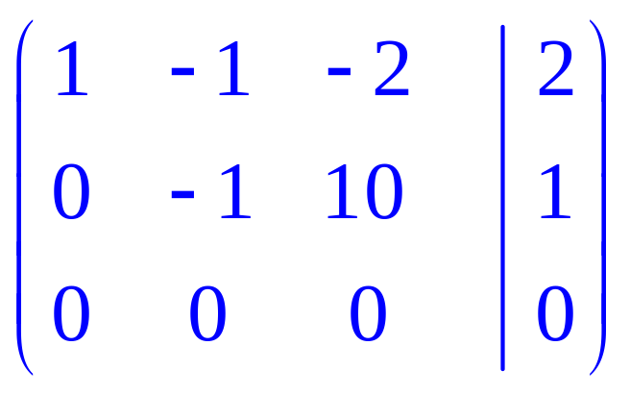
Final Result
To get a zero in the third row, second entry we multiply row 2 by –1 and add the result to R3 and replace R3 by that sum: Notice this operations “wipes out” row 3 so row 3 consists entirely of zeros.
Any time you have fewer non-zero rows than variables you will have a dependent system.
Barnett/Ziegler/Byleen College Mathematics 12e

Slide 25
Representation of a Solution of a Dependent System
We can interpret the second row of this matrix as
–y + 10z = 1, or
10z – 1 = y
So, if we let z = t (arbitrary real number,) then in terms of t,
y = 10t – 1.
Next we can express the variable x in terms of t as follows: From the first row of the matrix, we have x – y -2z = 2.
If z = t and y = 10t – 1, we have
x – (10t – 1) – 2t = 2 or x = 12t + 1.
Our general solution can now be expressed in terms of t: (12t + 1,10t – 1, t),
where t is an arbitrary real number.
Barnett/Ziegler/Byleen College Mathematics 12e

Slide 26
Procedure for
Gauss-Jordan Elimination
Step 1. Choose the leftmost nonzero column and use appropriate row operations to get a 1 at the top.
Step 2. Use multiples of the row containing the 1 from step 1 to get zeros in all remaining places in the column containing this 1.
Step 3. Repeat step 1 with the submatrix formed by (mentally) deleting the row used in step and all rows above this row.
Step 4. Repeat step 2 with the entire matrix, including the rows deleted mentally. Continue this process until the entire matrix is in reduced form.
Note: If at any point in this process we obtain a row with all zeros to the left of the vertical line and a nonzero number to the right, we can stop because we will have a contradiction.
Barnett/Ziegler/Byleen College Mathematics 12e

Slide 27
Applications
Systems of linear equations provide an excellent opportunity to discuss mathematical modeling. The process of using mathematics to solve real-world problems can be broken down into three steps:
Step 1. Construct a mathematical model whose solution will provide information about the real-world problem.
Real-world problem
3. Interpret
1. Construct
Mathematical Solution
Mathematical Model
2. Solve
Barnett/Ziegler/Byleen College Mathematics 12e

Slide 28

Applications
(continued)
Step 2. Solve the mathematical model.
Step 3. Interpret the solution to the mathematical model in terms of the original real-world problem.
Example: Purchasing. A company that rents small moving trucks wants to purchase 25 trucks with a combined capacity of 28,000 cubic feet. Three different types of trucks are available: a 10-foot truck with a capacity of 350 cubic feet, a 14-foot truck with a capacity of 700 cubic feet, and a 24-foot truck with a capacity of 1,400 cubic feet. How many of each type of truck should the company purchase?
Barnett/Ziegler/Byleen College Mathematics 12e

Slide 29
Solution
Step 1. The question in this example indicates that the relevant variables are the number of each type of truck.
x = number of 10-foot trucks
y = number of 14-foot trucks
z = number of 24-foot trucks
We form the mathematical model:
x + y + z = 25 (Total number of trucks)
350x + 700y + 1,400z = 28,000 (Total capacity)
Barnett/Ziegler/Byleen College Mathematics 12e

Slide 30
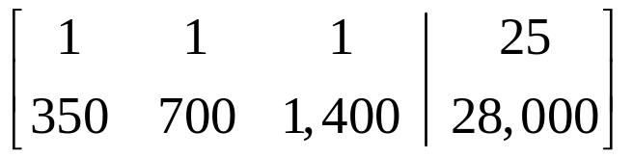
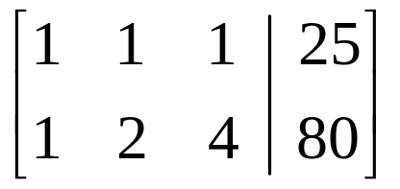
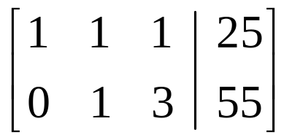
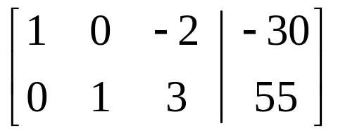
Solution
(continued)
Step 2. Now we form the augmented coefficient matrix of the system and solve by using Gauss-Jordan elimination:
(1/350)R₂ R₂
–R₁ + R₂ R₂
–R₂ + R₁ R₁
Matrix is in reduced form.
x – 2z = –30 or x = 2z – 30,
y + 3z = 55 or y = –3z + 55.
Barnett/Ziegler/Byleen College Mathematics 12e

Slide 31
Solution
(continued)
Let z = t. Then for t any real number
x = 2t – 30
y = –3t + 55
z = t
is a solution to our mathematical model.
Step 3. We must interpret this solution in terms of the original problem. Since the variables x, y, and z represent numbers of trucks, they must be nonnegative. And since we can’t purchase a fractional number of trucks, each must be a nonnegative whole number.
Barnett/Ziegler/Byleen College Mathematics 12e

Slide 32
Solution
(continued)
Since t = z, it follows that t must also be a nonnegative whole number. The first and second equations in the model place additional restrictions on the values t can assume:
x = 2t – 30 > 0 implies that t > 15
y = –3t + 55 > 0 implies that t < 55/3
Thus the only possible values of t that will produce meaningful solutions to the original problem are 15, 16, 17, and 18. A table is a convenient way to display these solutions.
 | 10-ft truck | 14-ft. truck | 24-ft truck
t | x | y | z
15 | 0 | 10 | 15
16 | 2 | 7 | 16
17 | 4 | 4 | 17
18 | 6 | 1 | 18
Barnett/Ziegler/Byleen College Mathematics 12e

