Slide 1
Chapter 4
Systems of Linear Equations; Matrices
Section 4
Matrices:
Basic Operations

Slide 2
Learning Objectives for Section 4.4
Matrices: Basic Operations
The student will be able to perform addition and subtraction of matrices.
The student will be able to find the scalar product of a
number k and a matrix M.
The student will be able to calculate a matrix product.
Barnett/Ziegler/Byleen College Mathematics 12e

Slide 3
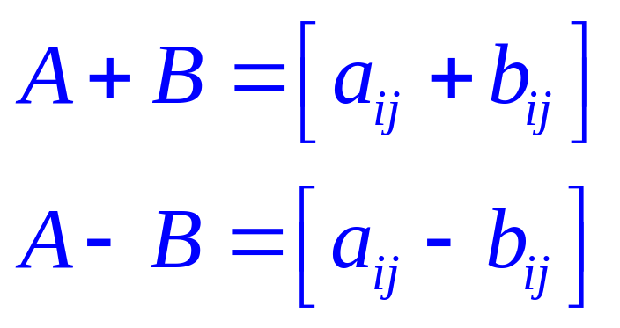
Addition and Subtraction of Matrices
To add or subtract matrices, they must be of the same order, m × n. To add matrices of the same order, add their corresponding entries. To subtract matrices of the same order, subtract their corresponding entries. The general rule is as follows using mathematical notation:
Barnett/Ziegler/Byleen College Mathematics 12e

Slide 4
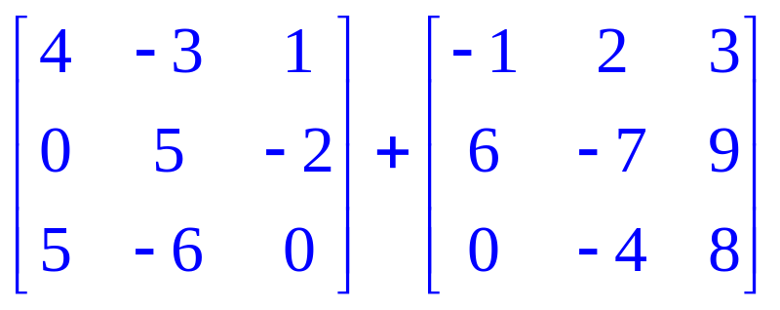
Example: Addition
Add the matrices
Barnett/Ziegler/Byleen College Mathematics 12e

Slide 5
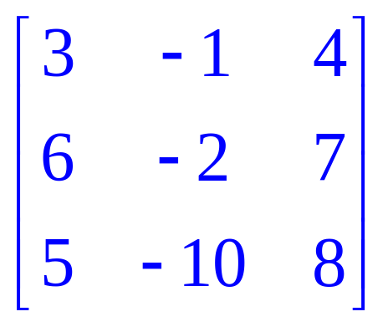
Example: Addition
Solution
Add the matrices
Solution: First note that each matrix has dimensions of 3x3, so we are able to perform the addition. The result is shown at right:
Adding corresponding entries, we have
Barnett/Ziegler/Byleen College Mathematics 12e

Slide 6

Example: Subtraction
Now, we will subtract the same two matrices
Barnett/Ziegler/Byleen College Mathematics 12e

Slide 7
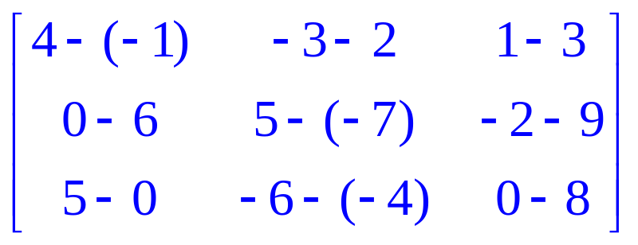
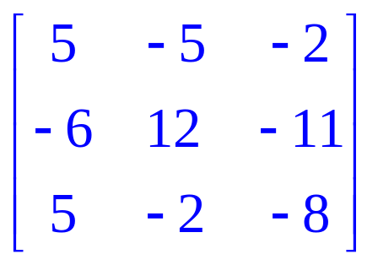
Example: Subtraction
Solution
Now, we will subtract the same two matrices
Subtract corresponding entries as follows:
=
Barnett/Ziegler/Byleen College Mathematics 12e

Slide 8
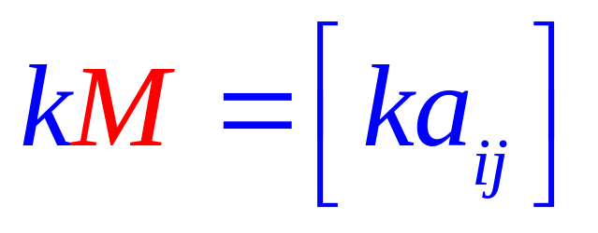
Scalar Multiplication
The product of a number k and a matrix M is the matrix denoted by kM, obtained by multiplying each entry of M by the number k. The number k is called a scalar. In mathematical notation,
Barnett/Ziegler/Byleen College Mathematics 12e

Slide 9
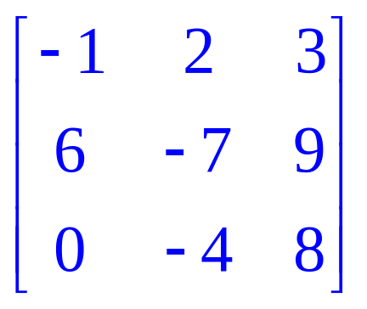
Example: Scalar Multiplication
Find (–1)A, where A =
Barnett/Ziegler/Byleen College Mathematics 12e

Slide 10
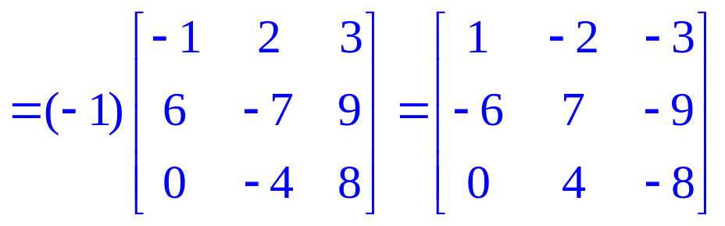
Example: Scalar Multiplication
Solution
Find (–1)A, where A =
Solution:
(–1)A= –1
Barnett/Ziegler/Byleen College Mathematics 12e

Slide 11
Alternate Definition of
Subtraction of Matrices
The definition of subtraction of two real numbers a and b is
a – b = a + (–1)b or
“a plus the opposite of b”. We can define subtraction of matrices similarly:
If A and B are two matrices of the same dimensions, then
A – B = A + (–1)B,
where (–1) is a scalar.
Barnett/Ziegler/Byleen College Mathematics 12e

Slide 12
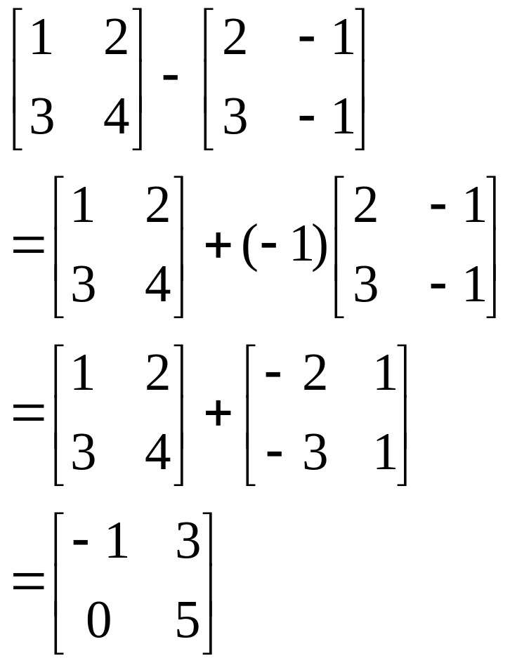
Example
The example on the right illustrates this procedure for two 2 × 2 matrices.
Barnett/Ziegler/Byleen College Mathematics 12e

Slide 13
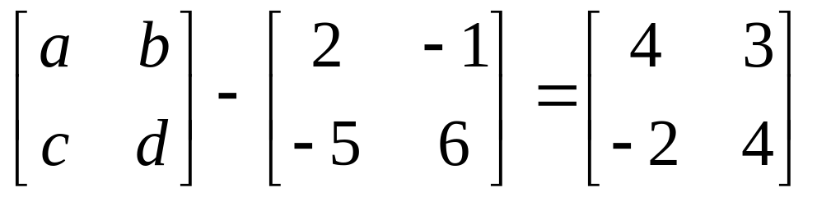
Matrix Equations
Example: Find a, b, c, and d so that
Barnett/Ziegler/Byleen College Mathematics 12e

Slide 14
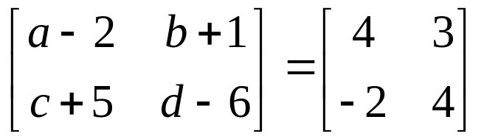
Matrix Equations
Example: Find a, b, c, and d so that
Solution: Subtract the matrices on the left side:
Use the definition of equality to change this matrix equation into 4 real number equations:
a – 2 = 4 b + 1 = 3 c + 5 = –2 d – 6 = 4 a = 6 b = 2 c = -7 d = 10
Barnett/Ziegler/Byleen College Mathematics 12e

Slide 15
Matrix Products
The method of multiplication of matrices is not as intuitive and may seem strange, although this method is extremely useful in many mathematical applications.
Matrix multiplication was introduced by an English mathematician named Arthur Cayley (1821-1895). We will see shortly how matrix multiplication can be used to solve systems of linear equations.
Barnett/Ziegler/Byleen College Mathematics 12e

Slide 16
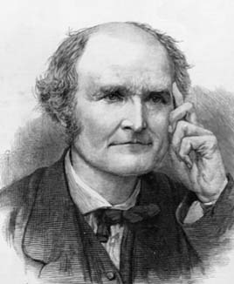
Arthur Cayley
1821-1895
Introduced matrix multiplication
Barnett/Ziegler/Byleen College Mathematics 12e

Slide 17
Product of a Row Matrix and a Column Matrix
In order to understand the general procedure of matrix multiplication, we will introduce the concept of the product of a row matrix by a column matrix.
A row matrix consists of a single row of numbers, while a column matrix consists of a single column of numbers. If the number of columns of a row matrix equals the number of rows of a column matrix, the product of a row matrix and column matrix is defined. Otherwise, the product is not defined.
Barnett/Ziegler/Byleen College Mathematics 12e

Slide 18
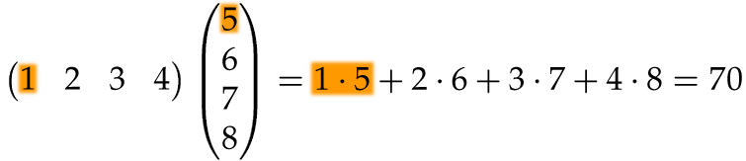
Row by Column Multiplication
Example: A row matrix consists of 1 row of 4 numbers so this matrix has four columns. It has dimensions 1 × 4. This matrix can be multiplied by a column matrix consisting of 4 numbers in a single column (this matrix has dimensions 4 × 1).
1 × 4 row matrix multiplied by a 4 × 1 column matrix. Notice the manner in which corresponding entries of each matrix are multiplied:
Barnett/Ziegler/Byleen College Mathematics 12e

Slide 19
Example:
Revenue of a Car Dealer
A car dealer sells four model types: A, B, C, D. In a given week, this dealer sold 10 cars of model A, 5 of model B, 8 of model C and 3 of model D. The selling prices of each automobile are respectively $12,500, $11,800, $15,900 and $25,300. Represent the data using matrices and use matrix multiplication to find the total revenue.
Barnett/Ziegler/Byleen College Mathematics 12e

Slide 20
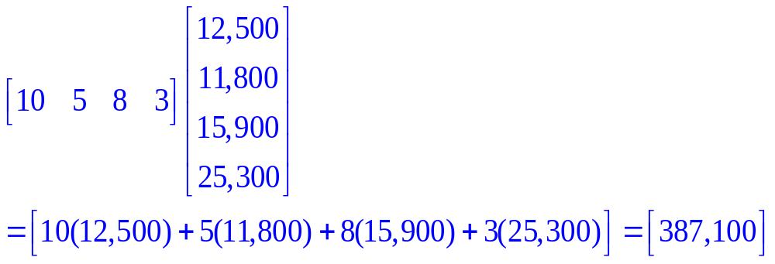
Solution using Matrix Multiplication
We represent the number of each model sold using a row matrix (4 × 1), and we use a 1 × 4 column matrix to represent the sales price of each model. When a 4 × 1 matrix is multiplied by a 1 × 4 matrix, the result is a 1 × 1 matrix containing a single number.
Barnett/Ziegler/Byleen College Mathematics 12e

Slide 21
Matrix Product
If A is an m × p matrix and B is a p × n matrix, the matrix product of A and B, denoted by AB, is an m × n matrix whose element in the i ^{th} row and j ^{th} column is the real number obtained from the product of the i ^{th} row of A and the j ^{th} column of B. If the number of columns of A does not equal the number of rows of B, the matrix product AB is not defined.
Barnett/Ziegler/Byleen College Mathematics 12e

Slide 22
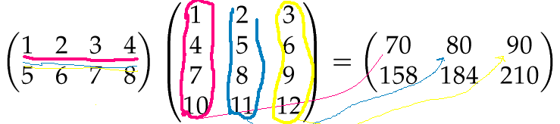
Multiplying a 2 × 4 matrix by a
4 × 3 matrix to obtain a 2 × 3
The following is an illustration of the product of a 2 × 4 matrix with a 4 × 3. First, the number of columns of the matrix on the left must equal the number of rows of the matrix on the right, so matrix multiplication is defined. A row-by column multiplication is performed three times to obtain the first row of the product: 70 80 90.
Barnett/Ziegler/Byleen College Mathematics 12e

Slide 23
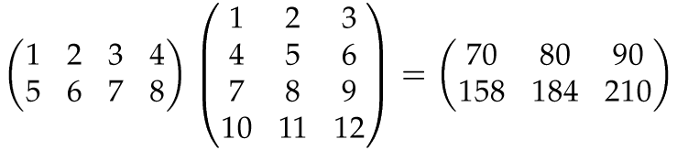
Final Result
Barnett/Ziegler/Byleen College Mathematics 12e

Slide 24
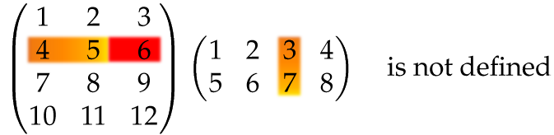
Undefined Matrix Multiplication
Why is the matrix multiplication below not defined?
Barnett/Ziegler/Byleen College Mathematics 12e

Slide 25
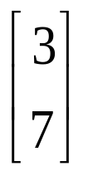
Undefined Matrix Multiplication
Solution
Why is the matrix multiplication below not defined?
The answer is that the left matrix has three columns but the matrix on the right has only two rows. To multiply the second row [4 5 6] by the third column, , there is no number to pair with 6 to multiply.
Barnett/Ziegler/Byleen College Mathematics 12e

Slide 26
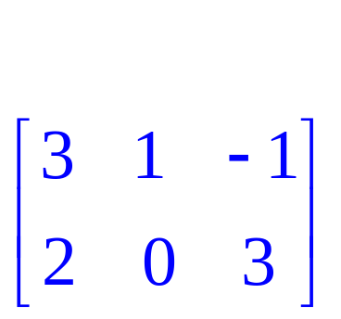
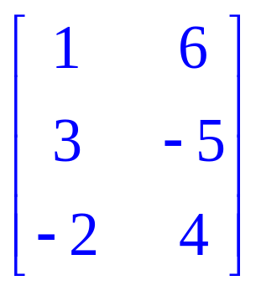
Example
Given A = B =
Find AB if it is defined:
Barnett/Ziegler/Byleen College Mathematics 12e

Slide 27
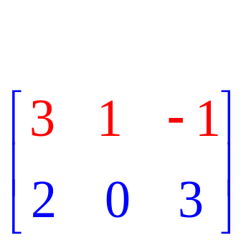
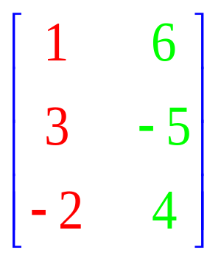
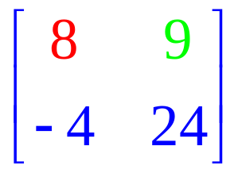
Solution
Since A is a 2 × 3 matrix and B is a 3 × 2 matrix, AB will be a 2 × 2 matrix.
1. Multiply first row of A by first column of B:
3(1) + 1(3) +(–1)(–2)=8
2. First row of A times second column of B: 3(6)+1(–5)+ (–1)(4)= 9
3. Proceeding as above the final result is
=
Barnett/Ziegler/Byleen College Mathematics 12e

Slide 28
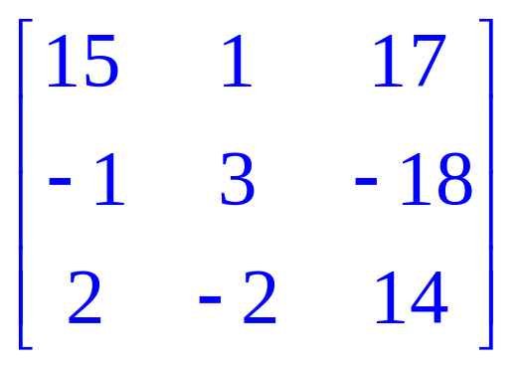
Is Matrix Multiplication Commutative?
Now we will attempt to multiply the matrices in reverse order: BA = ?
We are multiplying a 3 × 2 matrix by a 2 × 3 matrix. This matrix multiplication is defined, but the result will be a
3 × 3 matrix. Since AB does not equal BA, matrix multiplication is not commutative.
=
Barnett/Ziegler/Byleen College Mathematics 12e

Slide 29
Practical Application
Suppose you a business owner and sell clothing. The following represents the number of items sold and the cost for each item. Use matrix operations to determine the total revenue over the two days:
Monday: 3 T-shirts at $10 each, 4 hats at $15 each, and
1 pair of shorts at $20.
Tuesday: 4 T-shirts at $10 each, 2 hats at $15 each, and
3 pairs of shorts at $20.
Barnett/Ziegler/Byleen College Mathematics 12e

Slide 30
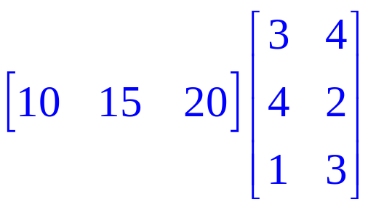
Solution of Practical Application
Represent the information using two matrices: The product of the two matrices gives the total revenue:
Then your total revenue for the two days is = [110 130] Price times Quantity = Revenue
Qty sold of each item on Monday
Unit price of each item:
Qty sold of each item on Tuesday
Barnett/Ziegler/Byleen College Mathematics 12e

