Slide 1
Chapter 4
Systems of Linear Equations; Matrices
Section 5
Inverse of a
Square Matrix

Slide 2
Learning Objectives for Section 4.5
Inverse of a Square Matrix
The student will be able to identify identity matrices for multiplication.
The student will be able to find the inverse of a square matrix.
The student will be able to work with applications of inverse matrices such as cryptography.
Barnett/Ziegler/Byleen College Mathematics 12e

Slide 3
Identity Matrix for Multiplication
1 is called the multiplicative identity for real numbers since a(1) = (1)a = a
For example,
5(1) = 5
A matrix is called square if it has the same number of rows and columns, that is, it has size n × n.
Barnett/Ziegler/Byleen College Mathematics 12e

Slide 4
Identity Matrix for Multiplication
The identity element for multiplication for the set of all square matrices of order n is the square matrix of order n, denoted by I, with 1’s along the principal diagonal (from the upper left corner to lower right) and 0’s elsewhere.
That is,
MI_{n} = I_{n}M = A
I_{n} is called the n × n identity matrix.
Barnett/Ziegler/Byleen College Mathematics 12e

Slide 5
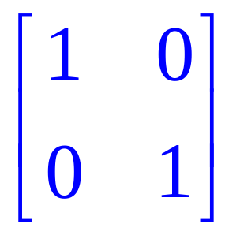
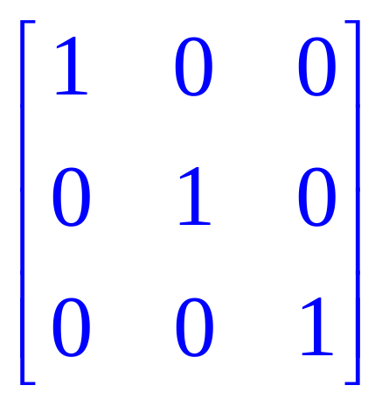
Identity Matrices
2 × 2 identity matrix:
3 × 3 identity matrix
Barnett/Ziegler/Byleen College Mathematics 12e

Slide 6
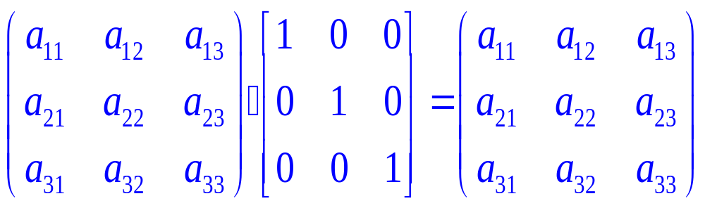
Identity Matrix Multiplication
MI = M (Verify the multiplication)
We can also show that IM = M and in general MI = IM = M for all square matrices M.
Barnett/Ziegler/Byleen College Mathematics 12e

Slide 7
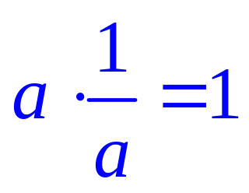
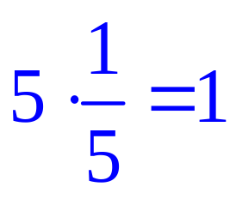
Inverse of a Matrix
All real numbers (excluding 0) have an inverse.
For example
.
Barnett/Ziegler/Byleen College Mathematics 12e

Slide 8
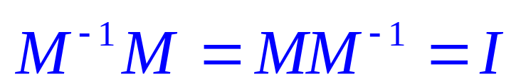
Matrix Inverses
Some (not all) square matrices also have matrix inverses
If the inverse of a matrix A exists, we shall call it M^{–1}
Let M be a square matrix of order n and I be the identity matrix of order n. If there exists a matrix M^{–1} (read “M inverse”) such that
then M^{–1} is called the multiplicative inverse of M or, more simply, the inverse of M. If no such matrix exists, then M is said to be a singular matrix.
Barnett/Ziegler/Byleen College Mathematics 12e

Slide 9
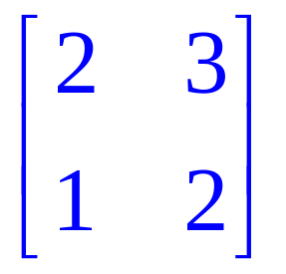
Inverse of a 2 × 2 Matrix
There is a simple procedure to find the inverse of a two by two matrix. This procedure only works for the 2 × 2 case.
An example will be used to illustrate the procedure.
Example: Find the inverse of
Barnett/Ziegler/Byleen College Mathematics 12e

Slide 10
Inverse of a 2x2 matrix
(continued)
Step 1: Determine whether or not the inverse actually exists. We define Δ = the difference of the product of the diagonal elements of the matrix.
In order for the inverse of a 2 × 2 matrix to exist, Δ cannot equal zero.
If Δ happens to be zero, then we conclude the inverse does not exist, and we stop all calculations.
In our case Δ = 2(2) – 1(3) = 1, so we can proceed.
.
Barnett/Ziegler/Byleen College Mathematics 12e

Slide 11
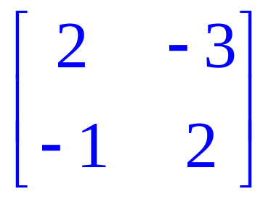
Inverse of a 2x2 matrix
(continued)
Step 2. Reverse the entries on the main diagonal.
In this example, both entries are 2, and no change is visible.
Step 3. Reverse the signs of the other diagonal entries 3 and 1 so they become –3 and –1.
Step 4. Divide each element of the matrix by which in this case is 1, so no apparent change will be noticed.
Barnett/Ziegler/Byleen College Mathematics 12e

Slide 12
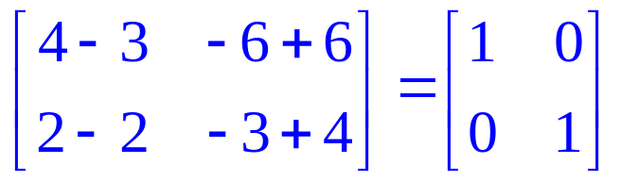
Inverse of a 2x2 matrix
(continued)
The inverse of the matrix is then
To verify that this is the inverse, we will multiply the original matrix by its inverse and hopefully obtain the 2 × 2 identity matrix:
=
Barnett/Ziegler/Byleen College Mathematics 12e

Slide 13
Inverse of a General
Square Matrix
1. Augment the matrix with the n × n identity matrix.
2. Use elementary row operations to transform the matrix on the left side of the vertical line to the n × n identity matrix. The row operations are used for the entire row, so that the matrix on the right hand side of the vertical line will also change.
3. When the matrix on the left is transformed to the n × n identity matrix, the matrix on the right of the vertical line is the inverse.
Barnett/Ziegler/Byleen College Mathematics 12e

Slide 14
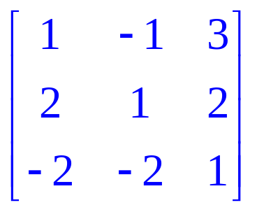

Example:
Inverse of a 3x3 Matrix
Find the inverse of
  Step 1. Multiply R1 by (-2) and add the result to R2.
  Step 2. Multiply R1 by 2 and add the result to R3
Barnett/Ziegler/Byleen College Mathematics 12e

Slide 15

Example
(continued)
  Step 3. Multiply row 2 by (1/3) to get a 1 in the second row, first position.
  Step 4. Add R2 to R1.
  Step 5. Multiply R2 by 4 and add the result to R3.
  Step 6. Multiply R3 by 3/5 to get a 1 in the third row, third position.
Barnett/Ziegler/Byleen College Mathematics 12e

Slide 16

Example
(continued)
  Step 7. Eliminate the (5/3) in the first row, third position by multiplying R3 by (–5/3) and adding result to R1.
  Step 8. Eliminate the (–4/3) in the second row, third position by multiplying R3 by (4/3) and adding result to R2.
  Step 9. You now have the identity matrix on the left, which is our goal.
Barnett/Ziegler/Byleen College Mathematics 12e

Slide 17

Example
Solution
The inverse matrix appears on the right hand side of the vertical line and is displayed below. Many calculators as well as computers have software programs that can calculate the inverse of a matrix quite easily. If you have access to a TI 83, consult the manual to determine how to find the inverse using a calculator.
Barnett/Ziegler/Byleen College Mathematics 12e

Slide 18

Application:
Cryptography
Matrix inverses can provide a simple and effective procedure for encoding and decoding messages. To begin, assign the numbers 1-26 to the letters in the alphabet, as shown below. Also assign the number 0 to a blank to provide for space between words.
Blank A B C D E F G H I J K L M N O P Q R S T U V W X Y Z
0 1 2 3 4 5 6 7 8 9 10 11 12 13 14 15 16 17 18 19 20 21 22 23 24 25 26
Thus the message “SECRET CODE” corresponds to the sequence
19 5 3 18 5 20 0 3 15 4 5
Barnett/Ziegler/Byleen College Mathematics 12e

Slide 19
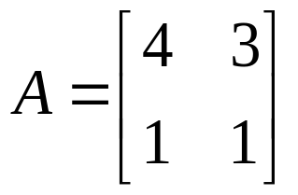
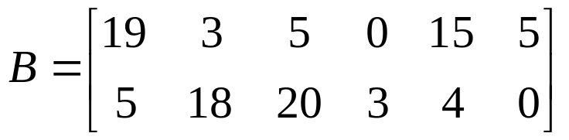
Cryptography
(continued)
Any matrix A whose elements are positive integers and whose inverse exists can be used as an encoding matrix. For example, to use the 2 × 2 matrix
to encode the message above, first divide the numbers in the sequence 19 5 3 18 5 20 0 3 15 4 5 into groups of 2, and use these groups as the columns of a matrix B:
We added an extra blank at the end of the message to make the columns come out even.
Barnett/Ziegler/Byleen College Mathematics 12e

Slide 20
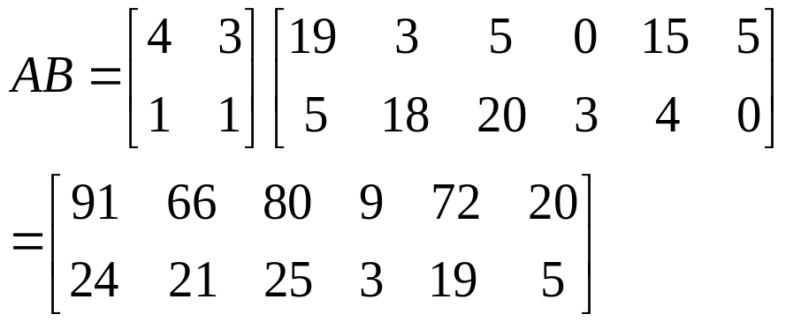
Cryptography
(continued)
Then we multiply this matrix on the left by A:
The coded message is
91 24 66 21 80 25 9 3 72 19 20 5
This message can be decoded simply by putting it back into matrix form and multiplying on the left by the decoding matrix A^{–1}.
Barnett/Ziegler/Byleen College Mathematics 12e

