Slide 1
Chapter 4
Systems of Linear Equations; Matrices
Section 6
Matrix Equations and Systems of Linear Equations

Slide 2
Learning Objectives for Section 4.6
Matrix Equations and Systems of Linear Equations
The student will be able to formulate matrix equations.
The student will be able to use matrix equations to solve linear systems.
The student will be able to solve applications using matrix equations.
Barnett/Ziegler/Byleen College Mathematics 12e

Slide 3
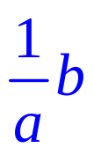

Matrix Equations
Let’s review one property of solving equations involving real numbers. Recall
If ax = b then x = , or
A similar property of matrices will be used to solve systems of linear equations.
Many of the basic properties of matrices are similar to the properties of real numbers, with the exception that matrix multiplication is not commutative.
Barnett/Ziegler/Byleen College Mathematics 12e

Slide 4
Basic Properties of Matrices
Assuming that all products and sums are defined for the indicated matrices A, B, C, I, and 0, we have
Addition Properties
  Associative: (A + B) + C = A + (B+ C)
  Commutative: A + B = B + A
  Additive Identity: A + 0 = 0 + A = A
  Additive Inverse: A + (–A) = (–A) + A = 0
Barnett/Ziegler/Byleen College Mathematics 12e

Slide 5
Basic Properties of Matrices
(continued)
Multiplication Properties
  Associative Property: A(BC) = (AB)C
  Multiplicative identity: AI = IA = A
  Multiplicative inverse: If A is a square matrix and A^{–1} exists, then AA^{–1} = A^{–1}A = I
Combined Properties
  Left distributive: A(B + C) = AB + AC
  Right distributive: (B + C)A = BA + CA
Barnett/Ziegler/Byleen College Mathematics 12e

Slide 6
Basic Properties of Matrices
(continued)
Equality
  Addition: If A = B, then A + C = B + C
  Left multiplication: If A = B, then CA = CB
  Right multiplication: If A = B, then AC = BC
The use of these properties is best illustrated by an example of solving a matrix equation.
Example: Given an n × n matrix A and an n × p matrix B and a third matrix denoted by X, we will solve the matrix equation AX = B for X.
Barnett/Ziegler/Byleen College Mathematics 12e

Slide 7
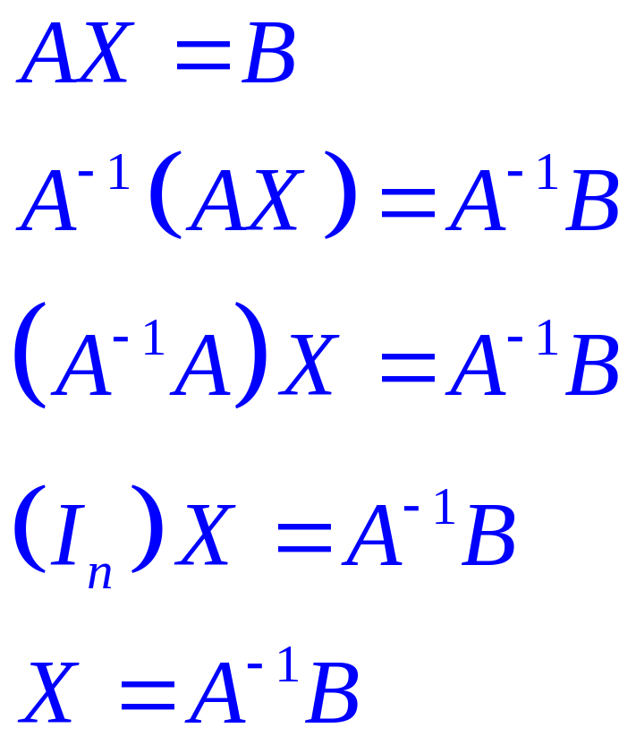
Solving a Matrix Equation
Given; since A is n × n, X must by n × p.
Multiply on the left by A⁻¹.
Associative property of matrices.
Property of matrix inverses.
Property of the identity matrix.
Barnett/Ziegler/Byleen College Mathematics 12e

Slide 8
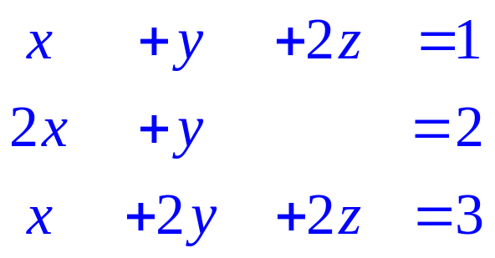
Example
Example: Use matrix inverses to solve the system
Barnett/Ziegler/Byleen College Mathematics 12e

Slide 9
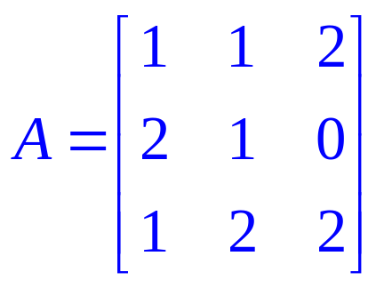
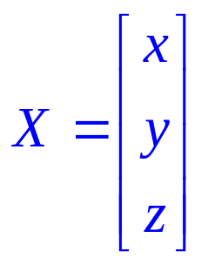
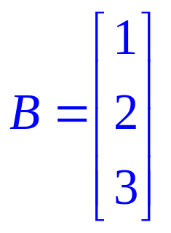
Example
Example: Use matrix inverses to solve the system
Solution:
  Write out the matrix of coefficients A, the matrix X containing the variables x, y, and z, and the column matrix B containing the numbers on the right hand side of the equal sign.
Barnett/Ziegler/Byleen College Mathematics 12e

Slide 10
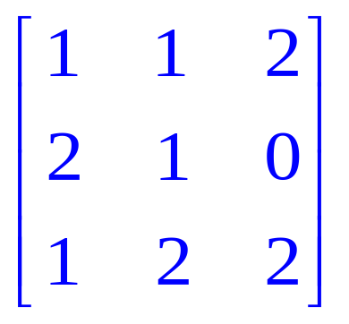
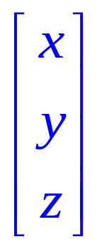
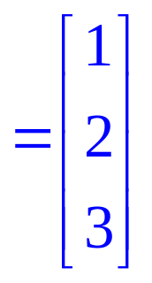
Example
(continued)
  Form the matrix equation AX = B. Multiply the 3 × 3 matrix A by the 3 × 1 matrix X to verify that this multiplication produces the 3 × 3 system at the bottom:
Barnett/Ziegler/Byleen College Mathematics 12e

Slide 11
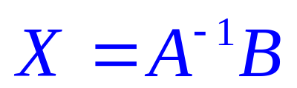
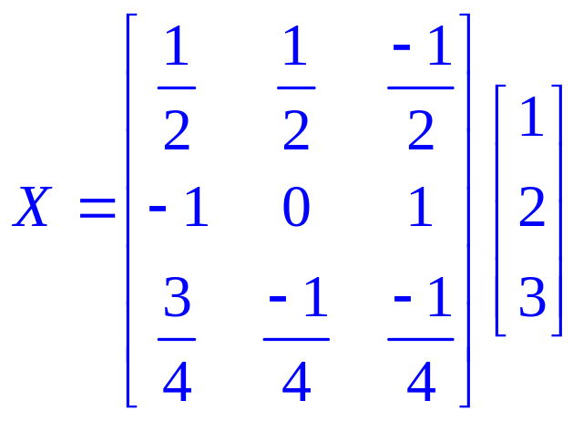
Example
(continued)
  If the matrix A^{–1} exists, then the solution is determined by multiplying A^{–1} by the matrix B. Since A^{–1} is 3 × 3 and B is 3 × 1, the resulting product will have dimensions 3 × 1 and will store the values of x, y and z.
  A⁻¹ can be determined by the methods of a previous section or by using a computer or calculator. The resulting equation is shown at the right:
Barnett/Ziegler/Byleen College Mathematics 12e

Slide 12
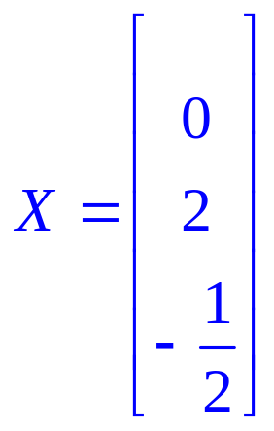
Example
Solution
The product of A^{–1} and B is
The solution can be read off from the X matrix:
x = 0,
y = 2,
z = -1/2
Written as an ordered triple of numbers, the solution is
(0, 2, –1/2).
Barnett/Ziegler/Byleen College Mathematics 12e

Slide 13
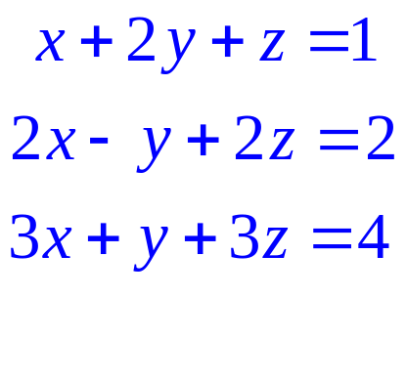
Another Example
Example: Solve the system on the right using the inverse matrix method.
Barnett/Ziegler/Byleen College Mathematics 12e

Slide 14
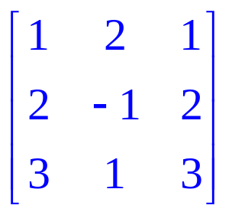
Another Example Solution
Example: Solve the system on the right using the inverse matrix method.
Solution:
The coefficient matrix A is displayed at the right. The inverse of A does not exist. (We can determine this by using a calculator.) We cannot use the inverse matrix method. Whenever the inverse of a matrix does not exist, we say that the matrix is singular.
Barnett/Ziegler/Byleen College Mathematics 12e

Slide 15
Cases When Matrix Techniques
Do Not Work
There are two cases when inverse methods will not work:
1. If the coefficient matrix is singular
2. If the number of variables is not the same as the number of equations.
Barnett/Ziegler/Byleen College Mathematics 12e

Slide 16
Application
Production scheduling: Labor and material costs for manufacturing two guitar models are given in the table below: Suppose that in a given week $1800 is used for labor and $1200 used for materials. How many of each model should be produced to use exactly each of these allocations?
Guitar model | Labor cost | Material cost
A | $30 | $20
B | $40 | $30
Barnett/Ziegler/Byleen College Mathematics 12e

Slide 17
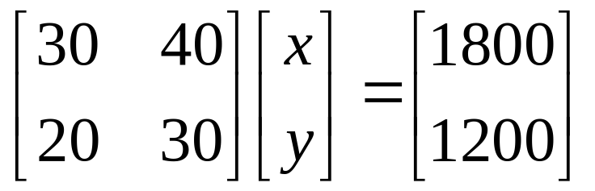
Application Solution
Let x be the number of model A guitars to produce and y represent the number of model B guitars. Then, multiplying the labor costs for each guitar by the number of guitars produced, we have
30x + 40y = 1800
Since the material costs are $20 and $30 for models A and B respectively, we have
20x + 30y = 1200.
This gives us the system of linear equations:
30x + 40y = 1800
20x + 30y = 1200
We can write this as a matrix equation:
Barnett/Ziegler/Byleen College Mathematics 12e

Slide 18
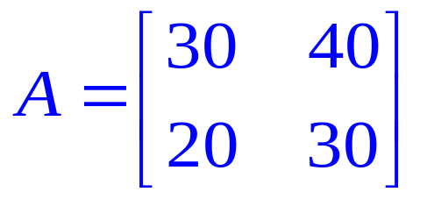
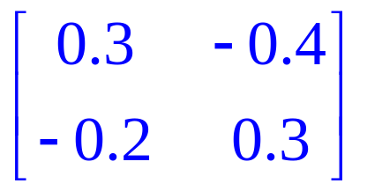
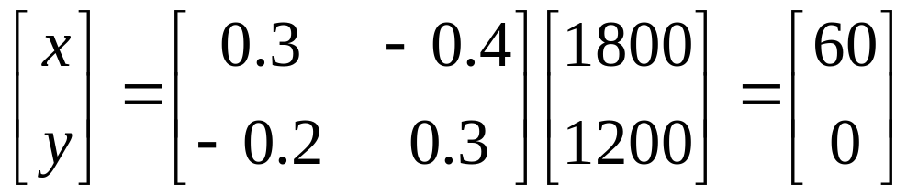
Application Solution
(continued)
Solution:
Produce 60 model A guitars and no model B guitars.
The inverse of matrix A is
Barnett/Ziegler/Byleen College Mathematics 12e

