Slide 1
Chapter 4
Systems of Linear Equations; Matrices
Section 7
Leontief Input-Output Analysis

Slide 2
Learning Objectives for Section 4.7
Leontief Input-Output Analysis
The student will be able to formulate and solve the
two-industry model of input-output analysis.
The student will be able to formulate and solve the
three-industry model of input-output analysis.
Barnett/Ziegler/Byleen College Mathematics 12e

Slide 3
Leontief Input-Output Analysis
In this section, we will study an important economic application of matrix inverses and matrix multiplication.
This branch of applied mathematics is called input-output analysis and was first proposed by Wassily Leontief, who won the Nobel Prize in economics in 1973 for his work in this area.
Barnett/Ziegler/Byleen College Mathematics 12e

Slide 4
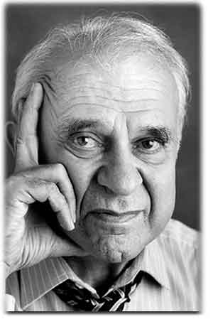
Wassily Leontief
1905-1999
Wassily Leontief was born August 5th, 1905 in St. Petersburg, the son of Wassily W. Leontief and his wife Eugenia. A brilliant student, he enrolled in the newly renamed University of Leningrad at only 15 years old.
He got in trouble by expressing vehement opposition to the lack of intellectual and personal freedom under the country's Communist regime, which had taken power three years earlier. He was arrested several times.
Wassily Leontief
in 1983
Barnett/Ziegler/Byleen College Mathematics 12e

Slide 5
Wassily Leontief
(continued)
At Harvard, he developed his theories and methods of Input-Output analysis. This work earned him the Nobel prize in Economics in 1973 for his analysis of America's production machinery. His analytic methods, as the Nobel committee observed, became a permanent part of production planning and forecasting in scores of industrialized nations and in private corporations all over the world.
Professor Leontief passed away on Friday February 6th, 1999.
For more information on his life, visit http://www.iioa.org/leontief/Life.html
Barnett/Ziegler/Byleen College Mathematics 12e

Slide 6
Basic Input-Output Problem
The main problem of input-output analysis is the following:
Consider an economy with several industries. Each industry has a demand for products from other instrustries (internal demand). There are also external demands from the outside. Find a production level for the industries that will meet both internal and external demands.
Barnett/Ziegler/Byleen College Mathematics 12e

Slide 7
Two-Industry Model
Example
We start with an economy that has only two industries (agriculture and energy) to illustrate the method. Later, this method will generalized to three or more industries.
These two industries depend upon each other. For example, each dollar’s worth of agriculture produced requires $0.40 of agriculture and $0.20 of energy. Each dollar’s worth of energy produced requires $0.20 of agriculture and $0.10 of energy.
So, both industries have an internal demand for each others resources. Let us suppose there is an external demand of
$12,000,000 of agriculture and $9,000,000 dollars of energy.
Barnett/Ziegler/Byleen College Mathematics 12e

Slide 8
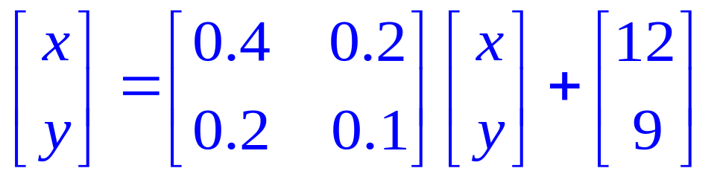
Example:
Matrix Equations
Let x represent the total output from agriculture and y represent the total output of energy (in millions of $)
The expressions
0.4x + 0.2y
0.2x + 0.1y
can be used to represent the internal demands for agriculture and energy.
The external demands of 12 and 9 million must also be met, so the revised equations are :
x = 0.4x + 0.2y + 12
y = 0.2x + 0.1y + 9
These equations can be represented by the following matrix equation:
Barnett/Ziegler/Byleen College Mathematics 12e

Slide 9
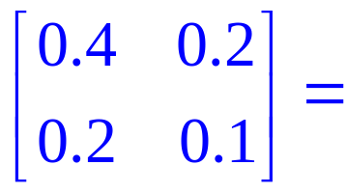
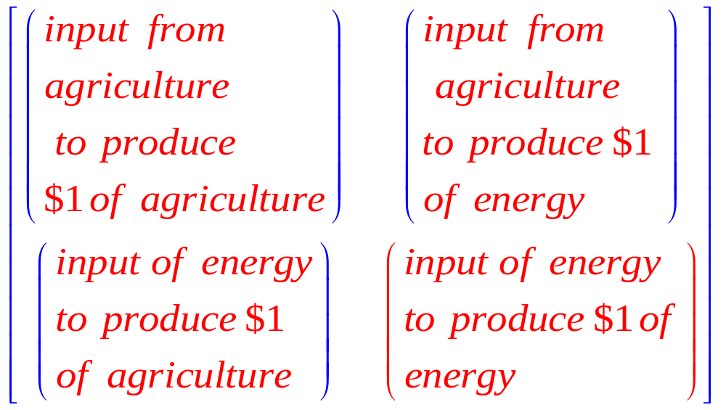
Example:
Technology Matrix (M )
A
Read left to right, E then up
A
= M
E
Barnett/Ziegler/Byleen College Mathematics 12e

Slide 10
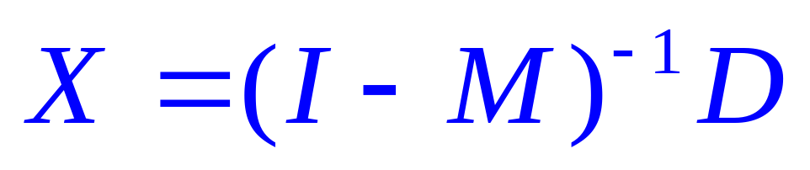
Example:
Solving the Matrix Equations
We can solve this matrix equation as follows:
X = MX+D
X – MX = D
IX – MX = D
(I – M)X = D
if the inverse of (I – M) exists.
Barnett/Ziegler/Byleen College Mathematics 12e

Slide 11
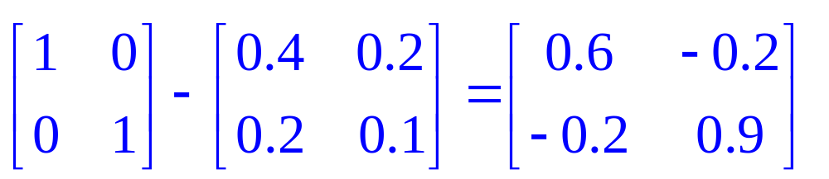
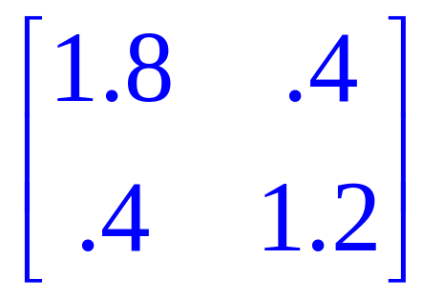
Example:
Solution
We will now find
First, find (I – M):
The inverse of (I – M) is:
Barnett/Ziegler/Byleen College Mathematics 12e

Slide 12
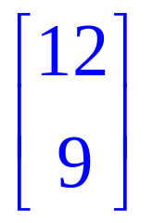
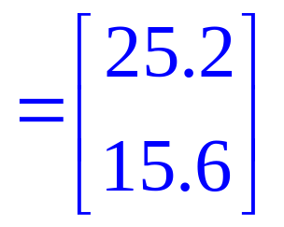
Solution
(continued)
After finding the inverse of (I – M), multiply that result by the external demand matrix D. The answer is:
Produce a total of $25.2 million of agriculture and $15.6 million of energy to meet both the internal demands of each resource and the external demand.
Barnett/Ziegler/Byleen College Mathematics 12e

Slide 13
Another Example
Suppose consumer demand changes from $12 million dollars of agriculture to $8 million dollars and energy consumption changes from $9 million to $5 million. Find the output for each sector that is needed to satisfy this final demand.
Barnett/Ziegler/Byleen College Mathematics 12e

Slide 14
Example
(continued)
Suppose consumer demand changes from $12 million dollars of agriculture to $8 million dollars and energy consumption changes from $9 million to $5 million. Find the output for each sector that is needed to satisfy this final demand.
Solution: Recall that our general solution of the problem is
The only change in the problem is the external demand matrix. (I – M) did not change. Therefore, our solution is to multiply the inverse of (I – M) by the new external demand matrix D.
Barnett/Ziegler/Byleen College Mathematics 12e

Slide 15
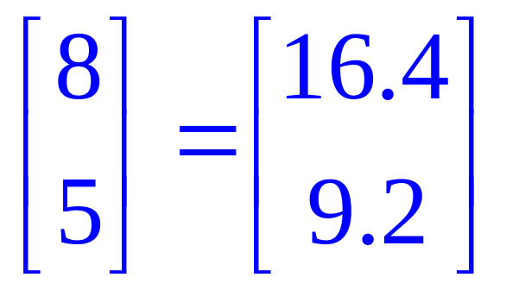
Example
Solution
Barnett/Ziegler/Byleen College Mathematics 12e

Slide 16
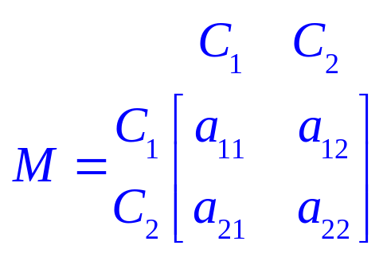
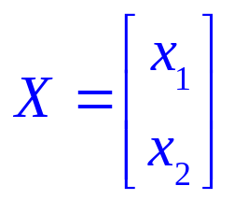
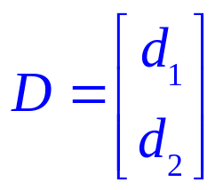

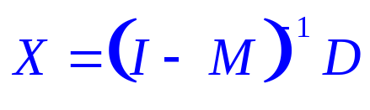
Summary of Two Industry Solution
Given two industries, C₁ and C₂ , with
where a_{ij} is the input required from C_{i} to produce a dollar’s worth of output for C_{j}, the solution to the input-output matrix equation
is
assuming that I – M has an inverse.
Barnett/Ziegler/Byleen College Mathematics 12e

Slide 17
More Than Two Sectors of the Economy
This method can also be used if there are more than two sectors of the economy. If there are three sectors, say agriculture, building and energy, the technology matrix M will be a 3 × 3 matrix. The solution to the problem will still be
although in this case it is necessary to determine the inverse of a 3 × 3 matrix.
Barnett/Ziegler/Byleen College Mathematics 12e

Slide 18
Example:
Three-Industry Model
An economy is based on three sectors, agriculture (A), energy (E), and manufacturing (M). Production of a dollar’s worth of agriculture requires an input of $0.20 from the agriculture sector and $0.40 from the energy sector. Production of a dollar’s worth of energy requires an input of $0.20 from the energy sector and $0.40 from the manufacturing sector. Production of a dollar’s worth of manufacturing requires an input of $0.10 from the agriculture sector, $0.10 from the energy sector, and $0.30 from the manufacturing sector.
Find the output from each sector that is needed to satisfy a final demand of $20 billion for agriculture, $10 billion for energy, and $30 billion for manufacturing.
Barnett/Ziegler/Byleen College Mathematics 12e

Slide 19
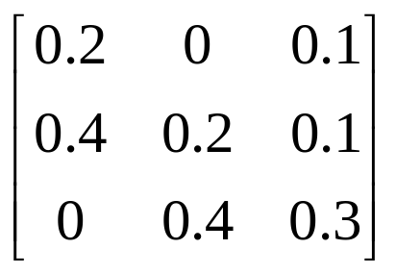
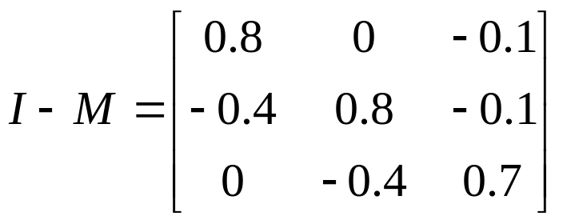
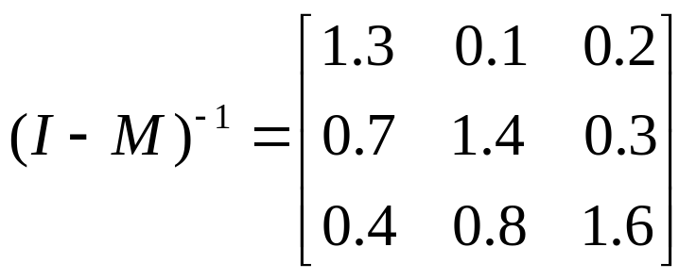
Example
(continued)
The technology matrix is as follows:
Output
A E M
A
E
M
Input
= M
Barnett/Ziegler/Byleen College Mathematics 12e

Slide 20
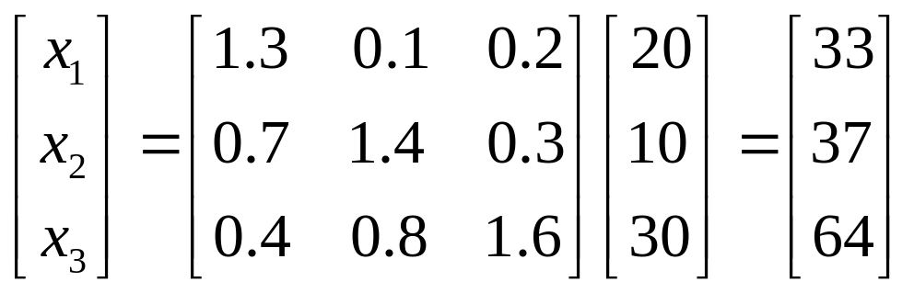
Example
(continued)
Thus, the output matrix X is given by:
X (I - M)⁻¹ D
An output of $33 billion for agriculture, $37 billion for energy, and $64 billion for manufacturing will meet the given final demands.
Barnett/Ziegler/Byleen College Mathematics 12e

