Slide 1
Appendix A
Basic Algebra Review
Section A-1
Real Numbers

Slide 2
Real Numbers
Set of Real Numbers
Real Number Line
Basic Real Number Properties
Further Properties
Fraction Properties
Barnett/Ziegler/Byleen College Mathematics 12e

Slide 3
Set of Real Numbers
  Informally, a real number is any number that has a decimal representation.
  N Natural numbers
  Counting numbers (also called positive integers)
  1, 2, 3, . . .
  Z Integers
  Natural numbers, their negatives, and 0
  . . . . –2, –1, 0, 1, 2, . . .
Barnett/Ziegler/Byleen College Mathematics 12e

Slide 4
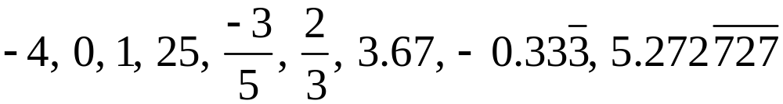
Set of Real Numbers
  Q Rational numbers
  Numbers that can be represented as a/b, where a and b are integers and b ≠ 0, repeating or terminating decimals
  I Irrational numbers
  Numbers that can be represented as nonrepeating and nonterminating decimals
  R Real numbers
  Rational and irrational numbers
Barnett/Ziegler/Byleen College Mathematics 12e

Slide 5
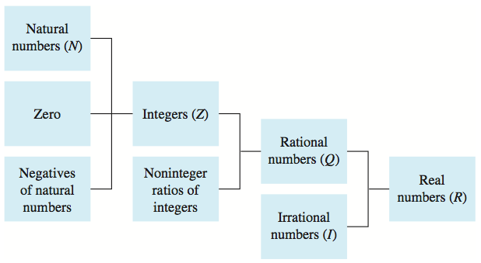
Set of Real Numbers
Barnett/Ziegler/Byleen College Mathematics 12e

Slide 6
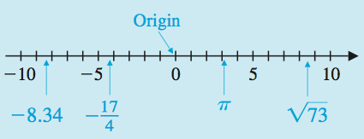
Real Number Line
A one-to-one correspondence exists between the set of real numbers and the set of points on a line.
Barnett/Ziegler/Byleen College Mathematics 12e

Slide 7
Basic Real Number Properties
Let a, b, and c be arbitrary elements in the set of real numbers R.
Addition Properties
Associative: (a + b) + c = a + (b + c)
Commutative: a + b = b + a
Identity: 0 is the additive identity; that is, 0 + a = a + 0 = a for all a in R, and 0 is the only element in R with this property
Inverse: For each a in R, –a, is its unique additive inverse; that is, a + (–a) = (–a) + a = 0 and –a is the only element in R relative to a with this property.
Barnett/Ziegler/Byleen College Mathematics 12e

Slide 8
Basic Real Number Properties
Let a, b, and c be arbitrary elements in the set of real numbers R.
Multiplication Properties
Associative: (ab)c = a(bc)
Commutative: ab = ba
Identity: 1 is the multiplicative identity; that is, (1)a = a(1) = a for all a in R, and 1 is the only element in R with this property.
Inverse: For each a in R, a ≠ 0, 1/a is its unique multiplicative inverse; that is, a(1/a) = (1/a)a = 1 and 1/a is the only element in R relative to a with this property.
Barnett/Ziegler/Byleen College Mathematics 12e

Slide 9
Basic Real Number Properties
Distributive Properties
5(3 + 4) = 5 • 3 + 5 • 4 = 15 + 20 = 35
9(m + n) = 9m + 9n
(7 + 2)u = 7u + 2u
Barnett/Ziegler/Byleen College Mathematics 12e

Slide 10
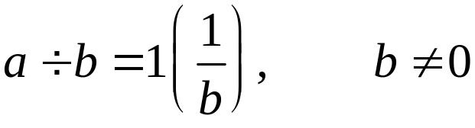
Further Properties
Subtraction and Division
  For all real numbers a and b,
  Subtraction: a – b = a + (–b)
  Division:
Barnett/Ziegler/Byleen College Mathematics 12e

Slide 11

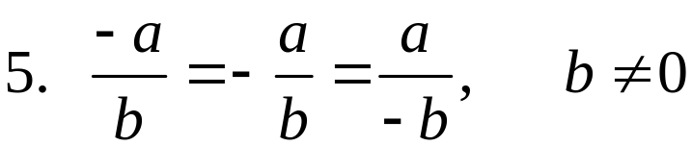

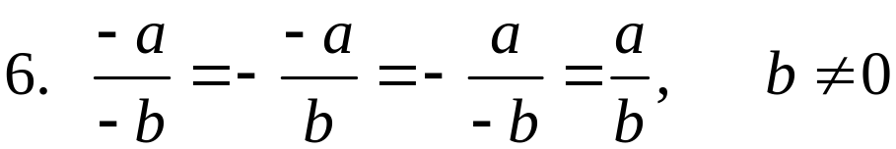


Further Properties
Negative Properties
  For all real numbers a and b,
Barnett/Ziegler/Byleen College Mathematics 12e

Slide 12

Further Properties
Zero Properties
  For all real numbers a and b,
Barnett/Ziegler/Byleen College Mathematics 12e

Slide 13
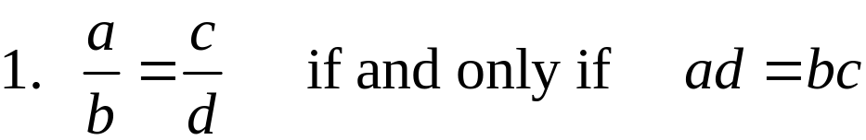
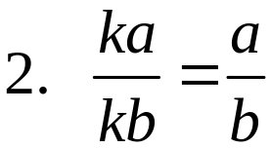
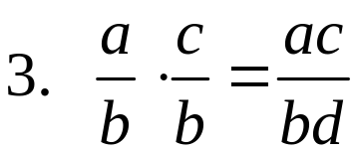
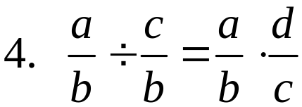
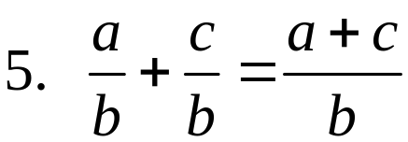
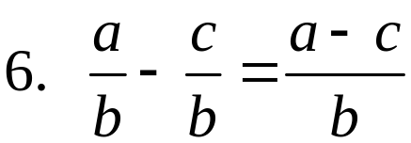
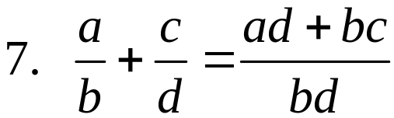
Fraction Properties
The quotient a ÷ b (b ≠ 0) written as a/b is called a fraction. The quantity a is called the numerator, and the quantity b is called the denominator.
  For all real numbers a, b, c, d, and k, (division by 0 excluded)
Barnett/Ziegler/Byleen College Mathematics 12e

