Slide 1
Appendix A
Basic Algebra Review
Section A-2
Operations on Polynomials

Slide 2
Operations on Polynomials
Natural Number Exponents
Polynomials
Combining Like Terms
Addition and Subtraction
Multiplication
Combined Operations
Barnett/Ziegler/Byleen College Mathematics 12e

Slide 3

Natural Number Exponent
  Natural Number Exponent
  For n a natural number and b any real number,
  where n is called the exponent and b is called the base.
  First Property of Exponents
  For any natural numbers m and n, and any real number b,
Barnett/Ziegler/Byleen College Mathematics 12e

Slide 4
Polynomials
  Algebraic expressions
  Constants and variables and the algebraic operations of addition, subtraction, multiplication, division, raising to powers, and taking roots. Special types of algebraic expressions are called polynomials.
  Polynomial in one variable x
  Adding or subtracting constants and terms of the form ax^{n}, where a is a real number and n is a natural number.
  Polynomial in two variables x and y
  Adding or subtracting constants and terms of the form ax^{m}y^{n}, where a is a real number and m and n are a natural numbers.
Barnett/Ziegler/Byleen College Mathematics 12e

Slide 5
Polynomials
  Degree of the term
  Power of the variable.
  Degree of the term with two or more variables
  Sum of the power of the variables.
  Degree of the polynomial
  Degree of the nonzero term with the highest degree in the polynomial.
  Polynomial of degree 0
  A nonzero constant. The number 0 is also a polynomial but is not assigned a degree.
Barnett/Ziegler/Byleen College Mathematics 12e

Slide 6
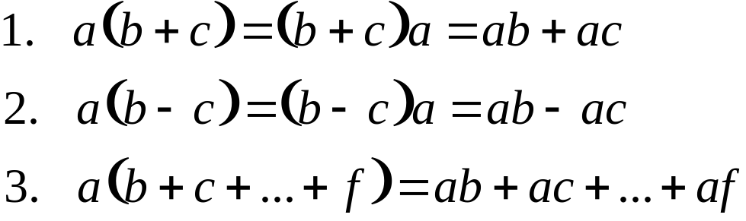
Combining Like Terms
A constant in a term of a polynomial, including the sign that precedes it, is called the numerical coefficient, or simply, the coefficient, of the term.
Distributive Properties of Real Numbers
Barnett/Ziegler/Byleen College Mathematics 12e

Slide 7
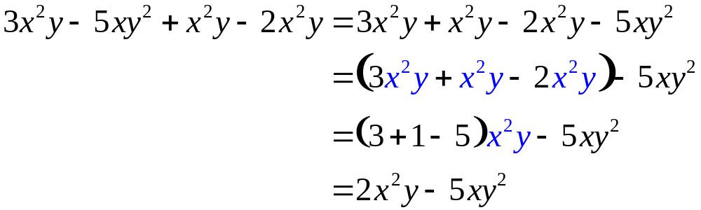
Combining Like Terms
Two terms in a polynomial are called like terms if they have exactly the same variable factors to the same powers.
If a polynomial contains two or more like terms, these terms can be combined into a single term by making use of distributive properties.
Barnett/Ziegler/Byleen College Mathematics 12e

Slide 8
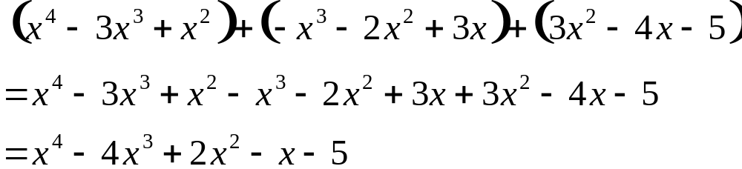
Addition and Subtraction
Addition and subtraction of polynomials can be thought of in terms of removing parentheses and combining like terms.
Add horizontally:
Barnett/Ziegler/Byleen College Mathematics 12e

Slide 9
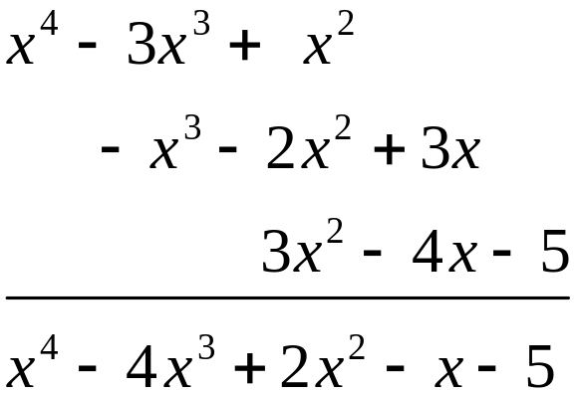
Addition and Subtraction
We can also add vertically:
Add:
Barnett/Ziegler/Byleen College Mathematics 12e

Slide 10

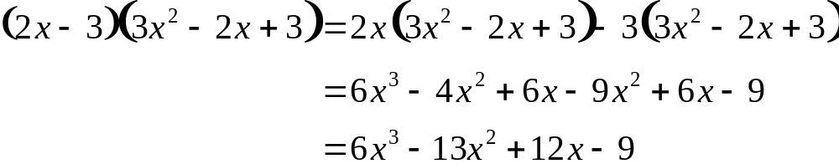
Multiplication
Multiplication of algebraic expressions involves the extensive use of distributive properties for real numbers, as well as other real number properties.
Multiply:
Barnett/Ziegler/Byleen College Mathematics 12e

Slide 11
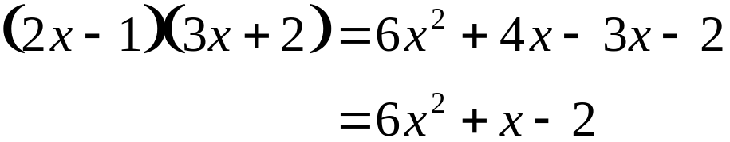
Multiplication
Thus, to multiply two polynomials, multiply each term of one by each term of the other, and combine like terms.
For the product of two binomials we use this process:
Barnett/Ziegler/Byleen College Mathematics 12e

Slide 12
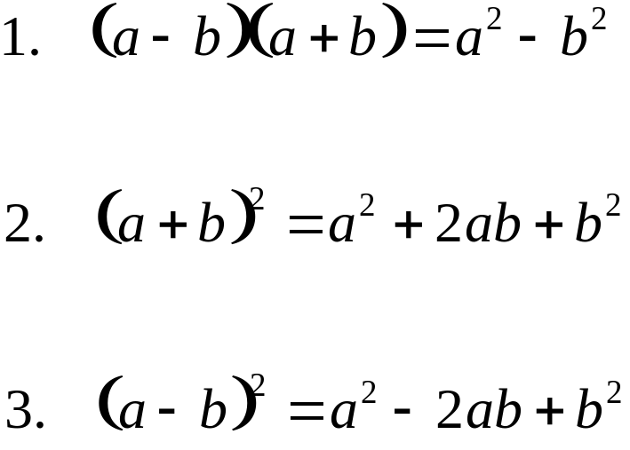
Special Products
Special products:
Barnett/Ziegler/Byleen College Mathematics 12e

Slide 13
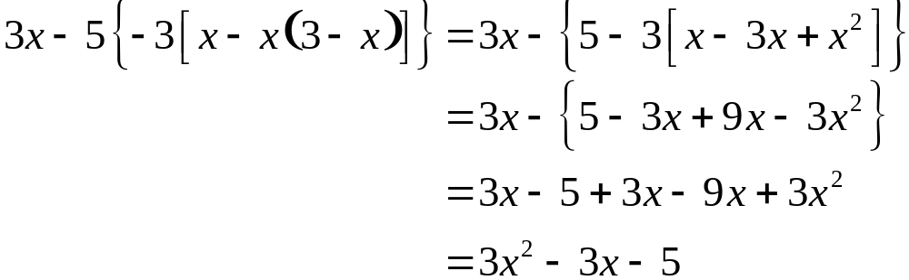
Combined Operations
Note that in simplifying, we usually remove grouping symbols starting from the inside. That is, we remove parentheses ( ) first, then brackets [ ], and finally braces { }, if present.
Order of Operations
Multiplication and division precede addition and subtraction, and taking powers precedes multiplication and division.
Barnett/Ziegler/Byleen College Mathematics 12e

