Slide 1
Appendix A
Basic Algebra Review
Section A-3
Factoring Polynomials

Slide 2
Factoring Polynomials
Common Factors
Factoring by Grouping
Factoring Second-Degree Polynomials
Special Factoring Formulas
Combined Factoring Techniques
Barnett/Ziegler/Byleen College Mathematics 12e

Slide 3
Polynomial in Factored Form
  A polynomial is written in factored form if it is written as the product of two or more polynomials.
  A polynomial with integer coefficients is said to be factored completely if each factor cannot be expressed as the product of two or more polynomials with integer coefficients, other than itself or 1.
Barnett/Ziegler/Byleen College Mathematics 12e

Slide 4
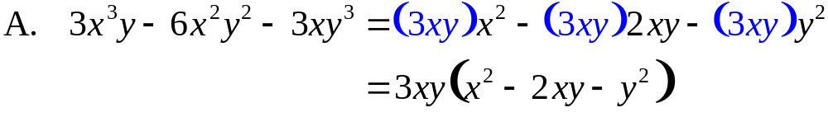
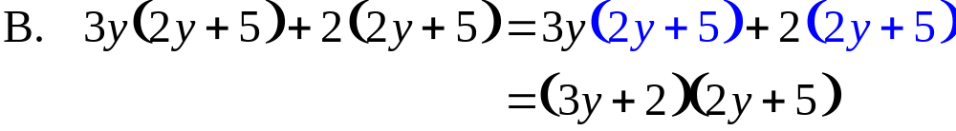
Common Factors
Generally, a first step in any factoring procedure is to factor out all factors common to all terms.
Factor out all factors common to all terms.
Barnett/Ziegler/Byleen College Mathematics 12e

Slide 5
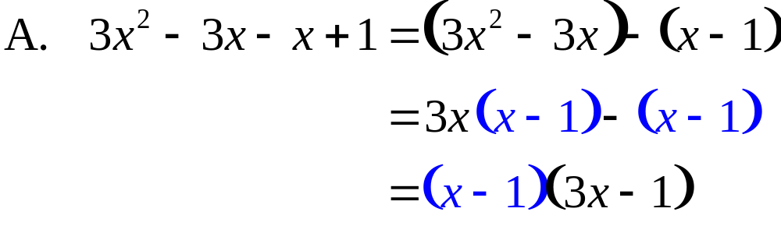
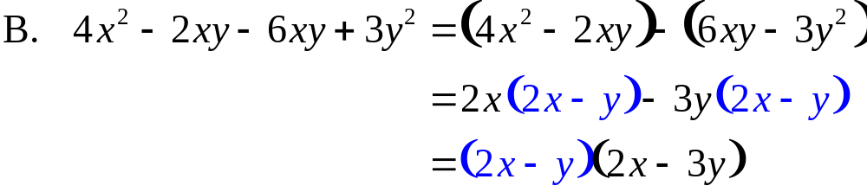
Factor by Grouping
Factor by grouping.
Barnett/Ziegler/Byleen College Mathematics 12e

Slide 6
Factoring Second-Degree Polynomials
ac Test for Factorability
If in polynomials of the form
the product ac has two integer factors p and q whose sum is the coefficient b of the middle term; that is, if integers p and q exist so that
then the polynomials have first-degree factors with integer coefficients. If no integers p and q exist that satisfy equations (2), then the polynomials in equations (1) will not have first-degree factors with integer coefficients.
Barnett/Ziegler/Byleen College Mathematics 12e

Slide 7

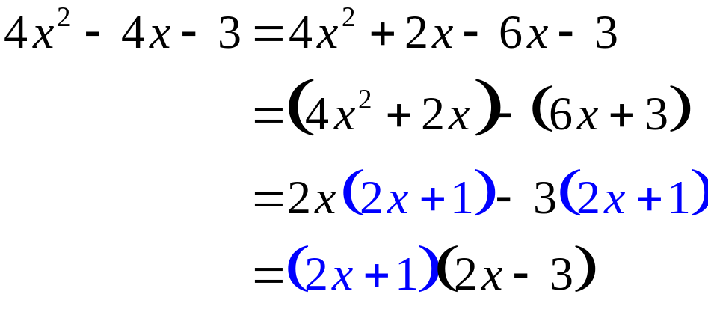
Factoring Second-Degree Polynomials
Factor, if possible, using integer coefficients.
ac = (4)(–3) = –12
(1)(–12)
(–1)(12)
(2)(–6): 2 + –6 = –4
(–2)(6)
(3)(–4)
(–3)(4)
Barnett/Ziegler/Byleen College Mathematics 12e

Slide 8

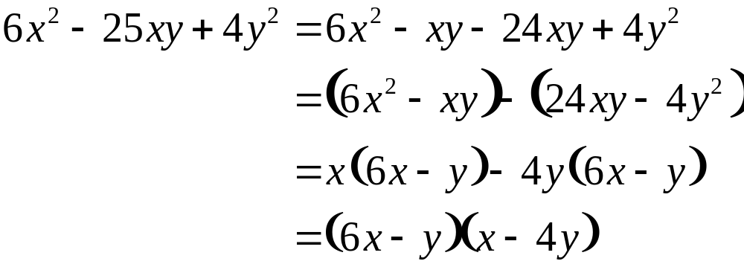
Factoring Second-Degree Polynomials
Factor, if possible, using integer coefficients.
ac = (6)(4) = 24
(1)(24)
(–1)(–24) –1 + –24 = –25
We can stop here!
Barnett/Ziegler/Byleen College Mathematics 12e

Slide 9
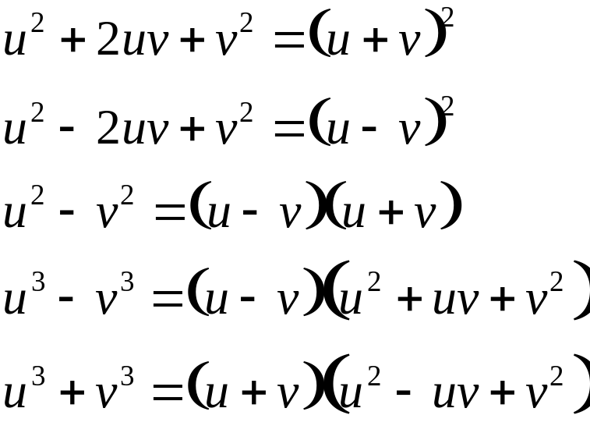
Special Factoring Formulas
Perfect square:
Perfect square:
Difference of squares:
Difference of cubes:
Sum of cubes:
Barnett/Ziegler/Byleen College Mathematics 12e

Slide 10
Combined Factoring Techniques
Factoring Polynomials
Step 1 Take out any factors common to all terms.
Step 2 Use any of the special factoring formulas.
Step 3 Apply the ac test to any remaining second-degree polynomial factors.
Note: It may be necessary to perform some of these steps more than once. Furthermore, the order of applying these steps can vary.
Barnett/Ziegler/Byleen College Mathematics 12e

Slide 11
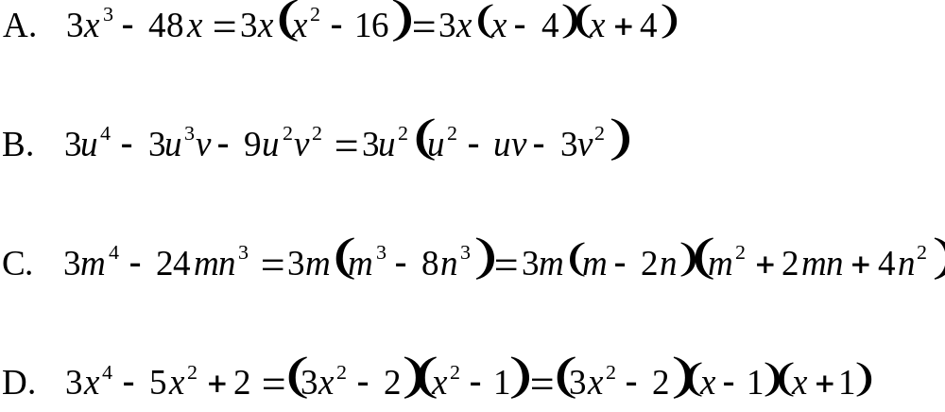
Combined Factoring Techniques
Factor completely.
Barnett/Ziegler/Byleen College Mathematics 12e

