Slide 1
Appendix A
Basic Algebra Review
Section A-4
Operations on
Rational Expressions

Slide 2
Operations on Rational Expressions
Reducing to Lowest Terms
Multiplication and Division
Addition and Subtraction
Compound Fractions
Barnett/Ziegler/Byleen College Mathematics 12e

Slide 3
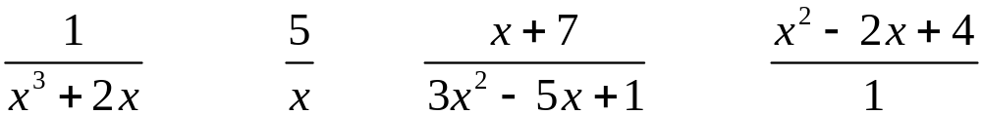
Rational Expressions
A quotient of two algebraic expressions (division by 0 excluded) is called a fractional expression.
If both the numerator and the denominator are polynomials, the fractional expression is called a rational expression.
Barnett/Ziegler/Byleen College Mathematics 12e

Slide 4
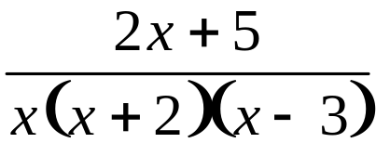
Rational Expressions
AGREEMENT Variable Restriction
Even though not always explicitly stated, we always assume that variables are restricted so that division by 0 is excluded.
For example, given the rational expression
the variable x is understood to be restricted from being 0, –2, or 3, since these values would cause the denominator to be 0.
Barnett/Ziegler/Byleen College Mathematics 12e

Slide 5
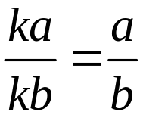
Reducing to Lowest Terms
Fundamental Property of Fractions
If a, b, and k are real numbers with b, k ≠ 0, then
For example, given the rational expression
the variable x is understood to be restricted from being 0, –2, or 3, since these values would cause the denominator to be 0.
Barnett/Ziegler/Byleen College Mathematics 12e

Slide 6
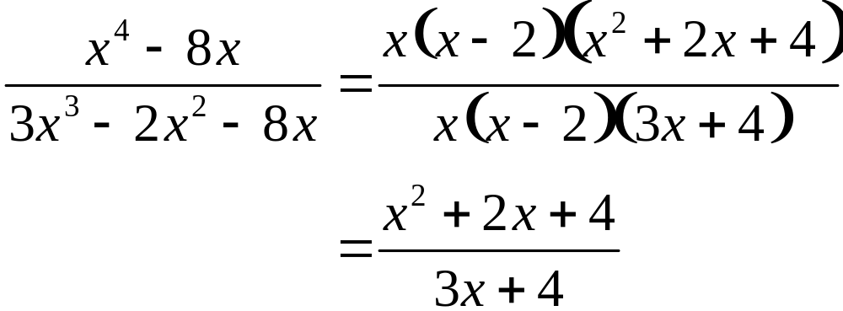
Reducing to Lowest Terms
Using this property from left to right to eliminate all common factors from the numerator and the denominator of a given fraction is referred to as reducing a fraction to lowest terms.
Using the property from right to left–that is, multiplying the numerator and denominator by the same nonzero factor–is referred to as raising a fraction to higher terms.
Reduce to lowest terms.
Barnett/Ziegler/Byleen College Mathematics 12e

Slide 7
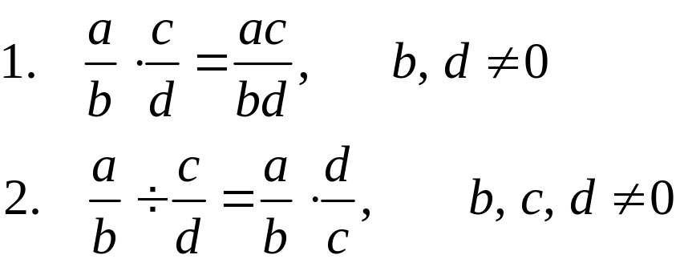
Multiplication and Division
Multiplication and Division
If a, b, c, and d are real numbers, then
Barnett/Ziegler/Byleen College Mathematics 12e

Slide 8
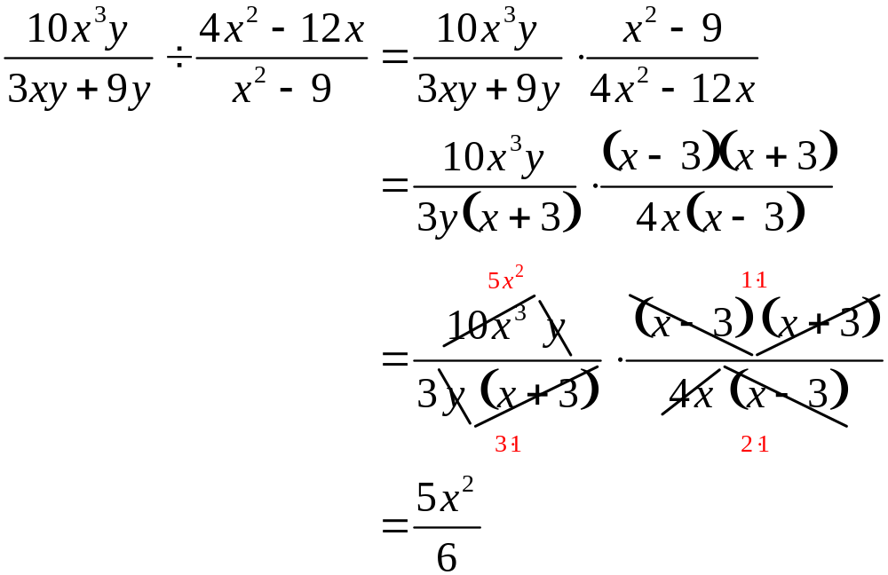
Multiplication and Division
Perform the indicated operation and reduce to lowest terms.
Barnett/Ziegler/Byleen College Mathematics 12e

Slide 9
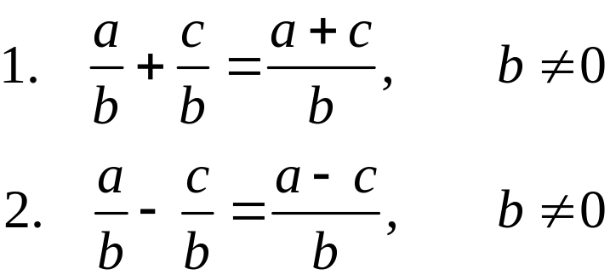
Addition and Subtraction
Addition and Subtraction
For a, b, and c real numbers,
Barnett/Ziegler/Byleen College Mathematics 12e

Slide 10
Addition and Subtraction
Least Common Denominator
The least common denominator (LCD) of two or more
rational expressions is found as follows:
Factor each denominator completely, including integer factors.
Identify each different factor from all the denominators.
Form a product using each different factor to the highest power that occurs in any one denominator. This product is the LCD.
Barnett/Ziegler/Byleen College Mathematics 12e

Slide 11
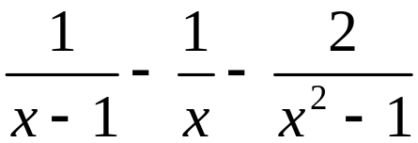
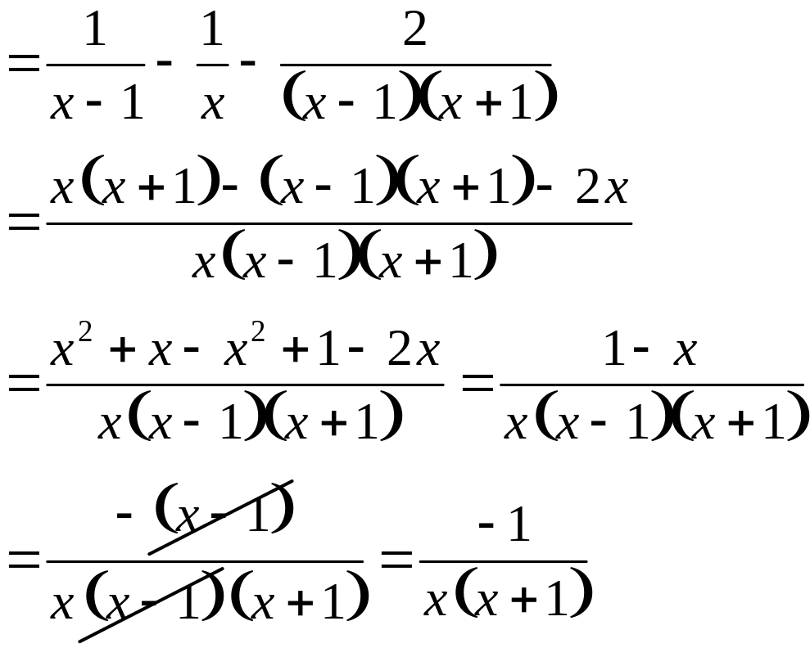
Addition and Subtraction
Combine into a single fraction and reduce to lowest terms.
LCD = x(x – 1)(x + 1)
Barnett/Ziegler/Byleen College Mathematics 12e

Slide 12
Compound Fractions
A fractional expression with fractions in its numerator, denominator, or both is called a compound fraction. It is often necessary to represent a compound fraction as a simple fraction–that is (in all cases we will consider), as the quotient of two polynomials.
We will use the two different methods.
Barnett/Ziegler/Byleen College Mathematics 12e

Slide 13
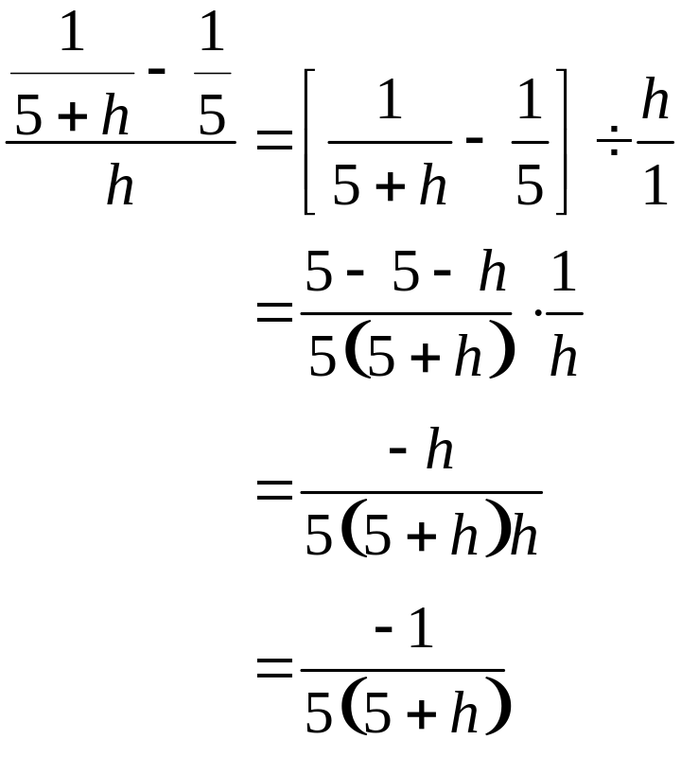
Compound Fractions
Express as a simple fraction reduced to lowest terms. Use division of rational forms.
Barnett/Ziegler/Byleen College Mathematics 12e

Slide 14
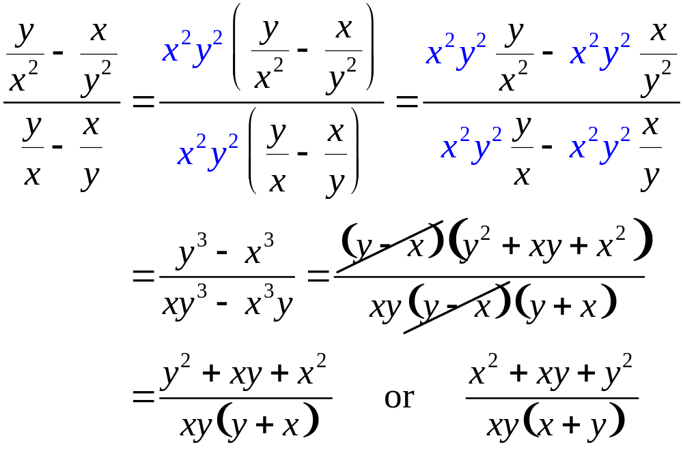
Compound Fractions
Express as a simple fraction reduced to lowest terms. Multiply the numerator and denominator by the LCD of all fractions.
Barnett/Ziegler/Byleen College Mathematics 12e

